Slide 1
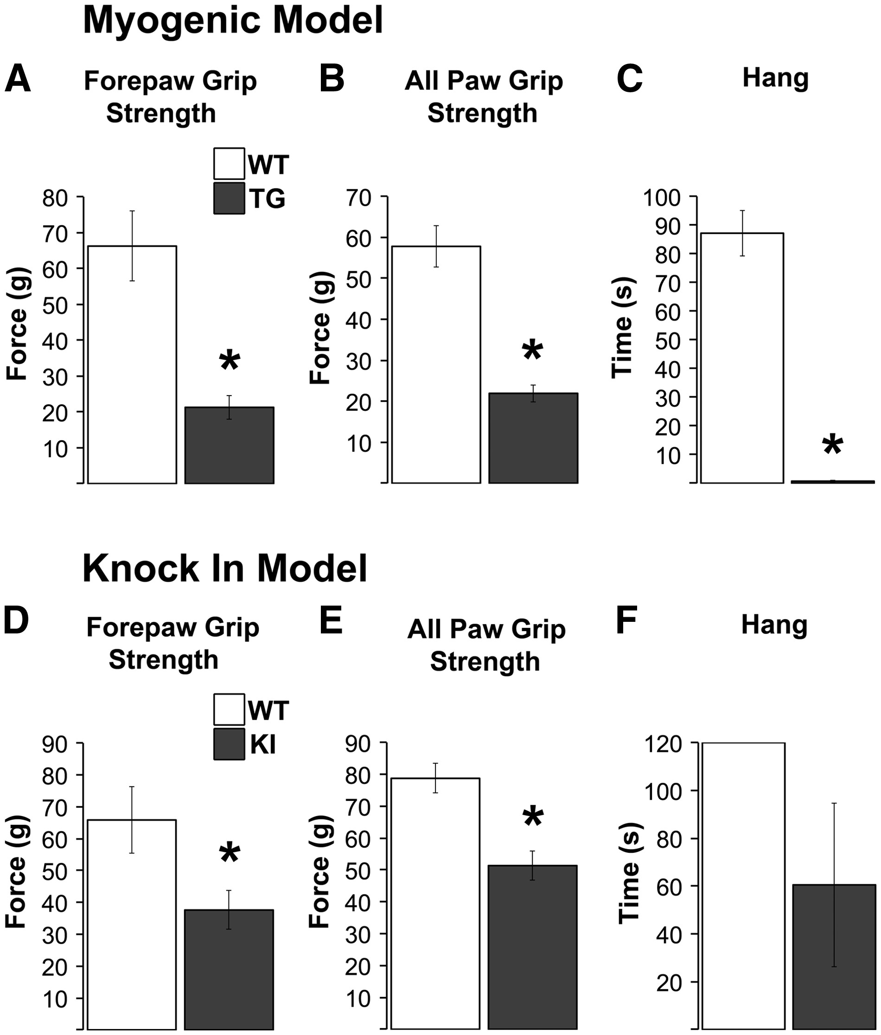
Figure 1. Male mice of two different SBMA models (myogenic transgenic (TG) and knock-in (KI)) show the expected motor ...
Notes:
Figure 1. Male mice of two different SBMA models (myogenic transgenic (TG) and knock-in (KI)) show the expected motor impairments. Grip strength, based on measures of forepaws and all paws was significantly decreased in myogenic TG males compared to wildtype (WT) control males (A, B). TG males also showed profound deficits in mean hang time, another indicator of overall neuromuscular function (C). As expected, grip strength in KI males was not as severely impaired as TG males, but nonetheless showed significant deficits (D, E). KI hang times were reduced, but not significantly, likely due to the substantial variance in KI males (F). *P < 0.05 compared to WT controls. Error bars represent standard error of the mean, with n = 8 mice/group for TGs and 5 mice/group for KIs that contributed to the confocal analysis. The second cohort of TG and KI males used for the EM analysis showed comparable levels of dysfunction as shown here.
Unless provided in the caption above, the following copyright applies to the content of this slide: © The Author 2016. Published by Oxford University Press. All rights reserved. For Permissions, please email: journals.permissions@oup.com

Slide 2
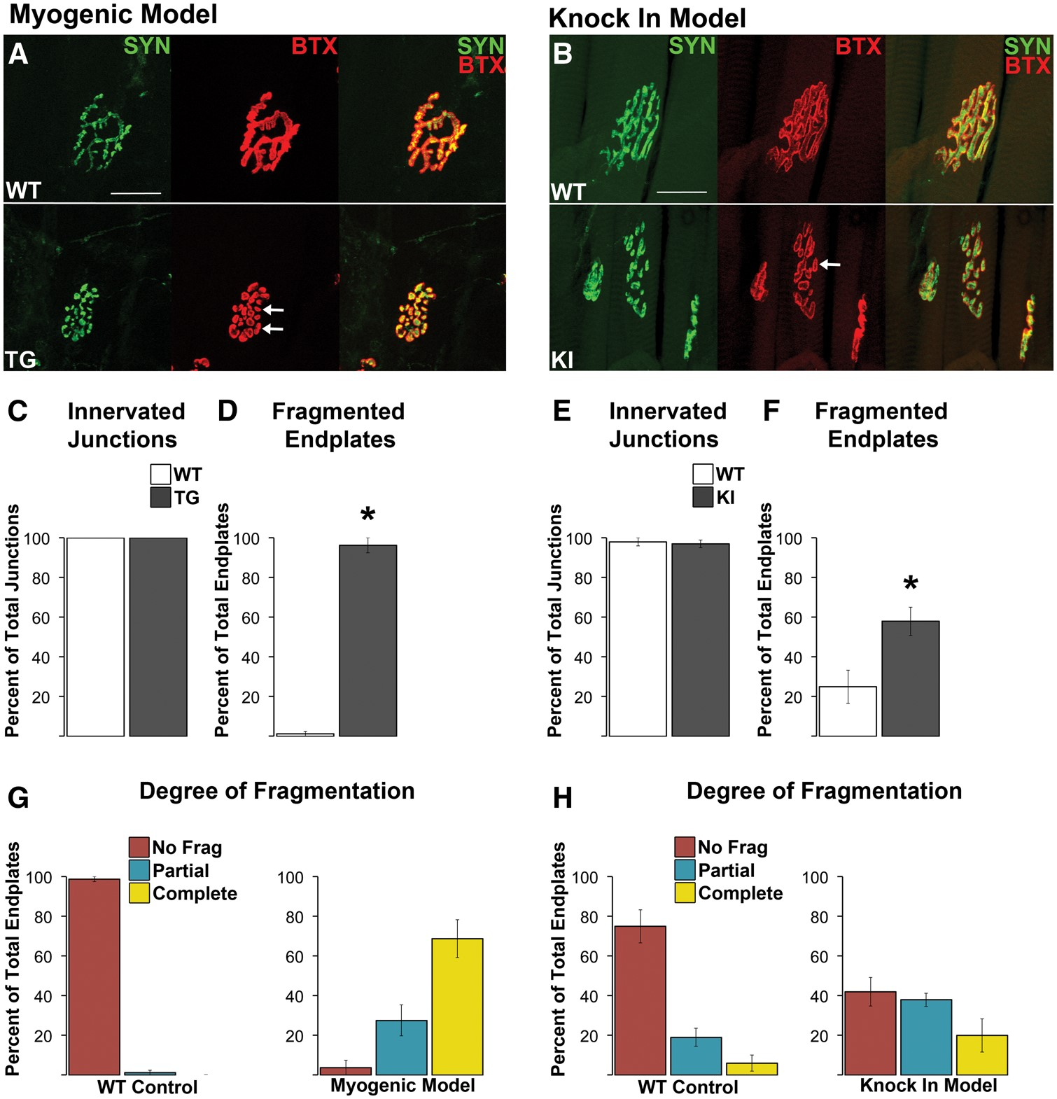
Figure 2. Neuromuscular junctions (NMJs) in both diseased TG and KI males show no evidence of morphological denervation ...
Notes:
Figure 2. Neuromuscular junctions (NMJs) in both diseased TG and KI males show no evidence of morphological denervation but are consistently fragmented. Despite notable fragmentation, pre- and postsynaptic components of the NMJ showed precise alignment between the overlying synaptophysin labelled nerve terminals and the underlying α-bungarotoxin labelled (BTX) acetylcholine receptors (A, B). In short, there was no evidence of exposed endplates indicative of denervation (B, F). NMJs of wildtype (WT) muscle showed the typical, pretzel like morphology (A), albeit junctions in the levator ani (LA) muscle used for the KI model normally look more fragmented, like a collection of grapes. Regardless, using a consistent criterion to identify and count the number of distinct postsynaptic clusters that made up the junction revealed that junctions in diseased muscle of both TG (A) and KI males (E) are markedly fragmented (white arrows point to examples of) compared to WT junctions. Nearly every NMJ in the anterior tibialis of myogenic TG males (C) was fragmented while 58% of LA junctions in KI males show fragmentation (G). Assessing the degree of fragmentation within each NMJ revealed that nearly all myogenic junctions are completely fragmented (D), while only about 20% of KI junctions show complete fragmentation. * P < 0.05 compared to WT controls. Error bars represent standard error of the mean, with n = 4 mice/group for TG and n = 5 mice/group for KI estimates of denervation and fragmentation. Twenty junctions were examined per mouse. Scale bars indicate 25 microns.
Unless provided in the caption above, the following copyright applies to the content of this slide: © The Author 2016. Published by Oxford University Press. All rights reserved. For Permissions, please email: journals.permissions@oup.com

Slide 3
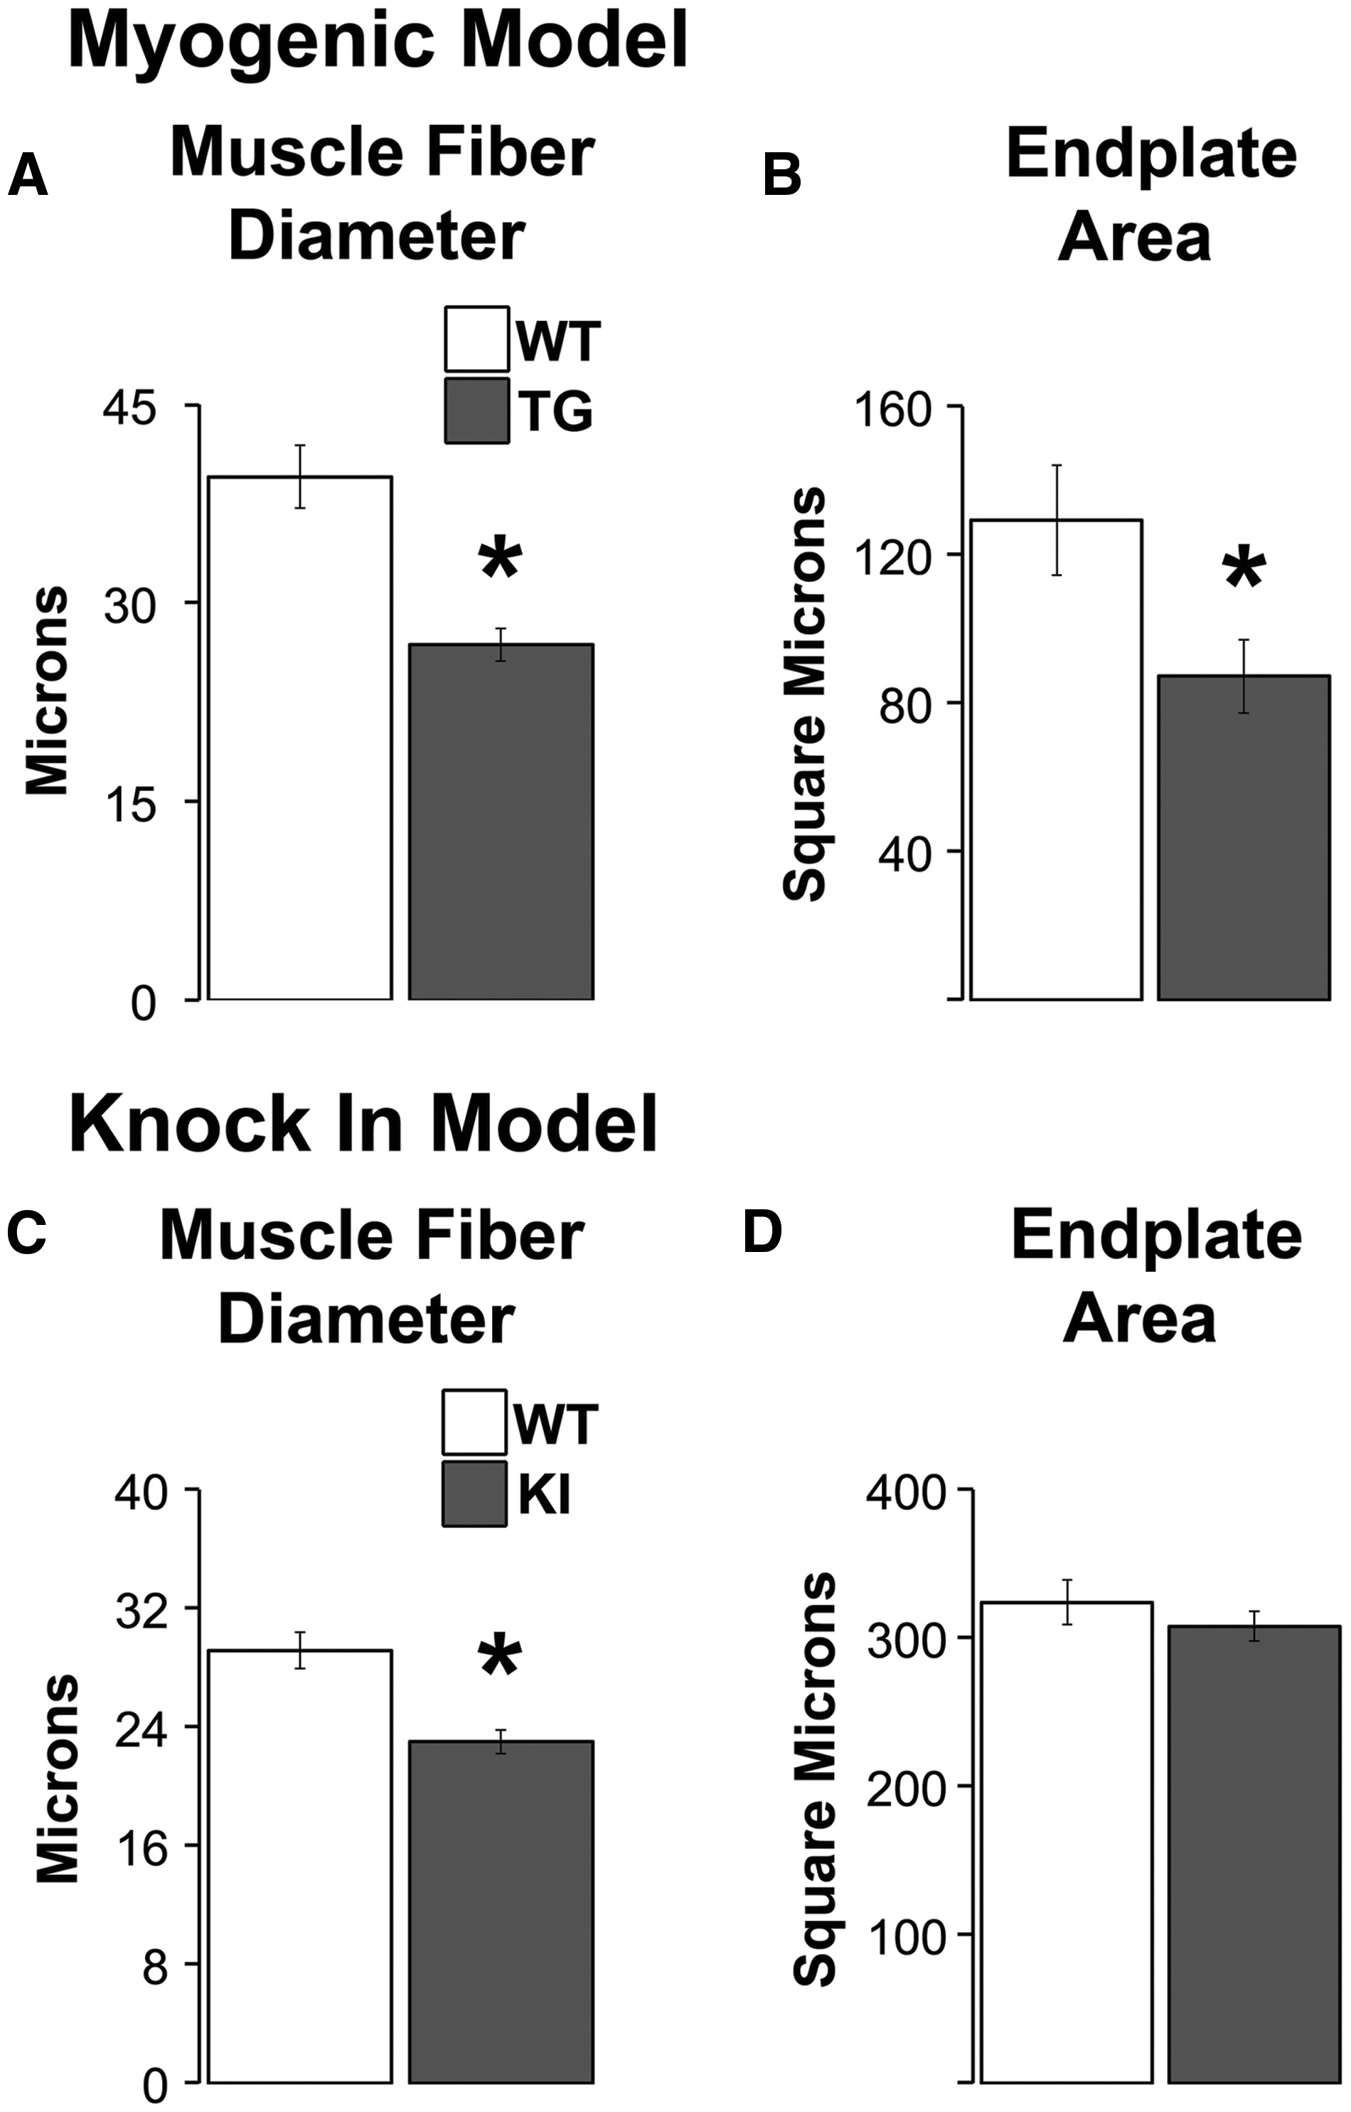
Figure 3. Endplates are reduced in size only in myogenic TG males but muscle fibres are smaller in diseased males of ...
Notes:
Figure 3. Endplates are reduced in size only in myogenic TG males but muscle fibres are smaller in diseased males of both models. The size of both fibres and endplates are significantly reduced in TG myogenic males compared to WT males (A, B). While muscle fibres are also smaller in diseased KI males compared to healthy WTs (C), the size of endplates is unaffected by disease in this model (D). This dissociation between endplate and fibre size in diseased KI males raises the possibility that synaptic strength is spared in KI males but direct measures of synaptic strength indicate the opposite, with significant losses in strength in both models (19). * P < 0.05 compared to WT controls. Error bars represent standard error of the mean. n = 4–5 mice/group for estimates of fibre diameter and n = 5–7 mice/group for estimates of endplate area. Twenty junctions were sampled per muscle/animal.
Unless provided in the caption above, the following copyright applies to the content of this slide: © The Author 2016. Published by Oxford University Press. All rights reserved. For Permissions, please email: journals.permissions@oup.com

Slide 4
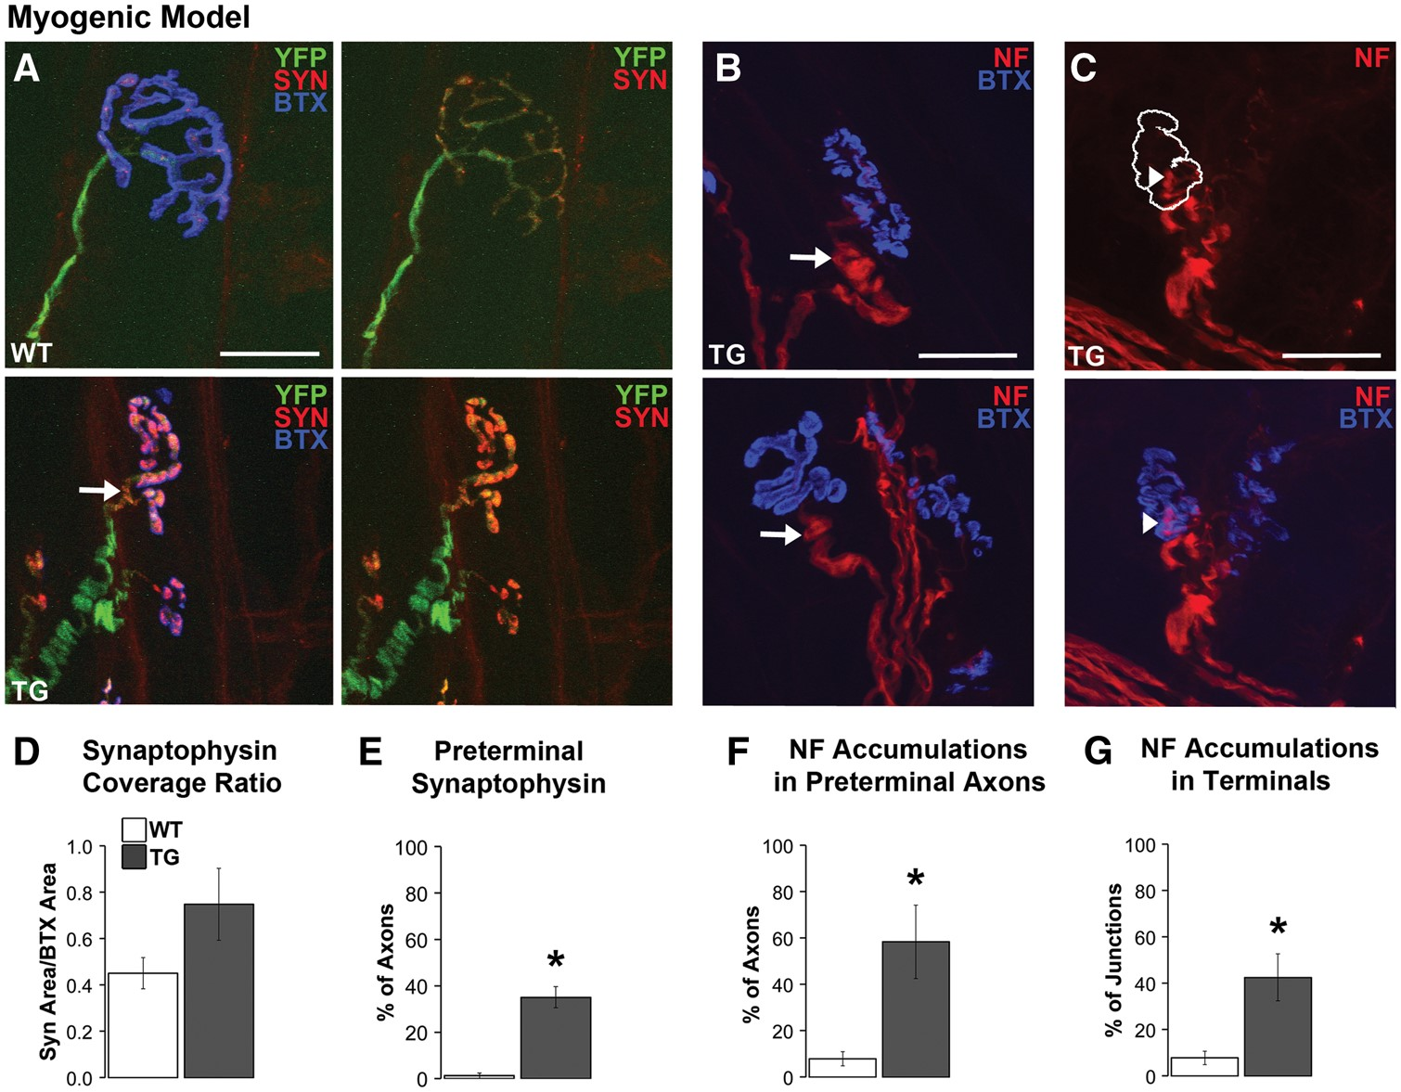
Figure 4. Disease alters the distribution of synaptophysin (SYN) and triggers neurofilament (NF) accumulations in ...
Notes:
Figure 4. Disease alters the distribution of synaptophysin (SYN) and triggers neurofilament (NF) accumulations in preterminal axons and nerve terminals of myogenic males. Synaptophysin staining was sparse in WT nerve terminals compared to a notable increased density within the nerve terminals of TG males (A). As a result, a greater percentage of the endplate was covered by synaptophysin staining in TG nerve terminals compared to WT terminals (D). Moreover, synaptophysin staining extended into the preterminal axon (by about 5 µm, arrow in A) in nearly 40% of TG junctions (E) compared to little or no such staining in preterminal axons of WT junctions. NF accumulations, which appeared as localized NF-positive bulbous swellings (>2 times of the overall calibre of the axon) in the preterminal unmyelinated axon (B, arrows) and nerve terminal (C, arrowhead) of diseased muscle from TG males. Such NF accumulations were often associated with a marked increase in staining intensity. The white outline in C denotes where the postsynaptic BTX label is found (shown in the image below). NF accumulations in the preterminal axon are also prominent at this junction (C). Forty to sixty percent of junctions contained NF accumulations in either presynaptic axons (F) and/or in the terminal itself (G). * P < 0.05 compared to WT controls. Error bars represent standard error of the mean, with n = 6–7 mice/group for synaptophysin estimates and 4–5 mice/group for neurofilament measures, with 20 junctions measured per mouse. Scale bars represent 25 µm.
Unless provided in the caption above, the following copyright applies to the content of this slide: © The Author 2016. Published by Oxford University Press. All rights reserved. For Permissions, please email: journals.permissions@oup.com

Slide 5
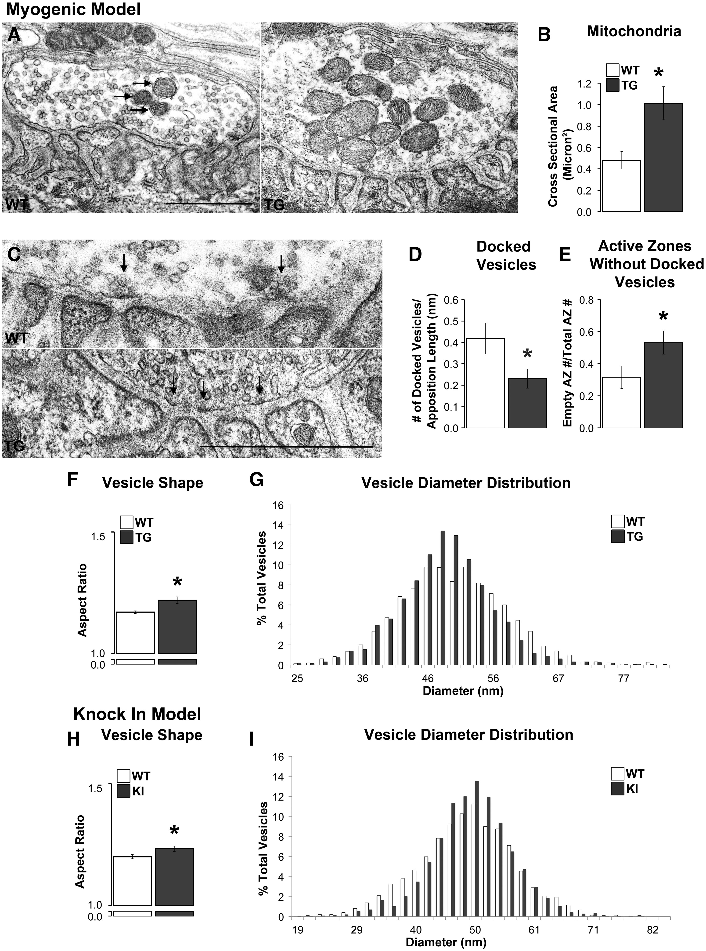
Figure 5. Disease affects the ultrastructure of motor nerve terminals primarily in myogenic TG males. The cross ...
Notes:
Figure 5. Disease affects the ultrastructure of motor nerve terminals primarily in myogenic TG males. The cross sectional area of mitochondria (arrows) in TG nerve terminals was significantly larger than in WT terminals (A, B) despite no changes in their number. While the number of active zones, which were identified by an electron dense area directly across from the mouth of a postsynaptic fold (C, denoted with arrows), per length of nerve terminal was unaffected by disease (Table 1), the number of docked vesicles contacting presynaptic membrane per active zone was, with significantly fewer docked vesicles at active zones in TGs compared to WTs (D). Consistent with this finding, the number of active zones without docked vesicles was increased in TG terminals compared to WT terminals (E). Vesicles in TG nerve terminals were also less round than WT vesicles based on their aspect ratio (minimum diameter over maximum diameter; F) although the distribution of average vesicle diameters appeared narrower and more centred around the mean in TG than WT terminals (G). Nerve terminals in KI compared to WT males showed less effects of disease with no difference in the number of active zones, docked vesicles, or active zones without docked vesicles (Table 1). However, vesicles in KI nerve terminals show an increase in their aspect ratio, like TG males, indicating that they are less round than those in WT males (H). Likewise, the distribution of vesicle diameters was narrower and more centred around the mean (I). * P < 0.05 compared to WT controls. Error bars represent standard error of the mean, with n = 30 junctions/group sampled from 3 animals/group, with 10 junctions sampled from each animal. Scale bars represent 1 µm.
Unless provided in the caption above, the following copyright applies to the content of this slide: © The Author 2016. Published by Oxford University Press. All rights reserved. For Permissions, please email: journals.permissions@oup.com

Slide 6
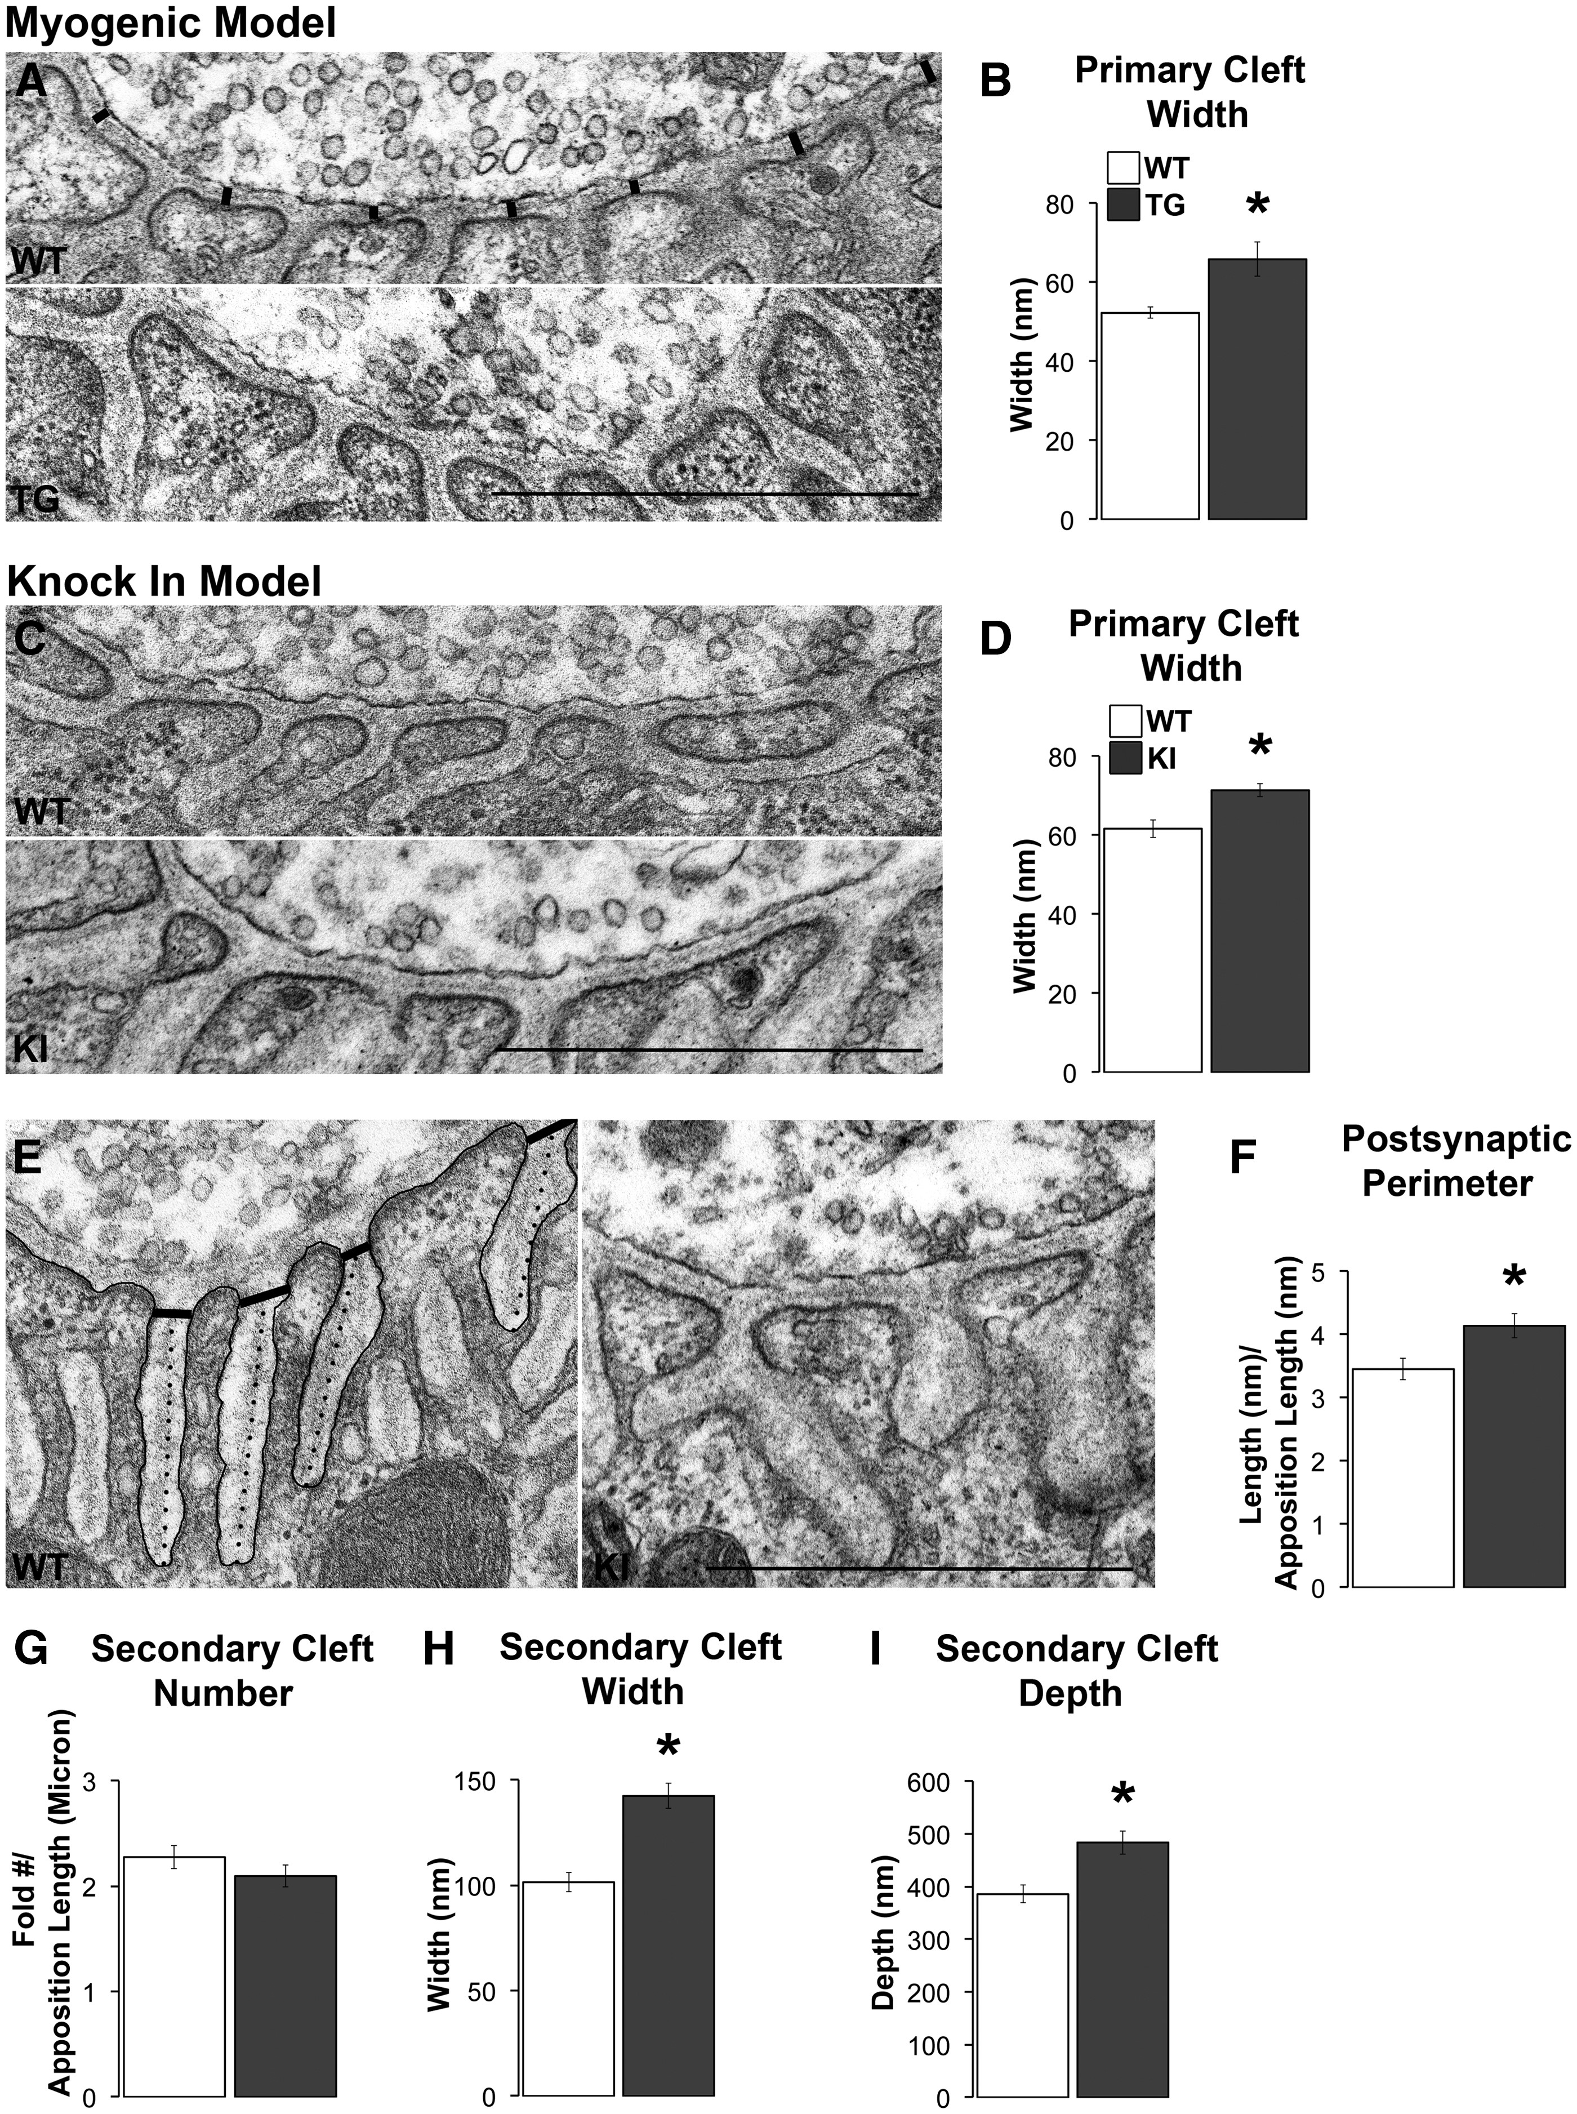
Figure 6. Disease affects the ultrastructure of postsynaptic junctions primarily in symptomatic KI males. Although the ...
Notes:
Figure 6. Disease affects the ultrastructure of postsynaptic junctions primarily in symptomatic KI males. Although the synaptic cleft in WT muscle showed tight apposition between the pre- and postsynaptic specializations, the synaptic cleft of diseased junctions appeared much looser (A, C). When measured (A, black lines), the width of the primary cleft was increased in both models (B, D). The postsynaptic folds of KI junctions also appeared simplified (E), a phenomenon not seen in TG junctions. The postsynaptic perimeter, indicated by the black tracing, was increased in KI junctions compared to WT junctions (F). While the number of secondary clefts for KI junctions did not appear appreciably affected by disease (G), the width of secondary clefts, measured at a standard distance from the cleft opening (denoted by the thick black lines in E), was increased in KI junctions compared to WT junctions (H). The depth of the secondary cleft of KI junctions was also increased (I), measured as indicated by the dotted lines in E. * P < 0.05 compared to WT. Error bars represent standard error of the mean, with N = 30 junctions/group, with 3 animals/group, and 10 junctions sampled from each animal. Scale bars represent one micron. Electron microscopic measures of postsynaptic features of diseased and healthy neuromuscular junctions in two SBMA mouse models, the TG myogenic model and the KI model. Unexpectedly, disease predominantly affects postsynaptic features in KI mice and not in myogenic mice where expression of the disease allele is only in muscle fibres. Values shown are mean ± SEM of 10 junctions from each of 3 mice/group. Statistically significant values denoted in bold font. Myogenic (TG) modelKnockin (KI) modelGenotypeP valueGenotypeP valuemeasureWTTGPWTKIpPrimary Synaptic Cleft Area, μm2 (Per μm of apposition length)51.6671.280.04957.4 ±2.1265.79 ±1.480.002±1.54±9.61Secondary Cleft Number (Per μm of apposition length)2.622.230.1692.27 ±0.112.09 ±0.100.232±0.14±0.25Number of Secondary Cleft Terminations (Per Cleft)1.291.270.6901.19 ±0.031.44 ±0.050.000±0.04±0.05Synaptic Cleft Depth, nm2485.59468.880.644385.44483.650.001±18.78±30.59±16.74±22.12Secondary Cleft Width, nm294.23104.730.158101.43142.340.000±4.56±5.76±4.46±5.99Secondary Cleft Area, nm2676.55X102793.73X1020.199529.94X1021142.56X1020.000±43.60X102±78.99X102±27.19X102±77.15X102Postsynaptic Perimeter Length, μm (Per μm of apposition length)4.744.000.0803.45 ±0.174.14 ±0.190.010±0.26±0.32
Unless provided in the caption above, the following copyright applies to the content of this slide: © The Author 2016. Published by Oxford University Press. All rights reserved. For Permissions, please email: journals.permissions@oup.com

