Slide 1
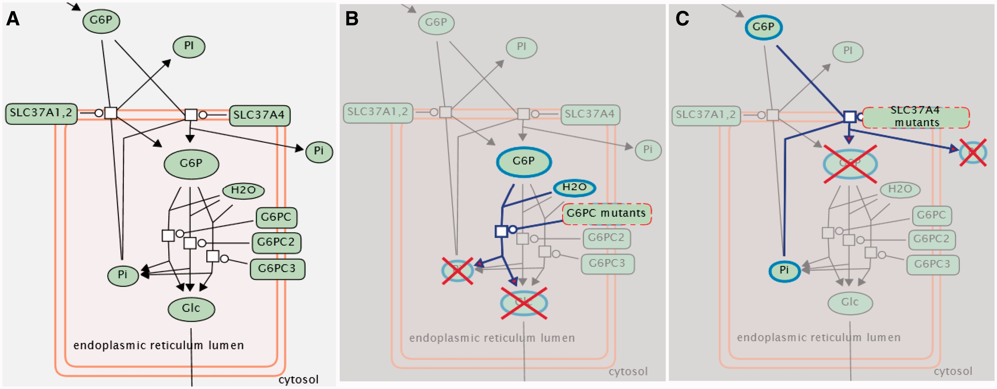
Figure 1. Example of disease curation and visualization in Reactome. The normal process of glucose export from the ...
Notes:
Figure 1. Example of disease curation and visualization in Reactome. The normal process of glucose export from the liver under fasting conditions (A) is disrupted by mutations that block glucose-6-phosphate hydrolysis within the endoplasmic reticulum (B) or the transport of glucose 6-phosphate and orthophosphate (Pi) between the endoplasmic reticulum and the cytosol (C).
Unless provided in the caption above, the following copyright applies to the content of this slide: © The Author(s) 2013. Published by Oxford University Press.This is an Open Access article distributed under the terms of the Creative Commons Attribution License (http://creativecommons.org/licenses/by/3.0/), which permits unrestricted reuse, distribution, and reproduction in any medium, provided the original work is properly cited.

Slide 2
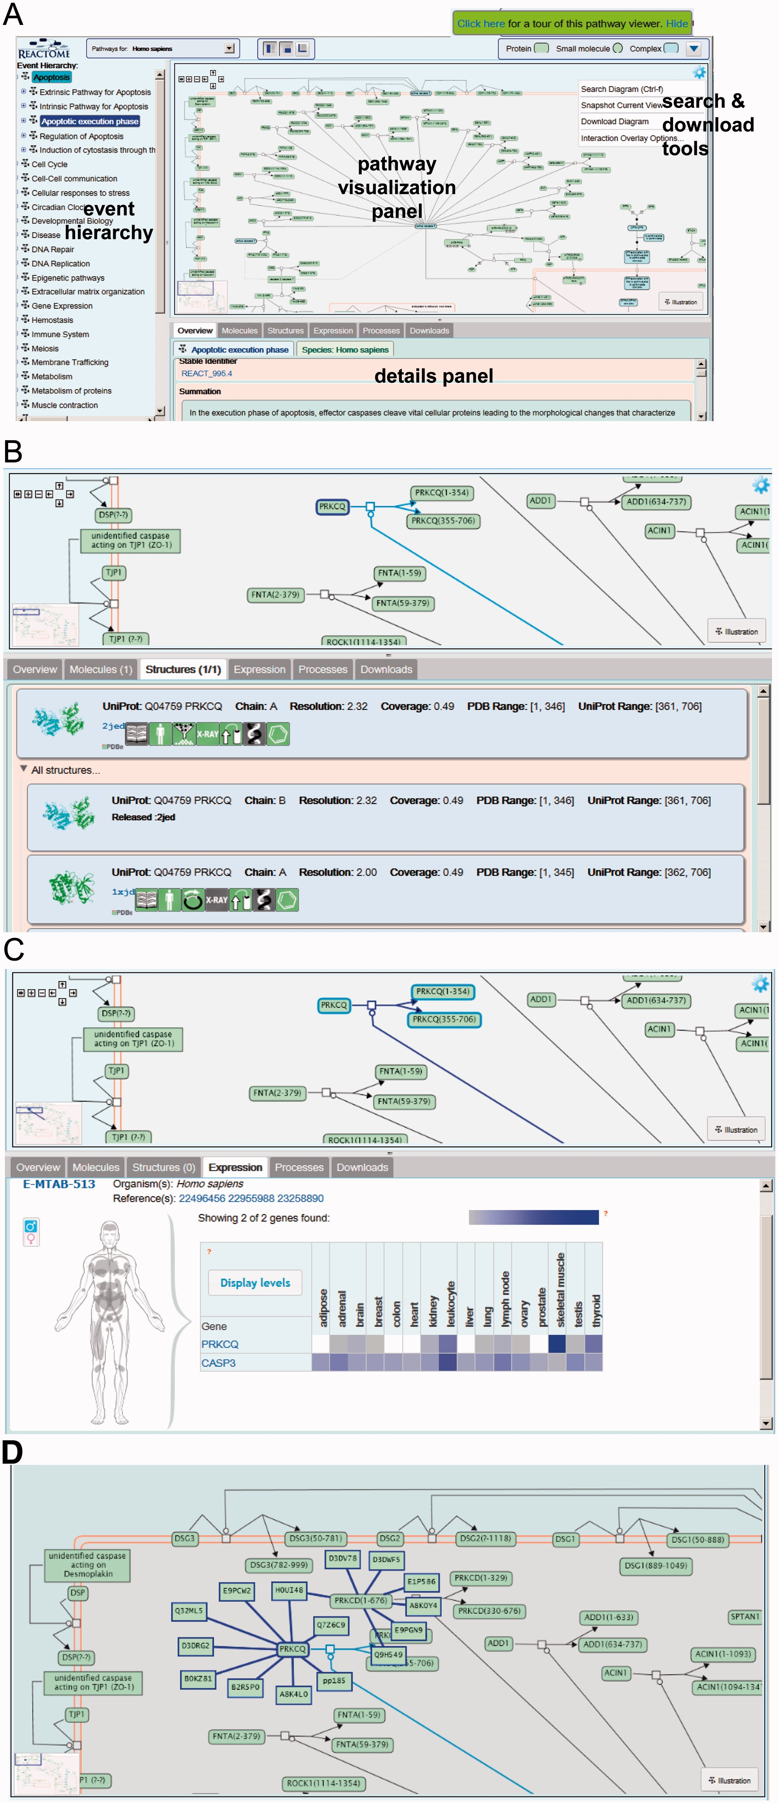
Figure 2. Visualization of the execution phase of apoptosis. (A) Choosing the entry for this event from the event ...
Notes:
Figure 2. Visualization of the execution phase of apoptosis. (A) Choosing the entry for this event from the event hierarchy in the left panel of the web page causes the pathway to be displayed in a large panel to the right, laid out in SBGN process description format. Buttons at the top of the panel open a diagram key and give access to a brief tour of features of the web page. The panel at the bottom of the page contains text descriptions of various features of the pathway and participating molecules, linked to external databases. (B) The user has selected the reaction ‘Caspase 3-mediated cleavage of PKC delta’; the ‘Structures’ detail tab displays PDB 3D structural data and citations for proteins in that reaction and the ‘Expression’ detail tab (C) displays condition-specific gene expression data from the Gene Expression Atlas. (D) The molecular interaction (MI) overlay displays proteins that interact with user-specified proteins PRKCQ and PRKCD.
Unless provided in the caption above, the following copyright applies to the content of this slide: © The Author(s) 2013. Published by Oxford University Press.This is an Open Access article distributed under the terms of the Creative Commons Attribution License (http://creativecommons.org/licenses/by/3.0/), which permits unrestricted reuse, distribution, and reproduction in any medium, provided the original work is properly cited.

Slide 3
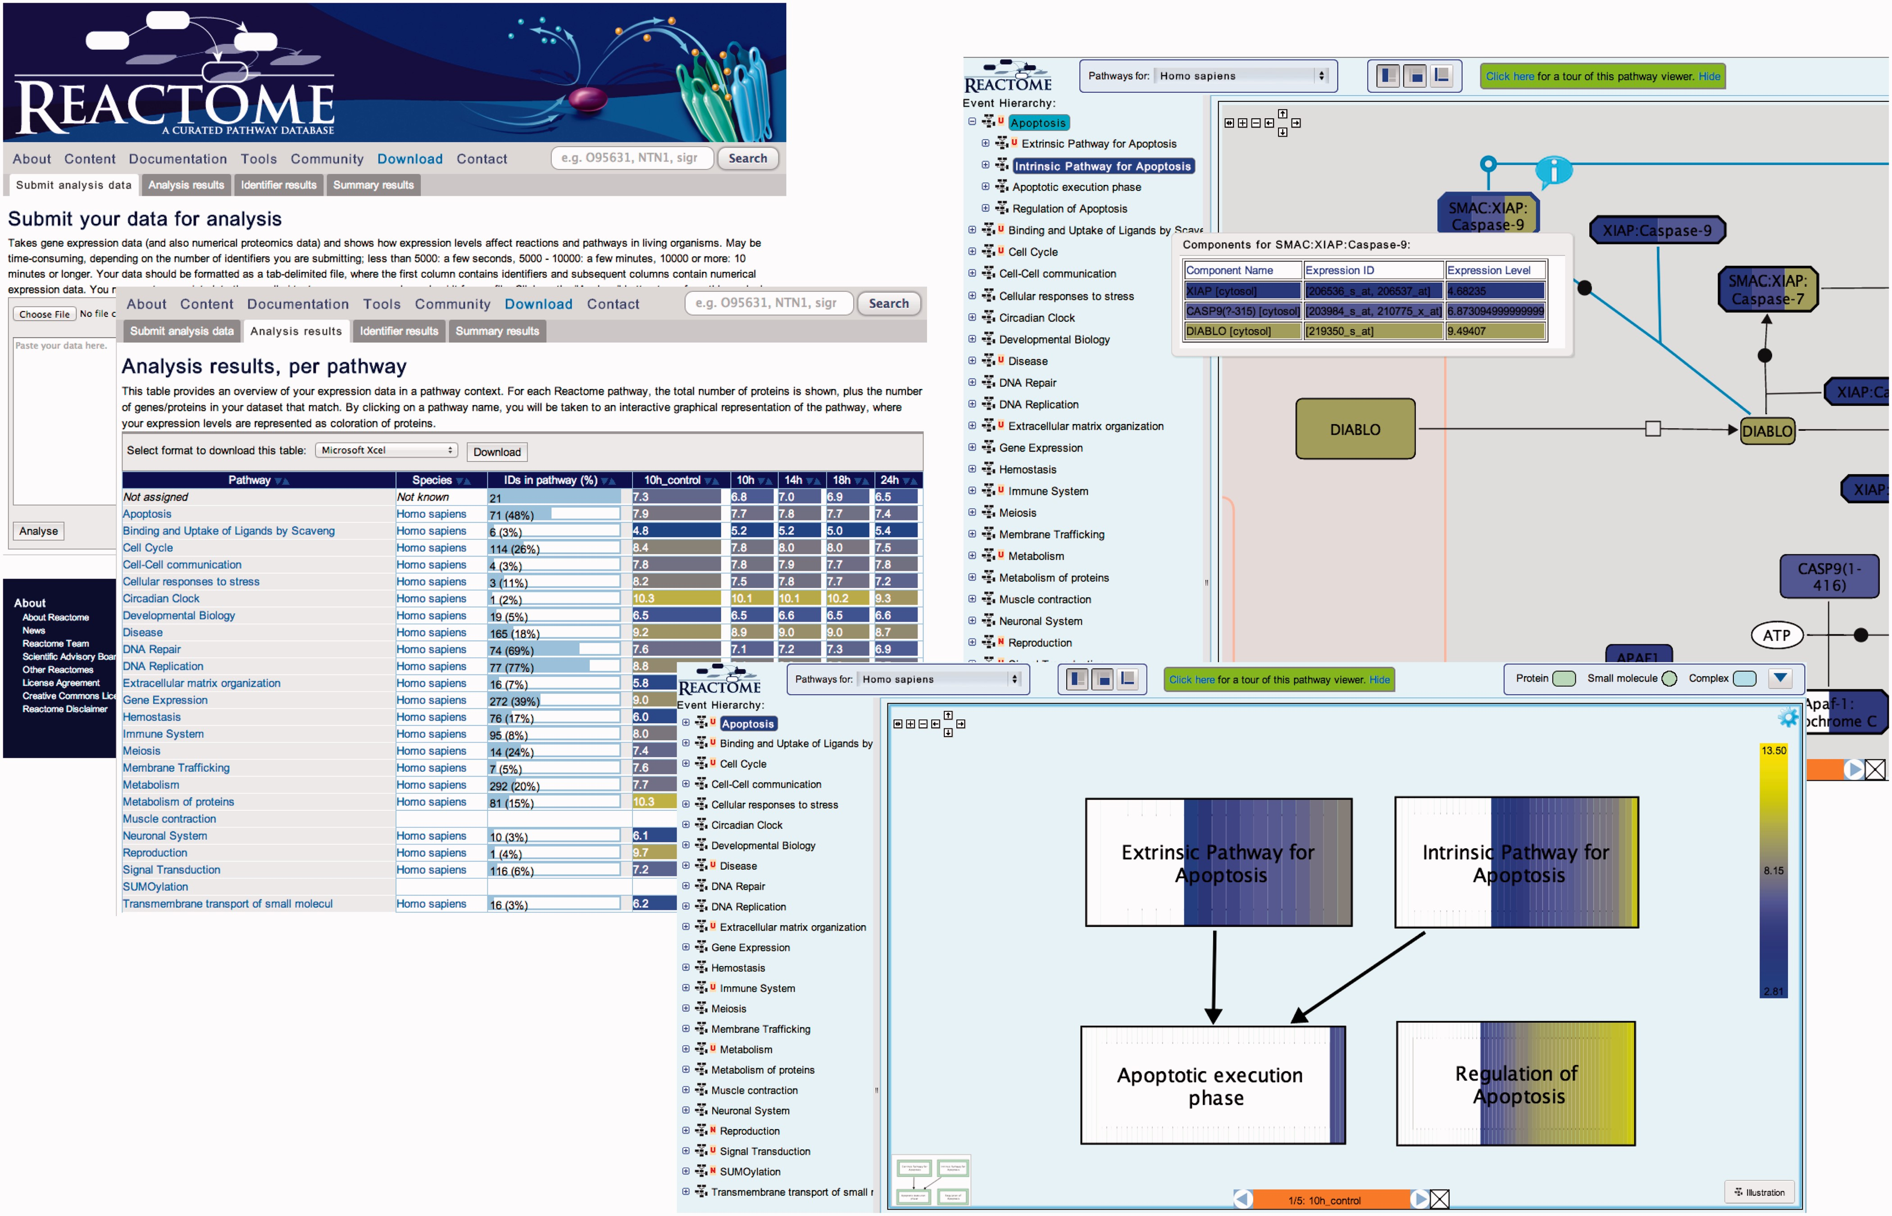
Figure 3. Pathway analysis. The data analysis workflow proceeds in three steps: data submission, a tabular display of ...
Notes:
Figure 3. Pathway analysis. The data analysis workflow proceeds in three steps: data submission, a tabular display of results and visual display of results as an overlay in a pathway browser window. The fourth pane shows a detail of the pathway browser window, to highlight the display of expression levels.
Unless provided in the caption above, the following copyright applies to the content of this slide: © The Author(s) 2013. Published by Oxford University Press.This is an Open Access article distributed under the terms of the Creative Commons Attribution License (http://creativecommons.org/licenses/by/3.0/), which permits unrestricted reuse, distribution, and reproduction in any medium, provided the original work is properly cited.

