Slide 1
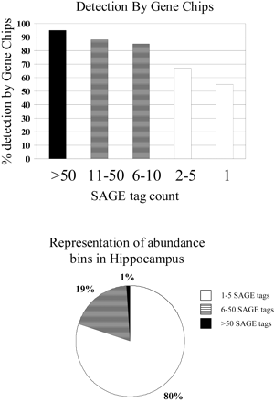
Fig. 1. Gene Chip Sensitivity. (A) The detection efficiencies of transcripts across 44 independent Affymetrix ...
Notes:
Fig. 1. Gene Chip Sensitivity. (A) The detection efficiencies of transcripts across 44 independent Affymetrix U34A Gene Chips is shown. The y-axis plots the percentage of time transcripts at various expression levels, given by SAGE tag bins shown on the x-axis, were detected by Gene Chip technology. (B) The estimated representation (from an extrapolation of SAGE data) of the various SAGE tag bins from (A) is shown as a total percentage of all unique hippocampal transcripts
Unless provided in the caption above, the following copyright applies to the content of this slide: The Society for Integrative and Comparative Biology

Slide 2
Fig. 2. Experiment Cluster. Hierarchical clustering of samples from Gene Chips described in the text. ...
Notes:
Fig. 2. Experiment Cluster. Hierarchical clustering of samples from Gene Chips described in the text. Clustering algorithms were based on Pearson correlation using only genes that were reliably detected in at least one brain region studies. The figure lists the processing site, brain region, and subject ID for each of the samples
Unless provided in the caption above, the following copyright applies to the content of this slide: The Society for Integrative and Comparative Biology

