Slide 1
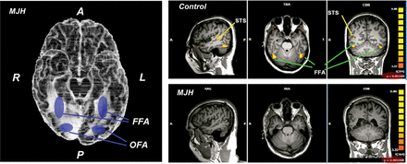
Figure 1. MRI brain imaging of MJH. (left) Ventral surface of MJH's brain reconstructed from anatomical MRI scans with ...
Notes:
Figure 1. MRI brain imaging of MJH. (left) Ventral surface of MJH's brain reconstructed from anatomical MRI scans with image provided by Hanna Damasio and Jessica L. Wisnowski from the Dana and David Dornsife Cognitive Neuroscience Imaging Center, USC, based on MR data obtained under P50NS019632. The blue colored patches (added by the authors) show the overlap between the FFA and OFA of controls and the lesion (cavities, shaded in white) in MJH. (right) The comparison of face-selective activation in controls and MJH based on a typical localizer functional scan. There is no preferential activation to faces, in contrast with objects, in MJH even with a liberal threshold.
Unless provided in the caption above, the following copyright applies to the content of this slide: © The Author 2013. Published by Oxford University Press. All rights reserved. For Permissions, please e-mail: journals.permissions@oup.com

Slide 2
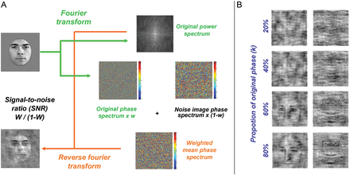
Figure 2. Illustration of phase-coherence modulation for faces. (A) Example of how the images were generated by the ...
Notes:
Figure 2. Illustration of phase-coherence modulation for faces. (A) Example of how the images were generated by the introduction of random noise into the phase spectrum. (B) Examples of resultant images with variation in the proportion of the original phase. The identical procedure was used with car targets.
Unless provided in the caption above, the following copyright applies to the content of this slide: © The Author 2013. Published by Oxford University Press. All rights reserved. For Permissions, please e-mail: journals.permissions@oup.com

Slide 3
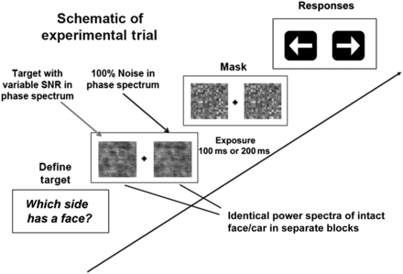
Figure 3. Illustration of experimental procedure, where the subject is to chose the image (left or right) containing ...
Notes:
Figure 3. Illustration of experimental procedure, where the subject is to chose the image (left or right) containing the target category (in this case, a face) with the variable SNR in the phase spectrum against the 100% phase noise image. The 2 images share identical power spectra. The QUEST staircase procedure (Watson and Pelli 1983) was used to probe the threshold SNR—the ratio between original phase and random noise phase—to achieve 75% detection accuracy separately for each stimulus category and exposure duration.
Unless provided in the caption above, the following copyright applies to the content of this slide: © The Author 2013. Published by Oxford University Press. All rights reserved. For Permissions, please e-mail: journals.permissions@oup.com

Slide 4
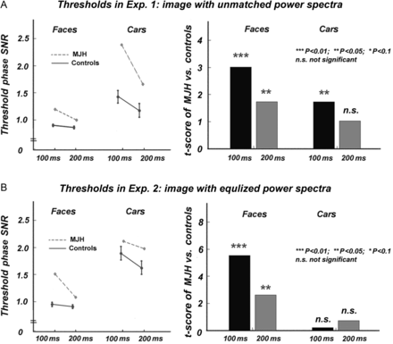
Figure 4. Detection thresholds measured as psSNR, with the face versus car power spectrum unmatched in Experiment 1 ...
Notes:
Figure 4. Detection thresholds measured as psSNR, with the face versus car power spectrum unmatched in Experiment 1 ( A) and equalized in Experiment 2. (B) Error bars indicate the standard error of the controls. Right panels are the values of the t-scores of MJH versus controls.
Unless provided in the caption above, the following copyright applies to the content of this slide: © The Author 2013. Published by Oxford University Press. All rights reserved. For Permissions, please e-mail: journals.permissions@oup.com

Slide 5
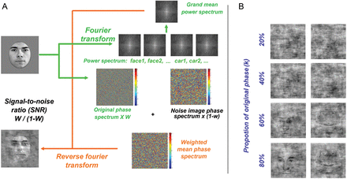
Figure 5. Illustration of phase-coherence modulation with power spectrum equalization for faces. (A) Example of how the ...
Notes:
Figure 5. Illustration of phase-coherence modulation with power spectrum equalization for faces. (A) Example of how the images were generated by the introduction of random noise into the phase spectrum. (B) Examples of resultant images with variation in the proportion of the original phase. The identical procedure was used with car targets.
Unless provided in the caption above, the following copyright applies to the content of this slide: © The Author 2013. Published by Oxford University Press. All rights reserved. For Permissions, please e-mail: journals.permissions@oup.com

Slide 6
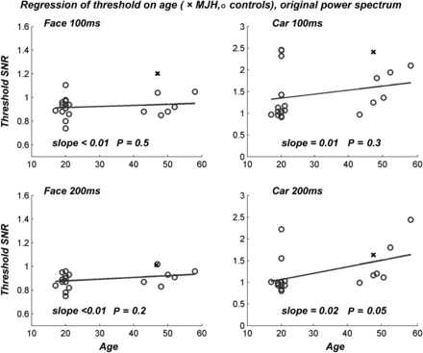
Figure 6. Regression of the detection threshold on age for controls in Experiment 1.
Notes:
Figure 6. Regression of the detection threshold on age for controls in Experiment 1.
Unless provided in the caption above, the following copyright applies to the content of this slide: © The Author 2013. Published by Oxford University Press. All rights reserved. For Permissions, please e-mail: journals.permissions@oup.com

Slide 7
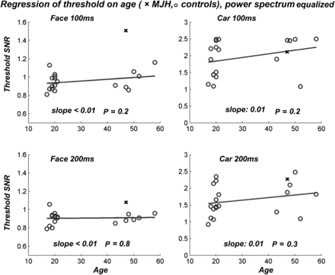
Figure 7. Regression of the detection thresholds on age for controls in Experiment 2 (equal power spectrum for faces ...
Notes:
Figure 7. Regression of the detection thresholds on age for controls in Experiment 2 (equal power spectrum for faces and cars).
Unless provided in the caption above, the following copyright applies to the content of this slide: © The Author 2013. Published by Oxford University Press. All rights reserved. For Permissions, please e-mail: journals.permissions@oup.com

