Slide 1
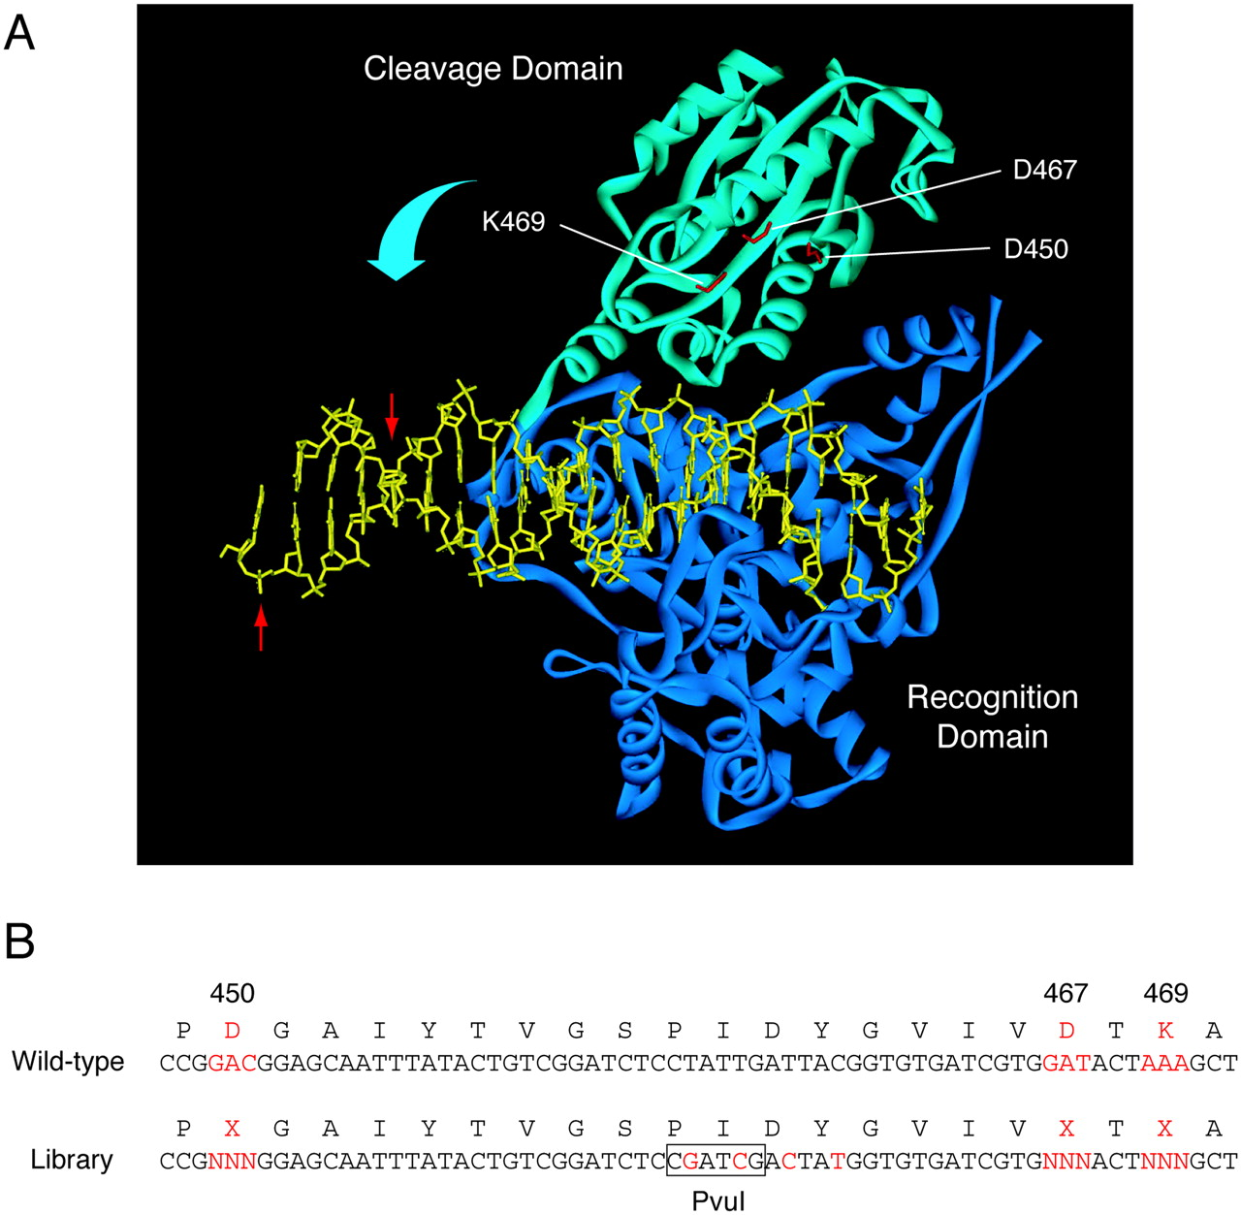
Figure 3. Randomized target residues involved in catalysis. ( A ) The structure of the FokI–DNA complex ( 28 , 29 ). ...
Notes:
Figure 3. Randomized target residues involved in catalysis. ( A ) The structure of the FokI–DNA complex ( 28 , 29 ). Target catalytic residues (Asp-450, Asp-467 and Lys-469) in FokI are in red. The cleavage domain (sky blue) moves toward the cleavage sites (red arrows) on the DNA (yellow). ( B ) The partial sequence of FokI including the target residues. In a library, the three amino acids were randomized with NNN codons (N = A, C, G or T) as shown in red. To distinguish a wild-type gene in the library from the original native gene, four silent mutations were also introduced in the library (red), yielding a PvuI cleavage site (box).
Unless provided in the caption above, the following copyright applies to the content of this slide: Nucleic Acids Research, Vol. 32 No. 12 © Oxford University Press 2004; all rights reserved

Slide 2
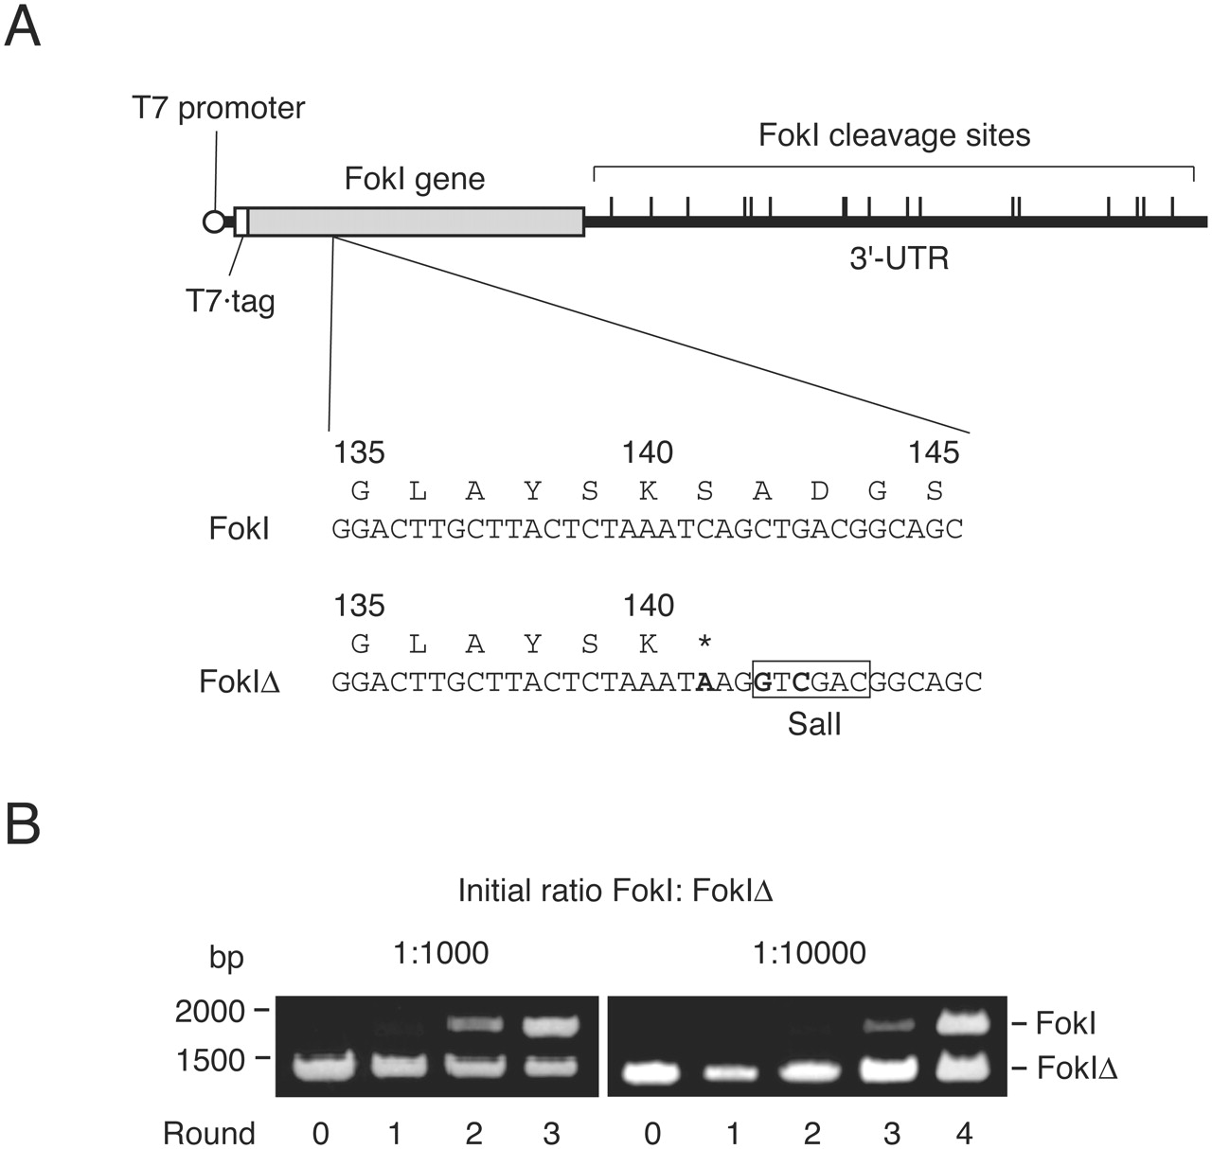
Figure 2. Selections for restriction endonuclease FokI by using IVC. ( A ) DNA templates for in vitro expression of ...
Notes:
Figure 2. Selections for restriction endonuclease FokI by using IVC. ( A ) DNA templates for in vitro expression of FokI. The 1740 bp FokI gene is fused with the N-terminal T7·tag coding sequence (42 bp). The 108 bp 5′-UTR fragment contains T7 promoter. The 3045 bp 3′-UTR fragment contains 17 FokI cleavage sites. A mutant FokIΔ gene contains three nucleotide mutations (boldface), yielding a stop codon (*) and a SalI cleavage site (box). ( B ) Enrichment of the active FokI gene in multiple rounds of selection. Reaction mixtures containing 1:1000 or 1:10 000 molar ratio of FokI:FokIΔ genes were emulsified. The DNA after each round of selection was digested with SalI and analyzed by agarose gel electrophoresis.
Unless provided in the caption above, the following copyright applies to the content of this slide: Nucleic Acids Research, Vol. 32 No. 12 © Oxford University Press 2004; all rights reserved

Slide 3
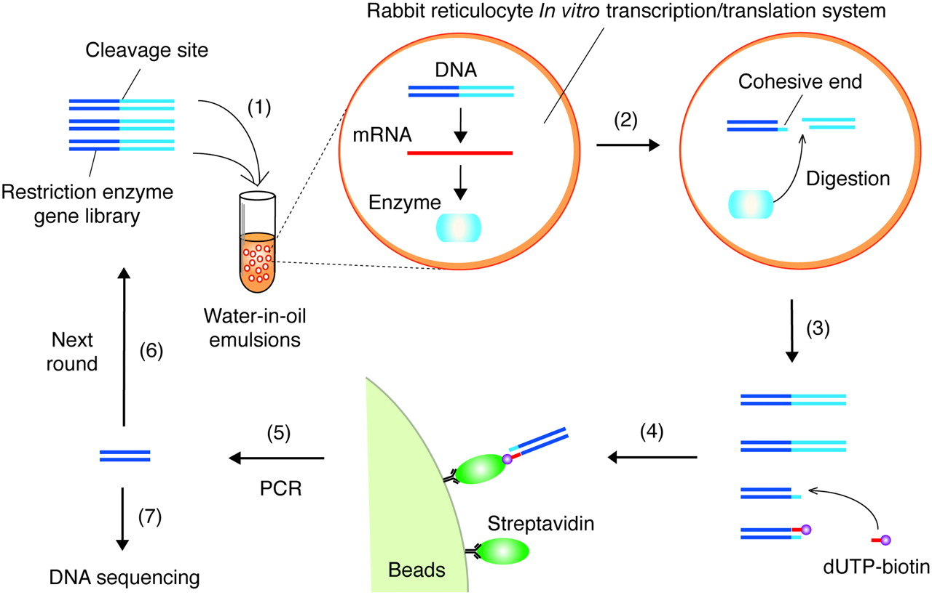
Figure 1. Schematic representation of the in vitro selection of restriction enzymes. ( 1 ) A DNA library encoding ...
Notes:
Figure 1. Schematic representation of the in vitro selection of restriction enzymes. ( 1 ) A DNA library encoding mutant restriction enzymes is introduced into a rabbit reticulocyte in vitro transcription/translation system. ( 2 ) A single DNA molecule compartmentalized in a reversed micelle of water-in-oil emulsions is transcribed and translated in vitro . In a compartment, a translated enzyme with high activity cleaves its encoding DNA. In other compartments, genes that do not express active enzymes remain intact. ( 3 ) The mixture of cleaved and intact DNA is recovered from the emulsions. A biotinylated derivative of deoxyribonucleoside 5′-triphosphate (e.g. dUTP-biotin) is specifically incorporated into the cohesive end of the cleaved DNA by DNA polymerase. ( 4 ) The biotinylated DNAs encoding active restriction enzymes are affinity-selected with streptavidin-immobilized beads. ( 5 ) The selected DNA is amplified by PCR and used for ( 6 ) the next round of enrichment or ( 7 ) cloning and sequencing.
Unless provided in the caption above, the following copyright applies to the content of this slide: Nucleic Acids Research, Vol. 32 No. 12 © Oxford University Press 2004; all rights reserved

Slide 4
Figure 4. DNA digestion activity at each round of emulsified or non-emulsified selection. Fluorescently labeled DNA ...
Notes:
Figure 4. DNA digestion activity at each round of emulsified or non-emulsified selection. Fluorescently labeled DNA after each round of selection was transcribed and translated en masse and analyzed by SDS–PAGE using an imaging analyzer. A result for the wild-type DNA (wt) is also shown.
Unless provided in the caption above, the following copyright applies to the content of this slide: Nucleic Acids Research, Vol. 32 No. 12 © Oxford University Press 2004; all rights reserved

Slide 5
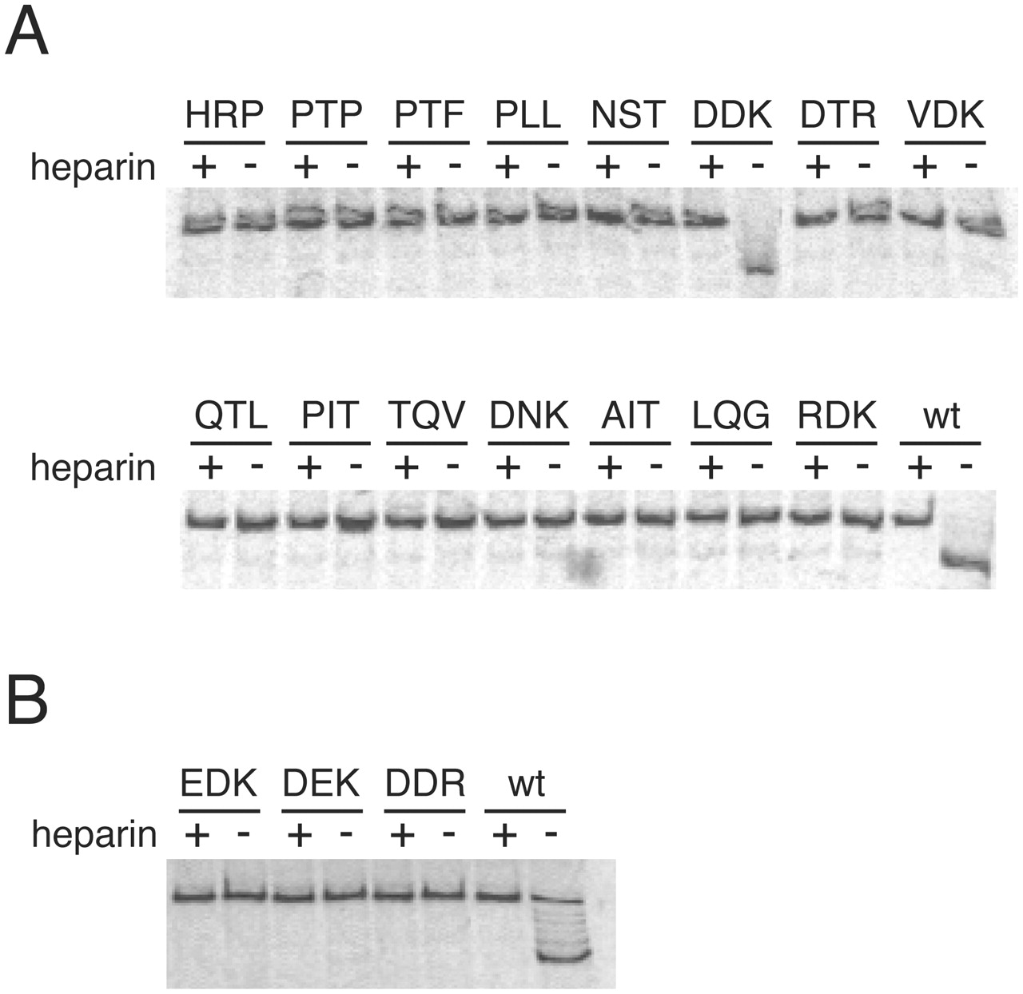
Figure 5. DNA digestion activity of FokI mutants. ( A ) Activity of selected mutants listed in Table 2 . The sequence ...
Notes:
Figure 5. DNA digestion activity of FokI mutants. ( A ) Activity of selected mutants listed in Table 2 . The sequence of three mutated amino acids at residues 450, 467 and 469 in each mutant is shown at the top of each lane. The DDK protein has the same amino acids as in native FokI, though the DNA sequence is different from that of the wild-type FokI (wt). Fluorescently labeled DNA encoding each mutant gene was translated and analyzed by SDS–PAGE with an imaging analyzer. Heparin was added to inhibit translation. ( B ) Activity of site-directed mutants D450E, D467E and K469R.
Unless provided in the caption above, the following copyright applies to the content of this slide: Nucleic Acids Research, Vol. 32 No. 12 © Oxford University Press 2004; all rights reserved

