Slide 1
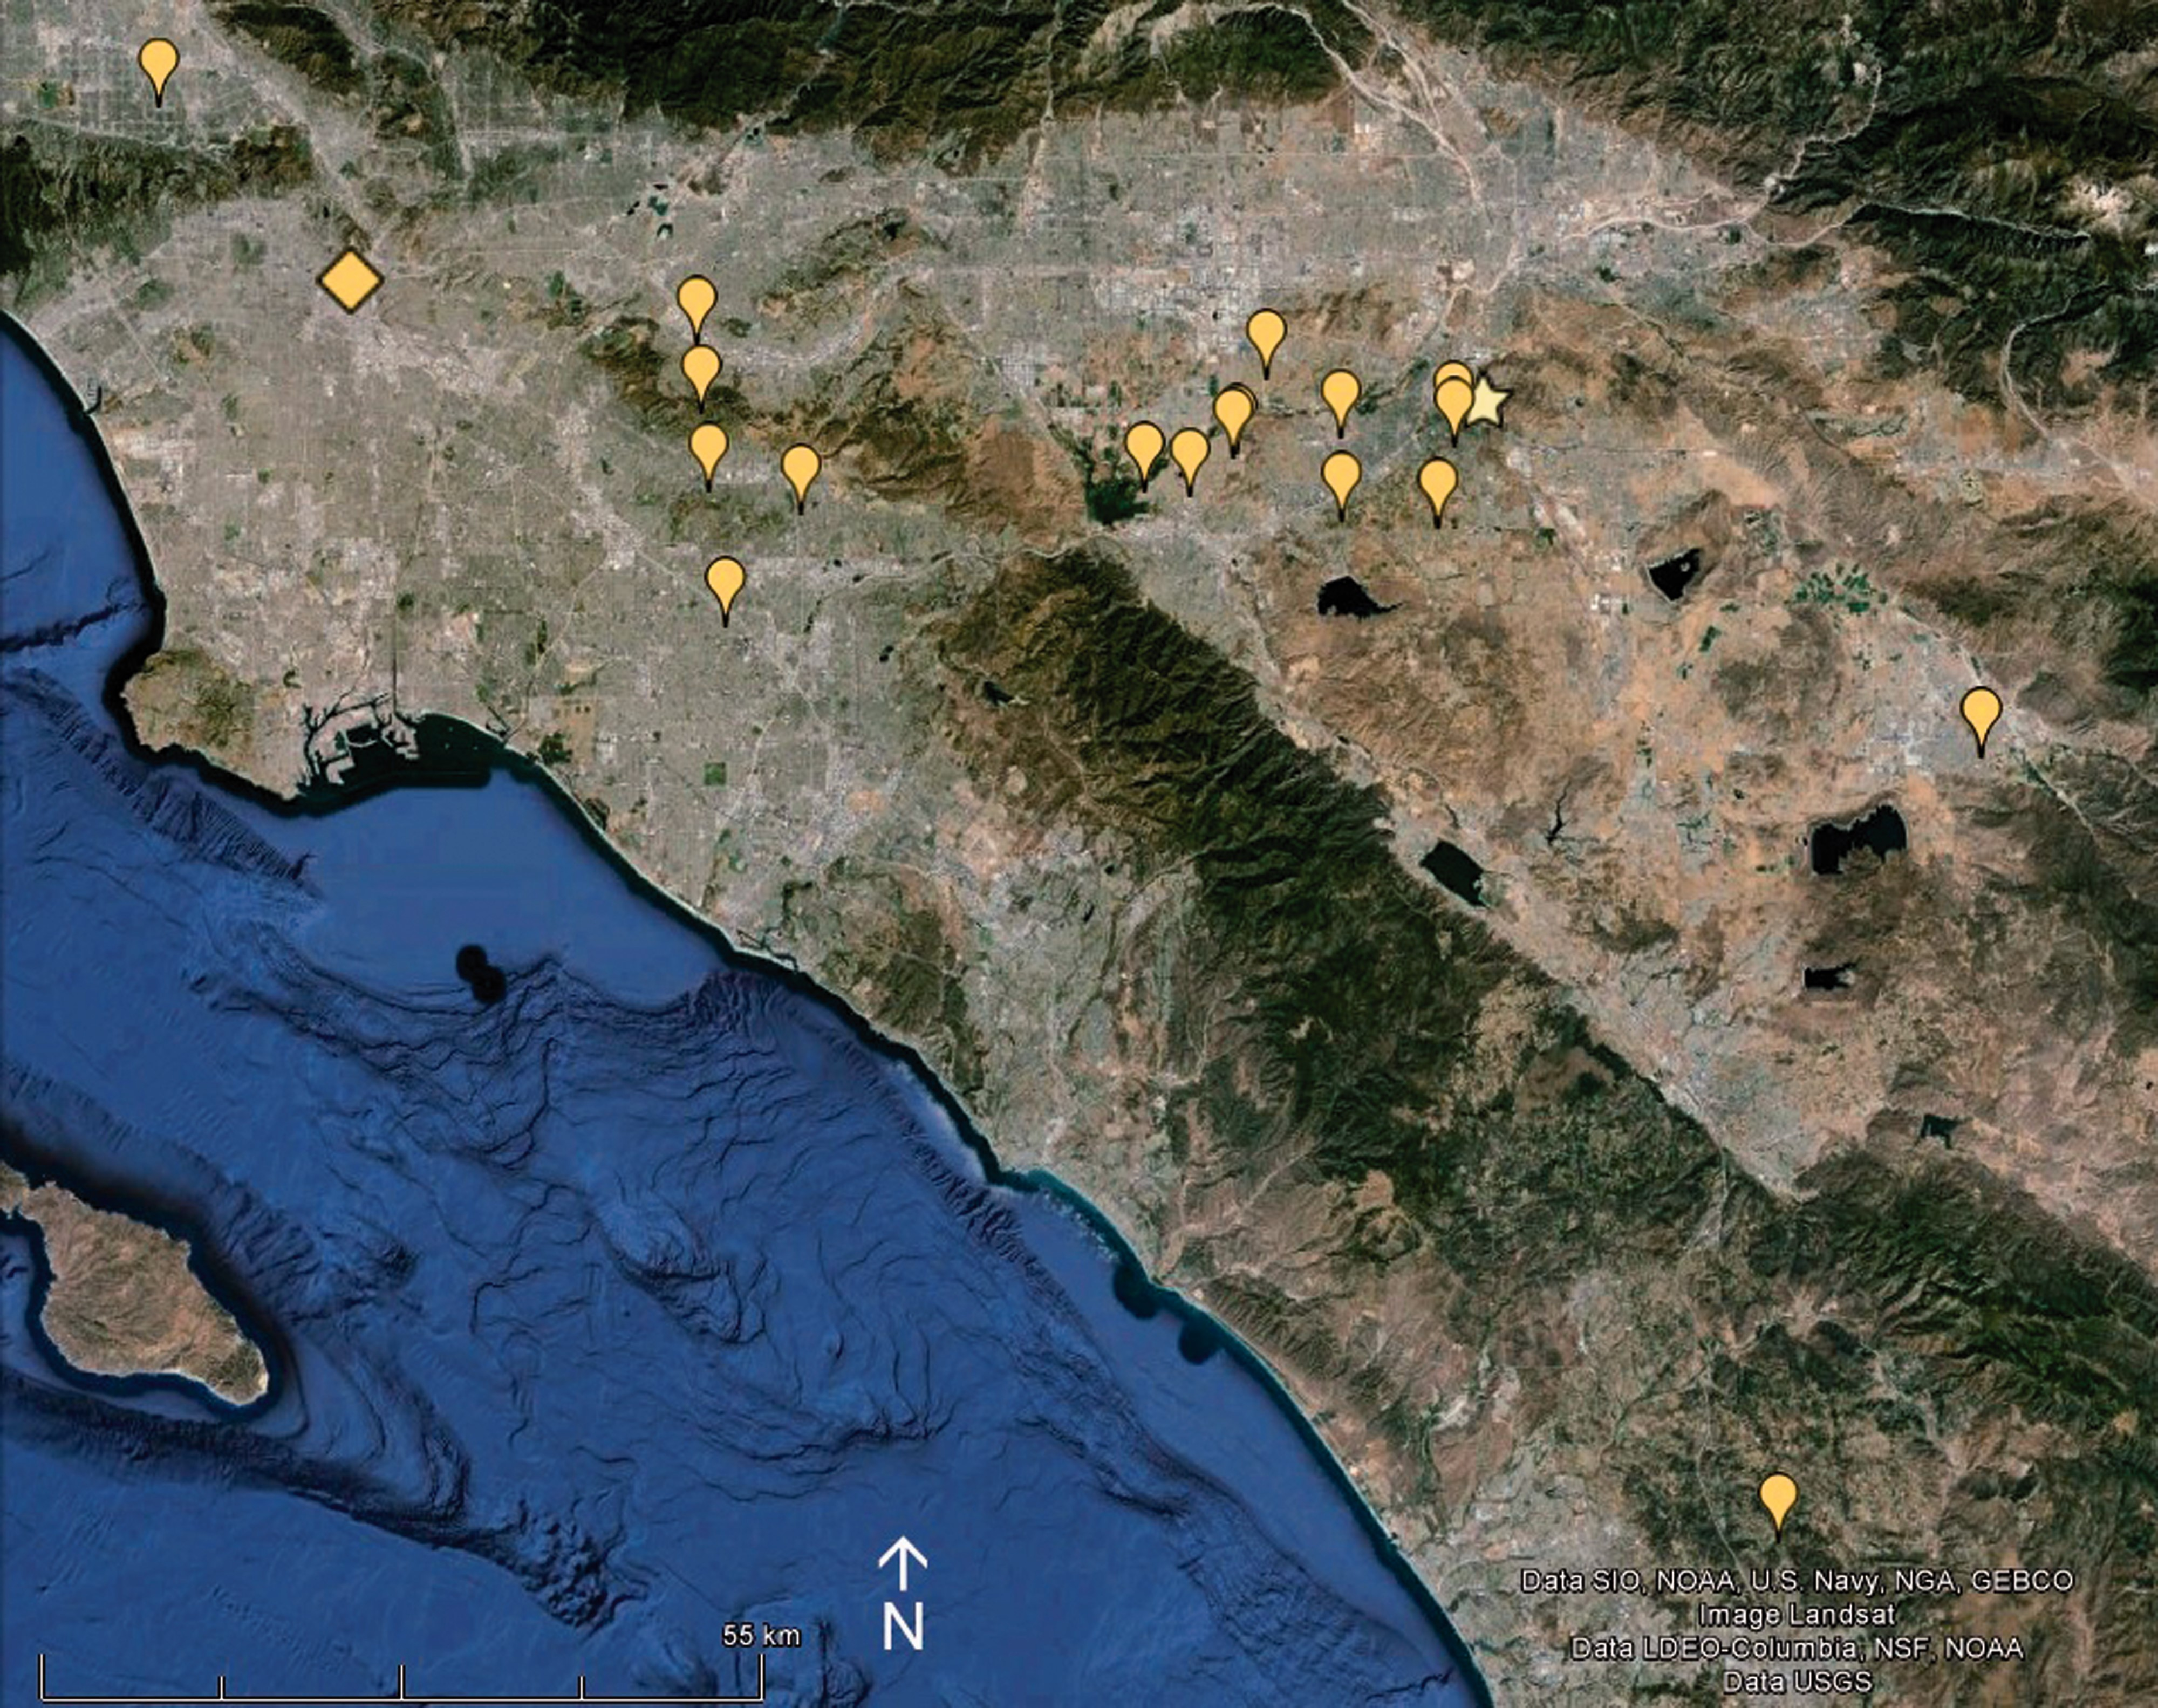
Fig. 1. Map (via Google Earth) of southern California showing study sites (pins) relative to the University of ...
Notes:
Fig. 1. Map (via Google Earth) of southern California showing study sites (pins) relative to the University of California, Riverside (star) and Los Angeles (diamond).
Unless provided in the caption above, the following copyright applies to the content of this slide: © The Authors 2016. Published by Oxford University Press on behalf of Entomological Society of America. All rights reserved. For Permissions, please email: journals.permissions@oup.com

Slide 2
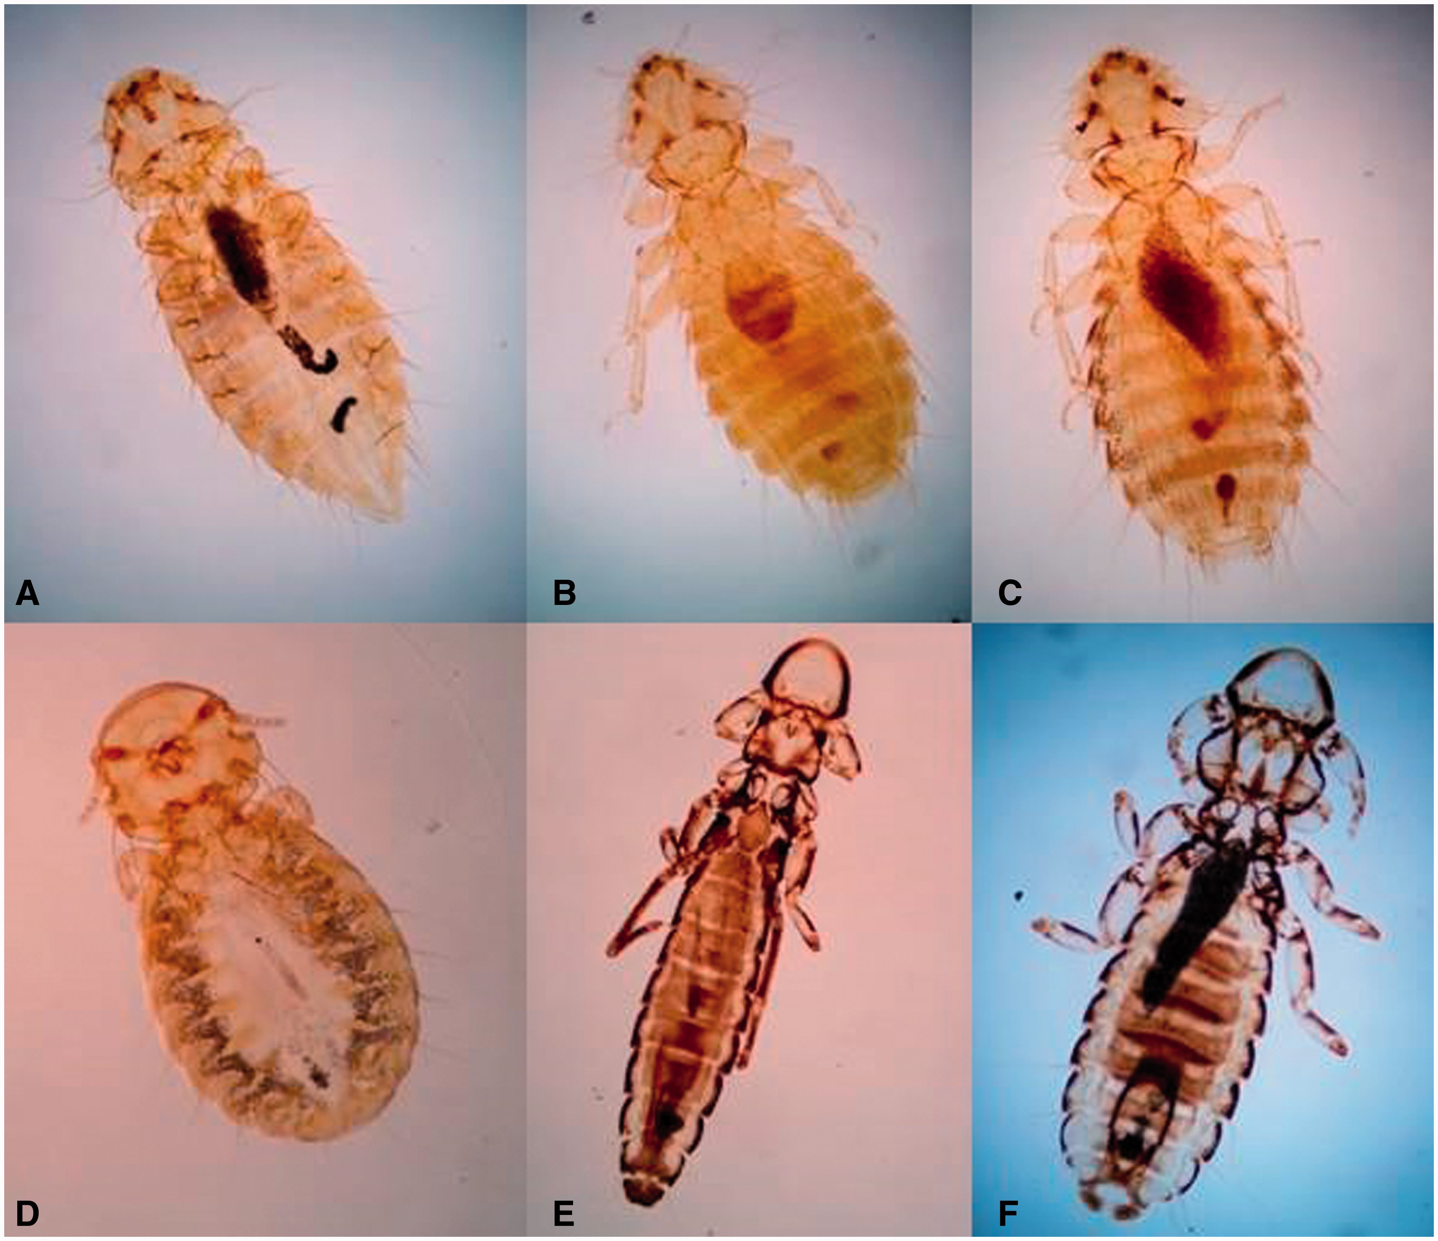
Fig. 2. Chicken lice (not to scale) collected in survey. ( A ) Menopon gallinae ; ( B ) Menacanthus cornutus ; ( C ) ...
Notes:
Fig. 2. Chicken lice (not to scale) collected in survey. ( A ) Menopon gallinae ; ( B ) Menacanthus cornutus ; ( C ) Menacanthus stramineus ; ( D ) Goniocotes gallinae ; ( E ) Lipeurus caponis ; and ( F ) Cuclotogaster heterographus .
Unless provided in the caption above, the following copyright applies to the content of this slide: © The Authors 2016. Published by Oxford University Press on behalf of Entomological Society of America. All rights reserved. For Permissions, please email: journals.permissions@oup.com

