Slide 1
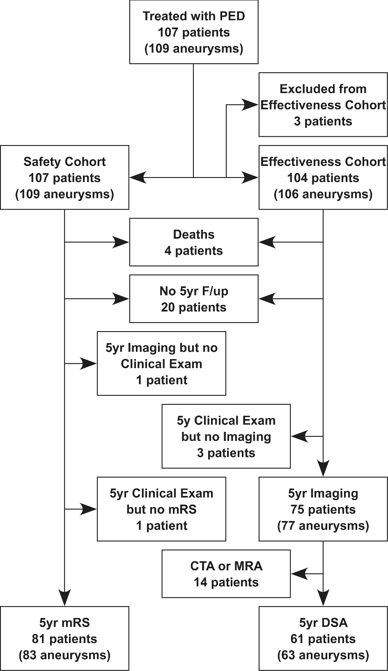
FIGURE. Subject follow-up flowchart.
Notes:
FIGURE. Subject follow-up flowchart.
Unless provided in the caption above, the following copyright applies to the content of this slide: Copyright © 2016 by the Congress of Neurological Surgeons

