Slide 1
Fig. 1. Examples of the physical environment changes and the provision of unfixed equipment from three of the seven ...
Notes:
Fig. 1. Examples of the physical environment changes and the provision of unfixed equipment from three of the seven intervention schools.
Unless provided in the caption above, the following copyright applies to the content of this slide: � The Author 2017. Published by Oxford University Press.This is an Open Access article distributed under the terms of the Creative Commons Attribution-NonCommercial-NoDerivs licence (http://creativecommons.org/licenses/by-nc-nd/4.0/), which permits non-commercial reproduction and distribution of the work, in any medium, provided the original work is not altered or transformed in any way, and that the work properly cited. For commercial re-use, please contact journals.permissions@oup.com

Slide 2
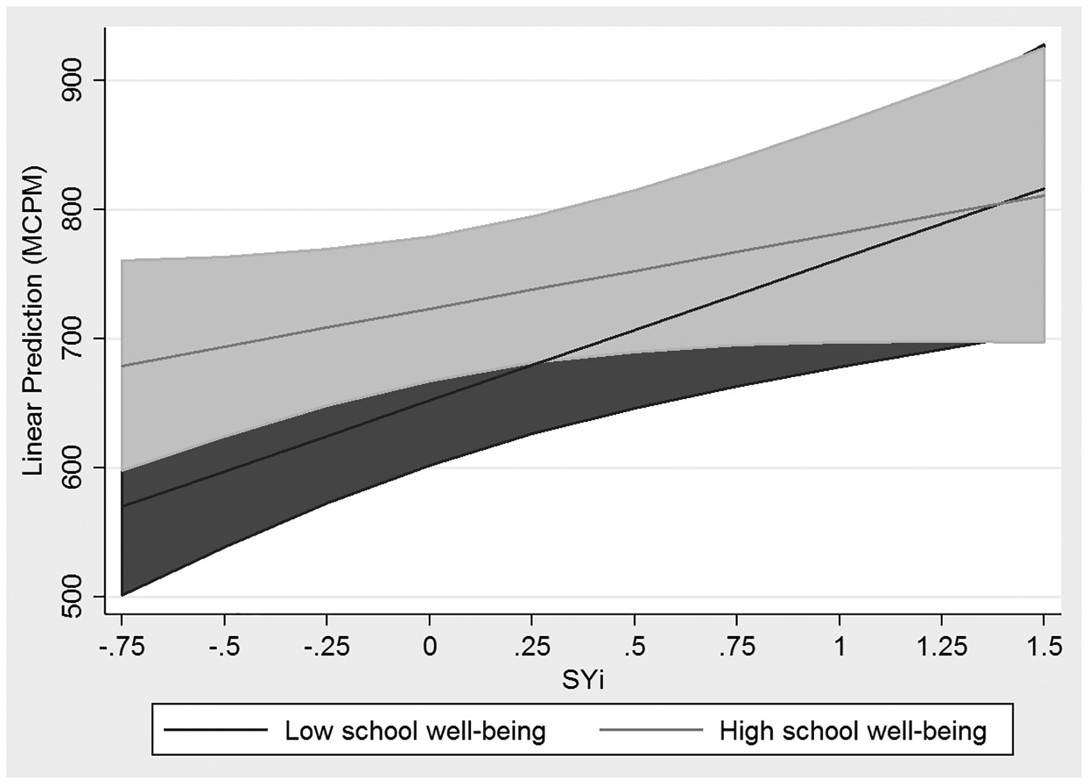
Fig. 2. Interaction plot for the estimated recess PA for different values of SYi and for students with highest and ...
Notes:
Fig. 2. Interaction plot for the estimated recess PA for different values of SYi and for students with highest and lower school well-being.
Unless provided in the caption above, the following copyright applies to the content of this slide: � The Author 2017. Published by Oxford University Press.This is an Open Access article distributed under the terms of the Creative Commons Attribution-NonCommercial-NoDerivs licence (http://creativecommons.org/licenses/by-nc-nd/4.0/), which permits non-commercial reproduction and distribution of the work, in any medium, provided the original work is not altered or transformed in any way, and that the work properly cited. For commercial re-use, please contact journals.permissions@oup.com

Slide 3
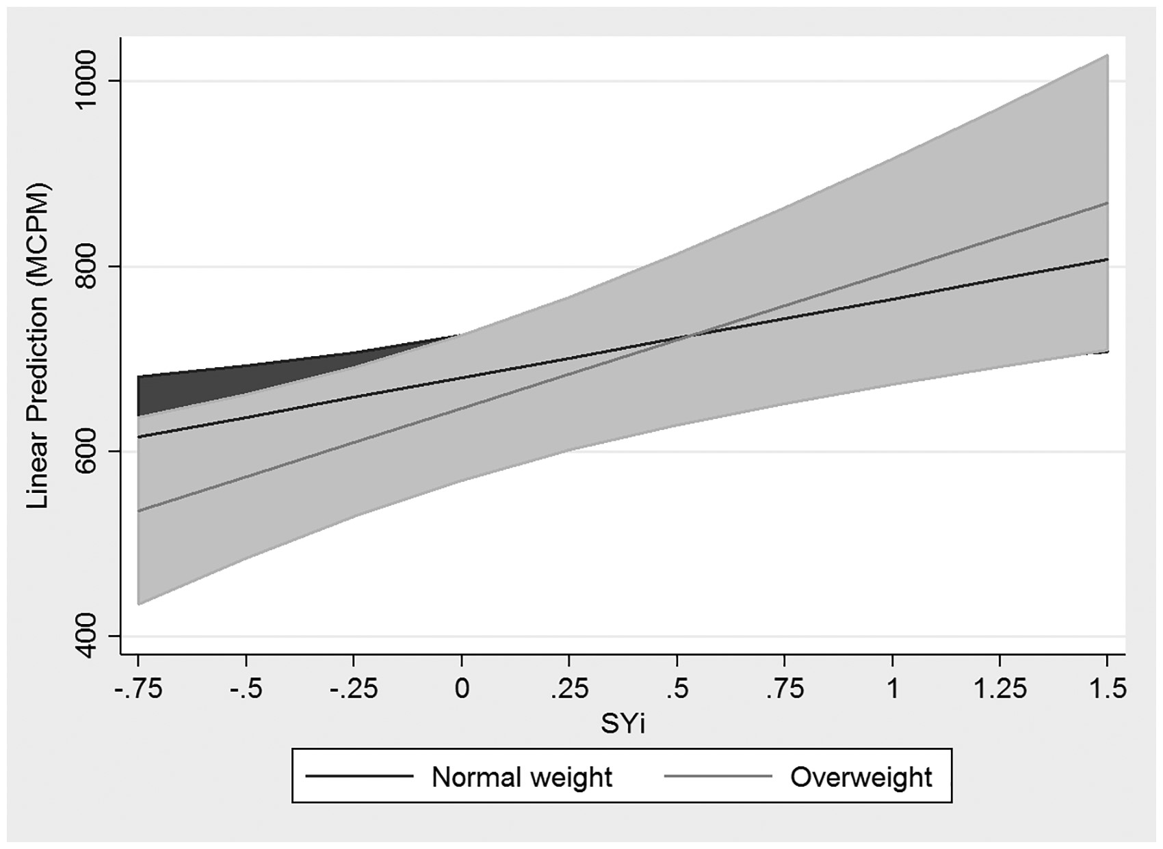
Fig. 3. Interaction plot for the estimated recess PA for different values of SYi and for normal weight and overweight ...
Notes:
Fig. 3. Interaction plot for the estimated recess PA for different values of SYi and for normal weight and overweight students.
Unless provided in the caption above, the following copyright applies to the content of this slide: � The Author 2017. Published by Oxford University Press.This is an Open Access article distributed under the terms of the Creative Commons Attribution-NonCommercial-NoDerivs licence (http://creativecommons.org/licenses/by-nc-nd/4.0/), which permits non-commercial reproduction and distribution of the work, in any medium, provided the original work is not altered or transformed in any way, and that the work properly cited. For commercial re-use, please contact journals.permissions@oup.com

