Slide 1
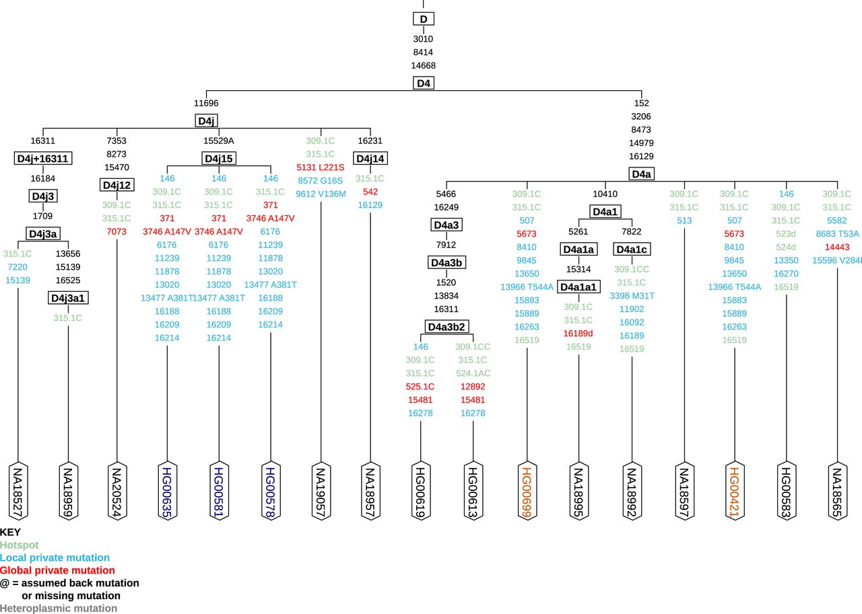
Figure 1. Excerpt of the 1000G Phase 1 data generated with the new provided ‘Graphical Phylogenetic Tree’. ...
Notes:
Figure 1. Excerpt of the 1000G Phase 1 data generated with the new provided ‘Graphical Phylogenetic Tree’. Polymorphisms in the tips of the phylogeny are candidates for new haplogroups, see for instance the samples belonging to haplogroup D4j15, (confirmed to be related (ftp://ftp.1000genomes.ebi.ac.uk/vol1/ftp/technical/working/20130606_sample_info/20130606_sample_info.xlsx)) or samples HG00699 and HG00421 (not related). Polymorphisms marked in red are not occurring in Phylotree and may require additional attention, whereas mutations in blue are private polymorphisms for this group, already known by Phylotree. The annotation of amino acid changes and mutational hotspots (green) can be defined by the user, thereby hotspots at positions 16182, 16183 and 16519, AC insertion and deletions at 515–524, inserts at 16193 as well as variation around position 310 and point heteroplasmies can be excluded for the phylogenetic reconstruction.
Unless provided in the caption above, the following copyright applies to the content of this slide: © The Author(s) 2016. Published by Oxford University Press on behalf of Nucleic Acids Research.This is an Open Access article distributed under the terms of the Creative Commons Attribution License (http://creativecommons.org/licenses/by-nc/4.0/), which permits non-commercial re-use, distribution, and reproduction in any medium, provided the original work is properly cited. For commercial re-use, please contact journals.permissions@oup.com

