Slide 1
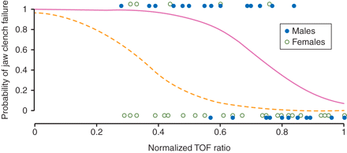
Fig 1 Results of a logistic regression analysis of the relationship between the probability of loss of ability to ...
Notes:
Fig 1 Results of a logistic regression analysis of the relationship between the probability of loss of ability to clench teeth and AMG AP TOF ratio in males and females. NONMEM (version VI) was used in the analysis and the Laplacian method of estimation was used to account for repeated measures within each individual. Each individual contributes four data points (baseline and three different levels of stable neuromuscular block). The relationships are significantly different between males and females (P<0.001).
Unless provided in the caption above, the following copyright applies to the content of this slide: © The Author [2011]. Published by Oxford University Press on behalf of the British Journal of Anaesthesia. All rights reserved. For Permissions, please email: journals.permissions@oup.com

Slide 2
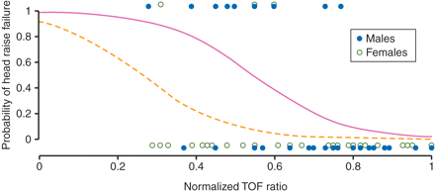
Fig 2 Results of a logistic regression analysis of the relationship between the probability of loss of ability to ...
Notes:
Fig 2 Results of a logistic regression analysis of the relationship between the probability of loss of ability to raise the head > 5 s and AMG AP TOF ratio in males and females. NONMEM (version VI) was used in the analysis and the Laplacian method of estimation was used to account for repeated measures within each individual. Each individual contributes four data points (baseline and three different levels of stable neuromuscular block) (P<0.01).
Unless provided in the caption above, the following copyright applies to the content of this slide: © The Author [2011]. Published by Oxford University Press on behalf of the British Journal of Anaesthesia. All rights reserved. For Permissions, please email: journals.permissions@oup.com

