Slide 1
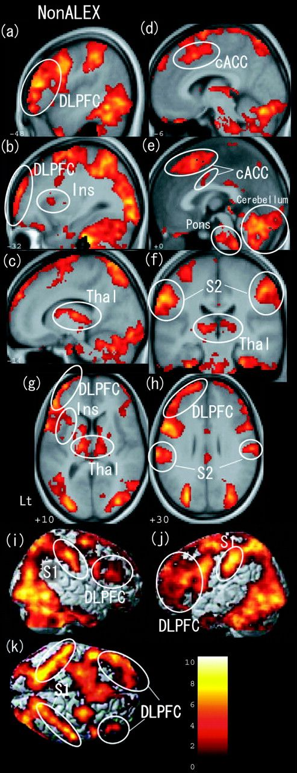
Figure 1. Brain images of the higher regional cerebral activation in response to the other's painful pictures compared ...
Notes:
Figure 1. Brain images of the higher regional cerebral activation in response to the other's painful pictures compared with control pictures in the non-alexithymic sample. The brain images illustrate the clusters with neural activities in response to the other's pain task (contrasted with no-pain control pictures) within pain-related regions using 1-sample tests for the non-ALEX group (n = 14). The white circles on the brain images indicate the notable clusters related to the pain network. The bar on the lower right shows the range of t scores for SPM. The height threshold for illustrating the clusters was P < 0.05 corrected (false discovery rate). (a–e) sagittal view; (f) coronal view; (g, h) axial view; (i) right side; (j) left side; (k) top. Ins, insula; Thal, thalamus; cACC, caudal anterior cingulate cortex; S2, secondary sensory cortex; S1, primary sensory cortex.
Unless provided in the caption above, the following copyright applies to the content of this slide: © The Author 2006. Published by Oxford University Press. All rights reserved. For permissions, please e-mail: journals.permissions@oxfordjournals.org

Slide 2
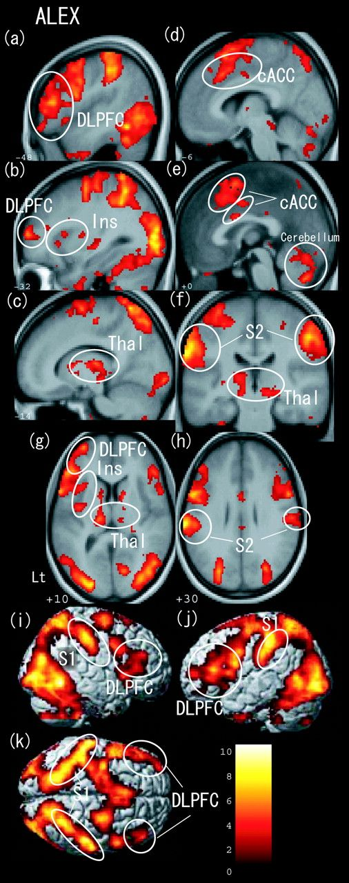
Figure 2. Brain images of the higher regional cerebral activation in response to the other's painful pictures compared ...
Notes:
Figure 2. Brain images of the higher regional cerebral activation in response to the other's painful pictures compared with control pictures in the alexithymic sample. The brain images illustrate the clusters with neural activities in response to the other's pain task (contrasted with no-pain control pictures) within pain-related regions using 1-sample tests for the ALEX group (n = 16). The white circles on the brain images indicate the notable clusters related to the pain network. The bar on the lower right shows the range of t scores for SPM. The height threshold for illustrating the clusters was P < 0.05 corrected (false discovery rate). (a–e) sagittal view; (f) coronal view; (g, h) axial view; (i) right side; (j) left side; (k) top. Ins, insula; Thal, thalamus; cACC, caudal anterior cingulate cortex; S2, secondary sensory cortex; S1, primary sensory cortex.
Unless provided in the caption above, the following copyright applies to the content of this slide: © The Author 2006. Published by Oxford University Press. All rights reserved. For permissions, please e-mail: journals.permissions@oxfordjournals.org

Slide 3
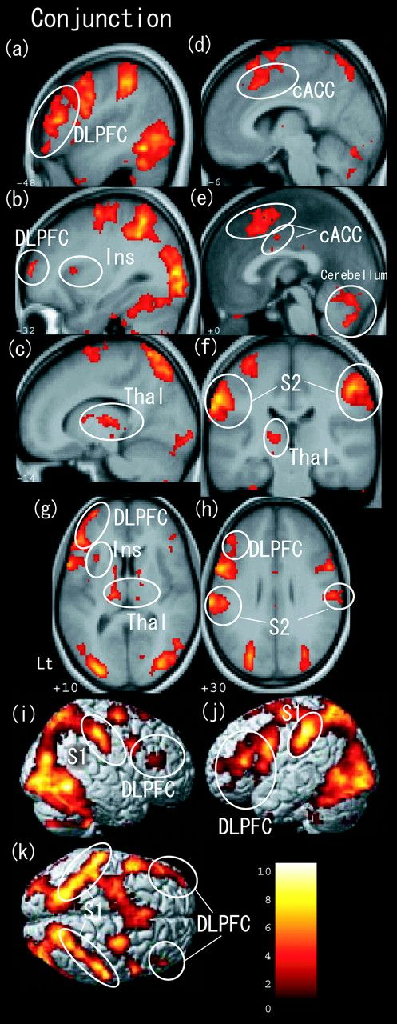
Figure 3. Brain images of the higher regional cerebral activations in response to the other's painful pictures compared ...
Notes:
Figure 3. Brain images of the higher regional cerebral activations in response to the other's painful pictures compared with control pictures in conjunction analysis of both groups. The brain images illustrate the clusters with neural activities in response to the other's pain task (contrasted with no-pain control pictures) within pain-related regions in conjunction analysis that shows overlapping areas using two 1-sample tests (ALEX group [n = 16] and non-ALEX group [n = 14]). The white circles on the brain images indicate the notable clusters related to the pain network. The bar on the lower right shows the range of t scores for SPM. The height threshold for illustrating the clusters was P < 0.05 corrected (false discovery rate). (a–e) sagittal view; (f) coronal view; (g, h) axial view; (i) left side; (j) right side; (k) top. Ins, insula; Thal, thalamus; cACC, caudal anterior cingulate cortex; S2, secondary sensory cortex; S1, primary sensory cortex.
Unless provided in the caption above, the following copyright applies to the content of this slide: © The Author 2006. Published by Oxford University Press. All rights reserved. For permissions, please e-mail: journals.permissions@oxfordjournals.org

Slide 4
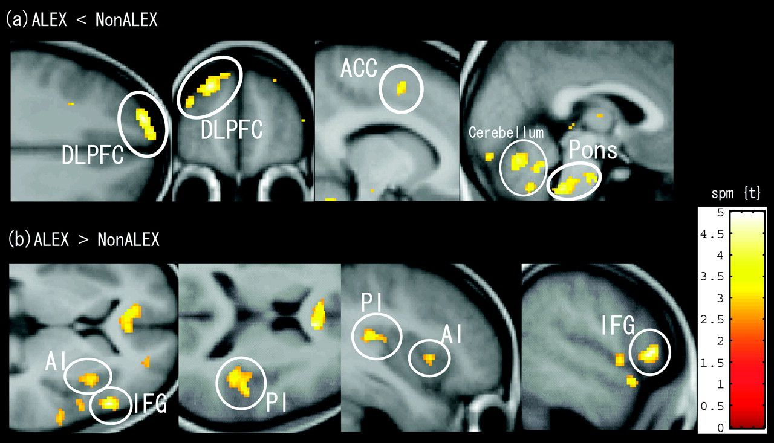
Figure 4. Brain images of the different regional cerebral activations between individuals with and without ALEX in ...
Notes:
Figure 4. Brain images of the different regional cerebral activations between individuals with and without ALEX in response to the other's painful picture task. The orthogonal views of brain images illustrate the clusters with different neural activities in response to the other's pain task (contrasted with no-pain control pictures) within pain-related regions. The bar on the lower right shows the range of t scores for SPM. The height and extent threshold for illustrating were Z = 2.6 (T = 3.33), (P < 0.005 uncorrected) and k = 20, respectively. (a) The figures for the notable clusters with less activation in the ALEX group compared with non-ALEX group. Peak MNI coordinates (x, y, z) = (−20, 56, 34); cACC, caudal anterior cingulate cortex (−12, 2, 52); brain stem (dorsal pons) (−2, 38, −42); and cerebellum (−14, −64, −32). (b) The figures for the clusters with more activation in the ALEX group than the non-ALEX group. AI, anterior insula (38, 14, 2); PI, posterior insula (38, −38, 18); and IFG, inferior frontal gyrus (54, 22, 4).
Unless provided in the caption above, the following copyright applies to the content of this slide: © The Author 2006. Published by Oxford University Press. All rights reserved. For permissions, please e-mail: journals.permissions@oxfordjournals.org

