Slide 1
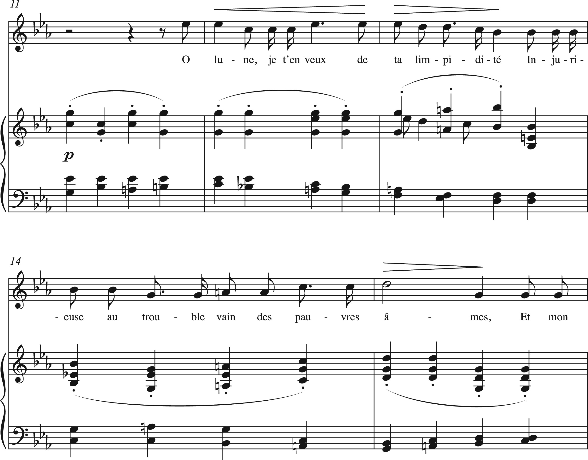
Example 9. Fauré, “Diane, Séléné,” L’Horizon chimérique, Op. 118, mm. 11–15.
Notes:
Example 9. Fauré, “Diane, Séléné,” L’Horizon chimérique, Op. 118, mm. 11–15.
Unless provided in the caption above, the following copyright applies to the content of this slide: © The Author 2017. Published by Oxford University Press. All rights reserved. For Permissions, please e-mail: journals.permissions@oup.com

Slide 2
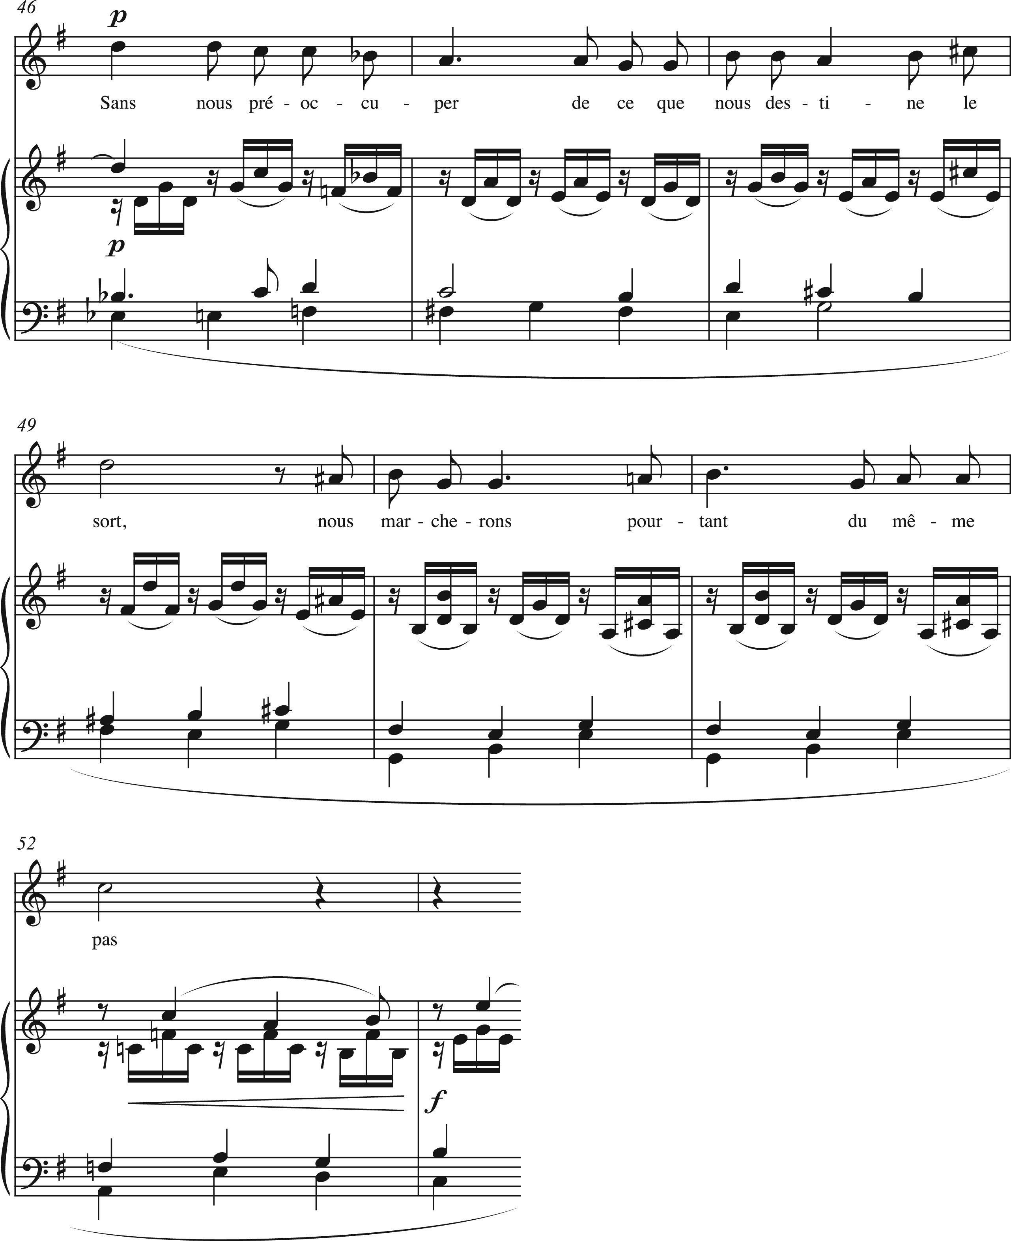
Example 8. Fauré, “N’est-ce pas?,” mm. 46–53.
Notes:
Example 8. Fauré, “N’est-ce pas?,” mm. 46–53.
Unless provided in the caption above, the following copyright applies to the content of this slide: © The Author 2017. Published by Oxford University Press. All rights reserved. For Permissions, please e-mail: journals.permissions@oup.com

Slide 3
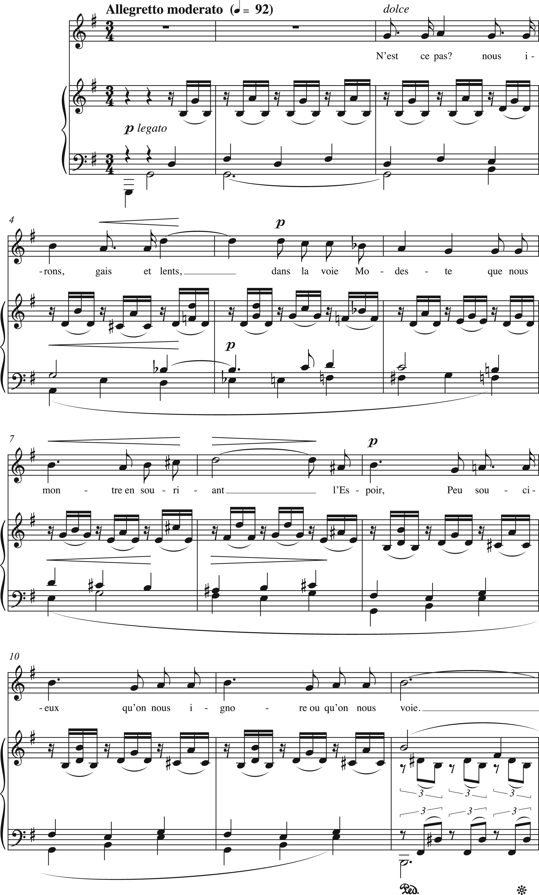
Example 7. Fauré, “N’est-ce pas?,” La bonne chanson, Op. 61, mm. 1–12. Sans nous préoccuper de ce que nous destine Le ...
Notes:
Example 7. Fauré, “N’est-ce pas?,” La bonne chanson, Op. 61, mm. 1–12. Sans nous préoccuper de ce que nous destine Le Sort, nous marcherons pourtant du même pas. Unconcerned about that which is destined for us By Fate, we shall walk at the same pace.34
Unless provided in the caption above, the following copyright applies to the content of this slide: © The Author 2017. Published by Oxford University Press. All rights reserved. For Permissions, please e-mail: journals.permissions@oup.com

Slide 4
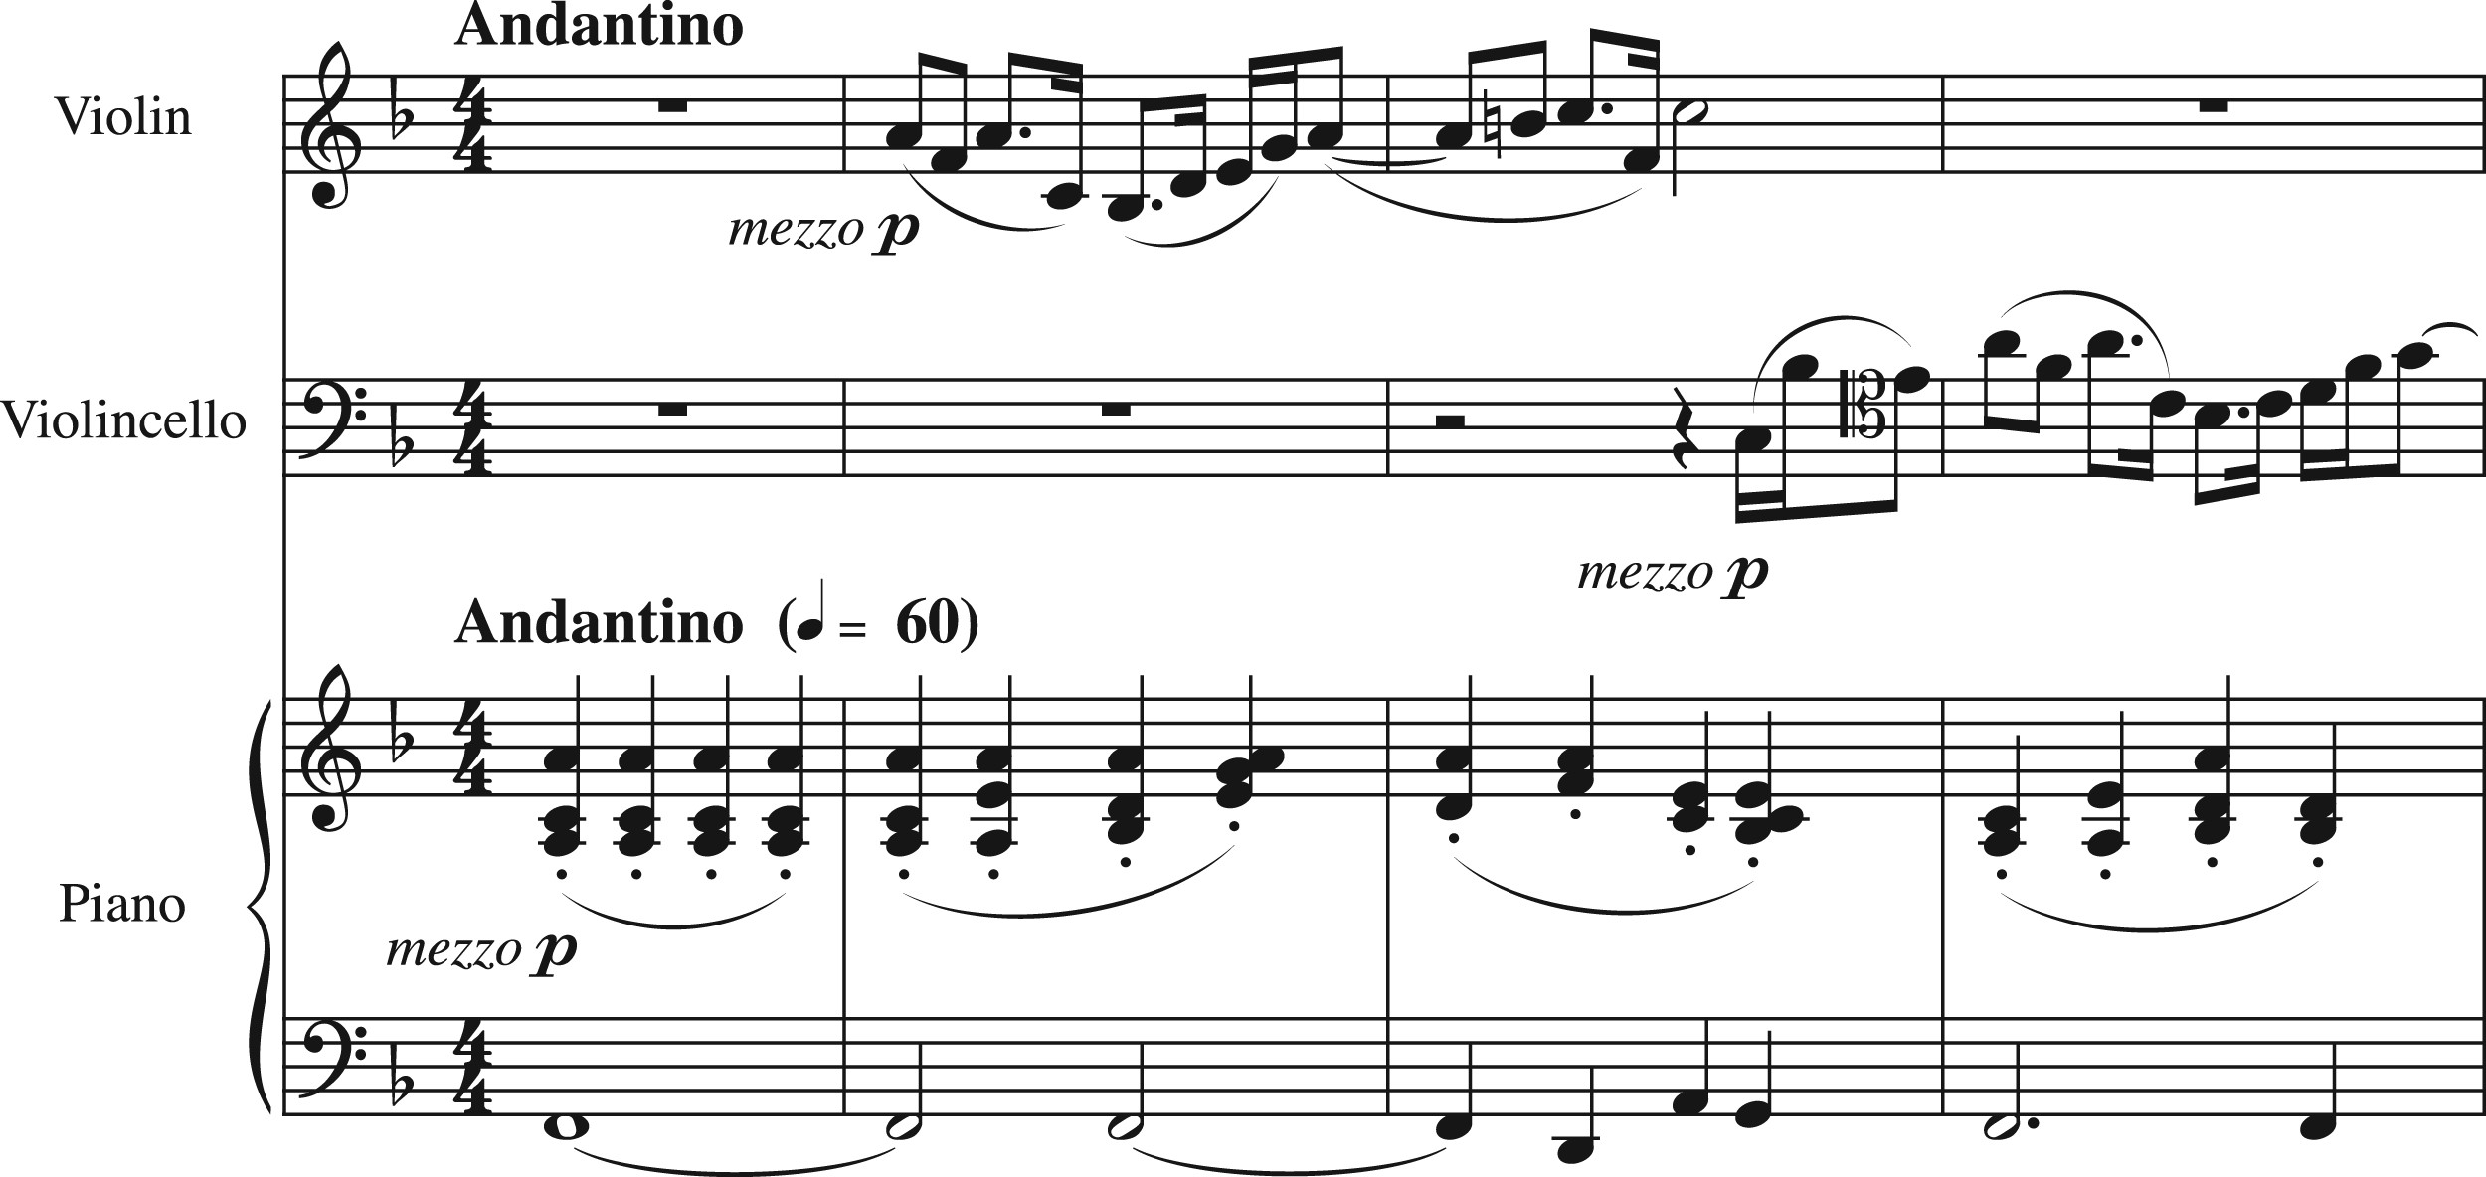
Example 6. Fauré, Piano Trio in D Minor, Op. 120, ii, mm. 1–4. N’est-ce pas? nous irons, gais et lents, dans la ...
Notes:
Example 6. Fauré, Piano Trio in D Minor, Op. 120, ii, mm. 1–4. N’est-ce pas? nous irons, gais et lents, dans la voie Modeste que nous montre en souriant l’Espoir, Peu soucieux qu'on nous ignore ou qu'on nous voie. Isn’t it so? We shall go, happily yet slowly, along the modest path That Hope, smiling, will show us, Caring little who notices or sees us.33
Unless provided in the caption above, the following copyright applies to the content of this slide: © The Author 2017. Published by Oxford University Press. All rights reserved. For Permissions, please e-mail: journals.permissions@oup.com

Slide 5
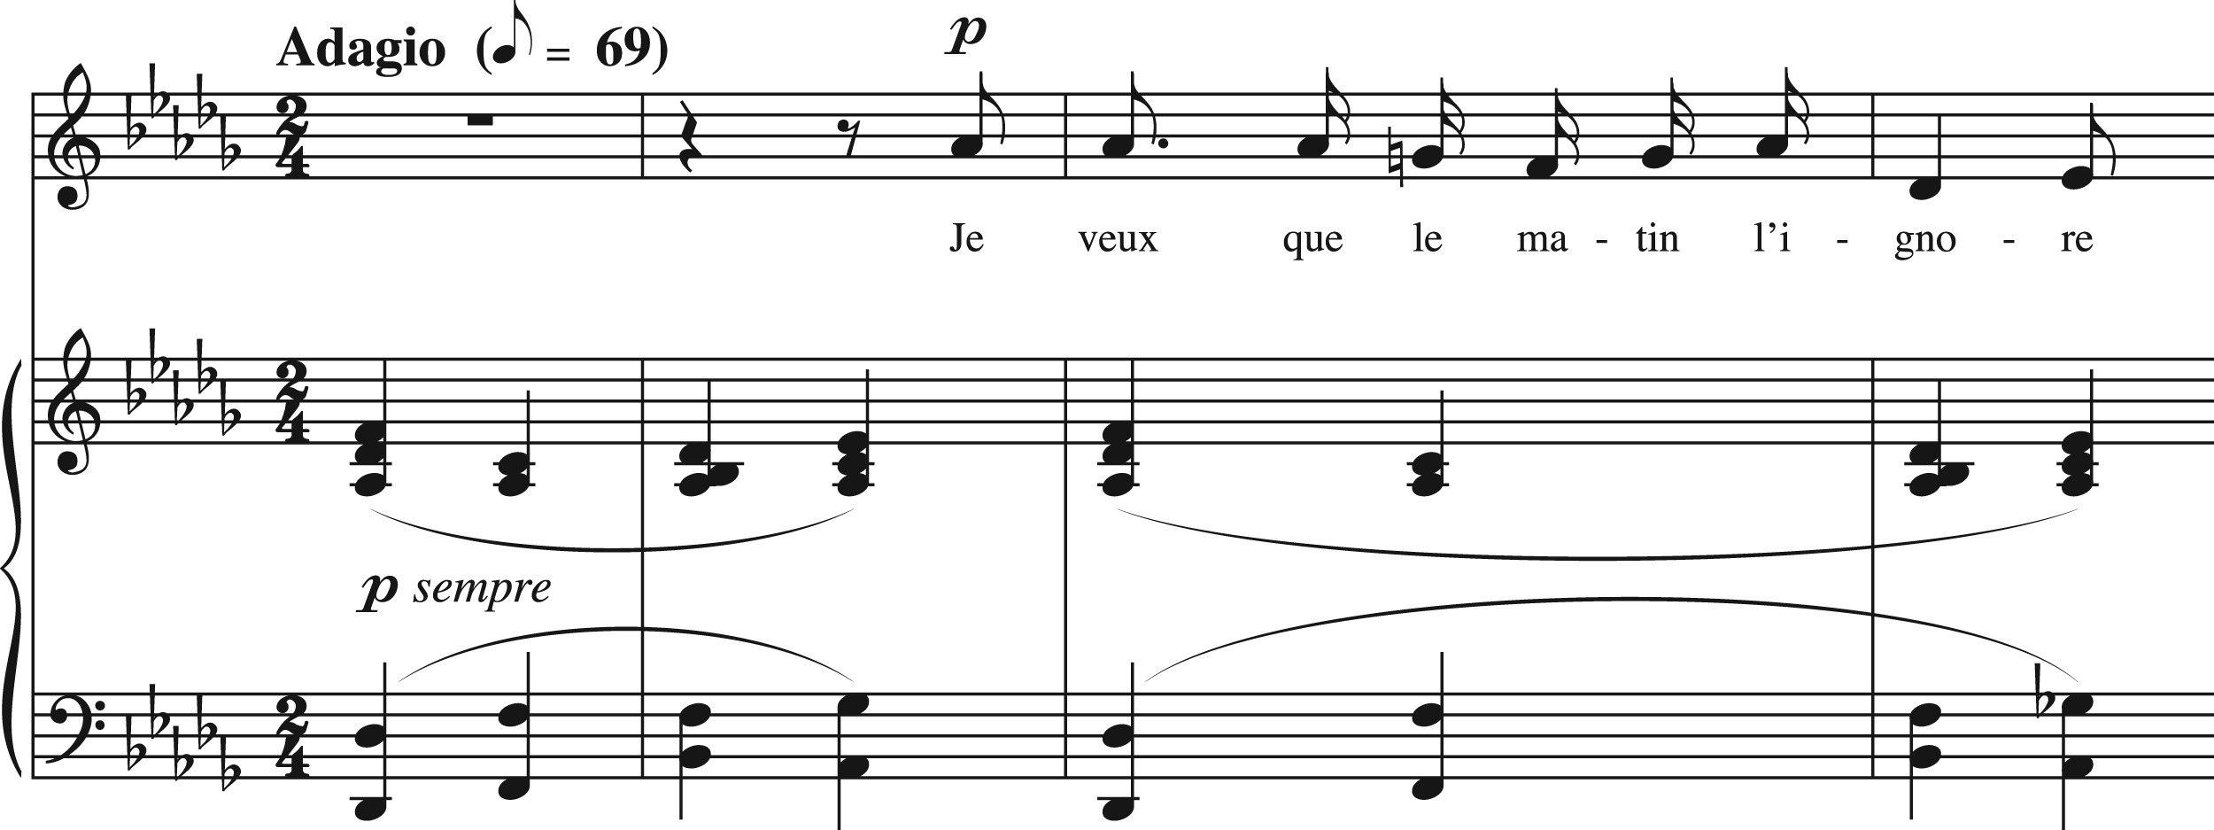
Example 2. Fauré, “Le secret,” mm. 1–4.
Notes:
Example 2. Fauré, “Le secret,” mm. 1–4.
Unless provided in the caption above, the following copyright applies to the content of this slide: © The Author 2017. Published by Oxford University Press. All rights reserved. For Permissions, please e-mail: journals.permissions@oup.com

Slide 6
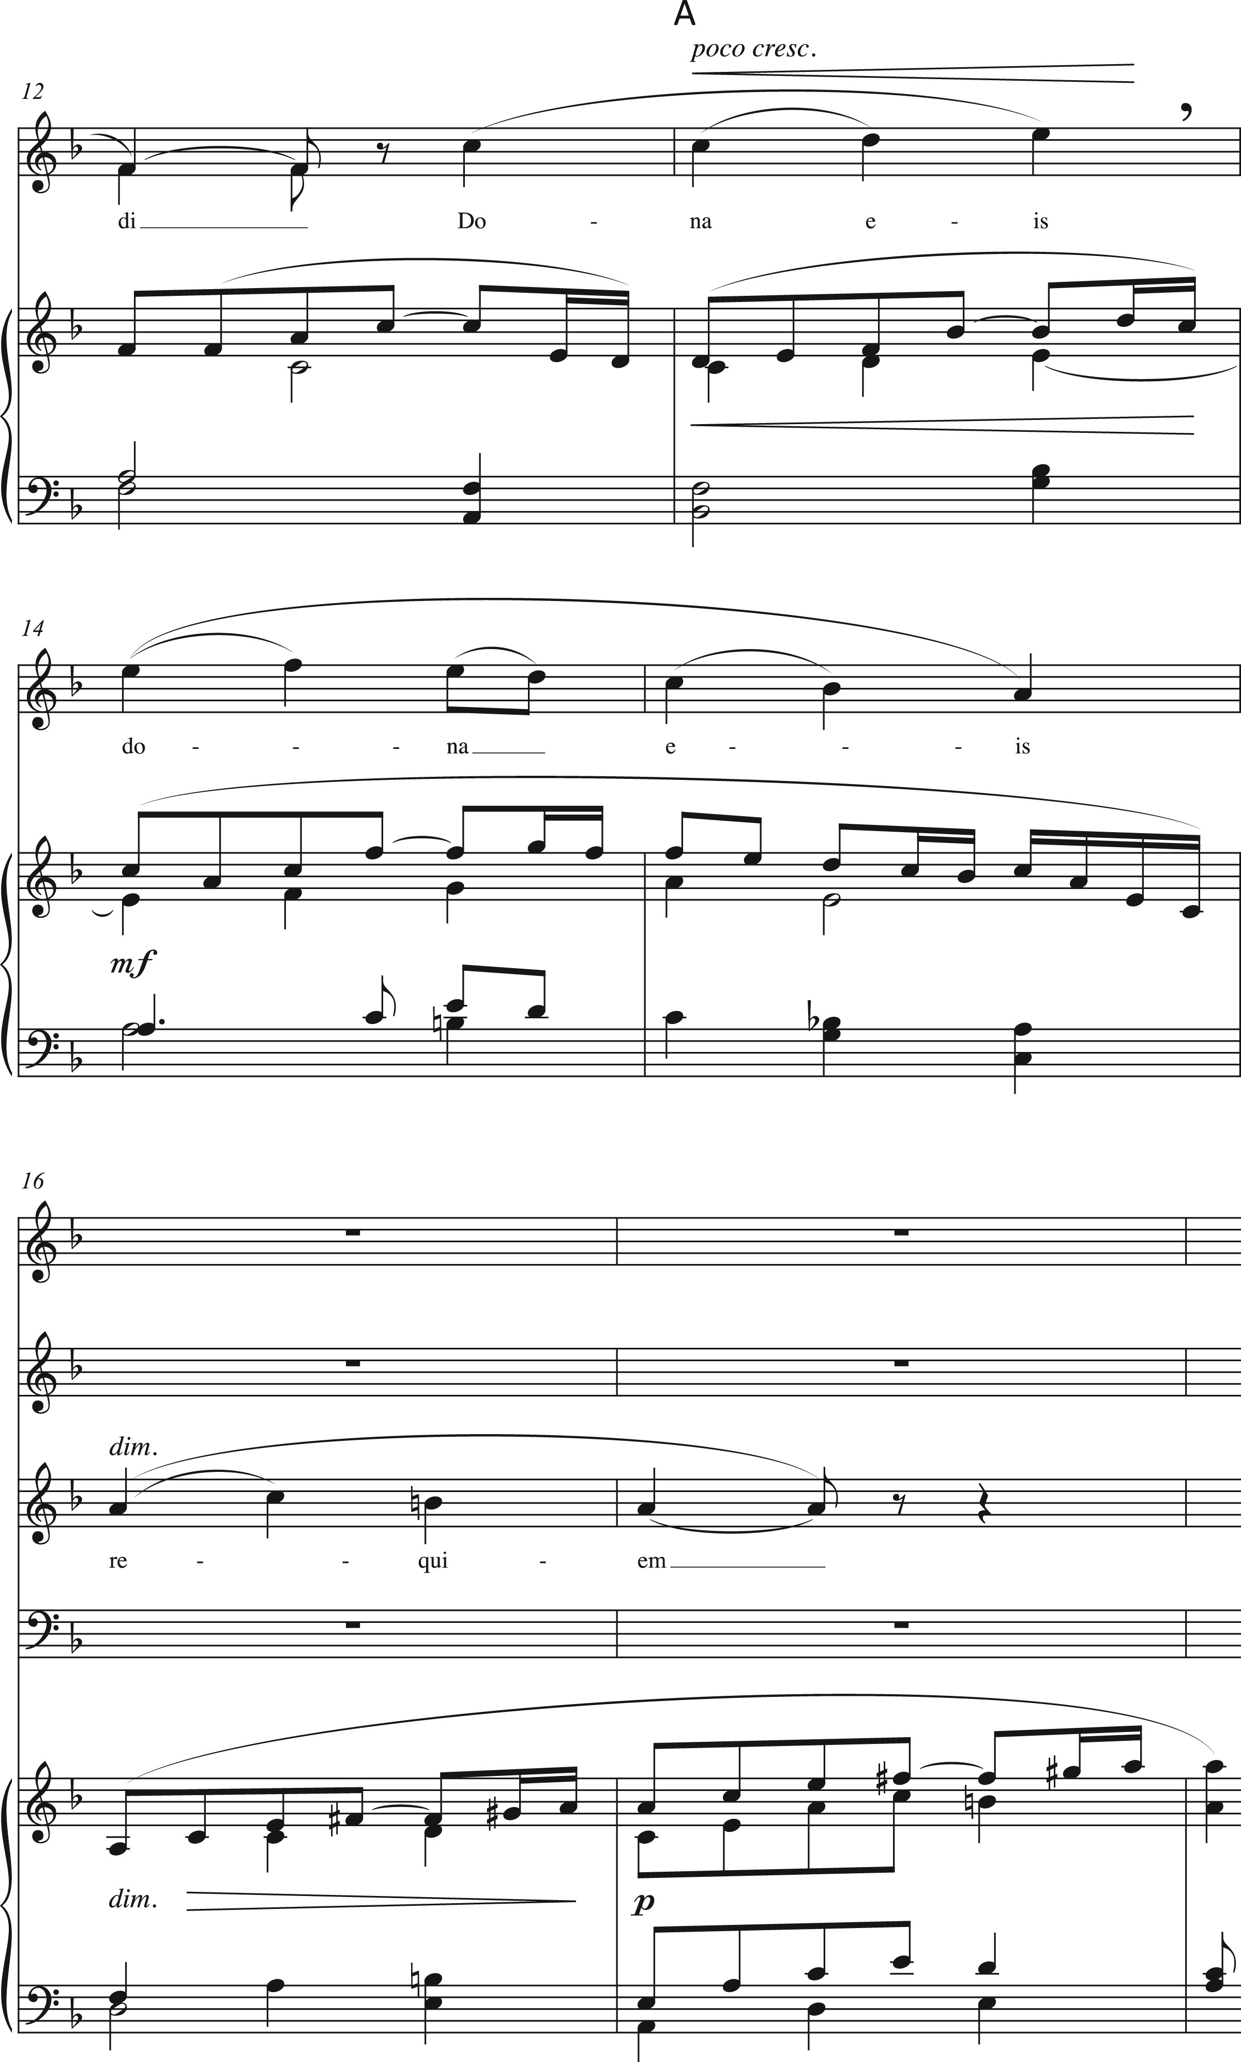
Example 3. Fauré, “Agnus Dei,” Requiem, Op. 48, mm. 12–18.
Notes:
Example 3. Fauré, “Agnus Dei,” Requiem, Op. 48, mm. 12–18.
Unless provided in the caption above, the following copyright applies to the content of this slide: © The Author 2017. Published by Oxford University Press. All rights reserved. For Permissions, please e-mail: journals.permissions@oup.com

Slide 7
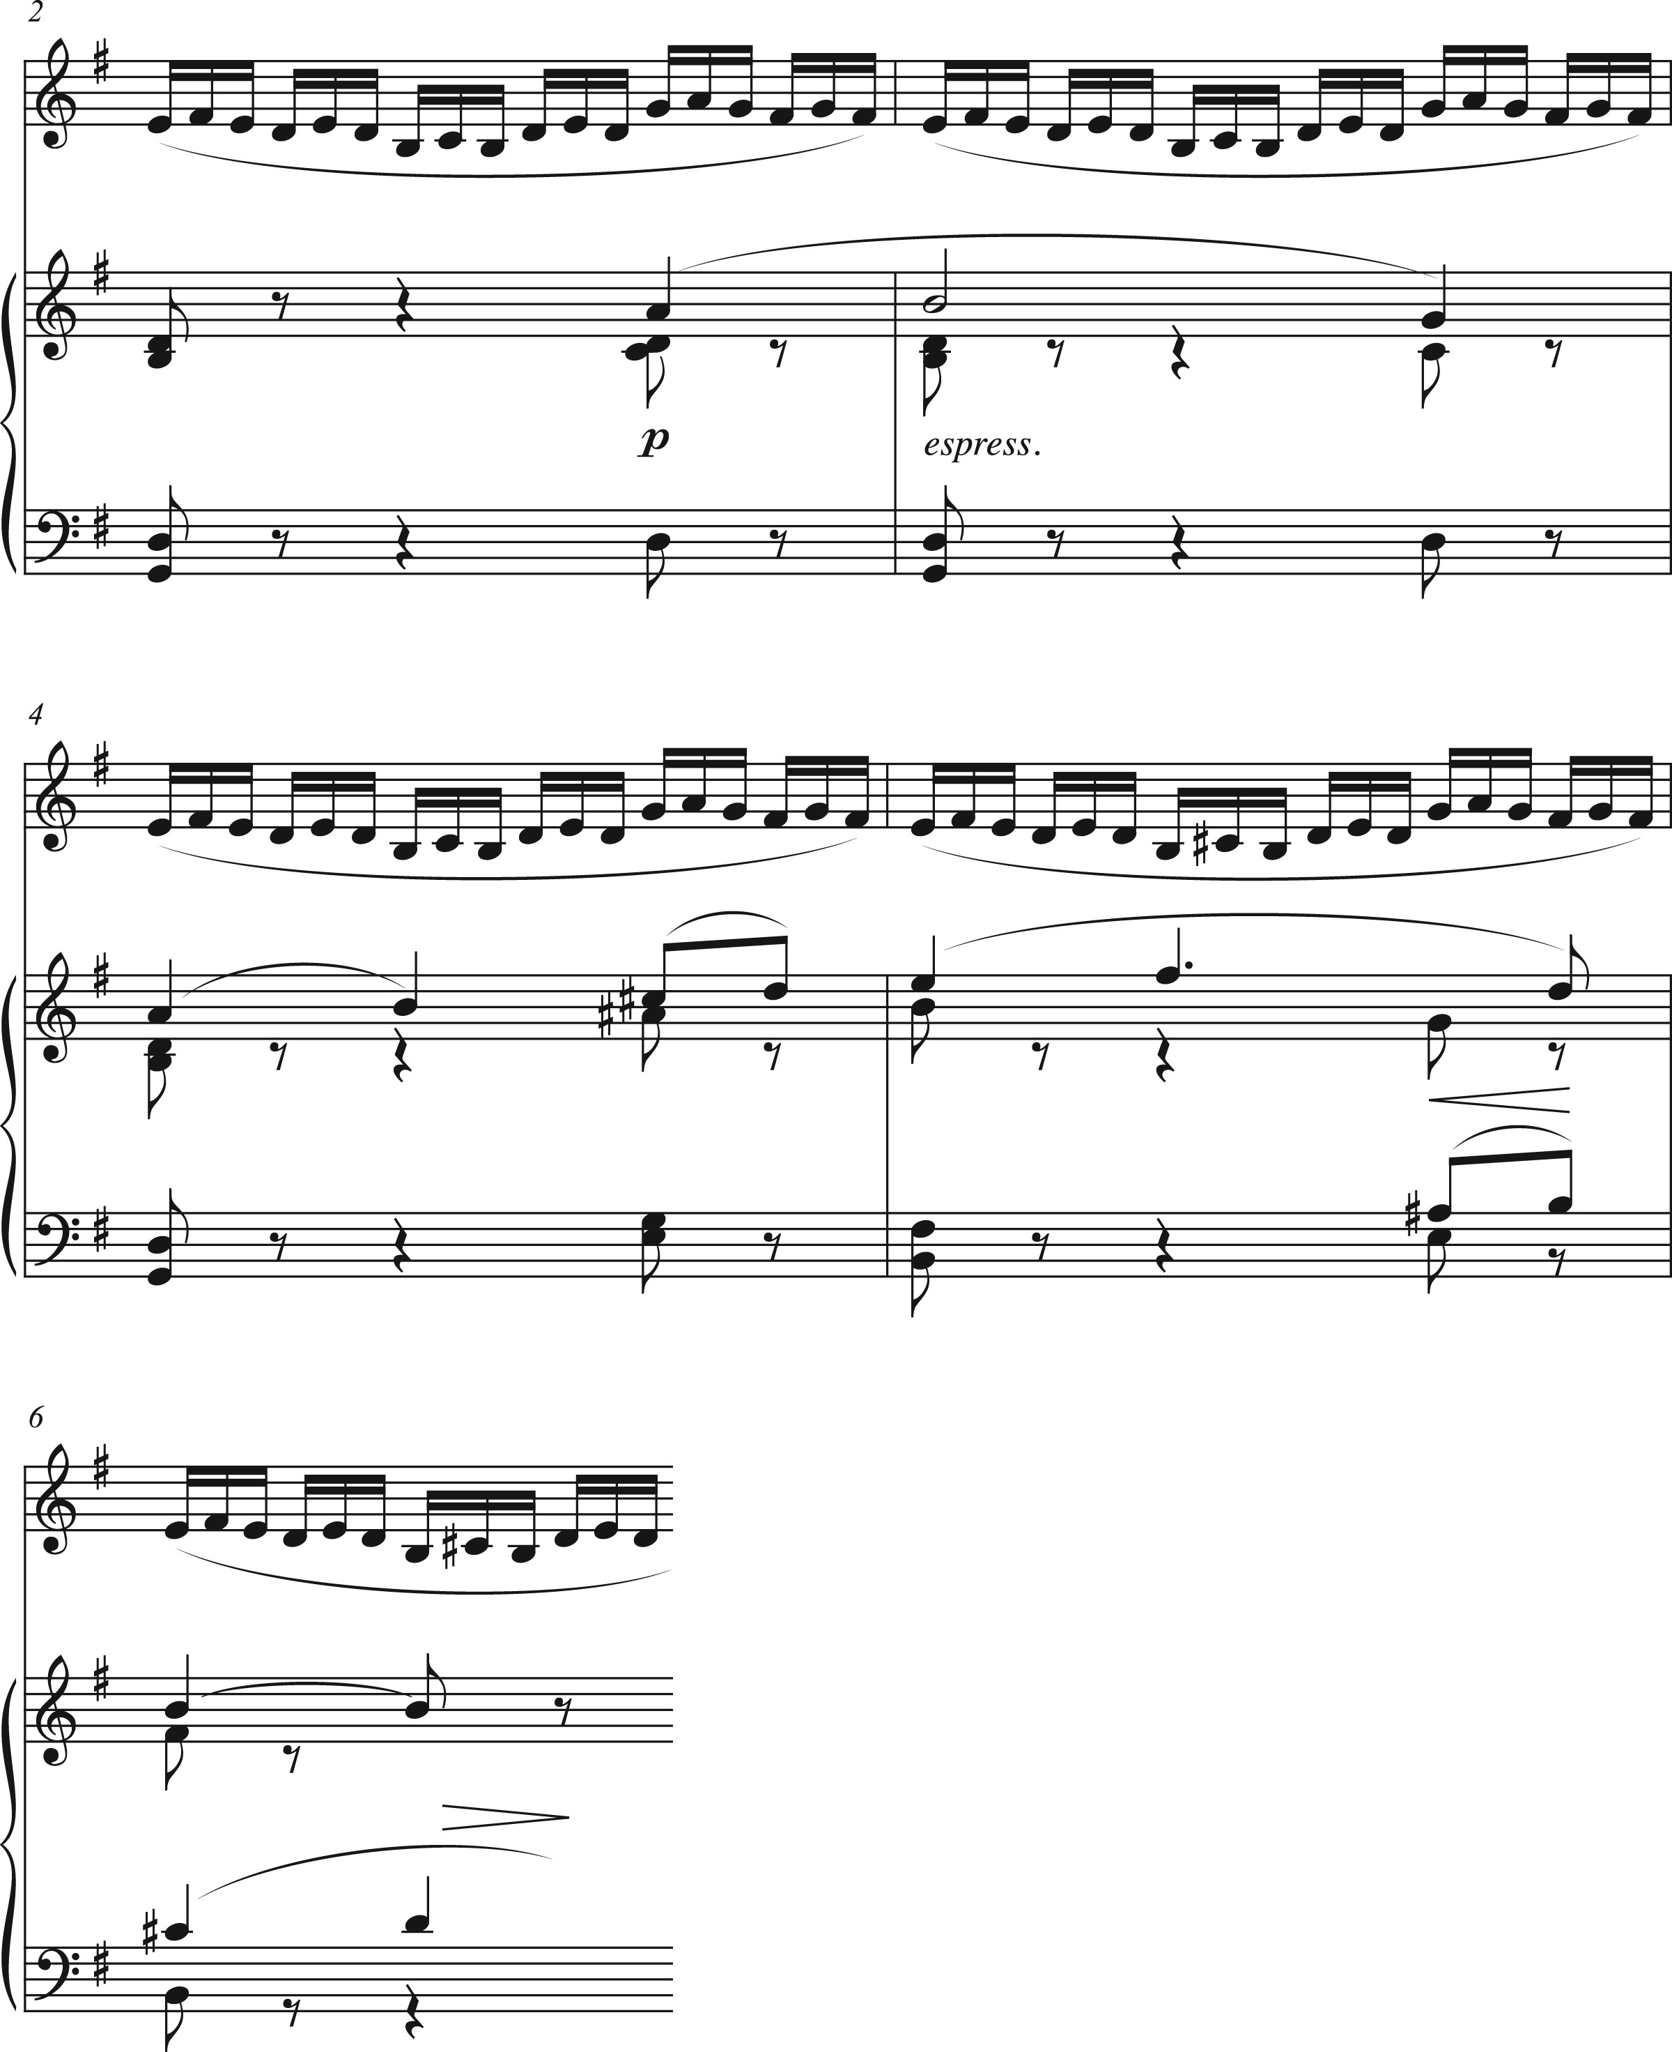
Example 4. Fauré, “Fileuse,” Pelléas et Mélisande, Op. 80, arr. Léopold Auer, mm. 2–6.
Notes:
Example 4. Fauré, “Fileuse,” Pelléas et Mélisande, Op. 80, arr. Léopold Auer, mm. 2–6.
Unless provided in the caption above, the following copyright applies to the content of this slide: © The Author 2017. Published by Oxford University Press. All rights reserved. For Permissions, please e-mail: journals.permissions@oup.com

Slide 8
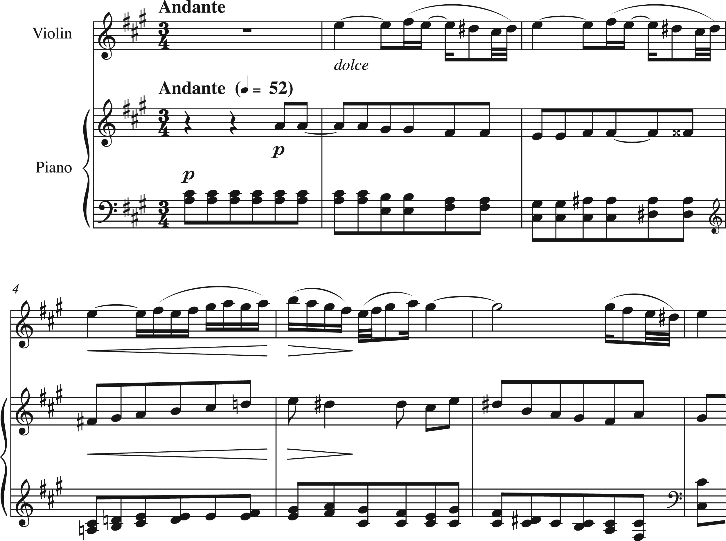
Example 5. Fauré, Violin Sonata No. 2 in E Minor, Op. 108, ii, mm. 1–7.
Notes:
Example 5. Fauré, Violin Sonata No. 2 in E Minor, Op. 108, ii, mm. 1–7.
Unless provided in the caption above, the following copyright applies to the content of this slide: © The Author 2017. Published by Oxford University Press. All rights reserved. For Permissions, please e-mail: journals.permissions@oup.com

Slide 9
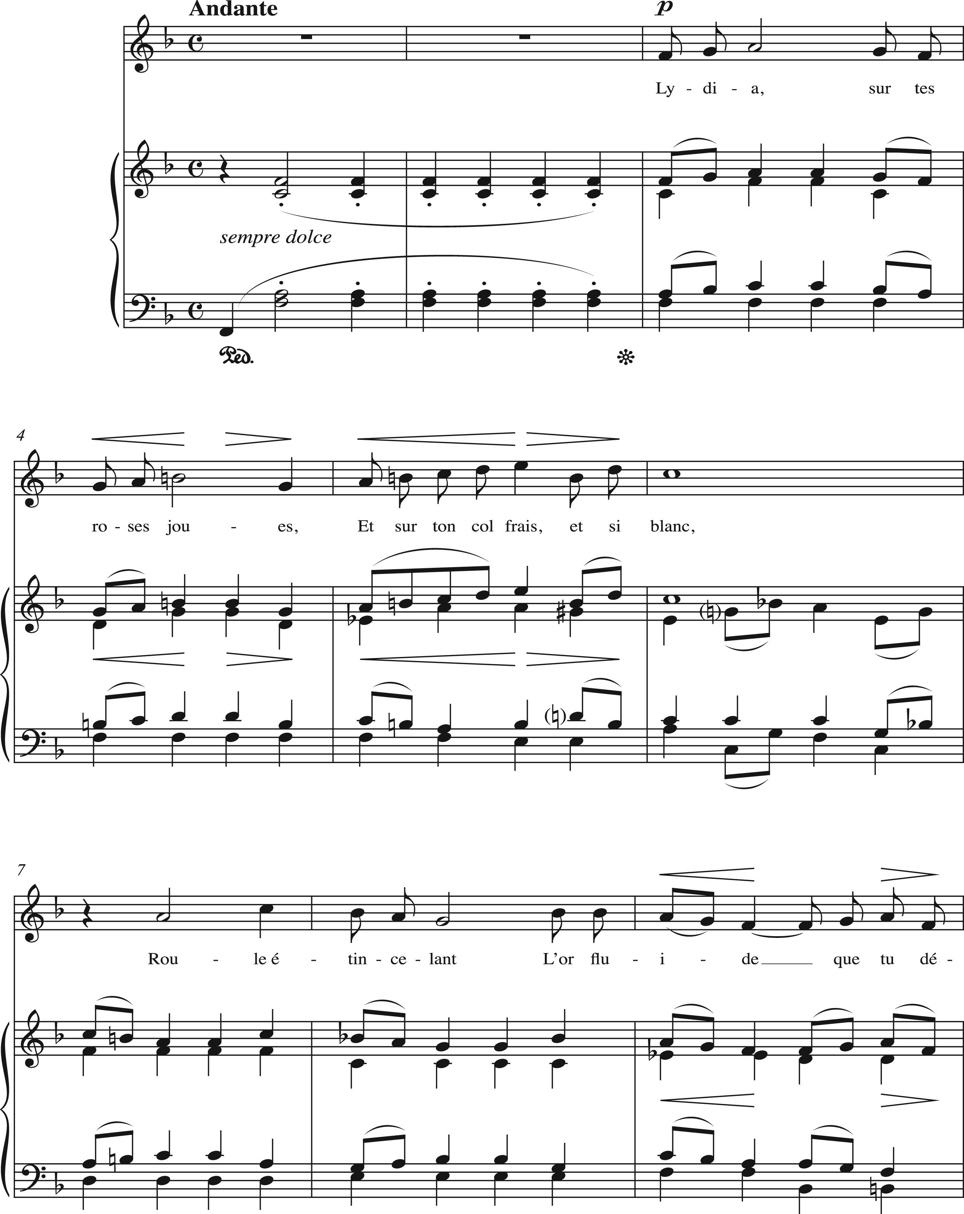
Example 1. Fauré, “Lydia,” mm. 1–19.
Notes:
Example 1. Fauré, “Lydia,” mm. 1–19.
Unless provided in the caption above, the following copyright applies to the content of this slide: © The Author 2017. Published by Oxford University Press. All rights reserved. For Permissions, please e-mail: journals.permissions@oup.com

Slide 10
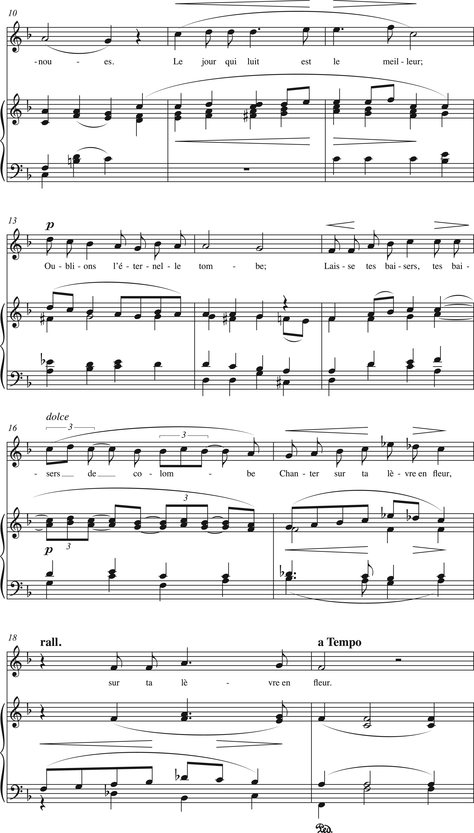
Example 1. Fauré, “Lydia,” mm. 1–19.
Notes:
Example 1. Fauré, “Lydia,” mm. 1–19.
Unless provided in the caption above, the following copyright applies to the content of this slide: © The Author 2017. Published by Oxford University Press. All rights reserved. For Permissions, please e-mail: journals.permissions@oup.com

Slide 11
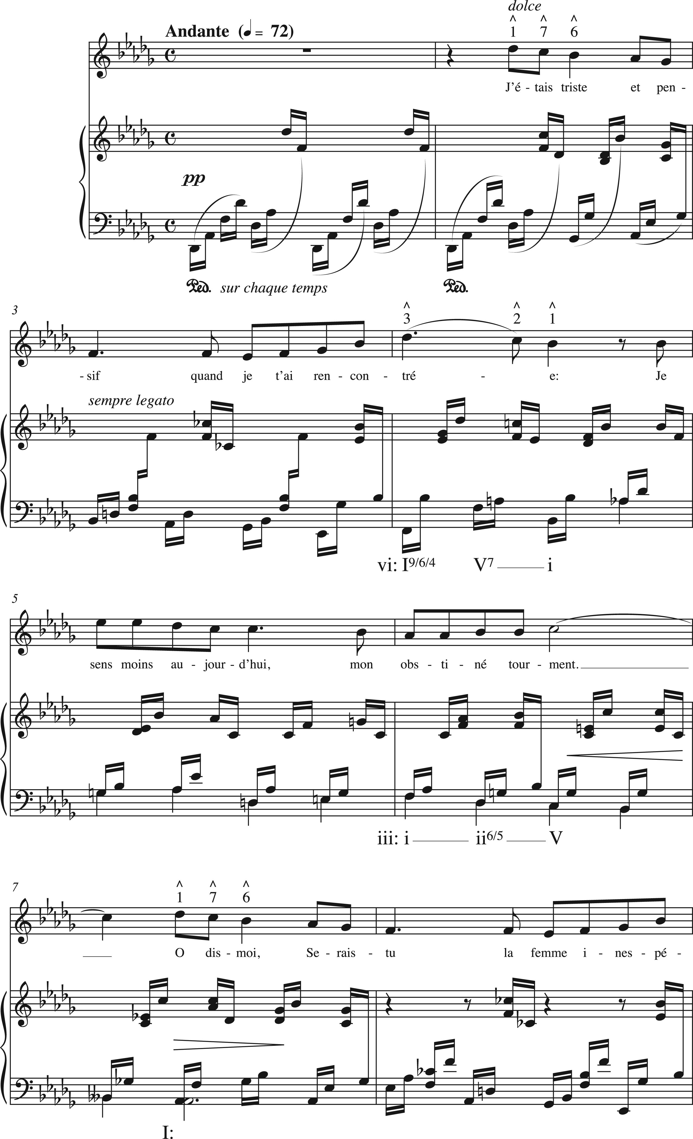
Example 10. Tonal ambivalence in Fauré, “Rencontre,” Poème d’un jour, Op. 21, mm. 1–21.
Notes:
Example 10. Tonal ambivalence in Fauré, “Rencontre,” Poème d’un jour, Op. 21, mm. 1–21.
Unless provided in the caption above, the following copyright applies to the content of this slide: © The Author 2017. Published by Oxford University Press. All rights reserved. For Permissions, please e-mail: journals.permissions@oup.com

Slide 12
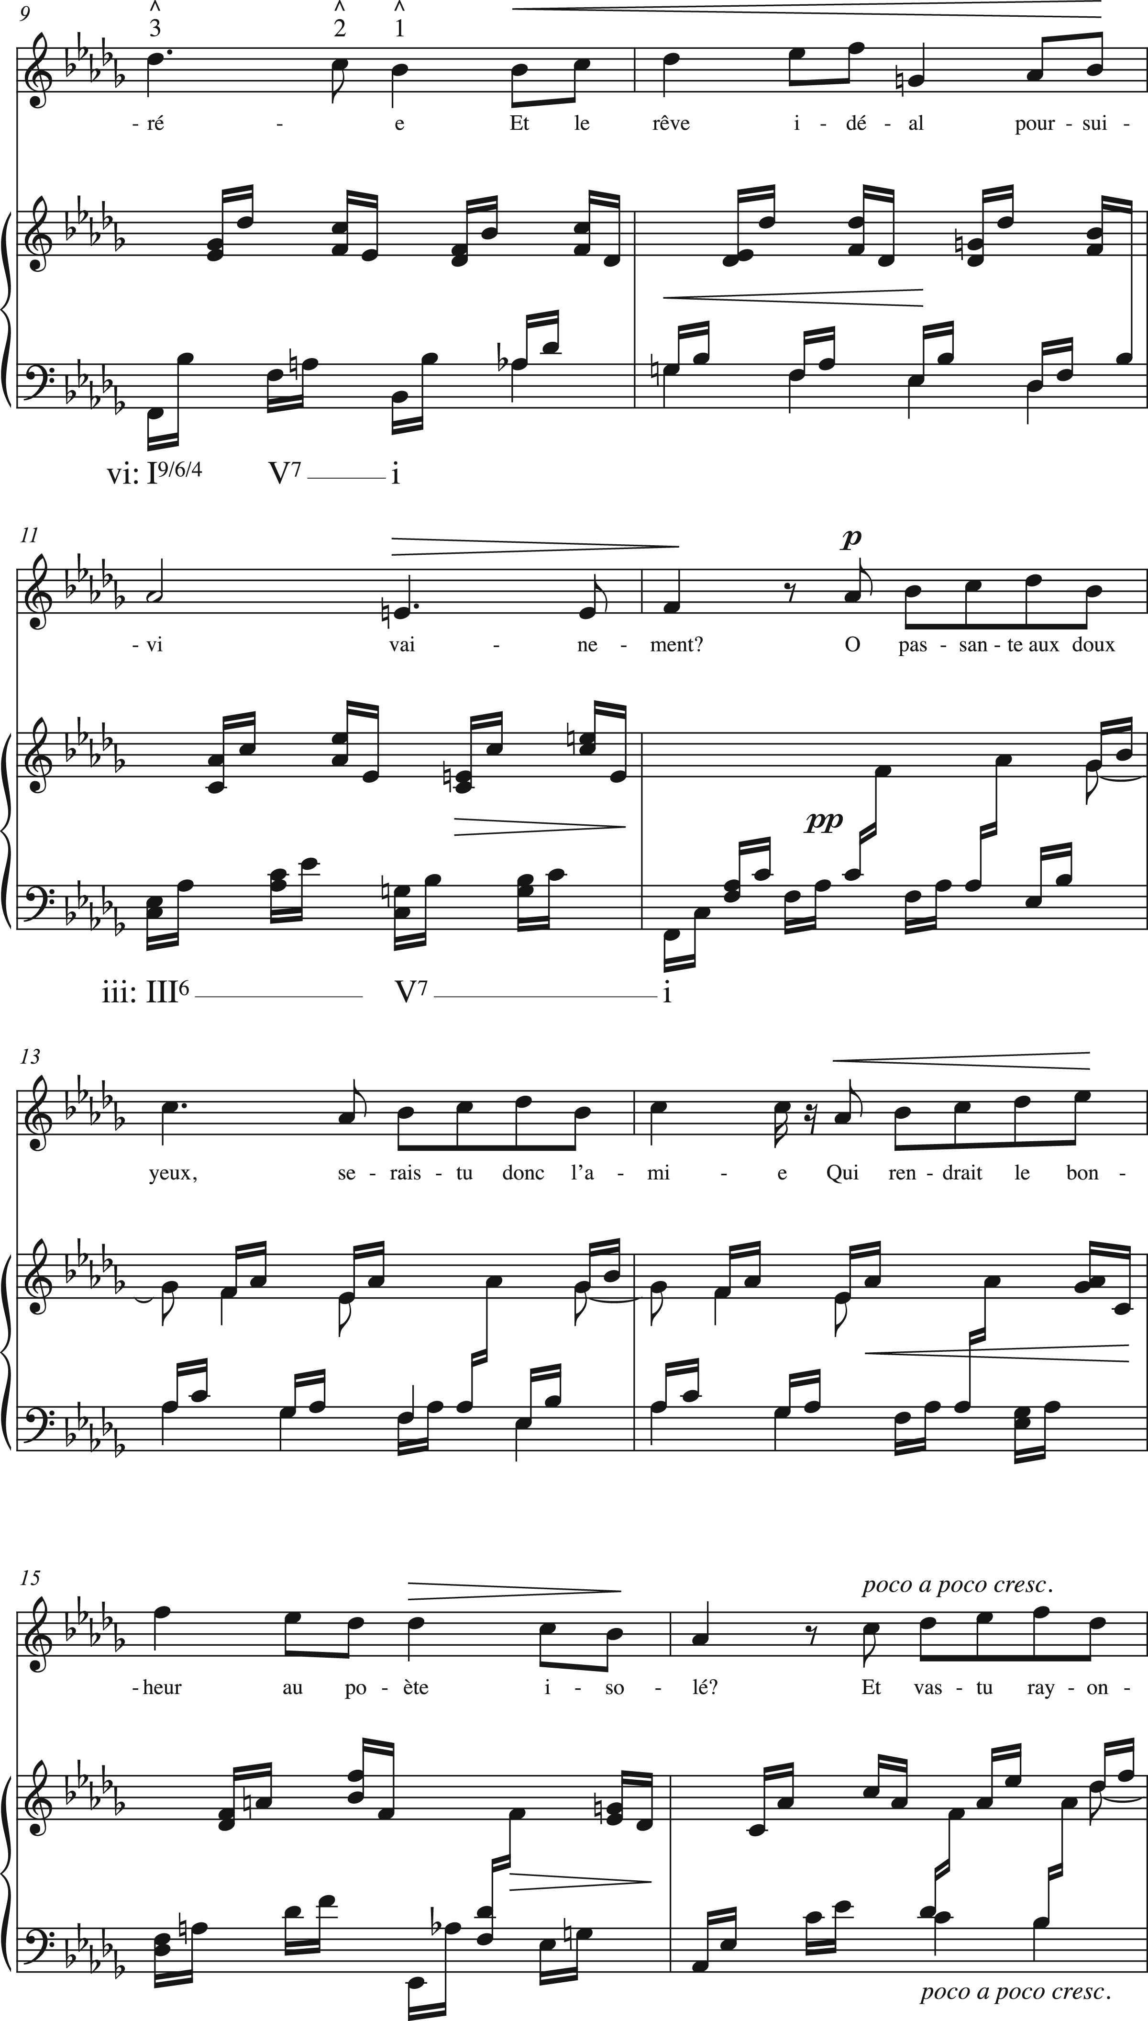
Example 10. Tonal ambivalence in Fauré, “Rencontre,” Poème d’un jour, Op. 21, mm. 1–21.
Notes:
Example 10. Tonal ambivalence in Fauré, “Rencontre,” Poème d’un jour, Op. 21, mm. 1–21.
Unless provided in the caption above, the following copyright applies to the content of this slide: © The Author 2017. Published by Oxford University Press. All rights reserved. For Permissions, please e-mail: journals.permissions@oup.com

Slide 13
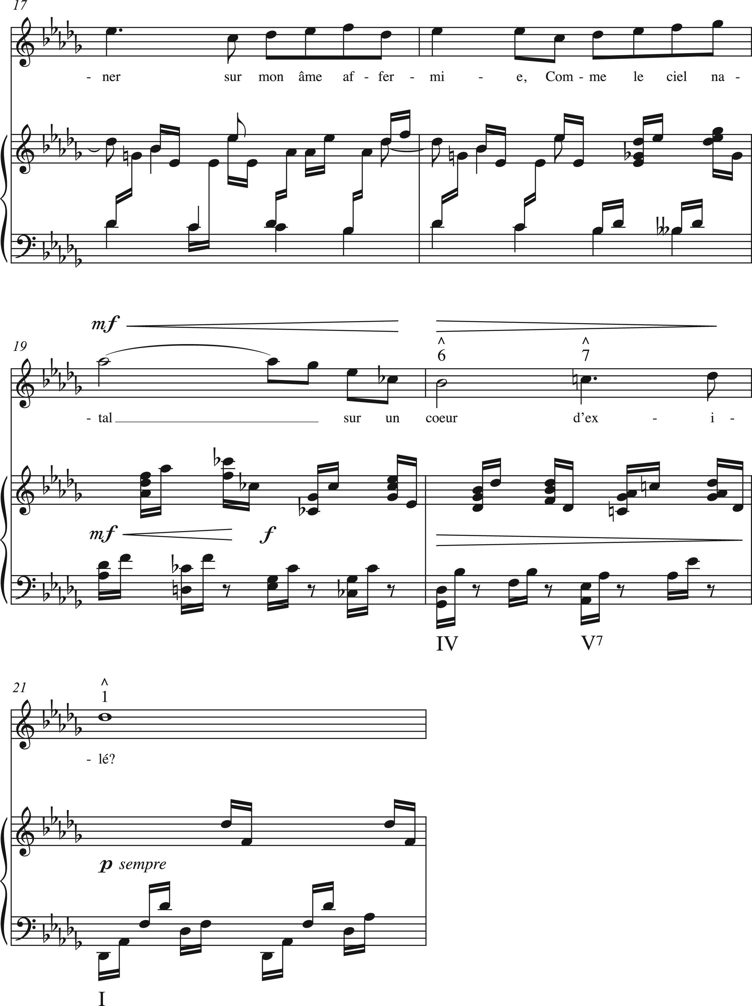
Example 10. Tonal ambivalence in Fauré, “Rencontre,” Poème d’un jour, Op. 21, mm. 1–21.
Notes:
Example 10. Tonal ambivalence in Fauré, “Rencontre,” Poème d’un jour, Op. 21, mm. 1–21.
Unless provided in the caption above, the following copyright applies to the content of this slide: © The Author 2017. Published by Oxford University Press. All rights reserved. For Permissions, please e-mail: journals.permissions@oup.com

Slide 14
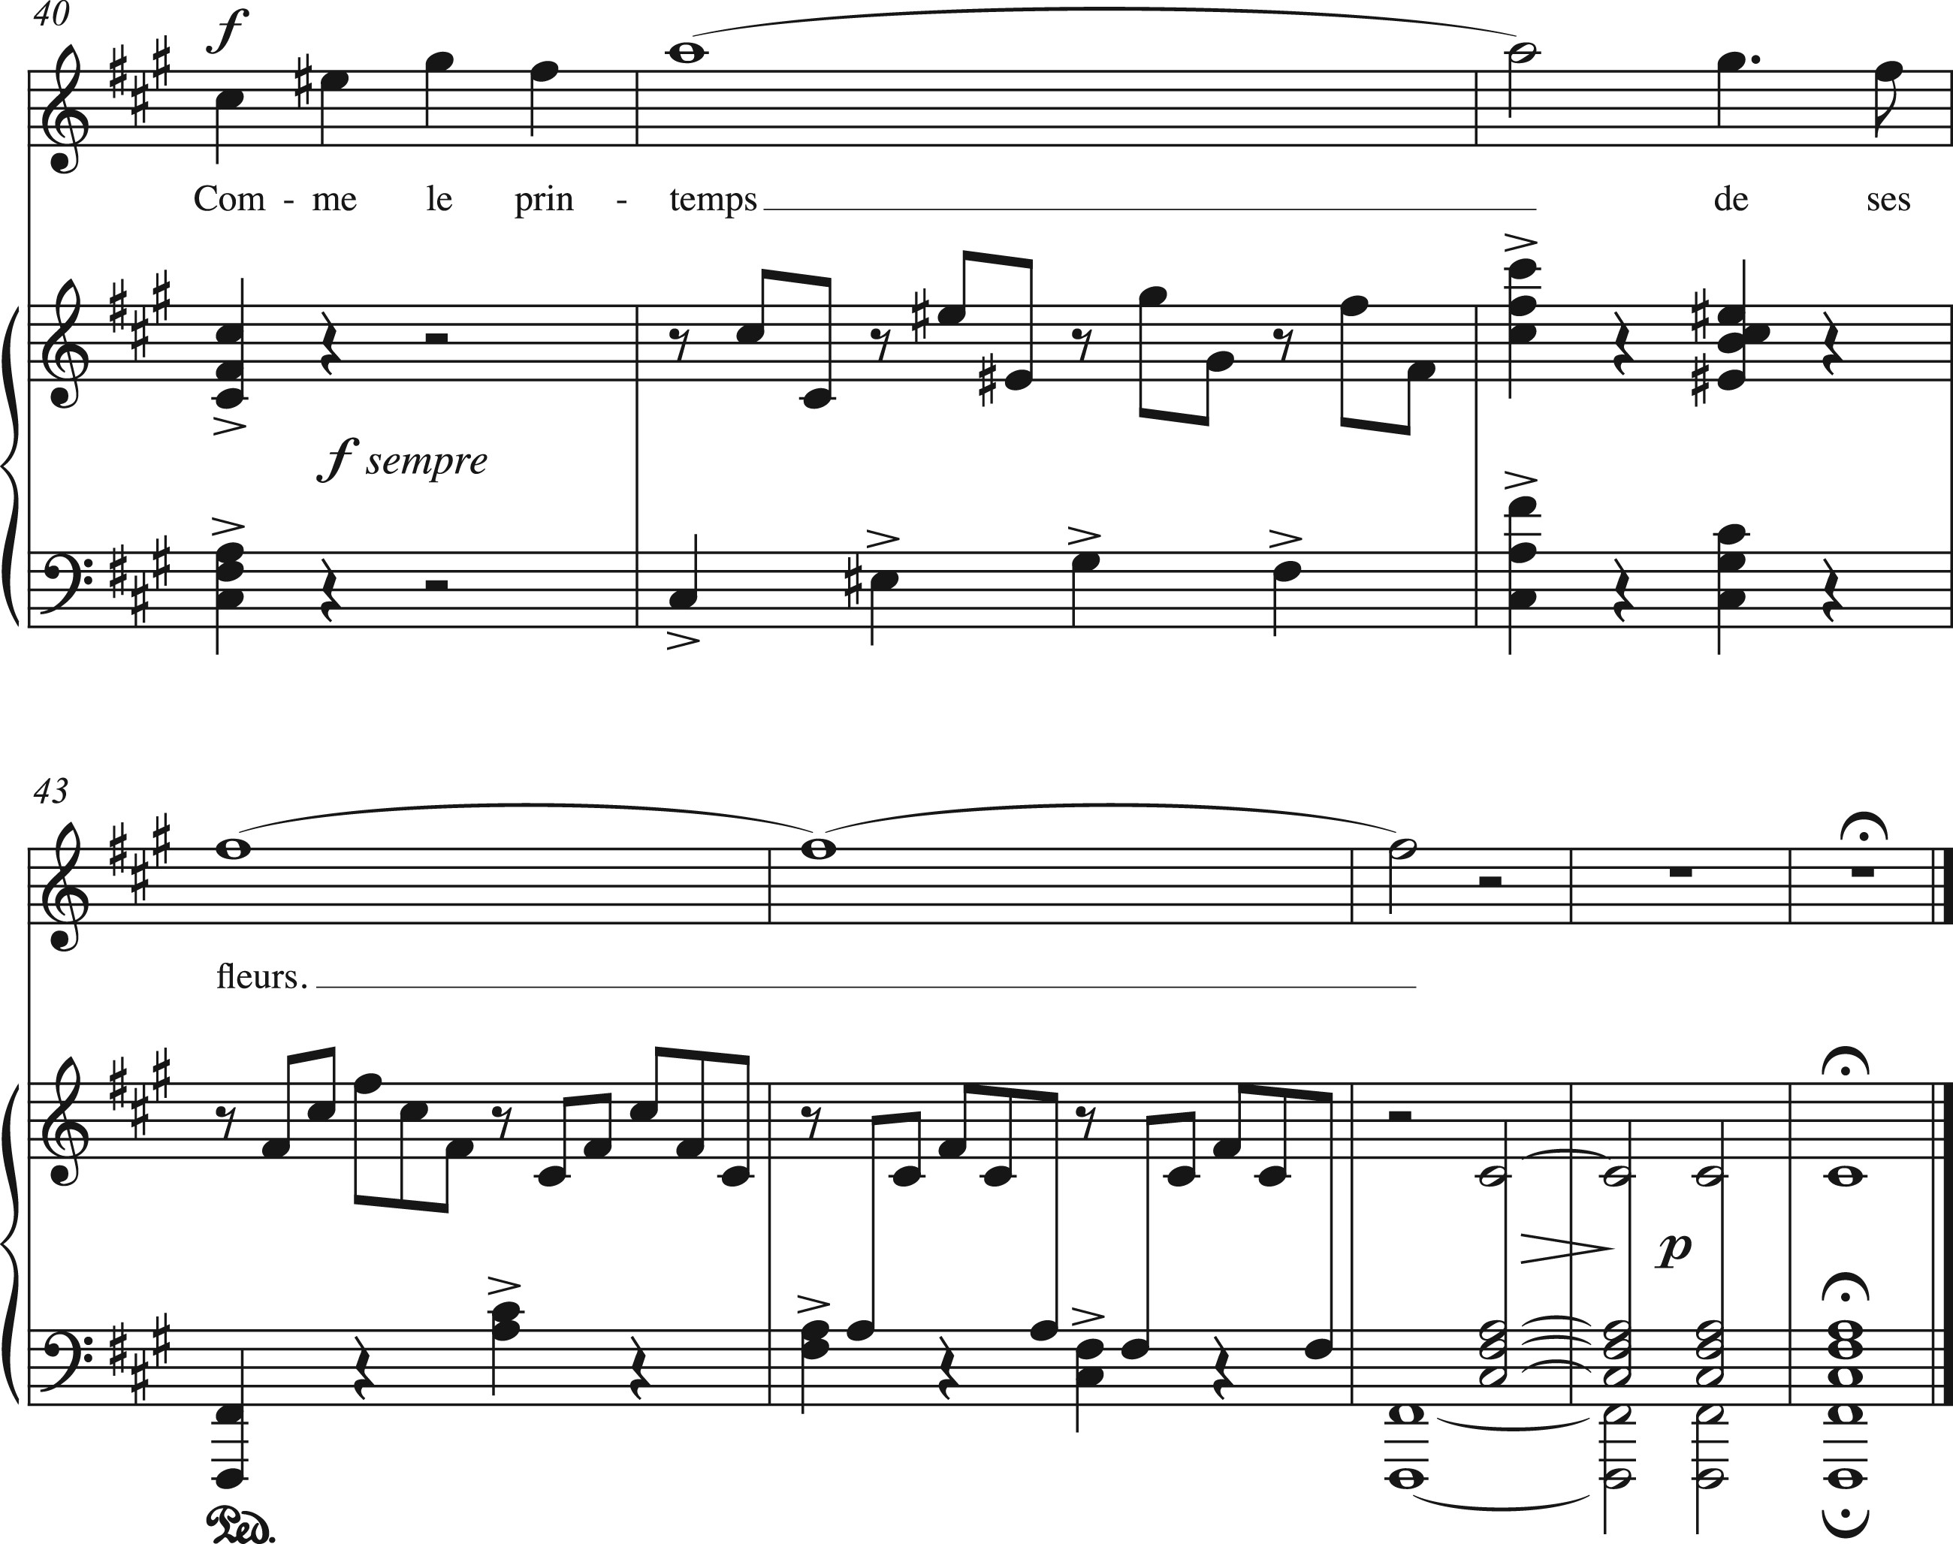
Example 11. Fauré, “Toujours,” Poème d’un jour, mm. 40–47.
Notes:
Example 11. Fauré, “Toujours,” Poème d’un jour, mm. 40–47.
Unless provided in the caption above, the following copyright applies to the content of this slide: © The Author 2017. Published by Oxford University Press. All rights reserved. For Permissions, please e-mail: journals.permissions@oup.com

Slide 15
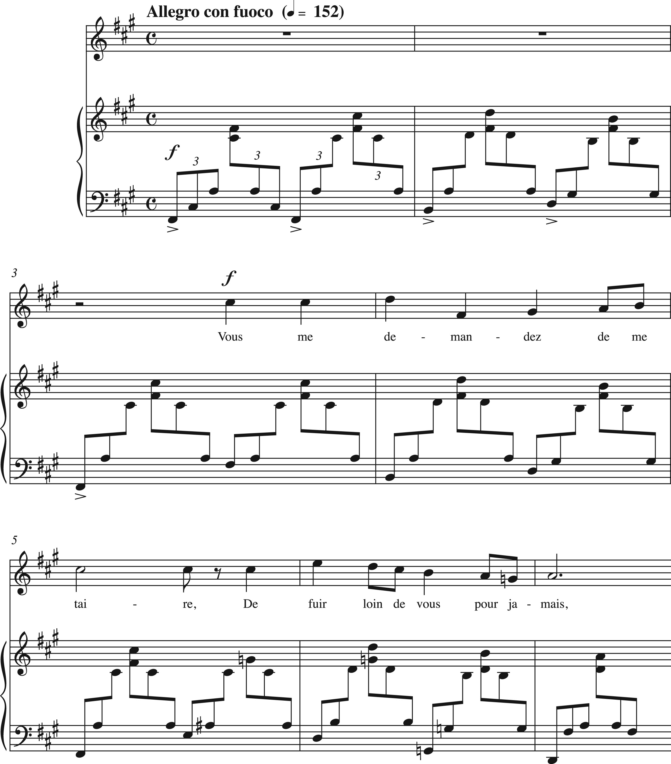
Example 12. Fauré, “Toujours,” mm. 1–7.
Notes:
Example 12. Fauré, “Toujours,” mm. 1–7.
Unless provided in the caption above, the following copyright applies to the content of this slide: © The Author 2017. Published by Oxford University Press. All rights reserved. For Permissions, please e-mail: journals.permissions@oup.com

Slide 16
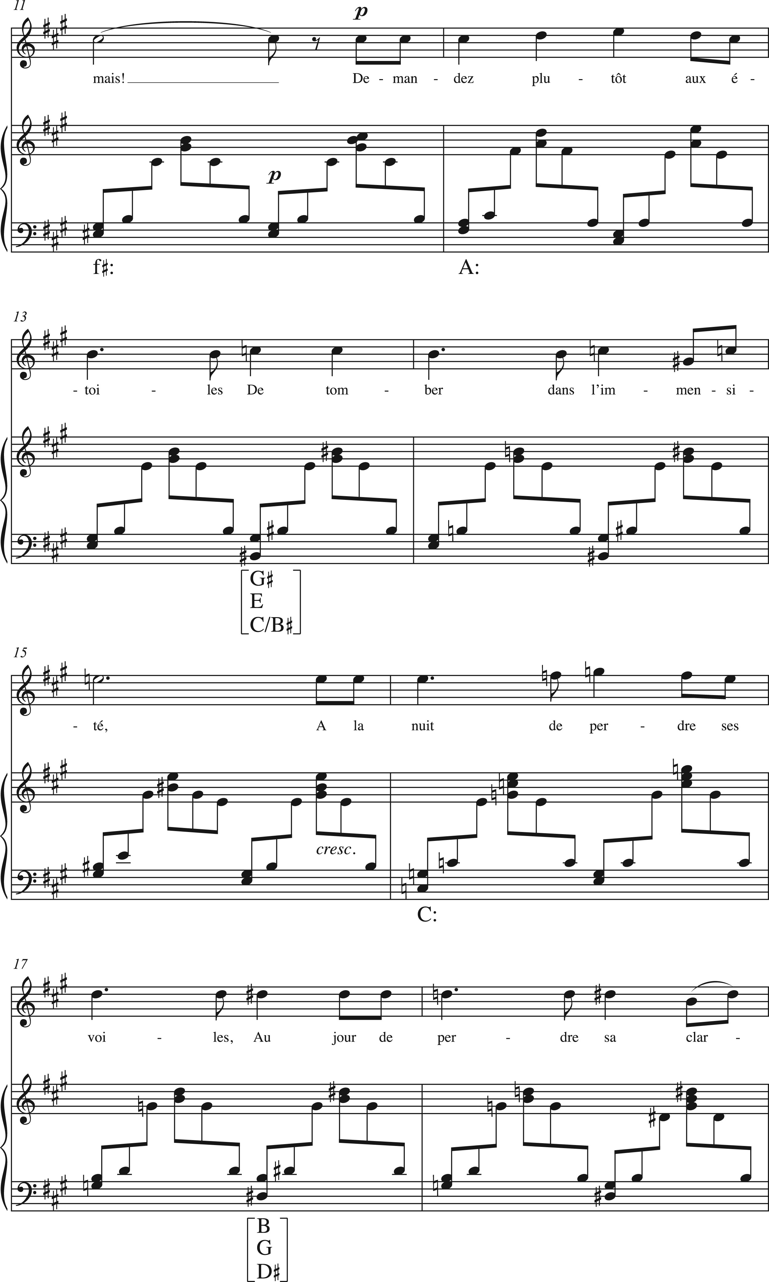
Example 13. Modulation by means of Weitzmann regions in Fauré, “Toujours,” mm. 11–25.
Notes:
Example 13. Modulation by means of Weitzmann regions in Fauré, “Toujours,” mm. 11–25.
Unless provided in the caption above, the following copyright applies to the content of this slide: © The Author 2017. Published by Oxford University Press. All rights reserved. For Permissions, please e-mail: journals.permissions@oup.com

Slide 17
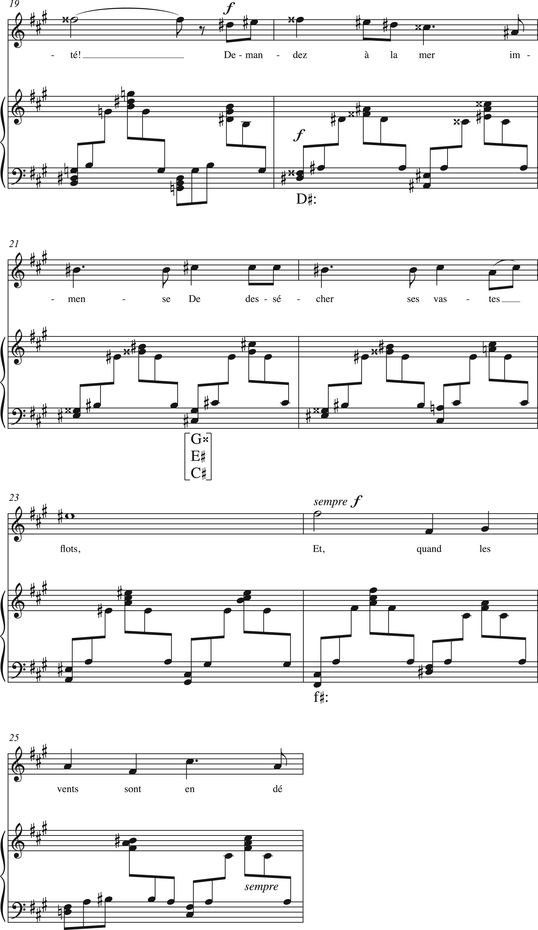
Example 13. Modulation by means of Weitzmann regions in Fauré, “Toujours,” mm. 11–25.
Notes:
Example 13. Modulation by means of Weitzmann regions in Fauré, “Toujours,” mm. 11–25.
Unless provided in the caption above, the following copyright applies to the content of this slide: © The Author 2017. Published by Oxford University Press. All rights reserved. For Permissions, please e-mail: journals.permissions@oup.com

Slide 18
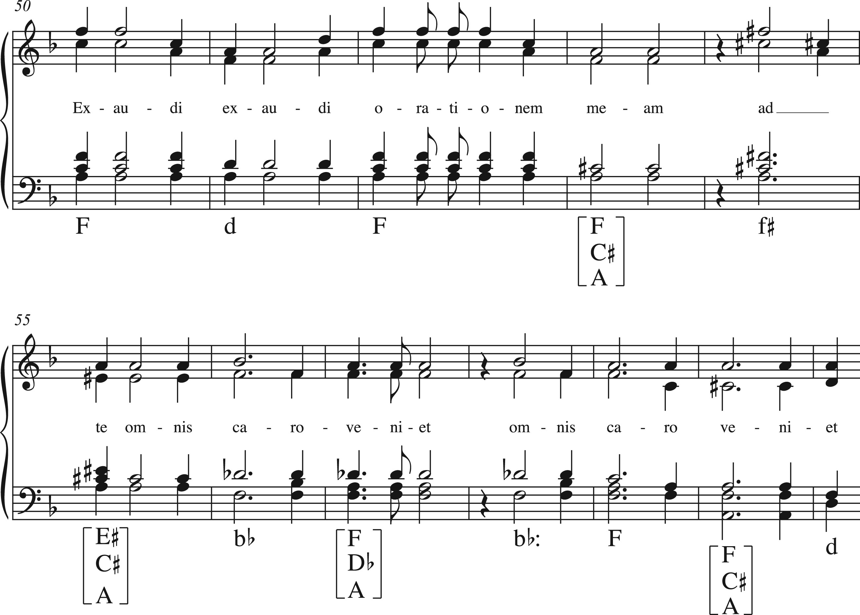
Example 14. Weitzmann region in Fauré, “Introït,” Requiem, mm. 50–61.
Notes:
Example 14. Weitzmann region in Fauré, “Introït,” Requiem, mm. 50–61.
Unless provided in the caption above, the following copyright applies to the content of this slide: © The Author 2017. Published by Oxford University Press. All rights reserved. For Permissions, please e-mail: journals.permissions@oup.com

Slide 19
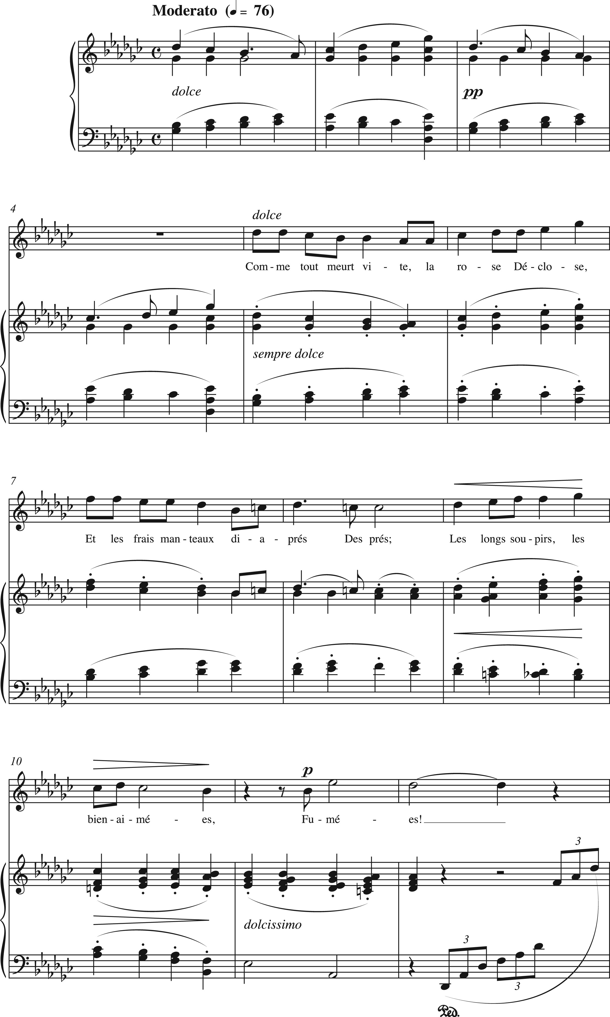
Example 15. Fauré, “Adieu,” Poème d’un jour, mm. 1–12.
Notes:
Example 15. Fauré, “Adieu,” Poème d’un jour, mm. 1–12.
Unless provided in the caption above, the following copyright applies to the content of this slide: © The Author 2017. Published by Oxford University Press. All rights reserved. For Permissions, please e-mail: journals.permissions@oup.com

Slide 20
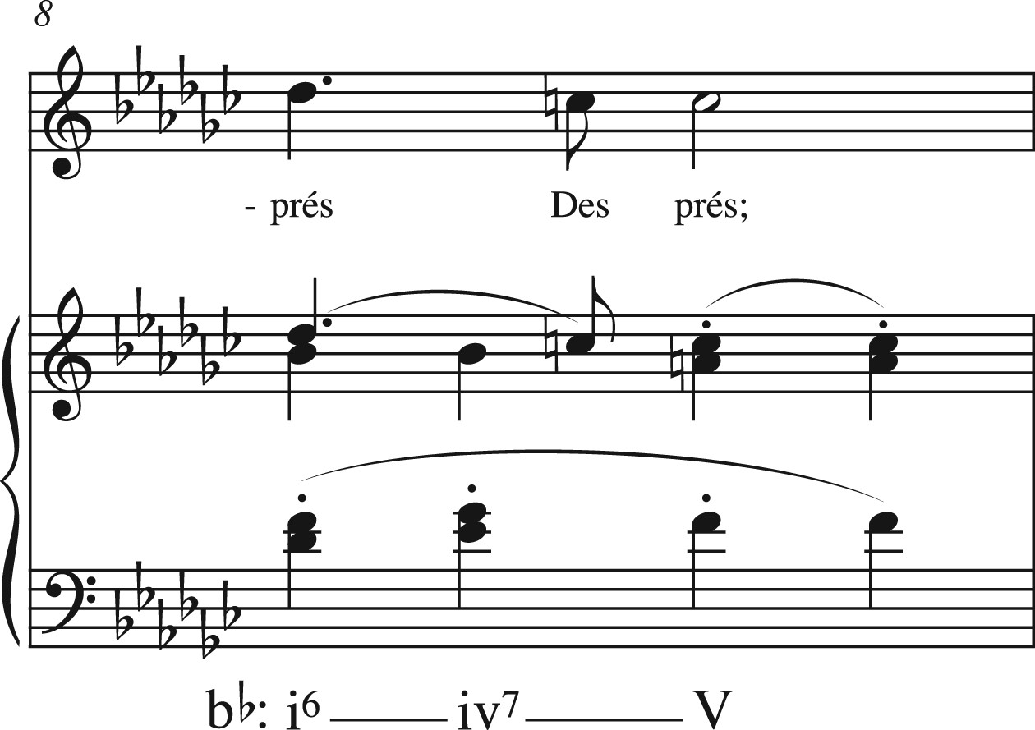
Example 16. Hypothetical half cadence in Fauré, “Adieu,” measure 8.
Notes:
Example 16. Hypothetical half cadence in Fauré, “Adieu,” measure 8.
Unless provided in the caption above, the following copyright applies to the content of this slide: © The Author 2017. Published by Oxford University Press. All rights reserved. For Permissions, please e-mail: journals.permissions@oup.com

Slide 21
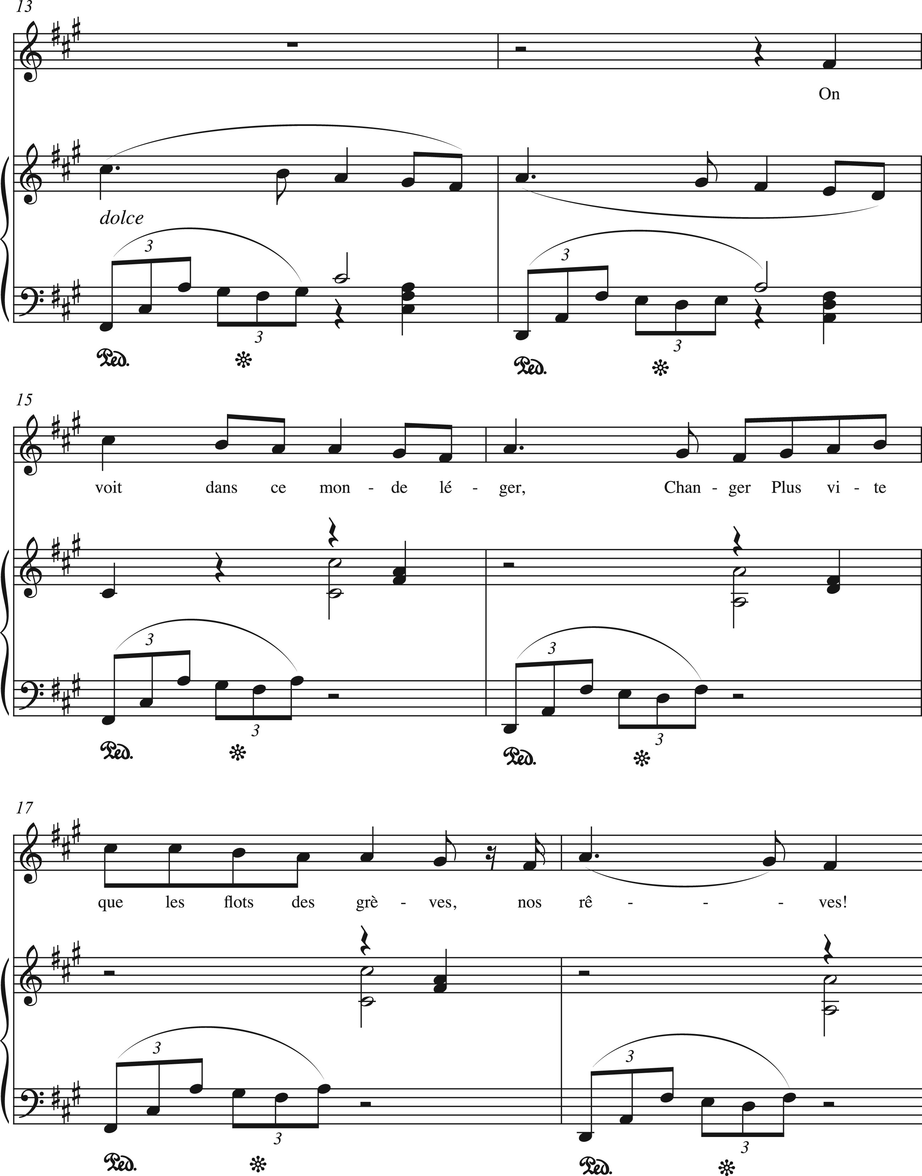
Example 17. Fauré, “Adieu,” mm. 13–18.
Notes:
Example 17. Fauré, “Adieu,” mm. 13–18.
Unless provided in the caption above, the following copyright applies to the content of this slide: © The Author 2017. Published by Oxford University Press. All rights reserved. For Permissions, please e-mail: journals.permissions@oup.com

Slide 22
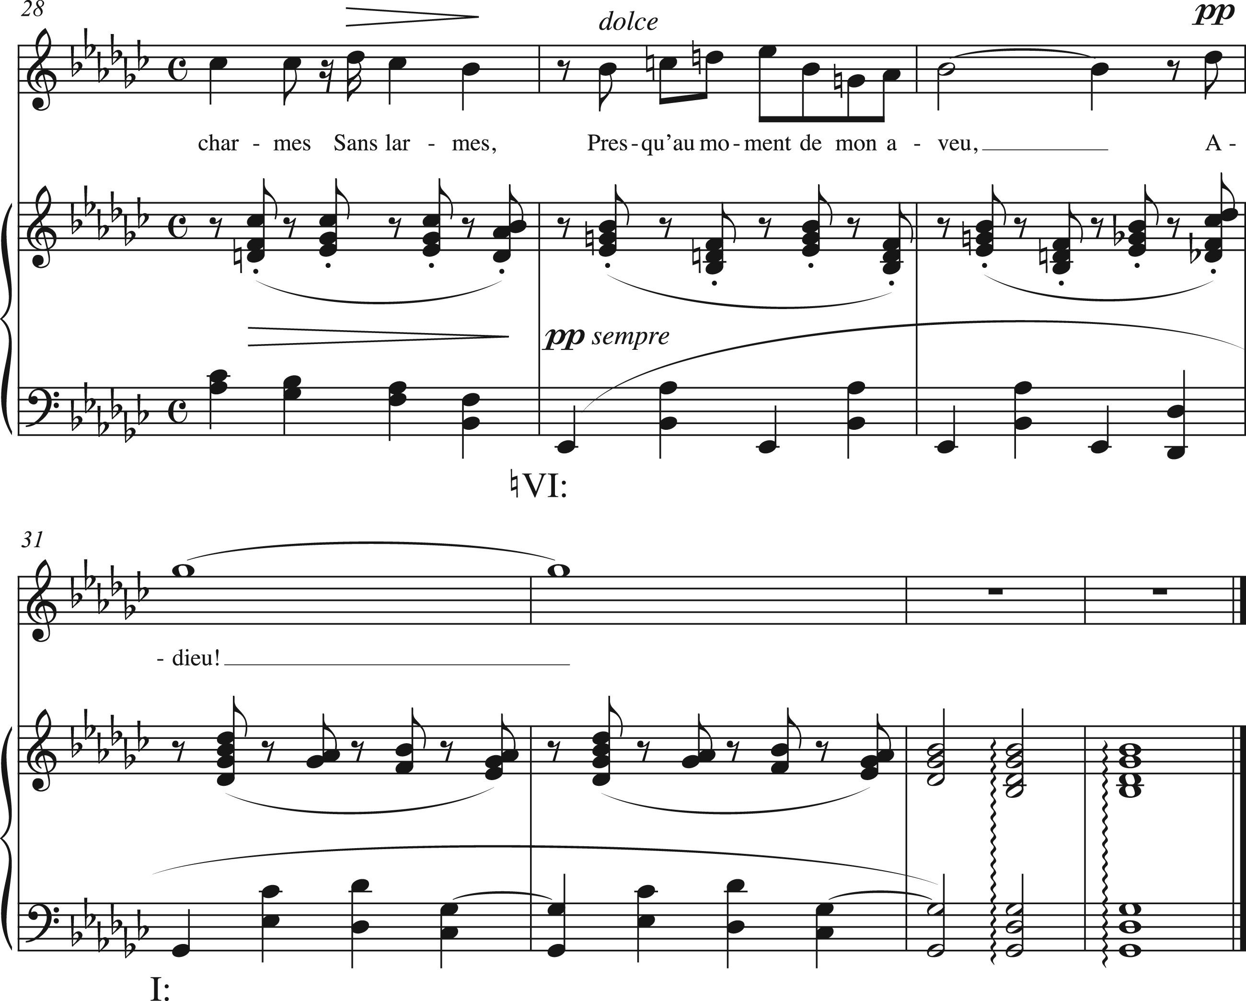
Example 18. Submediant detour in Fauré, “Adieu,” mm. 28–34.
Notes:
Example 18. Submediant detour in Fauré, “Adieu,” mm. 28–34.
Unless provided in the caption above, the following copyright applies to the content of this slide: © The Author 2017. Published by Oxford University Press. All rights reserved. For Permissions, please e-mail: journals.permissions@oup.com

