Slide 1
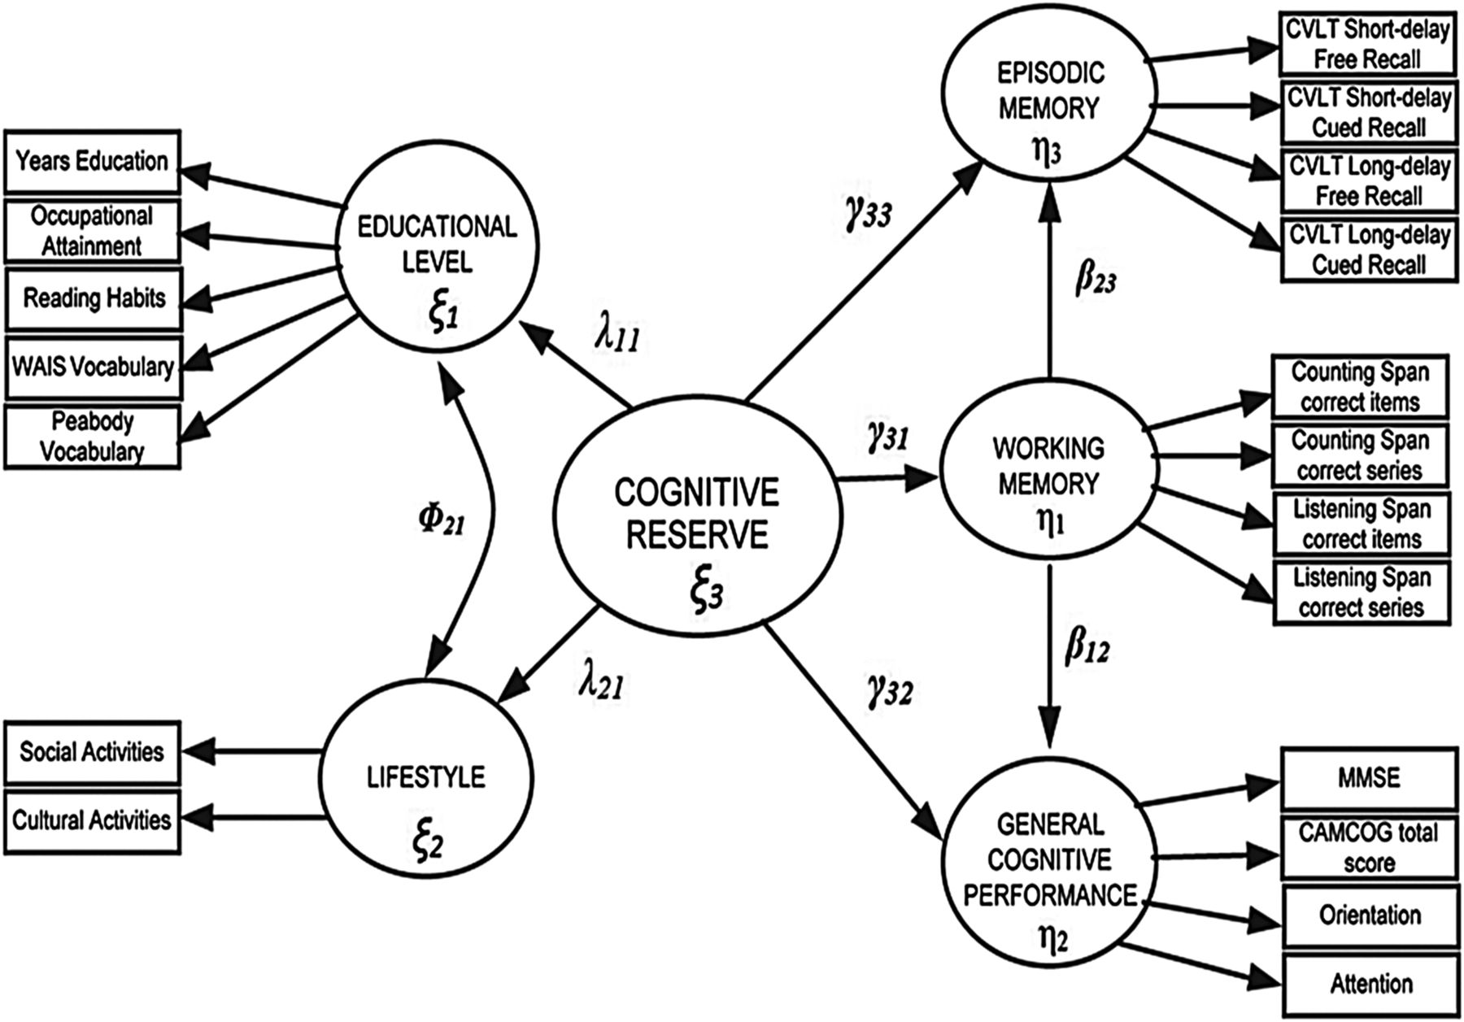
Fig. 1. Diagram of the proposed structural model. MMSE = Mini-mental State Examination; CAMCOG = Cambridge Cognitive ...
Notes:
Fig. 1. Diagram of the proposed structural model. MMSE = Mini-mental State Examination; CAMCOG = Cambridge Cognitive Examination.
Unless provided in the caption above, the following copyright applies to the content of this slide: © The Author 2014. Published by Oxford University Press. All rights reserved. For permissions, please e-mail: journals.permissions@oup.com.

Slide 2
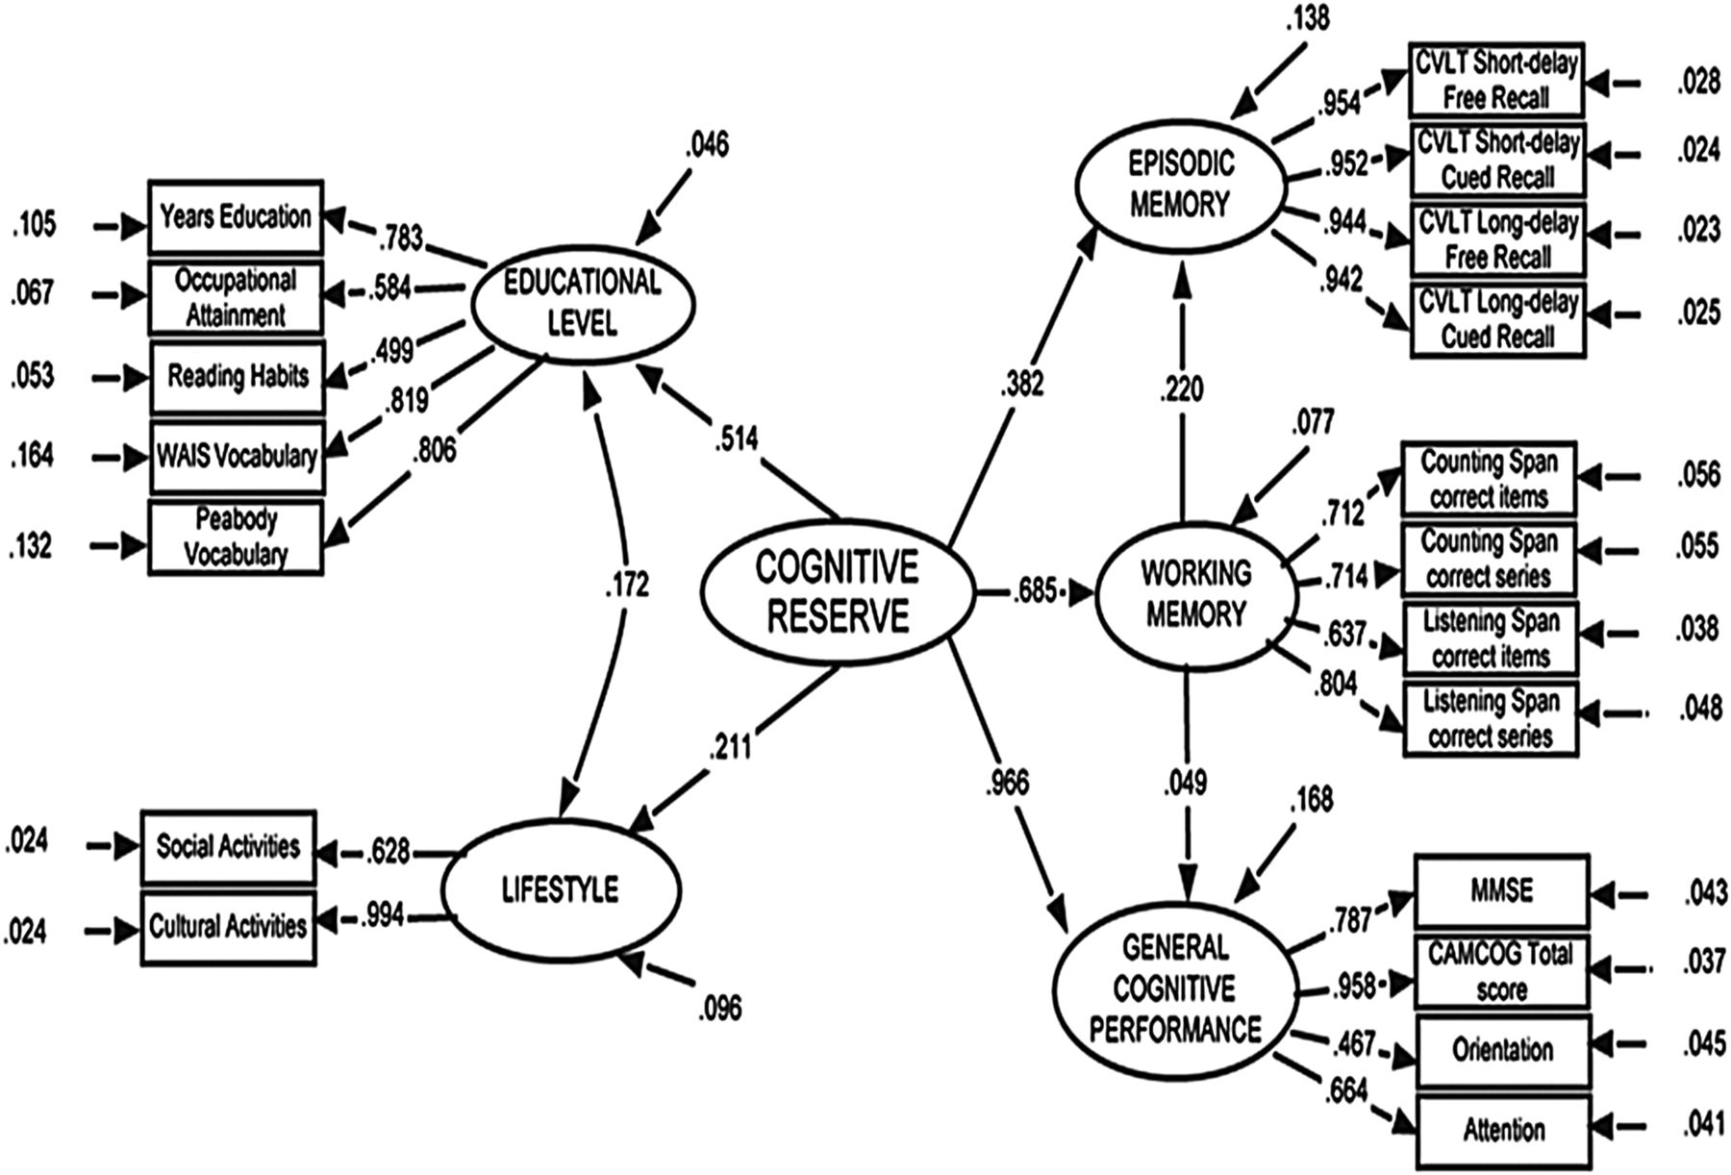
Fig. 2. Standardized estimates of each free parameter in the proposed structural equation model of CR.
Notes:
Fig. 2. Standardized estimates of each free parameter in the proposed structural equation model of CR.
Unless provided in the caption above, the following copyright applies to the content of this slide: © The Author 2014. Published by Oxford University Press. All rights reserved. For permissions, please e-mail: journals.permissions@oup.com.

