Slide 1
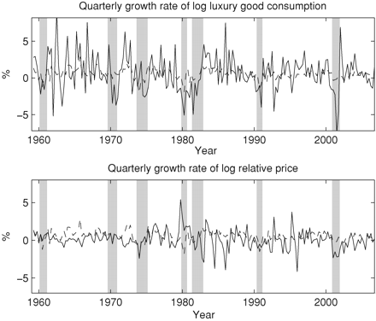
Figure 1 Growth rates of the macro variables The upper figure shows quarterly real log luxury good consumption growth ...
Notes:
Figure 1 Growth rates of the macro variables The upper figure shows quarterly real log luxury good consumption growth versus aggregate consumption growth (the dashed line) and NBER recessions (the bars). The lower figure shows the relative price growth versus aggregate consumption growth (the dashed line) and NBER recessions (the bars). The sample is1959:Q2–2006:Q4.
Unless provided in the caption above, the following copyright applies to the content of this slide: © Oxford University Press 2009

Slide 2
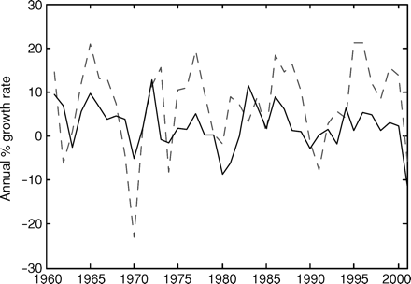
Figure 2 New luxury measure vs. APY (2004) series The figure shows the annual log luxury good consumption growth ...
Notes:
Figure 2 New luxury measure vs. APY (2004) series The figure shows the annual log luxury good consumption growth series given by Ait-Sahalia, Parker, and Yogo (2004), the dashed line, versus the annual log luxury good consumption growth of the series constructed in this paper, the solid line. The correlation between the two series is 0.49. The sample is 1961–2001.
Unless provided in the caption above, the following copyright applies to the content of this slide: © Oxford University Press 2009

Slide 3
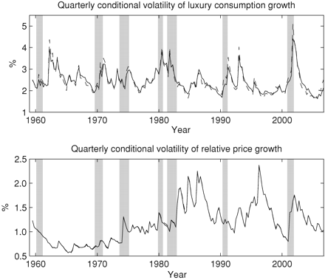
Figure 3 Conditional volatility of the macro variables The upper plot shows the estimated conditional volatility of ...
Notes:
Figure 3 Conditional volatility of the macro variables The upper plot shows the estimated conditional volatility of quarterly real log luxury good consumption growth. The dashed line shows the estimates from the unrestricted model, while the solid line shows the estimates from the restricted model. The lower plot shows the estimated quarterly conditional volatility of the relative price growth. The dashed line (mainly hidden behind the solid line) shows the estimates from the unrestricted model, while the solid line shows the estimates from the restricted model. The bars are NBER recession indicators. The sample is 1959:Q3–2006:Q4.
Unless provided in the caption above, the following copyright applies to the content of this slide: © Oxford University Press 2009

Slide 4
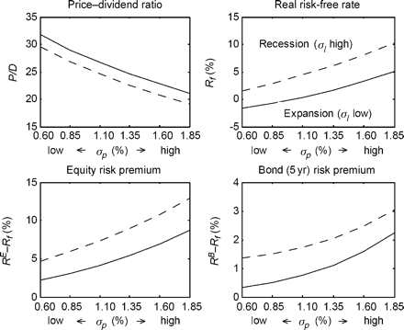
Figure 4 Asset pricing variables vs. state variables The figure gives two standard deviation fluctuations in the ...
Notes:
Figure 4 Asset pricing variables vs. state variables The figure gives two standard deviation fluctuations in the conditional variance of the relative price, $\sigma _{p,t}^2,$ on the horizontal-axis, and two standard deviations in the conditional variance of luxury good consumption growth, $\sigma _{l,t}^2,$ as a dashed line (high) and a solid line (low). The plots are of the equity market price–dividend ratio, the real risk-free rate, the equity premium, and the risk premium on a 5-year nominal zero-coupon bond. All variables are solved for at a quarterly frequency and annualized.
Unless provided in the caption above, the following copyright applies to the content of this slide: © Oxford University Press 2009

Slide 5
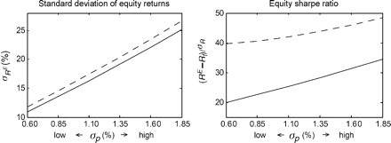
Figure 5 Equity volatility and Sharpe ratio vs. state variables The figure gives two standard deviation fluctuations ...
Notes:
Figure 5 Equity volatility and Sharpe ratio vs. state variables The figure gives two standard deviation fluctuations in the conditional variance of the relative price, $\sigma _{p,t}^2,$ on the horizontal-axis, and two standard deviations in the conditional variance of luxury good consumption growth, $\sigma _{l,t}^2,$ as a dashed line (high) and a solid line (low). The plots are of the volatility of equity market returns and the equity Sharpe ratio. All variables are solved for at a quarterly frequency and annualized.
Unless provided in the caption above, the following copyright applies to the content of this slide: © Oxford University Press 2009

Slide 6
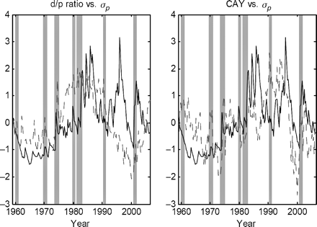
Figure 6 Empirical valuation ratios vs. $\sigma_p$ The figure shows the estimated historical conditional volatility of ...
Notes:
Figure 6 Empirical valuation ratios vs. $\sigma_p$ The figure shows the estimated historical conditional volatility of relative price growth $\sigma_{p,t}$ (the solid line) versus the aggregate historical log dividend yield and the $CAY$ variable of Lettau and Ludvigson (2001). The bars are NBER recession indicators. The sample is 1959:Q3–2006:Q4.
Unless provided in the caption above, the following copyright applies to the content of this slide: © Oxford University Press 2009

