Slide 1
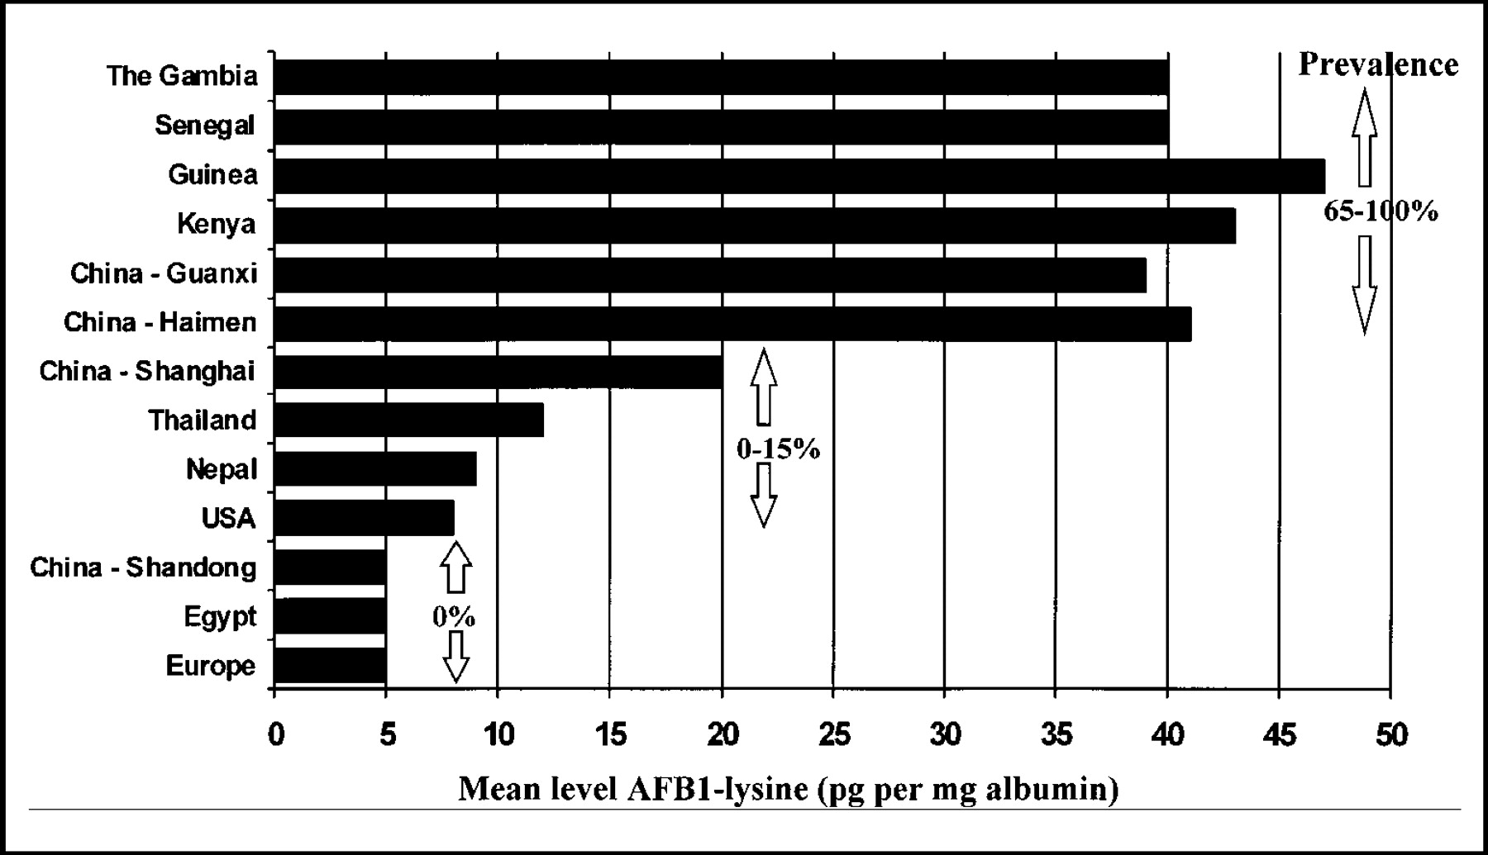
Fig. 1. Level and prevalence of aflatoxin exposure. Data are expressed as pg aflatoxin B ₁ (AFB1)-lysine ...
Notes:
Fig. 1. Level and prevalence of aflatoxin exposure. Data are expressed as pg aflatoxin B 1 (AFB1)-lysine equivalents/mg serum albumin and represent the mean levels in samples with levels above the detection limit of the enzyme-linked immunosorbent assay used (5 pg/mg). Shandong (China), Europe (France and Poland), and Egypt are represented at the detection limit, but no samples were above this level of adduct (0% prevalence). The number of sera analyzed varies per country, and original data are taken from Wild et al. ( 5 ) and from reference ( 90 ).
Unless provided in the caption above, the following copyright applies to the content of this slide: © Oxford University Press

Slide 2
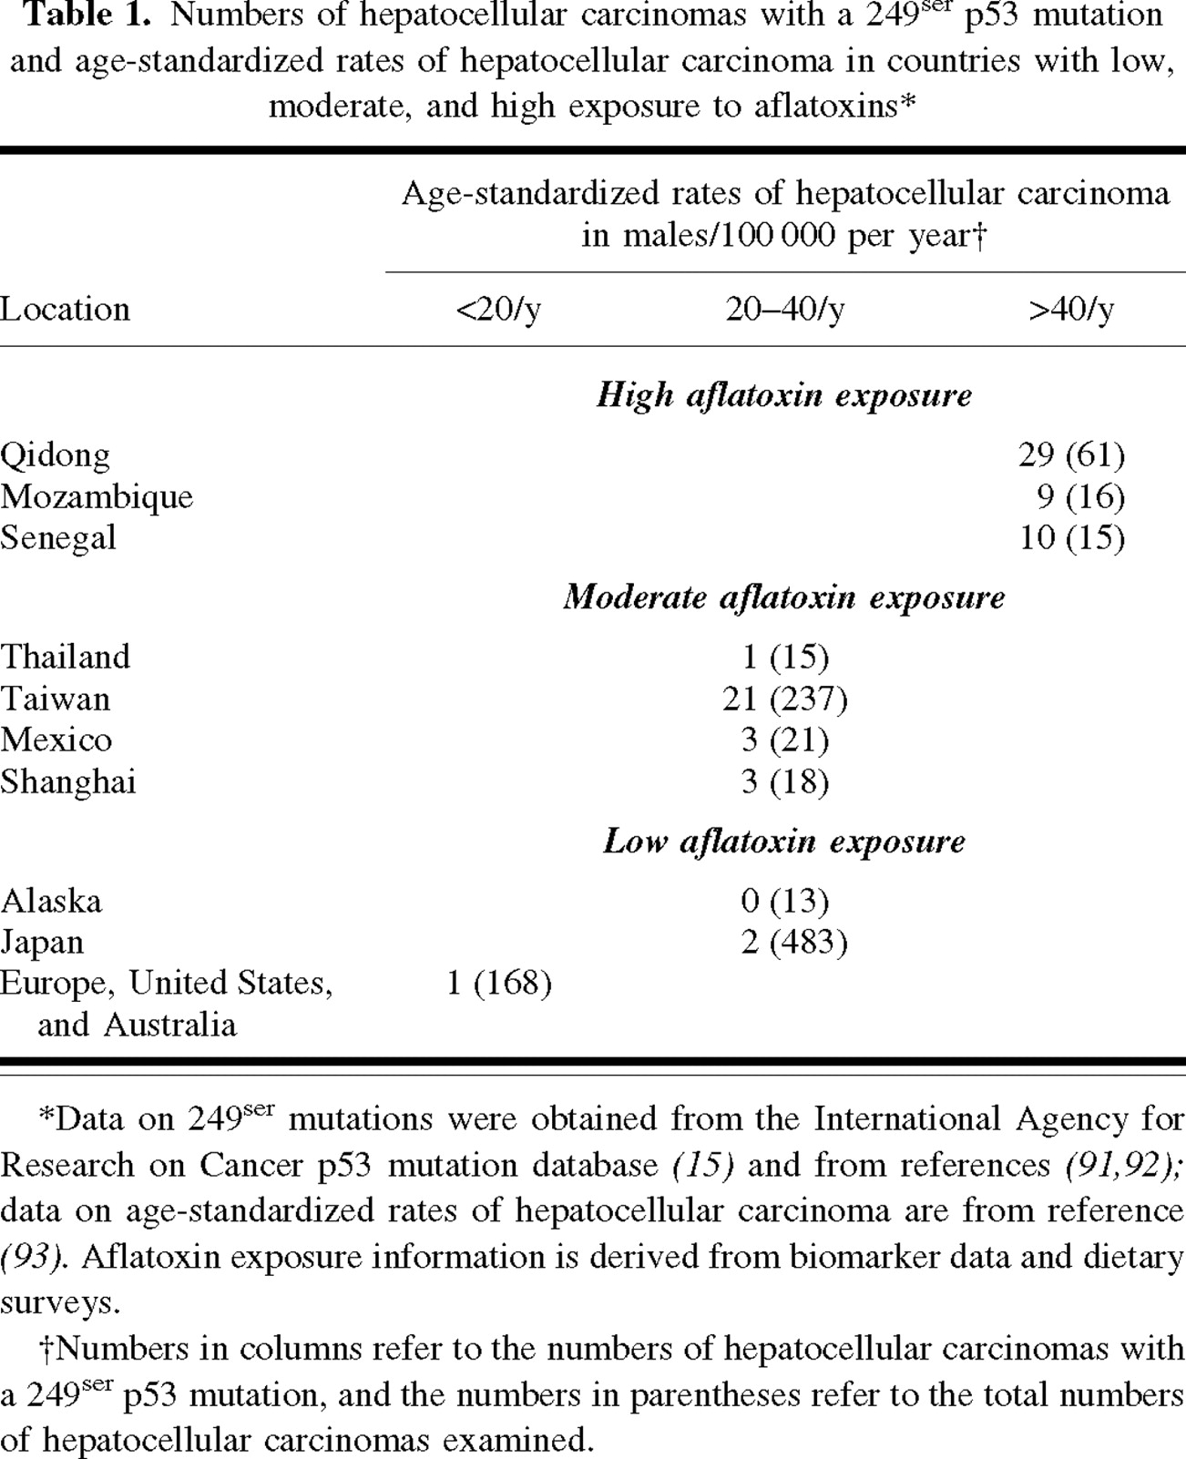
Notes:
Unless provided in the caption above, the following copyright applies to the content of this slide: © Oxford University Press

Slide 3
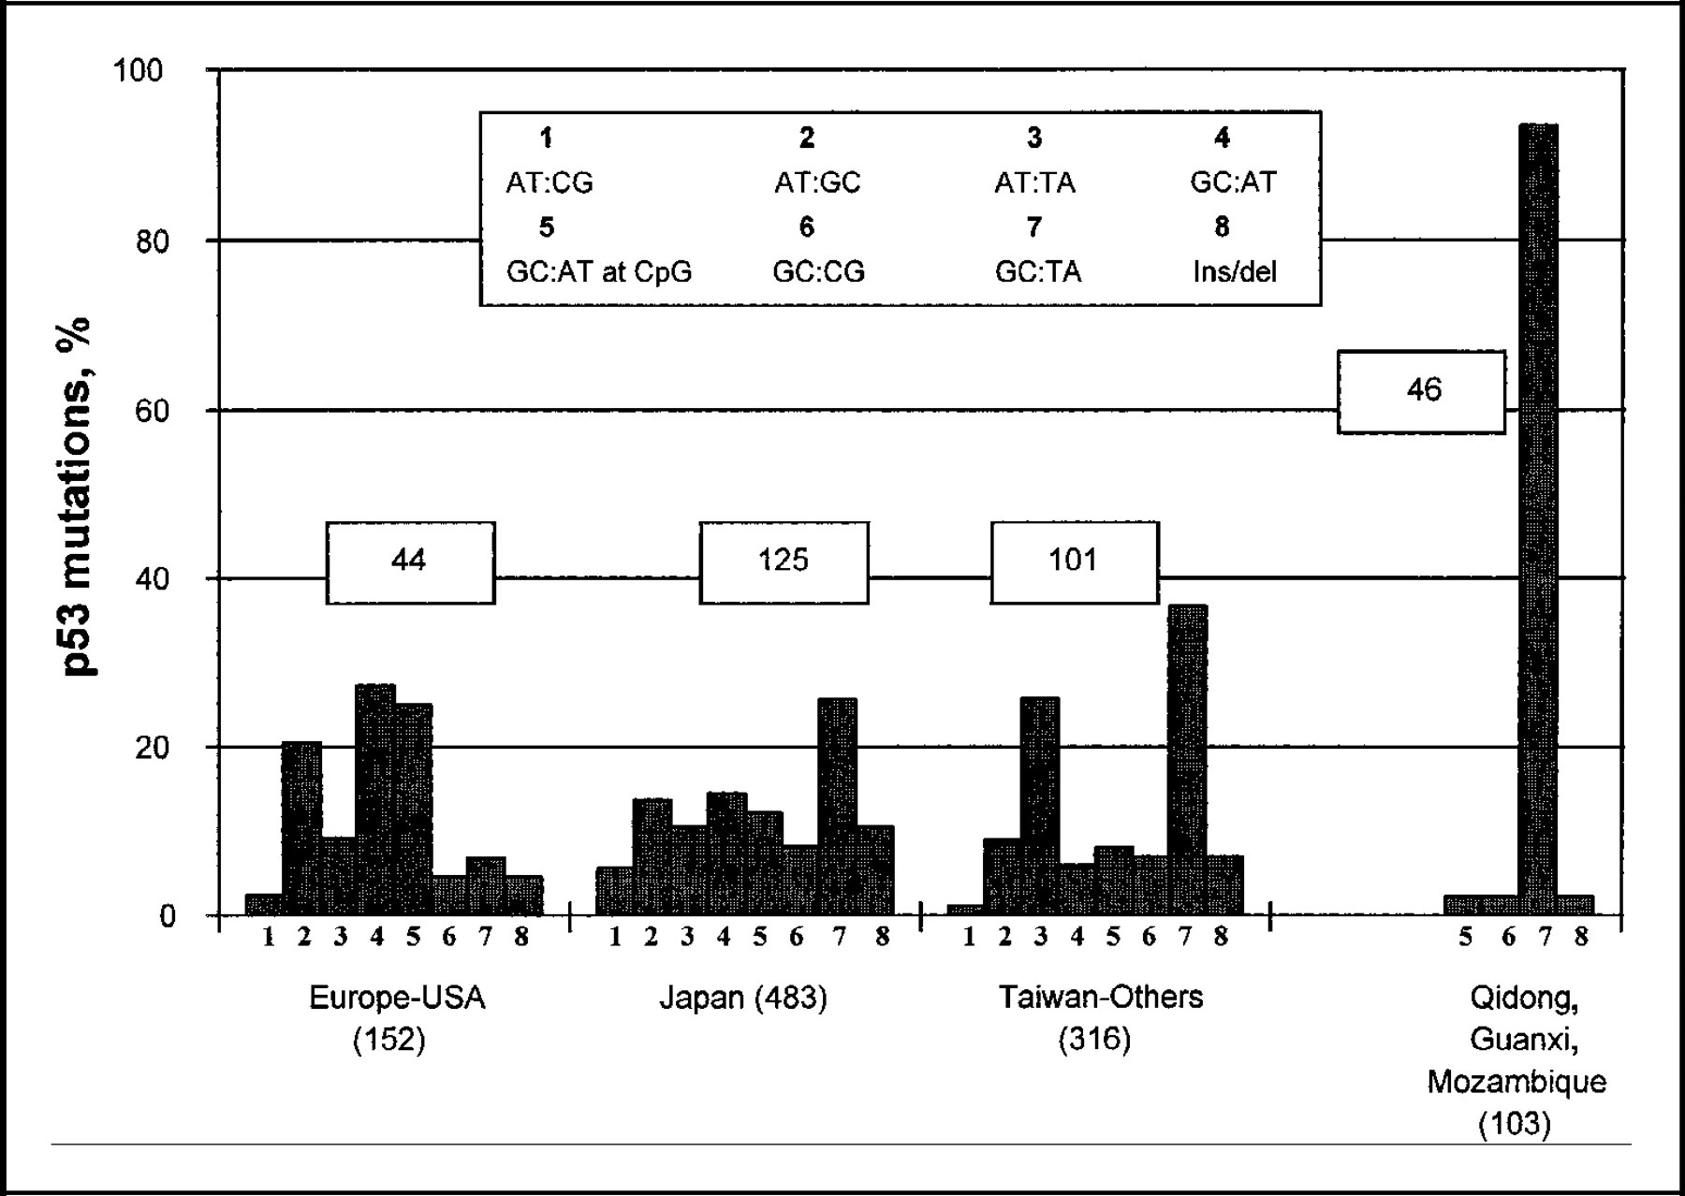
Fig. 2. p53 mutation spectra in hepatocellular carcinomas from different regions of the world. Data were obtained ...
Notes:
Fig. 2. p53 mutation spectra in hepatocellular carcinomas from different regions of the world. Data were obtained from the International Agency for Research on Cancer p53 mutation database ( 15 ). The numbers in parentheses refer to the numbers of hepatocellular carcinomas examined, and the numbers in the small boxes refer to the total number of p53 mutations detected (exons 5 through 8) in hepatocellular carcinomas from each region or country. The large box contains the key for the mutation types, which are denoted in the form of numbers, 1 through 8, on the x axis for each region or country. The key is read as follows: 1, AT to GC transversion; 2, AT to GC transition; 3, AT to TA transversion; 4, GC to AT transition; 5, GC to AT transition at CpG islands; 6, GC to CG transversion; 7, GC to TA transversion; and 8, insertion or deletion. “Others” refer collectively to Mexico, Shanghai, Beijing, Thailand, and Transkei.
Unless provided in the caption above, the following copyright applies to the content of this slide: © Oxford University Press

