Slide 1
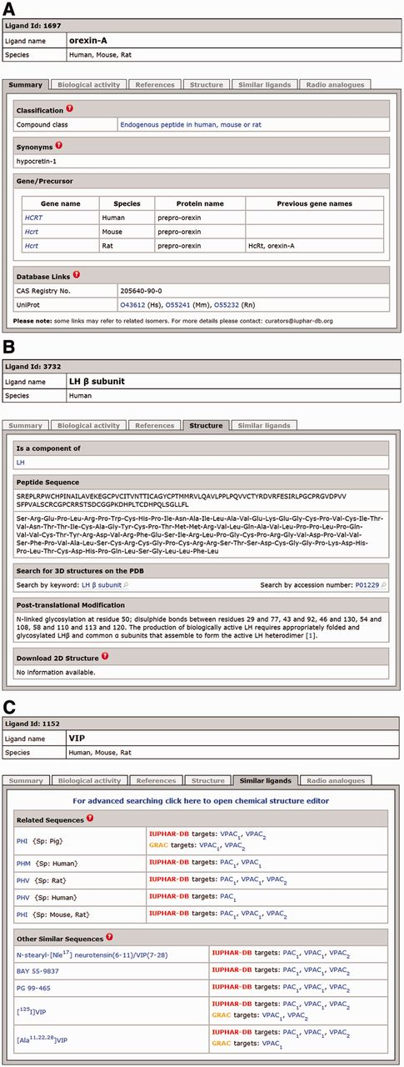
Figure 1. Panel (A) shows a screenshot of the ligand page for the endogenous peptide orexin-A open at the ‘Summary’ ...
Notes:
Figure 1. Panel (A) shows a screenshot of the ligand page for the endogenous peptide orexin-A open at the ‘Summary’ tab. The sequence of orexin-A is identical in human, mouse and rat so the information on this peptide is grouped into a single database entry. Panel (B) shows a screenshot of the LH β subunit ligand page, open at the ‘Structure’ tab and showing the peptide sequence, post-translational modifications and a link to the ligand page for the LH heterodimer. Panel (C) shows a screenshot of the ligand page for vasoactive intestinal peptide (VIP), open at the ‘Similar Ligands’ tab. The ‘Related Sequences’ table lists other peptides derived from the same precursor or orthologues in other species, whereas the ‘Other Similar Sequences’ table lists other peptides that have similar sequences to VIP, including synthetic and modified forms of VIP.
Unless provided in the caption above, the following copyright applies to the content of this slide: © The Author(s) 2012. Published by Oxford University Press.This is an Open Access article distributed under the terms of the Creative Commons Attribution License (http://creativecommons.org/licenses/by-nc/3.0/), which permits non-commercial reuse, distribution, and reproduction in any medium, provided the original work is properly cited. For commercial re-use, please contact journals.permissions@oup.com.

