Slide 1
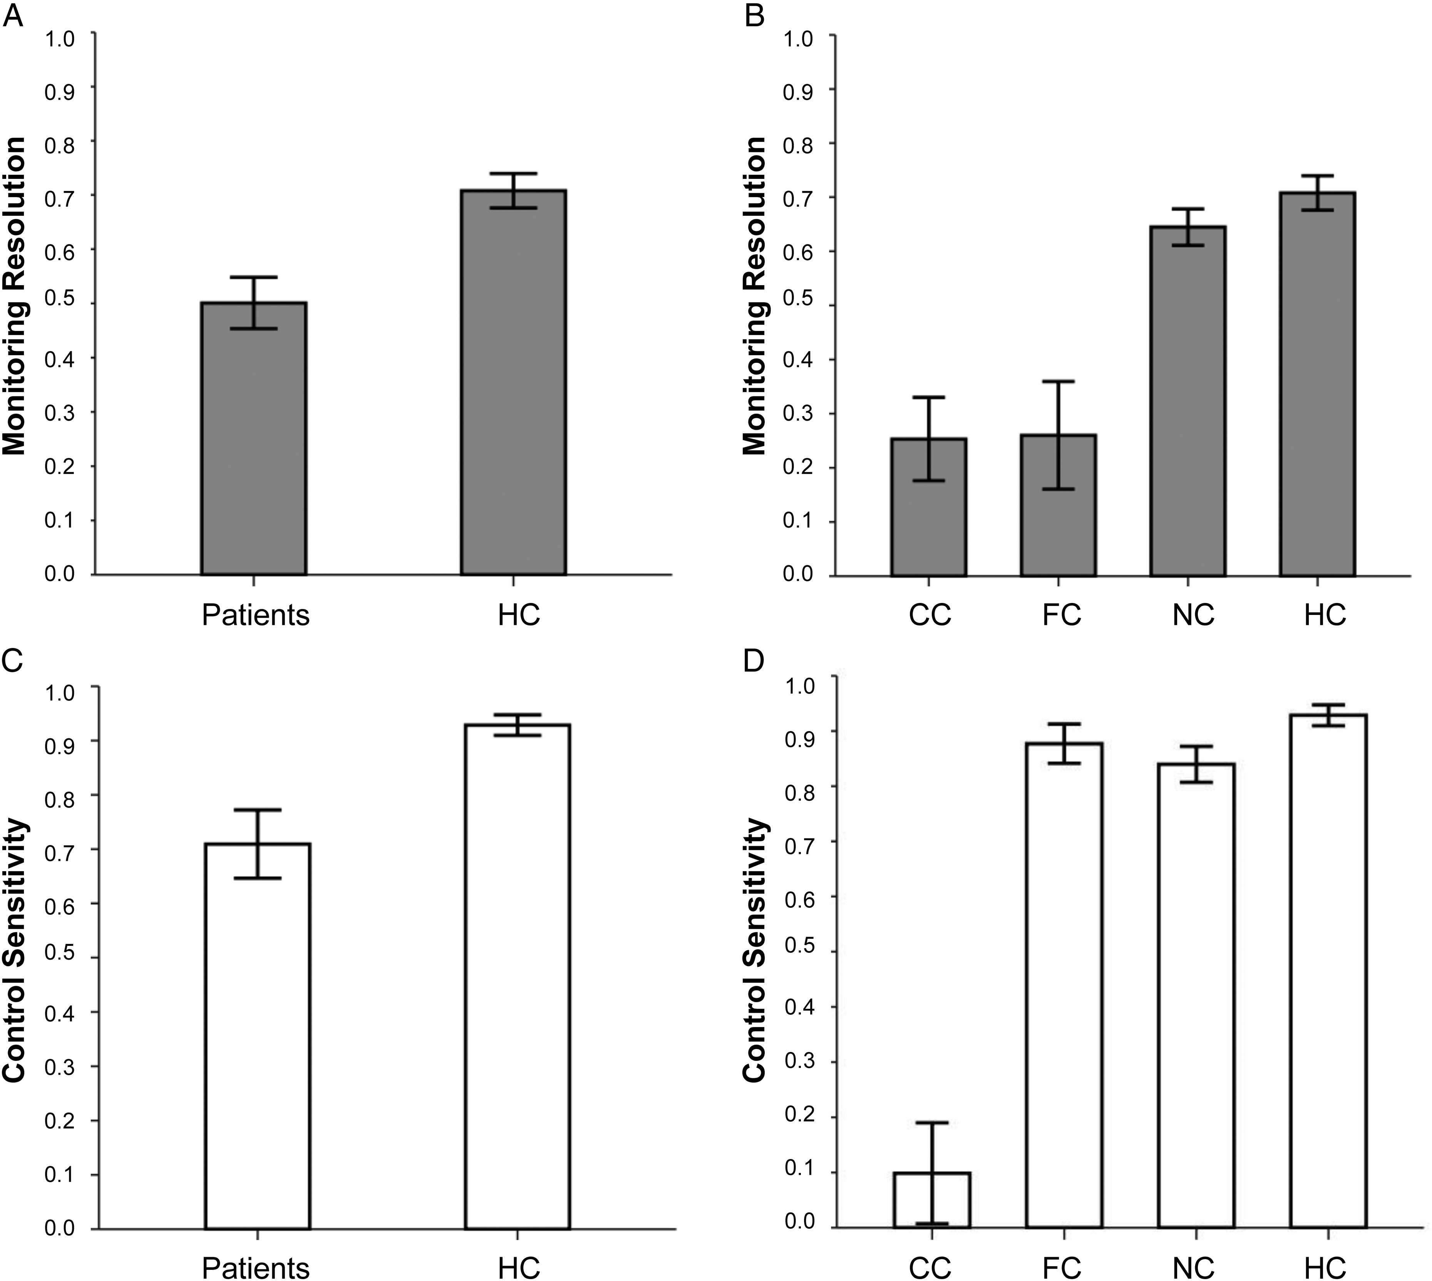
Figure 1. QAP components across groups. Results are reported as mean values for a given group. Error bars represent the ...
Notes:
Figure 1. QAP components across groups. Results are reported as mean values for a given group. Error bars represent the standard error of the mean. The top row shows metacognitive monitoring resolution for (A) all PFC patients compared with HCs and (B) PFC patient's clinical subgroups separately. The bottom row shows metacognitive control sensitivity for (C) all PFC patients compared with HCs and (D) PFC patient's clinical subgroups separately.
Unless provided in the caption above, the following copyright applies to the content of this slide: © The Author 2015. Published by Oxford University Press. All rights reserved. For Permissions, please e-mail: journals.permissions@oup.com

Slide 2
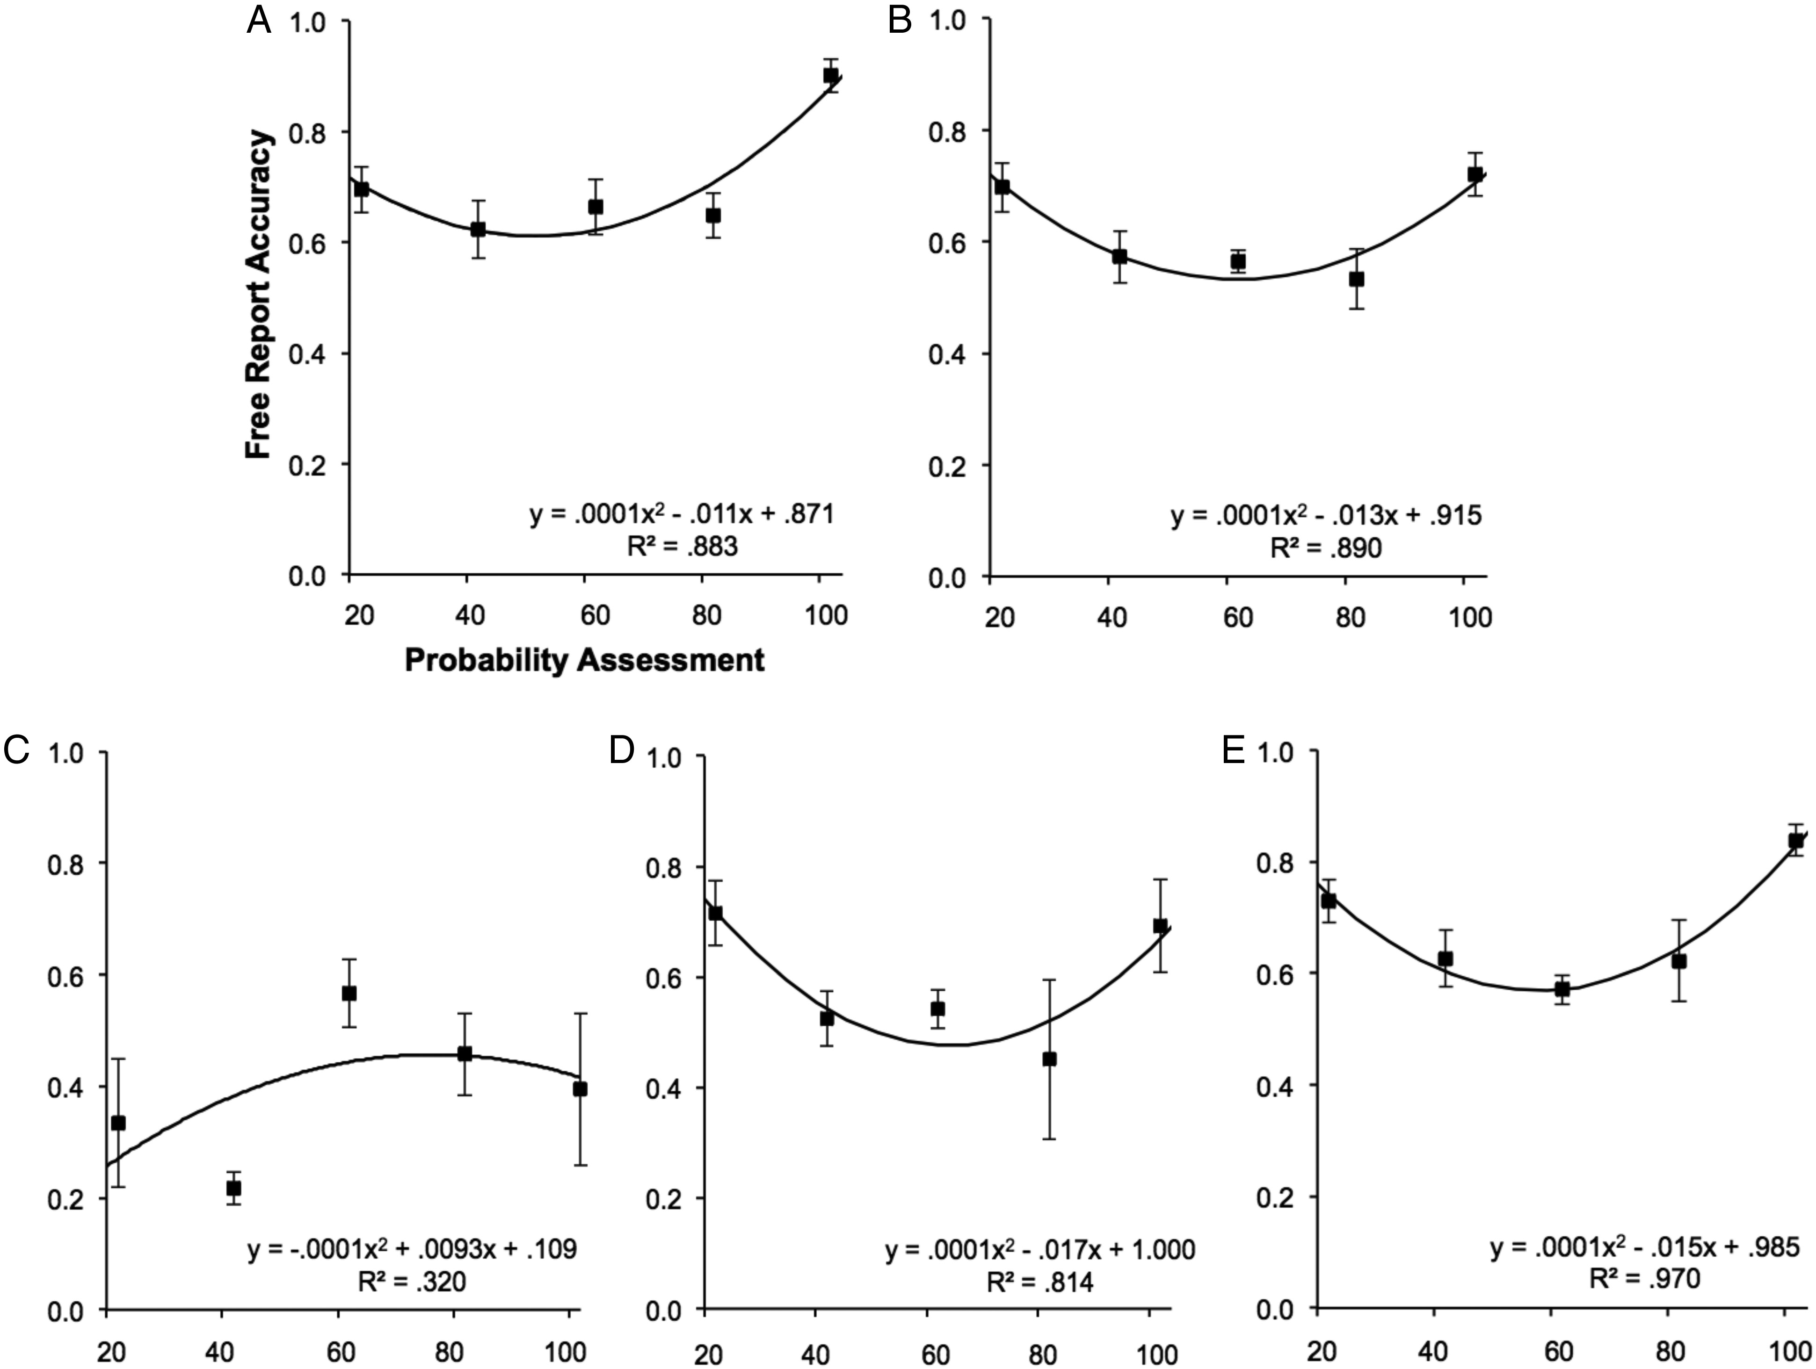
Figure 2. Free-report accuracy by probability assessment across participant groups. Lines represent quadratic ...
Notes:
Figure 2. Free-report accuracy by probability assessment across participant groups. Lines represent quadratic regressions and squares represent mean free-report accuracy for probability assessment rounded to the nearest multiple of 20. The top row shows quadratic regressions for (A) HCs and (B) all PFC patients, whereas the bottom row shows (C) CCs, (D) FCs, and (E) NC patients separately. Equations and R2 values are listed for each regression. Note: Performing the same analyses with the probability of the decision to withhold or report rather than free report accuracy yielded almost identical results.
Unless provided in the caption above, the following copyright applies to the content of this slide: © The Author 2015. Published by Oxford University Press. All rights reserved. For Permissions, please e-mail: journals.permissions@oup.com

Slide 3
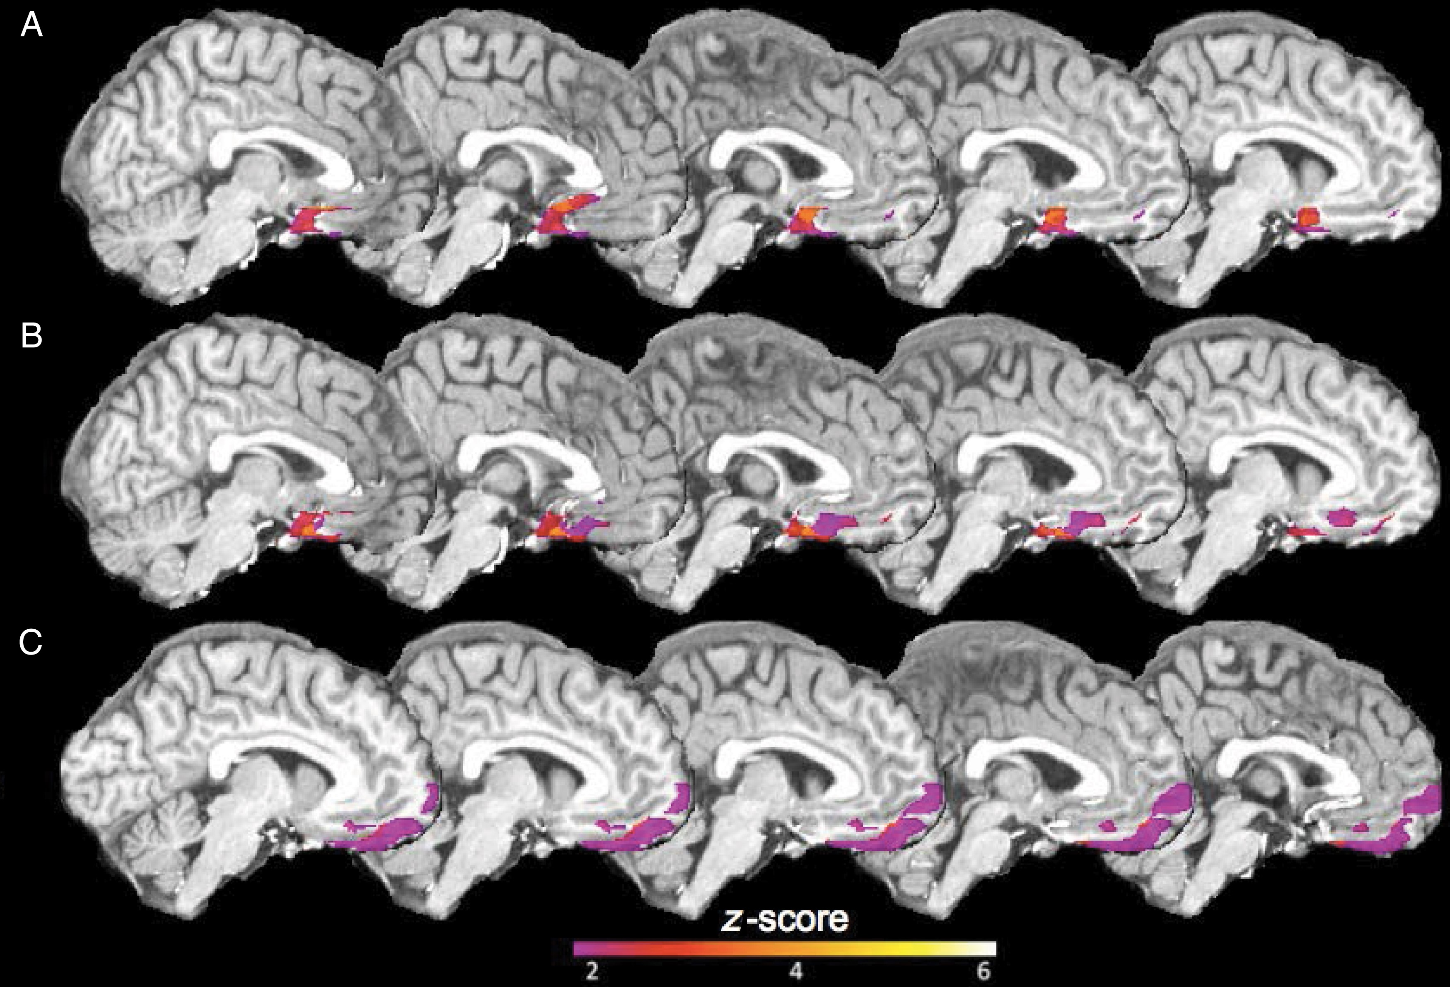
Figure 3. VLSM results for (A) monitoring resolution, (B) control sensitivity, and (C) quadratic regression leading ...
Notes:
Figure 3. VLSM results for (A) monitoring resolution, (B) control sensitivity, and (C) quadratic regression leading coefficients. Threshold is set to P < 0.05 using a FDR for multiple comparisons. Warm colors indicate higher z-scores and cool colors indicate lower z-scores.
Unless provided in the caption above, the following copyright applies to the content of this slide: © The Author 2015. Published by Oxford University Press. All rights reserved. For Permissions, please e-mail: journals.permissions@oup.com

Slide 4
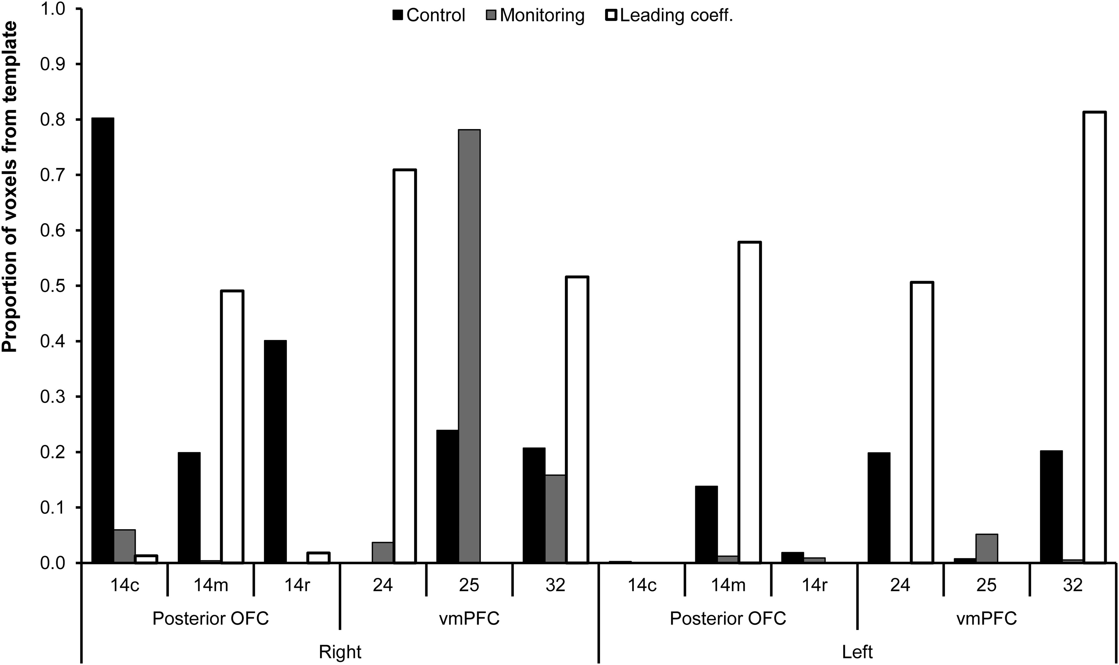
Figure 4. Proportion of voxels within each template map that overlap with FDR-corrected voxels from VLSM for control ...
Notes:
Figure 4. Proportion of voxels within each template map that overlap with FDR-corrected voxels from VLSM for control sensitivity, monitoring resolution, and leading coefficient.
Unless provided in the caption above, the following copyright applies to the content of this slide: © The Author 2015. Published by Oxford University Press. All rights reserved. For Permissions, please e-mail: journals.permissions@oup.com

Slide 5
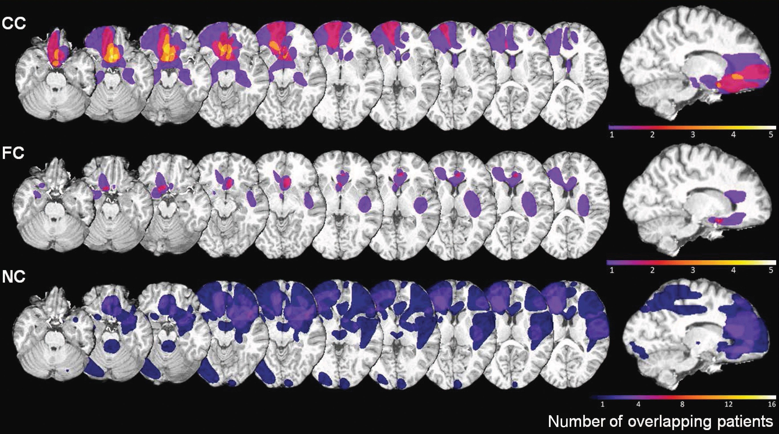
Figure 5. Patient lesion comparisons for 25 patients with available scans. Lesion overlap of CC patients (top panel), ...
Notes:
Figure 5. Patient lesion comparisons for 25 patients with available scans. Lesion overlap of CC patients (top panel), lesion overlap of FC patients (middle panel), and lesion overlap of NC patients (bottom panel). Bars represent the number of patients with damage to a particular area, with cool colors indicating regions damaged in fewer patients and warm colors indicating regions damaged in more patients.
Unless provided in the caption above, the following copyright applies to the content of this slide: © The Author 2015. Published by Oxford University Press. All rights reserved. For Permissions, please e-mail: journals.permissions@oup.com

