Slide 1
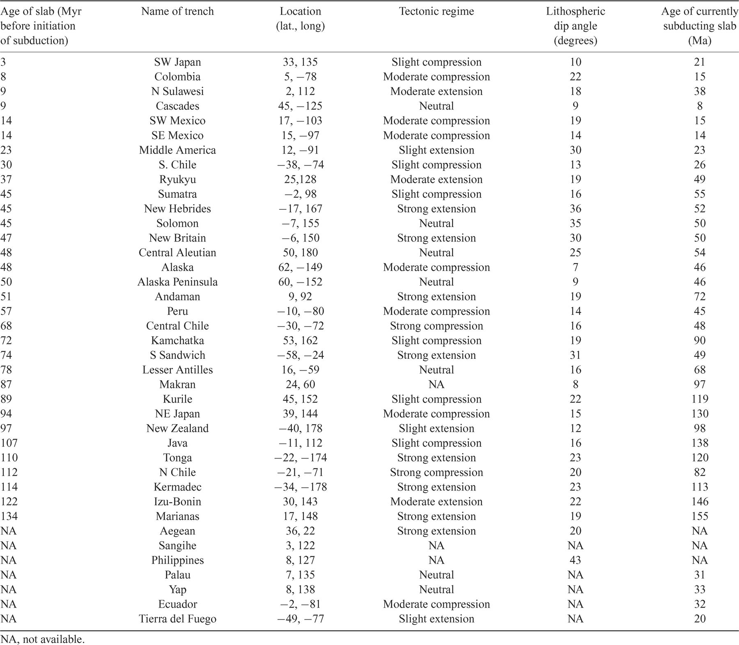
Table 1 Ocean trenches characteristically show great variability with respect to their age, their tectonic regime, ...
Notes:
Table 1 Ocean trenches characteristically show great variability with respect to their age, their tectonic regime, their location and the presumed age of the oceanic lithosphere before the initiation of the subduction(after Jarrard 1986
Unless provided in the caption above, the following copyright applies to the content of this slide: © 2005 RAS

Slide 2
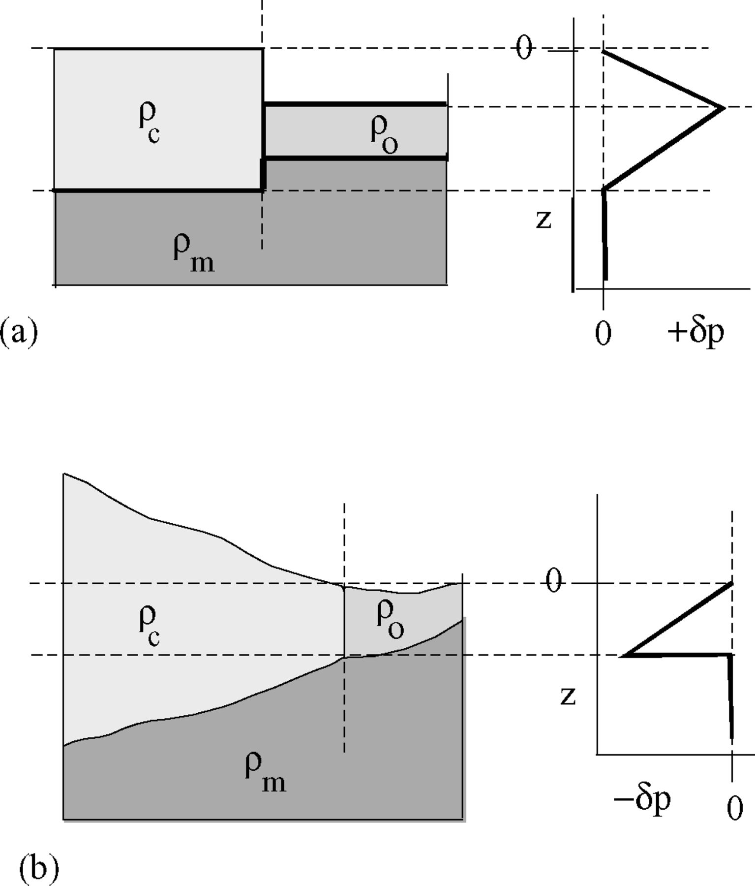
Figure 1 (a) Juxtaposition of oceanic and continental lithospheres along a free contact zone, marked by a vertical ...
Notes:
Figure 1 (a) Juxtaposition of oceanic and continental lithospheres along a free contact zone, marked by a vertical dashed line (left) shows that the differential lateral pressure δp concentrates at the upper level of the oceanic lithosphere and is oriented seawards (right). (b) Where the continental margin is tapered and the lithospheres are locked (left), the differential pressure distribution in the oceanic lithosphere (right) shows that pressure rises gradually with depth and reaches its highest values at the base of the lithospheres, driving the deformation landwards at that zone, provided that the densities of the asthenosphere and the base of the oceanic lithosphere are similar. Densities of continental and oceanic lithospheres and the asthenosphere are marked by ρc, ρo and ρm respectively, z marks the depth, and δp is the differential lateral pressure.
Unless provided in the caption above, the following copyright applies to the content of this slide: © 2005 RAS

Slide 3
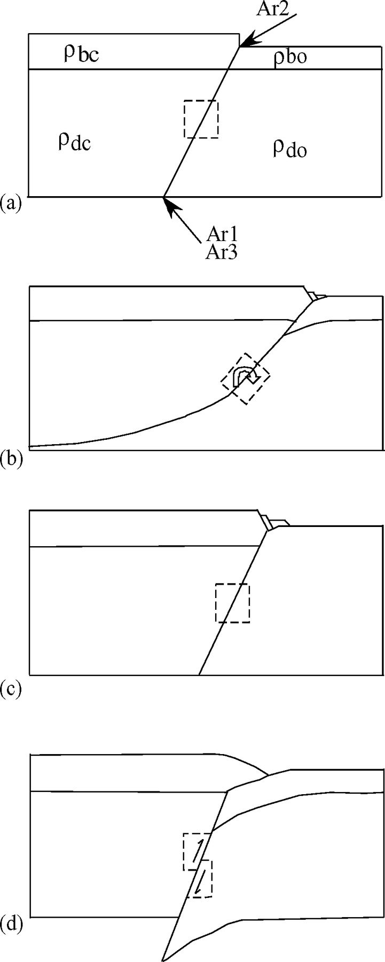
Figure 2 The location and effect of Argand numbers. The reference square, in dashed lines, shows the orientation of ...
Notes:
Figure 2 The location and effect of Argand numbers. The reference square, in dashed lines, shows the orientation of motion of the rock mass surrounding the incipient subduction plane. (a) Shows the locations where the Argand numbers reach their maximal value: Ar1 and Ar3 at the intersection of the subduction plane with the base of the lithosphere, Ar2 at the intersection of the subduction plane with the base of the brittle lithosphere. (b) When Ar1 exceeds 1.0 the viscous strength of the lithosphere cannot support its tendency to lower its potential energy, so that the result is rotation of the subduction plane and the oceanic lithosphere is thrust under the continental lithosphere. (c) When Ar2 exceeds 1.0, brittle failure is expected at the brittle portion of the lithosphere, forming faults. (d) When Ar3 exceeds 1.0, stick-slip motion is presumed along the subduction plane so that the lithosphere may founder into the asthenosphere.
Unless provided in the caption above, the following copyright applies to the content of this slide: © 2005 RAS

Slide 4
Table 2 The materials used in the first series of subduction experiments and their physical characteristics. Argand ...
Notes:
Table 2 The materials used in the first series of subduction experiments and their physical characteristics. Argand numbers have the following values: Ar1= 168, Ar3= 1.1. No Ar2 was calculated since the models did not have a brittle layer (see Fig. 2 and text for additional explanations).
Unless provided in the caption above, the following copyright applies to the content of this slide: © 2005 RAS

Slide 5
Table 3 Physical properties of the three-layer model. Argand numbers have the following values: Ar₁= 206, ...
Notes:
Table 3 Physical properties of the three-layer model. Argand numbers have the following values: Ar1= 206, Ar2= 2, Ar3= 0.45. See text and Fig. 3 for additional explanation.
Unless provided in the caption above, the following copyright applies to the content of this slide: © 2005 RAS

Slide 6
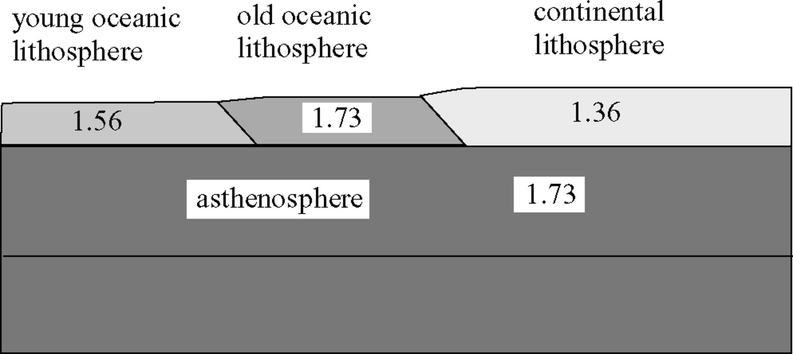
Figure 3 Side view of the initial set-up of the two-layer analogue subduction model. The upper layer is composed of ...
Notes:
Figure 3 Side view of the initial set-up of the two-layer analogue subduction model. The upper layer is composed of three viscous plates representing old and new oceanic lithosphere and continental lithosphere; the relative thickness between the plates is not to scale. The lower layer is the low-viscosity asthenosphere, within it can be seen a thin layer of black powder that acts as a tracer. The layer densities are shown in 103kg m−3. See Table 2 for the physical characteristics of the various layers.
Unless provided in the caption above, the following copyright applies to the content of this slide: © 2005 RAS

Slide 7
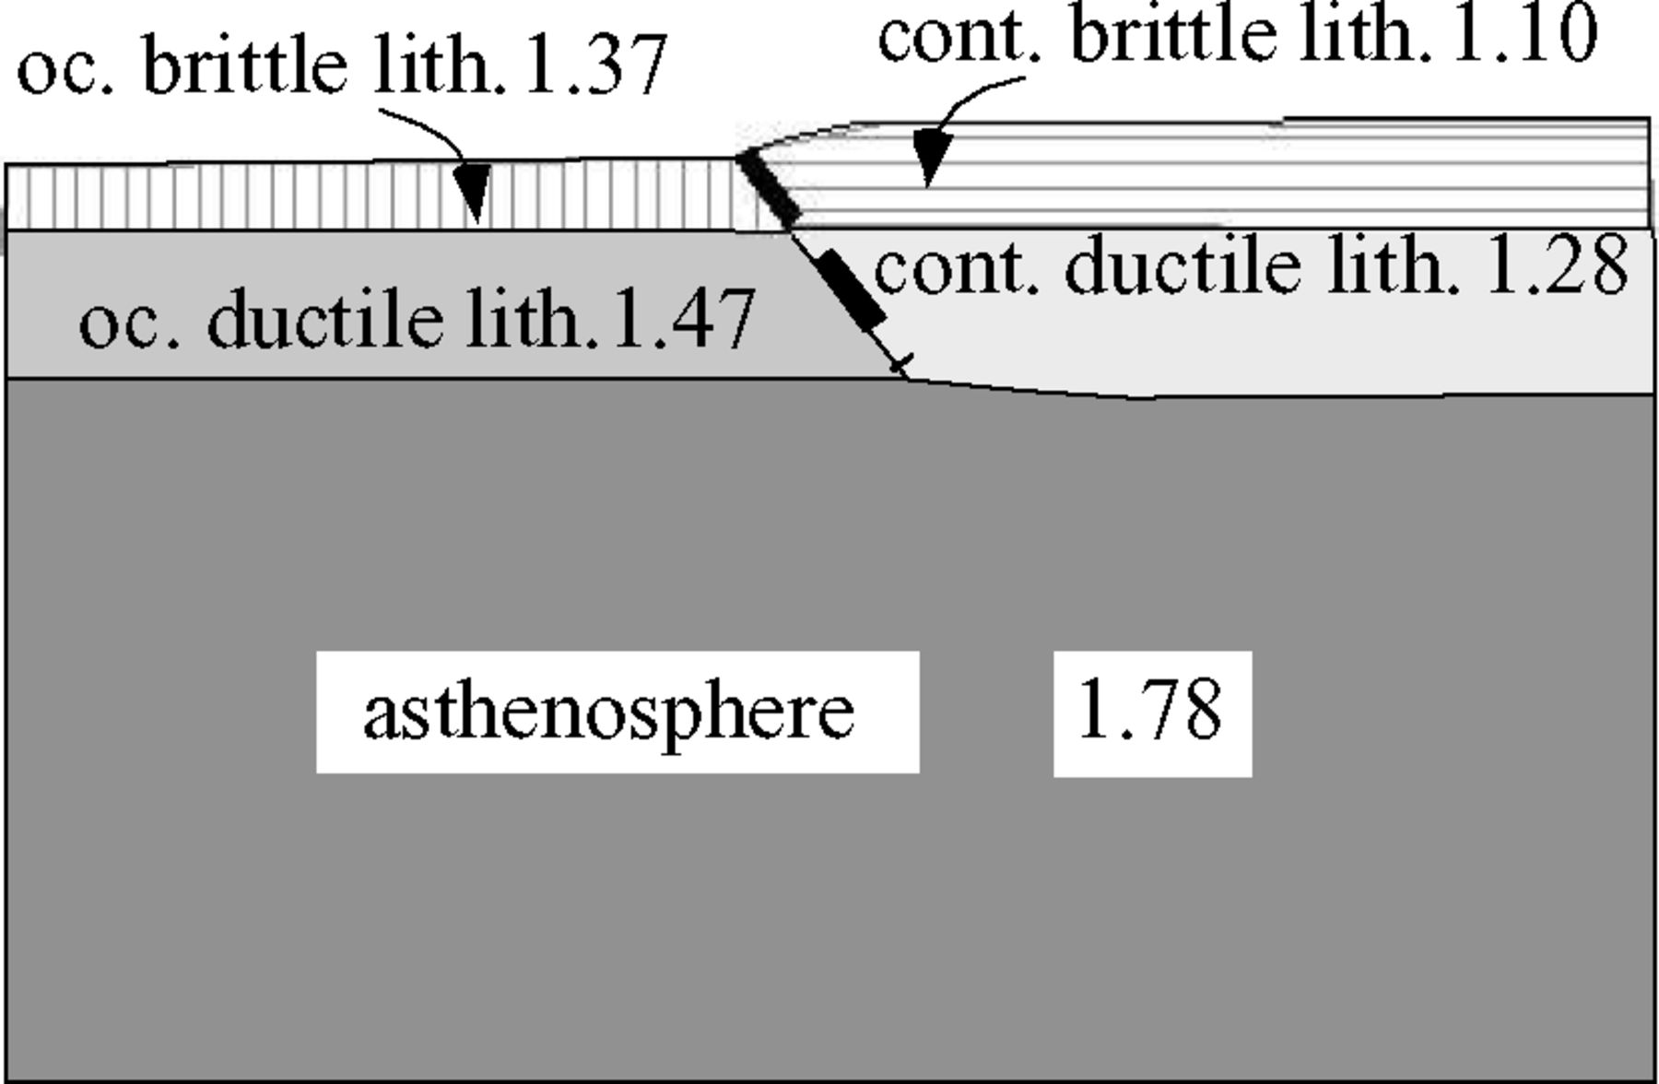
Figure 4 Side view of the initial set-up of the three-layer analogue subduction model. The uppermost layers represent ...
Notes:
Figure 4 Side view of the initial set-up of the three-layer analogue subduction model. The uppermost layers represent the brittle portion of the oceanic and continental lithospheres, the mid-layers represent the ductile upper oceanic and continental lithospheric mantle, and the lower layer represents the low-viscosity asthenosphere. The lower boundary of the lithospheric plates is placed at the same height for simplicity. Densities are shown in 103kg m−3. The heavy dashed line marks the location where lubrication was applied. Abbreviations: cont, continental; oc, oceanic; lith, lithosphere. See Table 3 for the physical characteristics of the various components.
Unless provided in the caption above, the following copyright applies to the content of this slide: © 2005 RAS

Slide 8
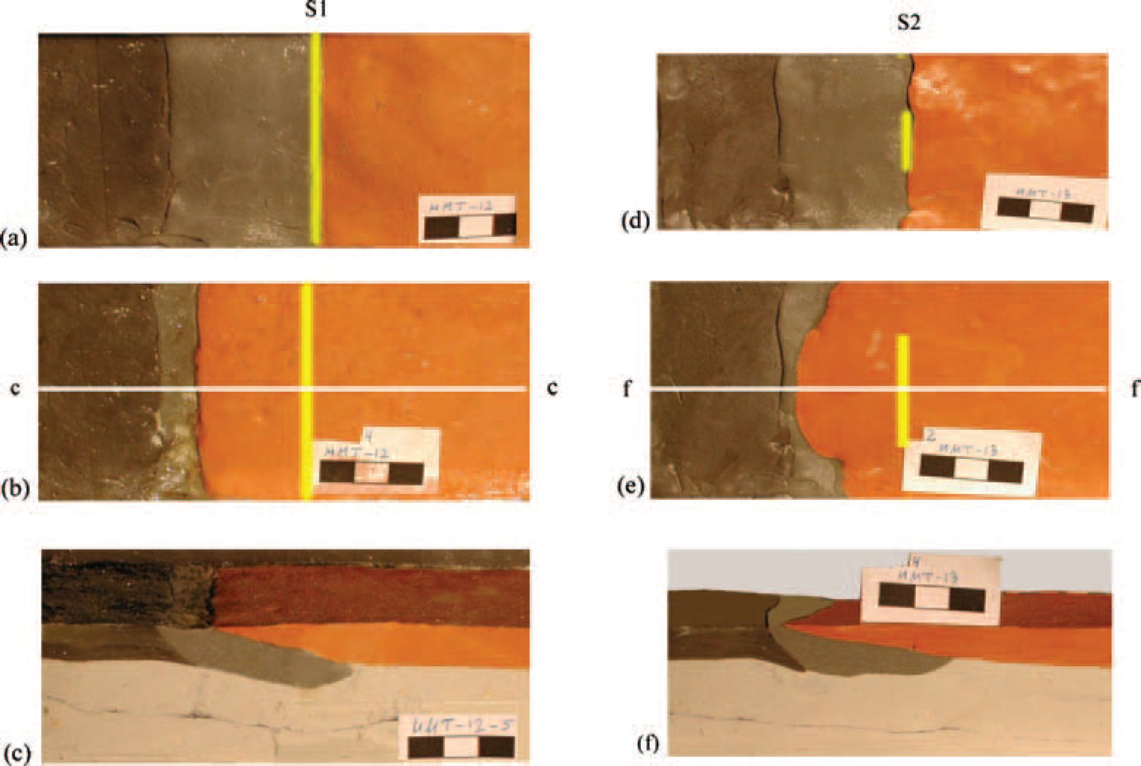
Figure 5 Subduction experiments with a two-layer model, where the densities of the ‘old oceanic lithosphere’ (light ...
Notes:
Figure 5 Subduction experiments with a two-layer model, where the densities of the ‘old oceanic lithosphere’ (light brown) and the ‘asthenosphere’ are similar, and the ‘young oceanic lithosphere’ (dark brown) is lighter; yellow lines show the location of the initial lubrication between the ‘lithospheric slabs’. (a) Initial and (b) final plan view of the experimental set-up with a lubricated subduction zone, which forms a straight trench and uniform roll-back. The white line c–c is the location of the vertical section across the subduction zone (c) that shows the ‘continental’ slab stretching ‘seawards’ and the subducting ‘oceanic lithosphere’ squeezes its way below the ‘continental’ lithosphere. There is some sagging of the ‘asthenosphere’ (light tan) under the combined weight of the overlapping ‘lithospheres’. Line S1 marks the initial juxtaposition of the oceanic and continental slabs. The lubrication in other experiments of this series (d–f) was applied mostly to the centre of the contact between the ‘oceanic’ and ‘continental’ slabs. At the end of the experiment (e) an arcuate subduction zone developed, and a vertical section along line f–f shows (f) the stretching of the ‘continental’ slab and the concurrent plunging of the ‘oceanic’ slab between the continental lithosphere and the asthenosphere. Line S2 marks the initial ocean–continental juxtaposition.
Unless provided in the caption above, the following copyright applies to the content of this slide: © 2005 RAS

Slide 9
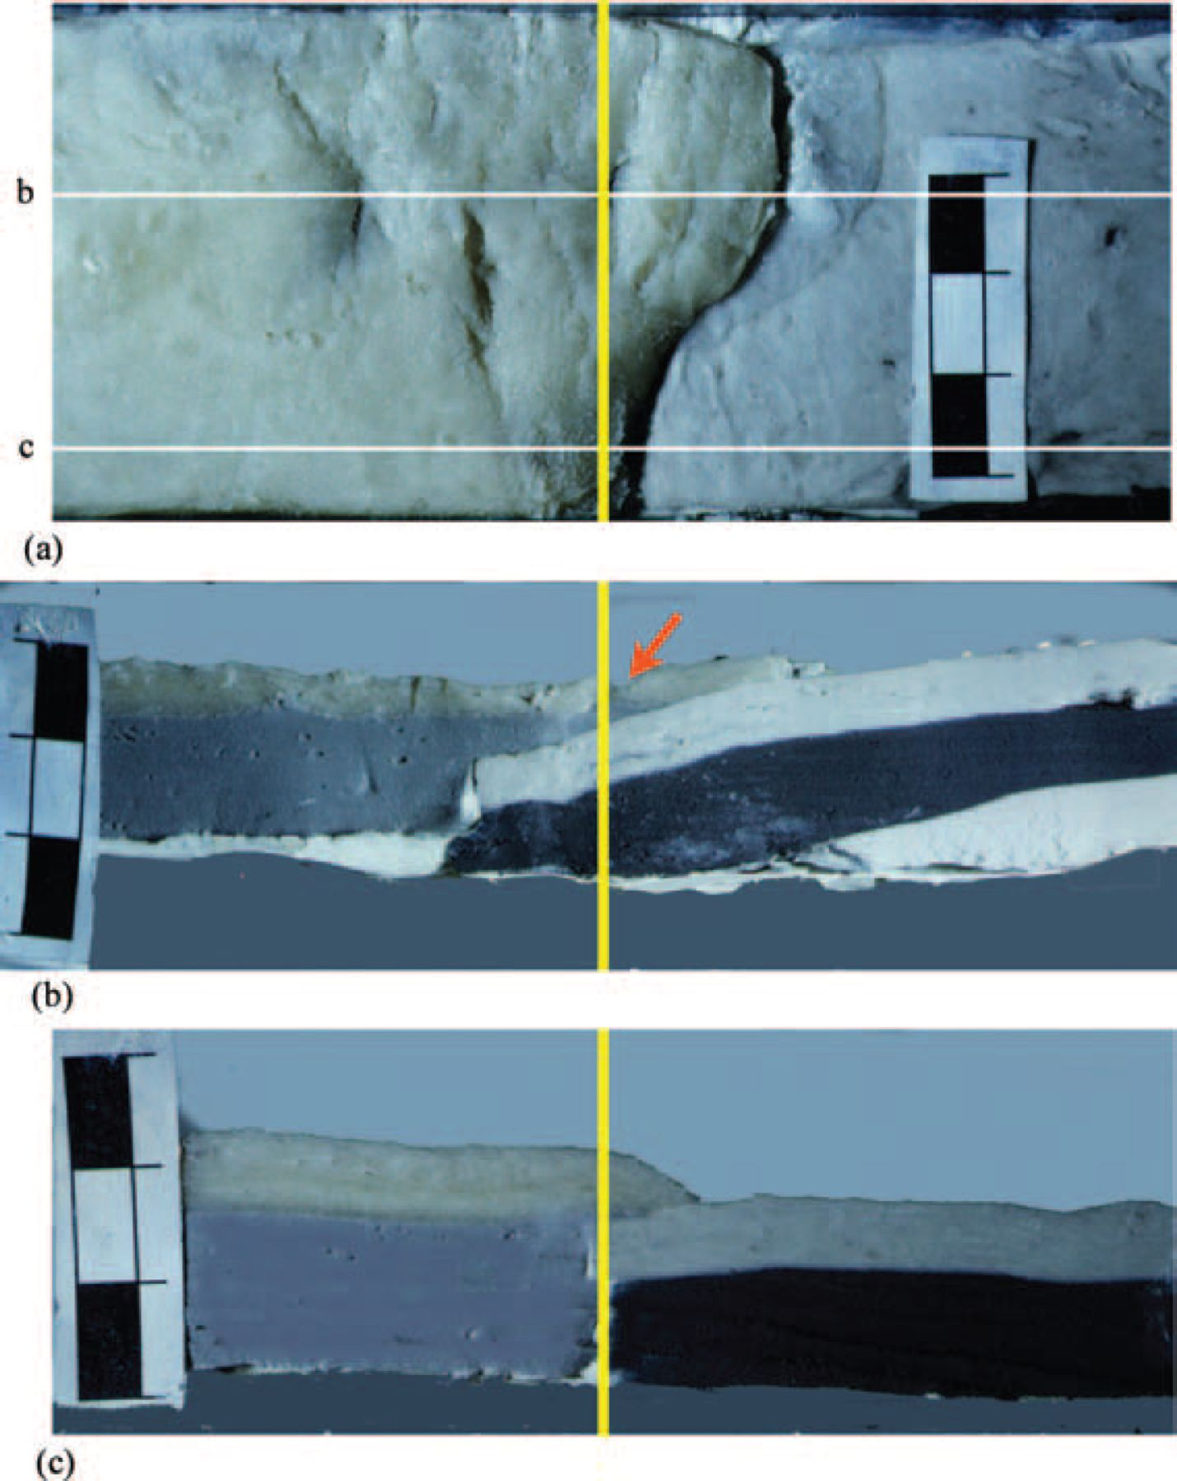
Figure 6 (a) A three-layered model, with variable friction along the contact zone between the ‘continental’ (on the ...
Notes:
Figure 6 (a) A three-layered model, with variable friction along the contact zone between the ‘continental’ (on the left) and ‘oceanic’ (on the right) ‘lithospheres,’ developed an arcuate subduction zone in the centrifuge. Lines b and c show the position of vertical sections (b) and (c) in plan view. (b) Where friction was low, the lighter ‘continental lithosphere’ extended as it was overthrust on top of the ‘oceanic lithosphere’, causing the ‘seaward’ roll-back of the subduction arc, and extensional rifting of an emerging backarc basin. The ‘oceanic lithosphere’, which was lighter than the ‘asthenosphere’, squeezed its way ‘landwards’ along the base of the ‘continental lithosphere’. The red arrow marks the position of Fig. 7. (c) Where friction was high, the subduction advanced very slowly and compressional features developed in the ‘lithospheric’ slab, such as the fold shown in the section.
Unless provided in the caption above, the following copyright applies to the content of this slide: © 2005 RAS

Slide 10
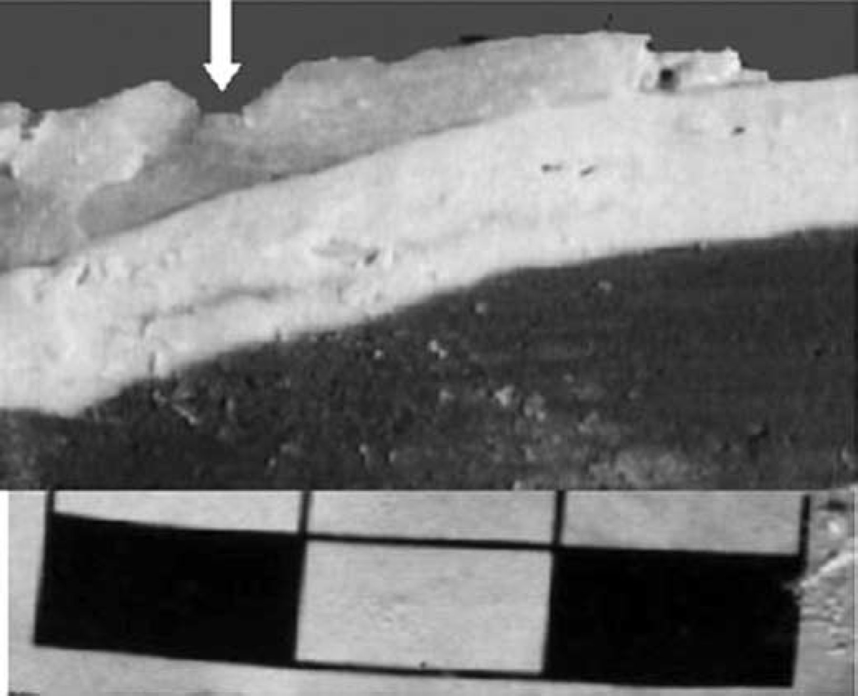
Figure 7 A rift in the extended ‘brittle continental asthenosphere’ shown in Fig. 6(b) opens a structural window where ...
Notes:
Figure 7 A rift in the extended ‘brittle continental asthenosphere’ shown in Fig. 6(b) opens a structural window where the ‘ductile continental lithosphere’ is exposed.
Unless provided in the caption above, the following copyright applies to the content of this slide: © 2005 RAS

