Slide 1
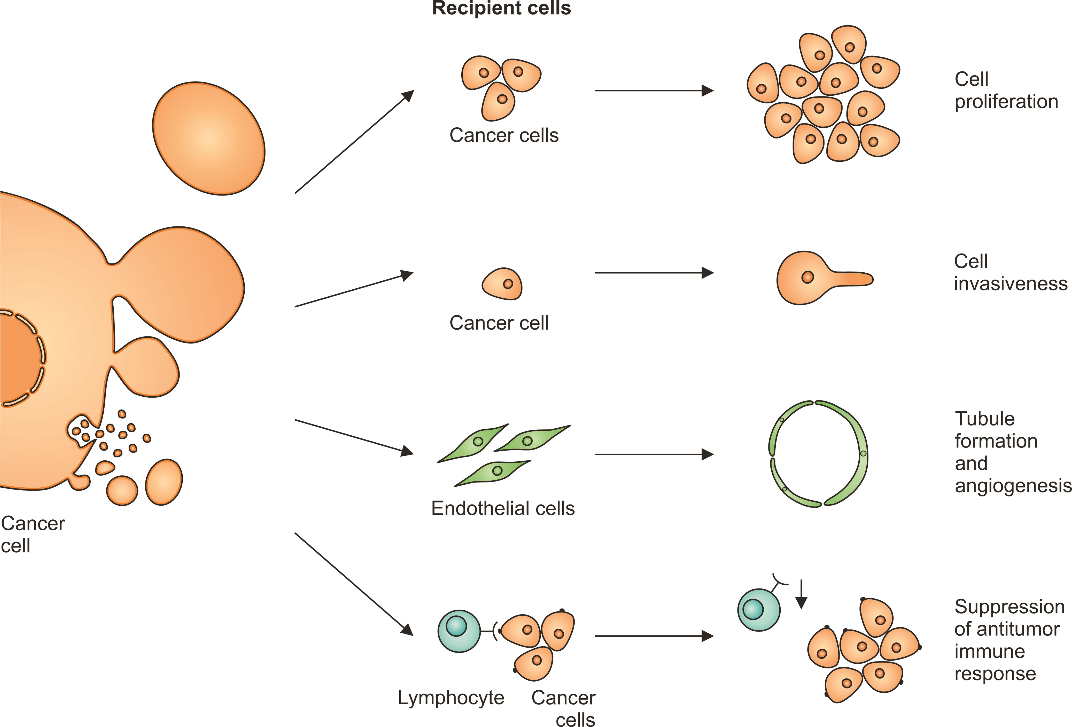
Figure 2. Extracellular vesicles (EVs) released from transformed cells can exert biological effects. They increase the ...
Notes:
Figure 2. Extracellular vesicles (EVs) released from transformed cells can exert biological effects. They increase the proliferation rate and invasiveness of other cancer cells. They stimulate endothelial cells to form tubules that support tumor angiogenesis. Tumor-derived EVs render cytotoxic T lymphocytes less reactive, which results in the suppression of antitumor immune response.
Unless provided in the caption above, the following copyright applies to the content of this slide: © The Author(s) 2015. Published by Oxford University Press on behalf of the American Institute of Biological Sciences. All rights reserved. For Permissions, please e-mail: journals.permissions@oup.com.

Slide 2
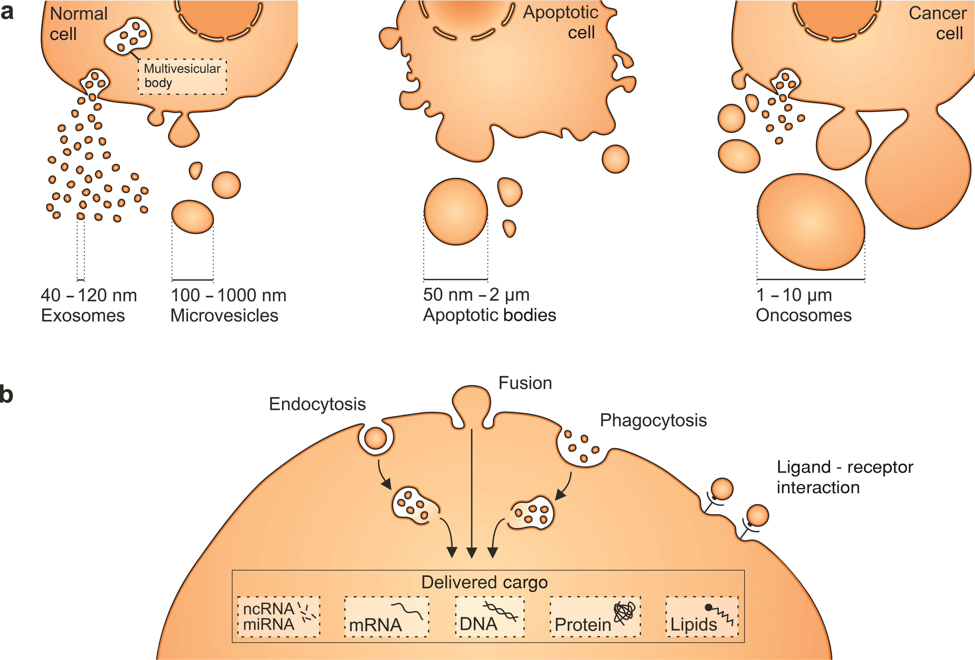
Figure 1. Cells produce different types of extracellular vesicles (EVs) that vary in size. (a) Exosomes and ...
Notes:
Figure 1. Cells produce different types of extracellular vesicles (EVs) that vary in size. (a) Exosomes and microvesicles (MVs) are produced by normal and diseased cells. Apoptosis triggers the release of apoptotic bodies. In addition, some cancer cells were reported to generate large EVs, termed oncosomes. (b) EVs can be taken up via different mechanisms, including endocytosis, membrane fusion, or phagocytosis. They deliver nucleic acids, proteins, and lipids that can be functional in recipient cells. Ligand–receptor interactions on the cell surface can also result in biological effects and help to target vesicles to specific cell types. Abbreviations: nm, nanometers; μm, micrometers.
Unless provided in the caption above, the following copyright applies to the content of this slide: © The Author(s) 2015. Published by Oxford University Press on behalf of the American Institute of Biological Sciences. All rights reserved. For Permissions, please e-mail: journals.permissions@oup.com.

Slide 3
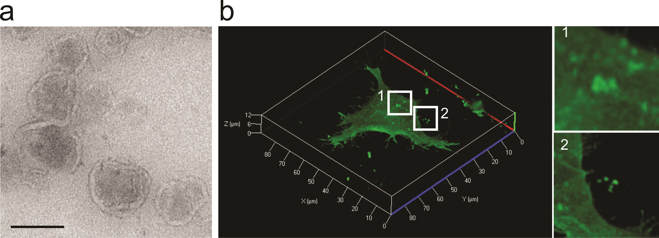
Figure 3. A visualization of extracellular vesicles. (a) A transmission electron micrograph showing extracellular ...
Notes:
Figure 3. A visualization of extracellular vesicles. (a) A transmission electron micrograph showing extracellular vesicles (EVs) isolated from HEK293T cells. Note the lipid bilayer–enclosed vesicle characteristic of EVs. Bar, 100 nanometers. (b) Live-cell confocal microscopy of human embryonic kidney (HEK) 293T cells expressing palmitoylated GFP (PalmGFP). Plasma membranes are labeled with PalmGFP, allowing the observation of bud-like structures on the cell surface (subpanel 1), suggesting their subsequent release as EVs. Released PalmGFP-EVs were readily observed around the microenvironment of 293T-PalmGFP cells (subpanel 2).
Unless provided in the caption above, the following copyright applies to the content of this slide: © The Author(s) 2015. Published by Oxford University Press on behalf of the American Institute of Biological Sciences. All rights reserved. For Permissions, please e-mail: journals.permissions@oup.com.

