Slide 1
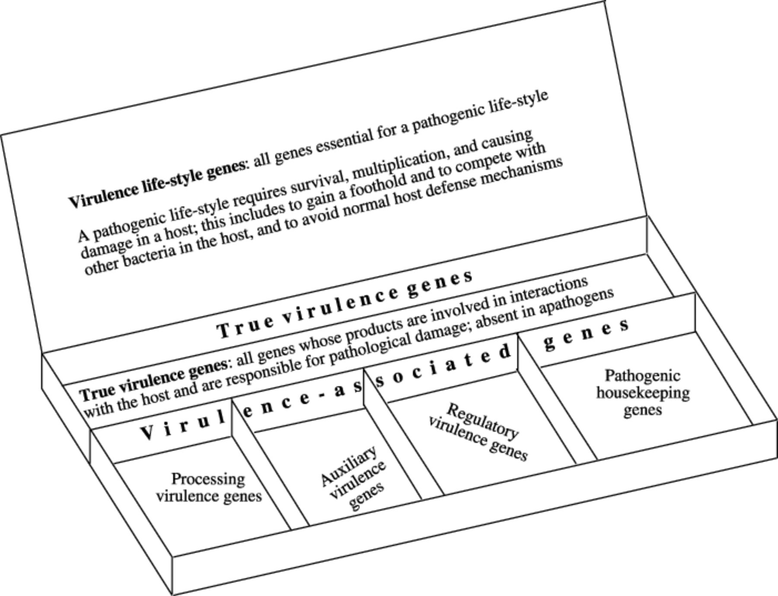
3 The multi-compartment virulence Pandora's box. This box contains all virulence life-style genes. They consist ...
Notes:
3 The multi-compartment virulence Pandora's box. This box contains all virulence life-style genes. They consist of true virulent genes and virulence-associated genes. The true virulent genes are directly responsible for pathological damage and are absent in non-pathogens. Virulence-associated genes can be genes whose products process virulent factors (by post-translational modification, folding, secretion, etc.); genes encoding auxiliary virulence factors (that are needed for virulent factors to be active); genes that regulate expression of virulence genes; housekeeping genes that produce enzymes required for those metabolic processes required for the pathogenic life-style of the organism. More classes are listed in Table 1. Virulence-associated genes can be present in non-pathogens that live in association with a host (commensals, opportunists).
Unless provided in the caption above, the following copyright applies to the content of this slide: © 2001 Federation of European Microbiological Societies

Slide 2
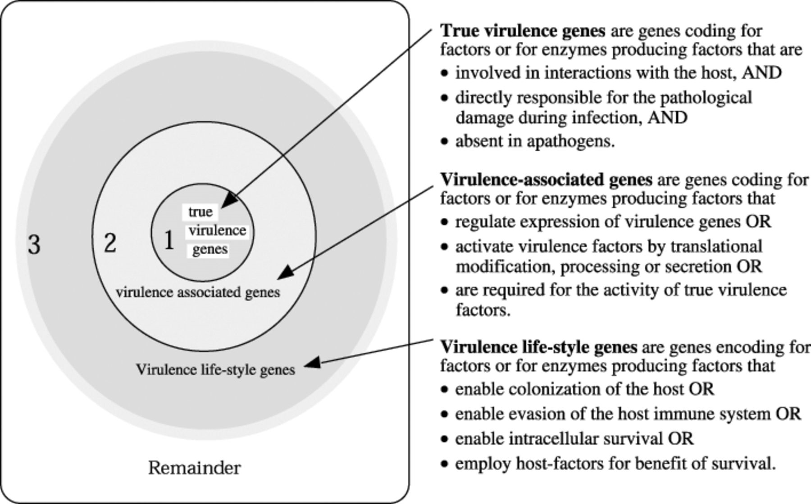
2 Depending on the definition of virulence, more or fewer genes are called ‘virulence genes’. The number of ...
Notes:
2 Depending on the definition of virulence, more or fewer genes are called ‘virulence genes’. The number of virulence genes and virulence-associated genes included in a given definition are represented by concentric circles. In collection 1, only those virulence factors are included that are directly involved in causing disease (‘true virulence genes’). The addition of ‘virulence-associated genes’ increases the number of identified virulence genes and thus the size of circle 2. The gene pool identified by inactivation and phenotypic characterization (see Fig. 1) includes all genes that lead to an attenuated phenotype as ‘virulence life-style genes’ (circle 3). The remaining genes are other housekeeping genes, structural genes, and essential genes. The border between collection 3 and the remainder cannot be exactly defined.
Unless provided in the caption above, the following copyright applies to the content of this slide: © 2001 Federation of European Microbiological Societies

Slide 3
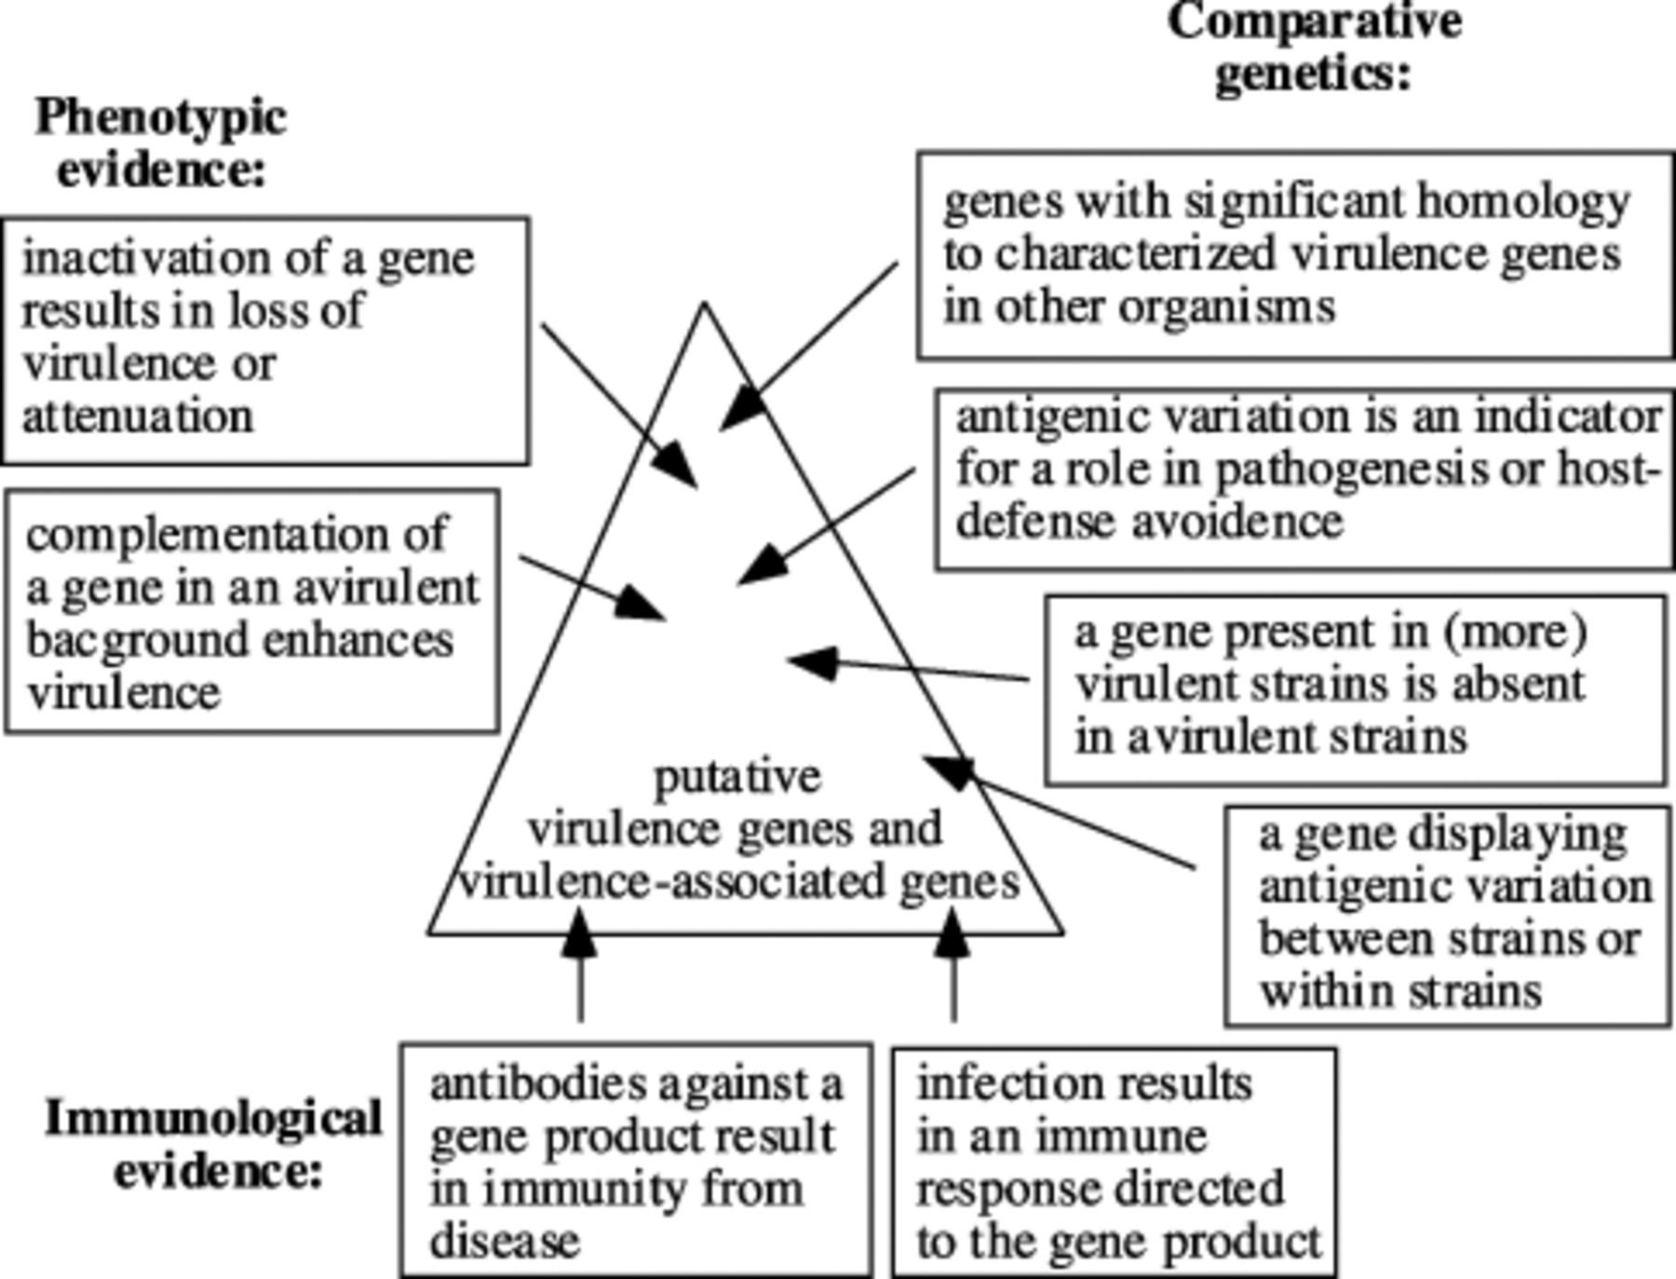
1 Different approaches to identify virulence genes and virulence-associated genes.
Notes:
1 Different approaches to identify virulence genes and virulence-associated genes.
Unless provided in the caption above, the following copyright applies to the content of this slide: © 2001 Federation of European Microbiological Societies

