Slide 1
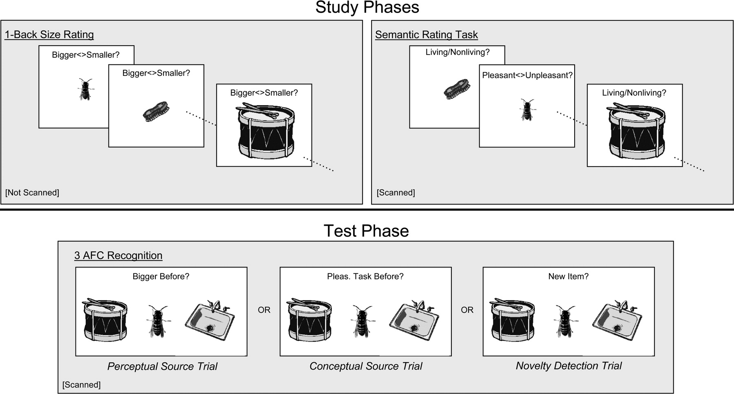
Figure 1. Experimental design. During the initial encounter, items were shown individually and subjects decided if each ...
Notes:
Figure 1. Experimental design. During the initial encounter, items were shown individually and subjects decided if each item occupied a bigger screen area than the immediately preceding item (one-back size rating). This manipulation was not scanned and was conducted in order to familiarize the subjects with the screen size of the objects. Immediately following, one of two semantic encoding judgements (pleasant/unpleasant or living/nonliving) was performed on pictures that maintained the same physical size as during the one-back task. At test, three objects were shown (one novel and two studied) in an intermediate and similar size, and either novelty detection or one of two source judgements was required (source versus novelty detection). Conceptual source retrieval required selection of the item earlier rated for pleasantness, whereas the perceptual source task required selecting the one that was physically larger on the screen during previous viewings.
Unless provided in the caption above, the following copyright applies to the content of this slide: © The Author 2005. Published by Oxford University Press. All rights reserved. For permissions, please e-mail: journals.permissions@oupjournals.org

Slide 2
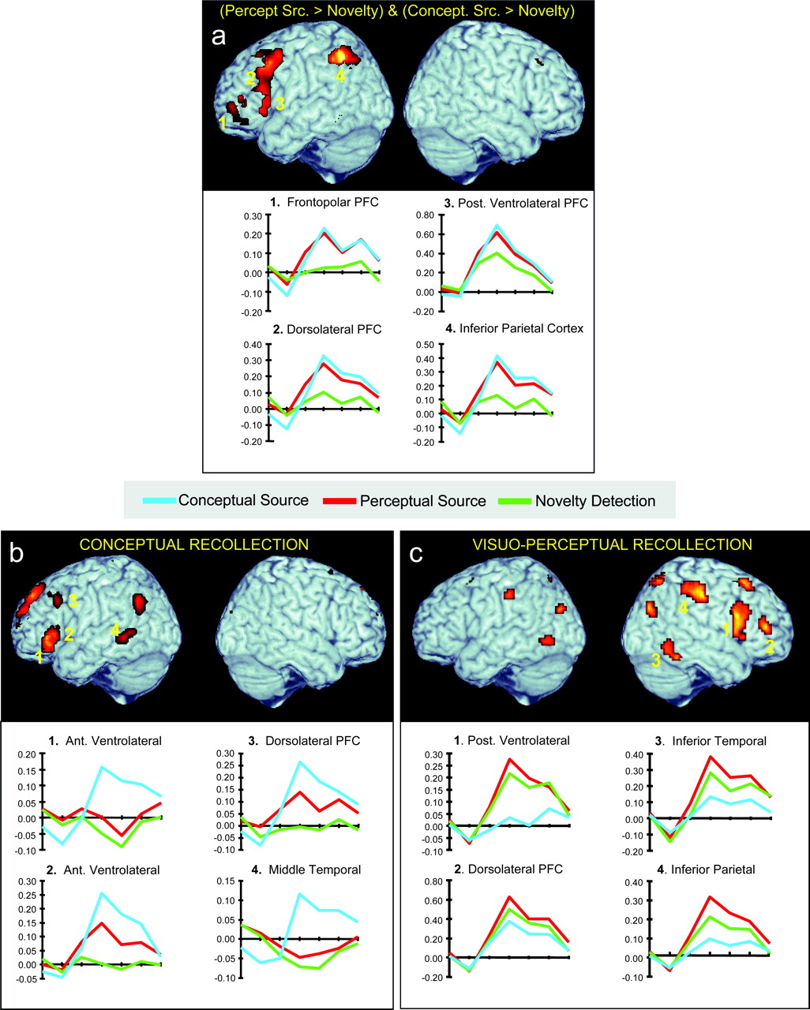
Figure 2. (a) Regions demonstrating greater activation for source recollection in comparison to novelty detection, ...
Notes:
Figure 2. (a) Regions demonstrating greater activation for source recollection in comparison to novelty detection, regardless of target domain (conceptual or perceptual). SPM is overlaid on a canonical brain using MRIcro and depicts the overlap between regions demonstrating a greater response during perceptual source versus novelty-detection and a greater response during conceptual source versus novelty-detection (joint probability 0.001). Regions demonstrating any appreciable difference between the two source conditions are excluded from the map (exclusive masking 0.1). Hemodynamic response functions are depicted for representative ROIs, with the ordinate representing percent signal change and tick marks on abscissa representing 2 s time increments following stimulus onset. (b) Regions showing a greater response to the pleasant/unpleasant rating task than the living/nonliving rating task at encoding, and a greater response during conceptual than perceptual source retrieval (joint probability 0.001). This pattern is consistent with a role in the conceptual elaboration of probes. (c) Regions showing a greater response during perceptual compared with conceptual source retrieval (0.001) consistent with a role in the perceptual elaboration of probes.
Unless provided in the caption above, the following copyright applies to the content of this slide: © The Author 2005. Published by Oxford University Press. All rights reserved. For permissions, please e-mail: journals.permissions@oupjournals.org

Slide 3
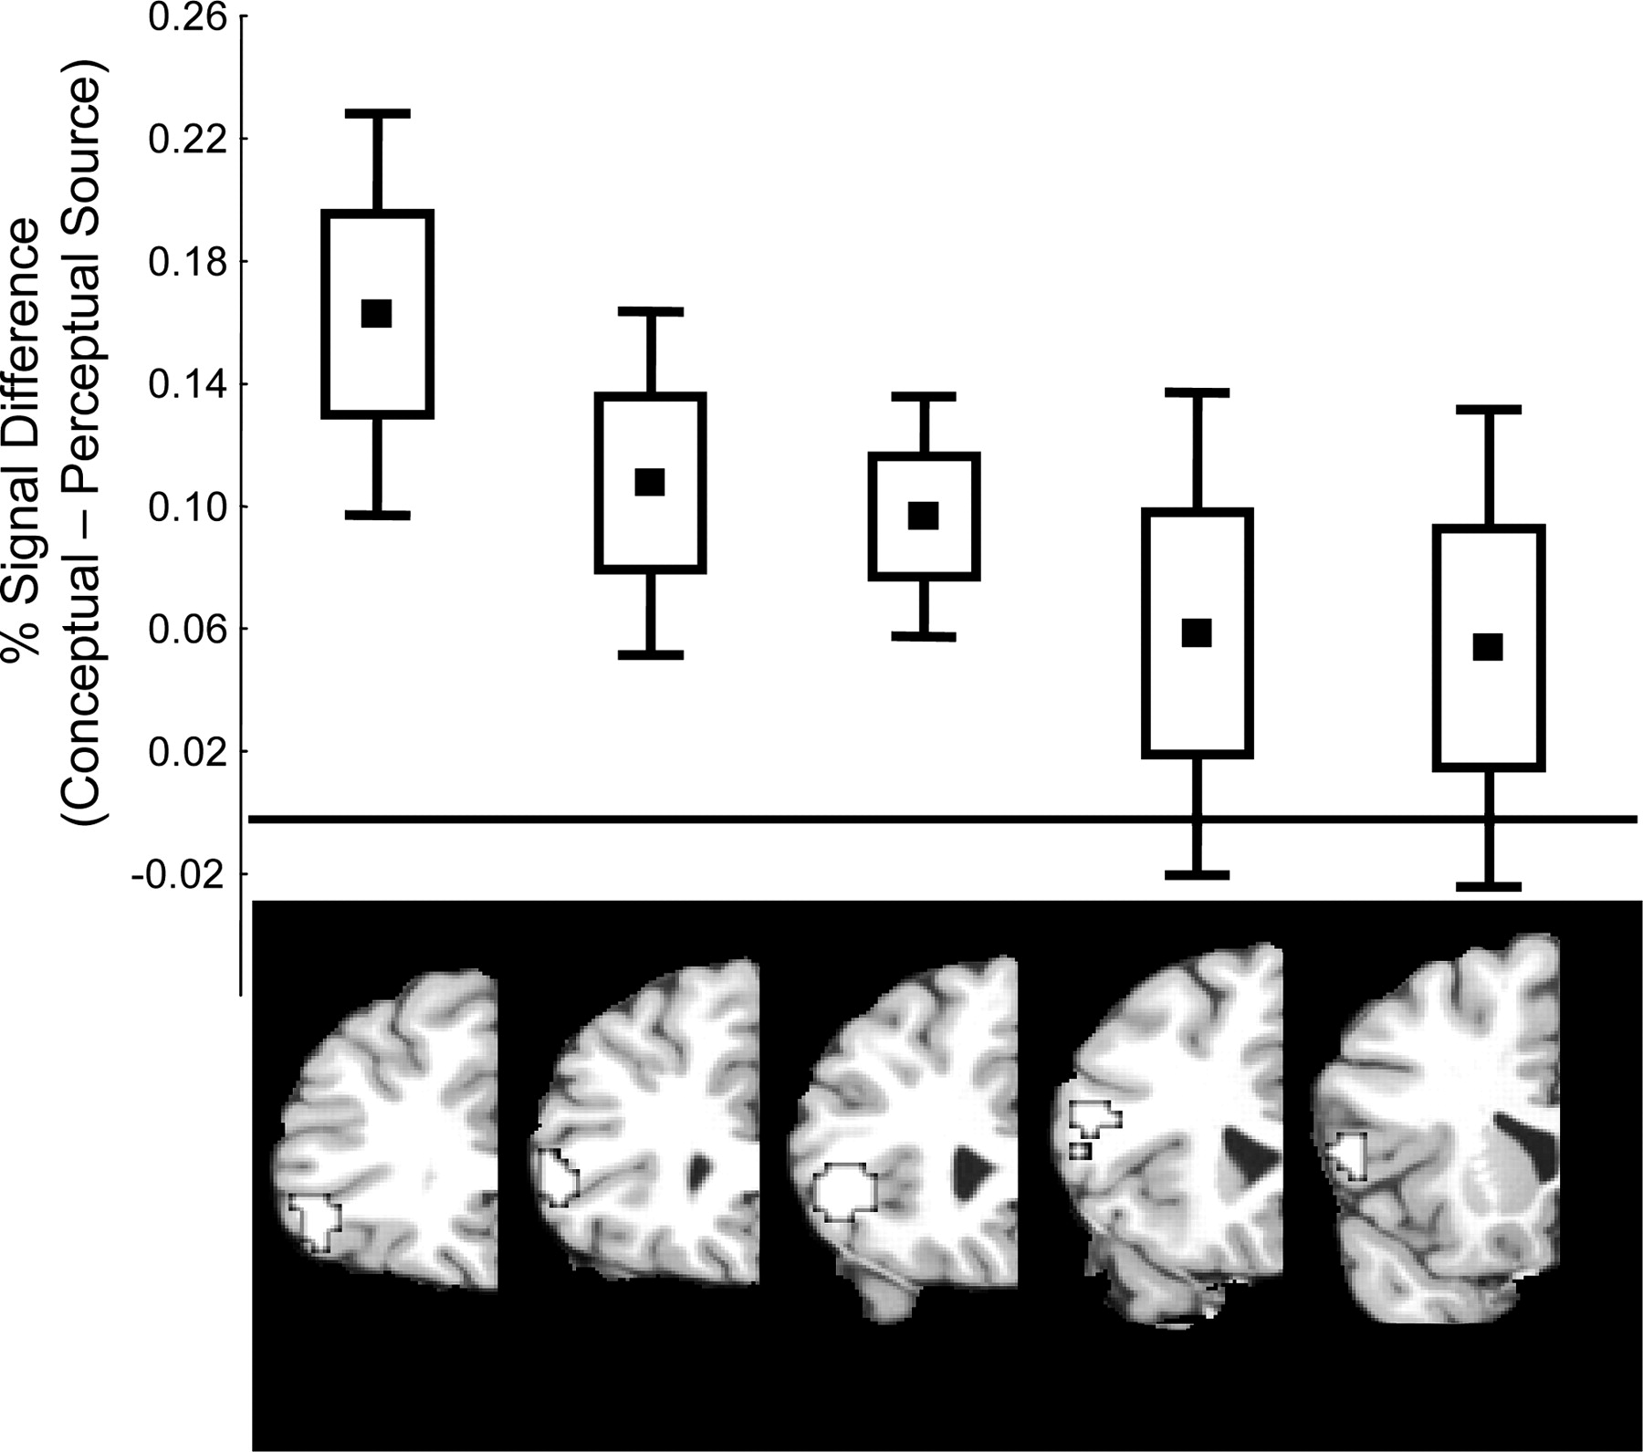
Figure 3. Functional heterogeneity in left ventrolateral PFC during source memory retrieval. Anterior ventrolateral PFC ...
Notes:
Figure 3. Functional heterogeneity in left ventrolateral PFC during source memory retrieval. Anterior ventrolateral PFC demonstrated a selective increase for conceptual source retrieval in comparison to perceptual source retrieval and novelty-detection. The difference in response between conceptual and perceptual source declined along the anterior-to-posterior axis of left ventrolateral PFC. Each box equals one standard error of the between-subjects mean; box plus whiskers equal two standard errors of the mean.
Unless provided in the caption above, the following copyright applies to the content of this slide: © The Author 2005. Published by Oxford University Press. All rights reserved. For permissions, please e-mail: journals.permissions@oupjournals.org

Slide 4
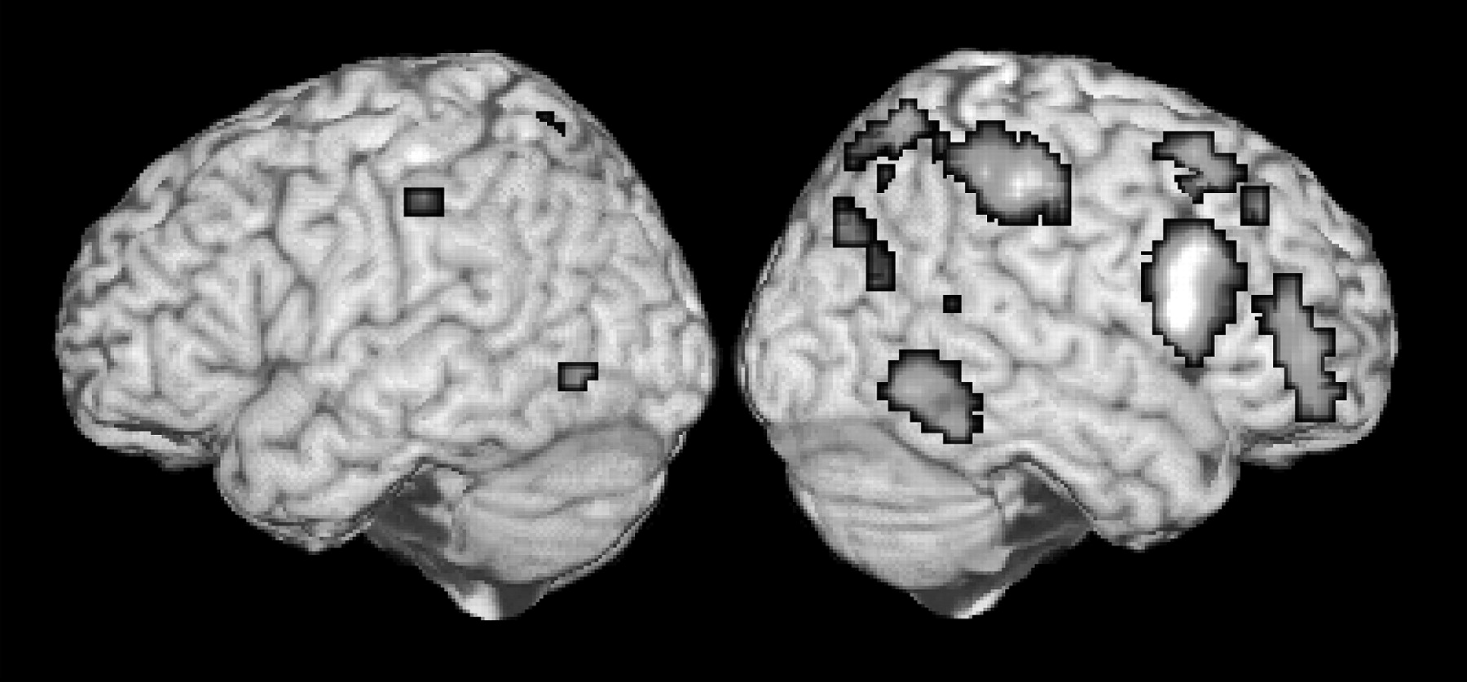
Figure 4. Regions demonstrating an overlap due to common visuo-perceptual attentional demands during novelty detection ...
Notes:
Figure 4. Regions demonstrating an overlap due to common visuo-perceptual attentional demands during novelty detection and perceptual recollection. The overlap is revealed as an increased response for both perceptual source and novelty detection in comparison to the conceptual source task (joint probability 0.001).
Unless provided in the caption above, the following copyright applies to the content of this slide: © The Author 2005. Published by Oxford University Press. All rights reserved. For permissions, please e-mail: journals.permissions@oupjournals.org

Slide 5
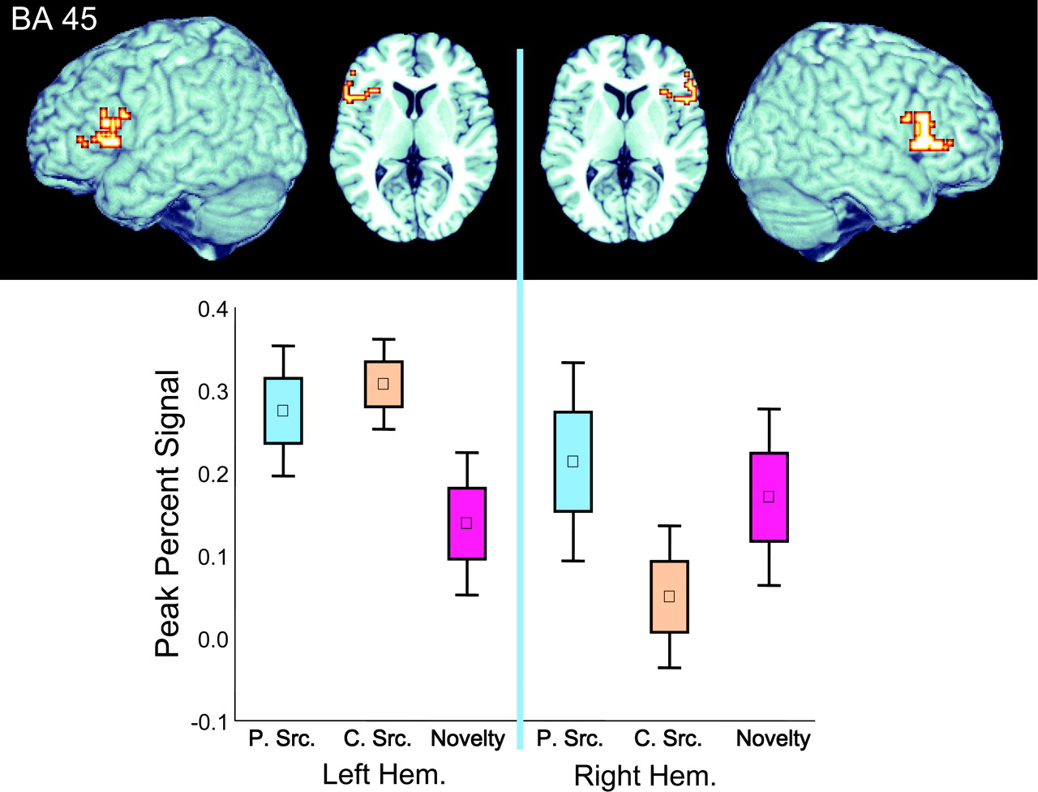
Figure 5. Hemispheric interaction of Brodmann's area 45 during retrieval. The peak response at 6 s post-stimulus onset ...
Notes:
Figure 5. Hemispheric interaction of Brodmann's area 45 during retrieval. The peak response at 6 s post-stimulus onset was calculated for anatomically based ROIs in each hemisphere across the three retrieval tasks (PSrc = perceptual source; CSrc = conceptual source; Novelty = novelty detection). ANOVA demonstrated a qualitatively different response pattern across the two hemispheres. The box plot demonstrates the interaction. (Box equals one standard error of the mean, box plus whiskers correspond to two standard errors.)
Unless provided in the caption above, the following copyright applies to the content of this slide: © The Author 2005. Published by Oxford University Press. All rights reserved. For permissions, please e-mail: journals.permissions@oupjournals.org

