Slide 1
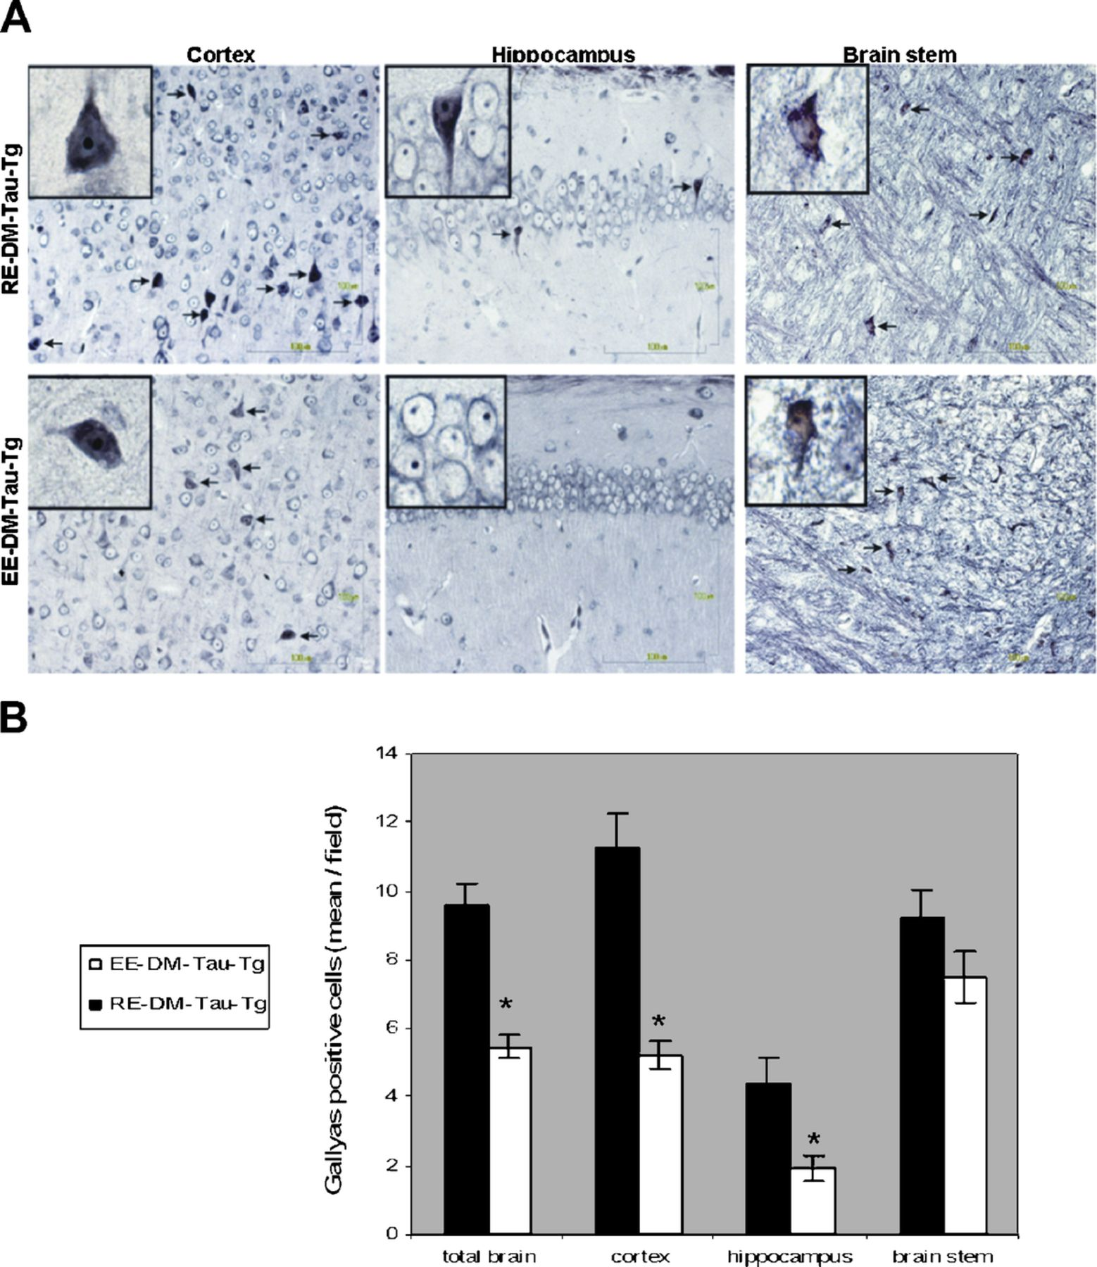
FIGURE 1. Reduced neurofibrillary tangle (NFT) burden assessed by the Gallyas method in environmentally enriched ...
Notes:
FIGURE 1. Reduced neurofibrillary tangle (NFT) burden assessed by the Gallyas method in environmentally enriched (EE)-DM-Tau-tg mice. (A) There are fewer Gallyas-positive cells (arrows) in the cortex, hippocampus, and brainstem of EE-DM-Tau-tg versus regular-environment (RE)-DM-Tau-tg mice. Scale bars = 100 μm. Insets are higher-magnification images from the same fields. (B) Semiquantitative assessment of Gallyas staining (p < 0.0001, p < 0.0001, and p = 0.006 for total brain, cortex, and hippocampus, respectively).
Unless provided in the caption above, the following copyright applies to the content of this slide: Copyright © 2011 by the American Association of Neuropathologists, Inc.

Slide 2
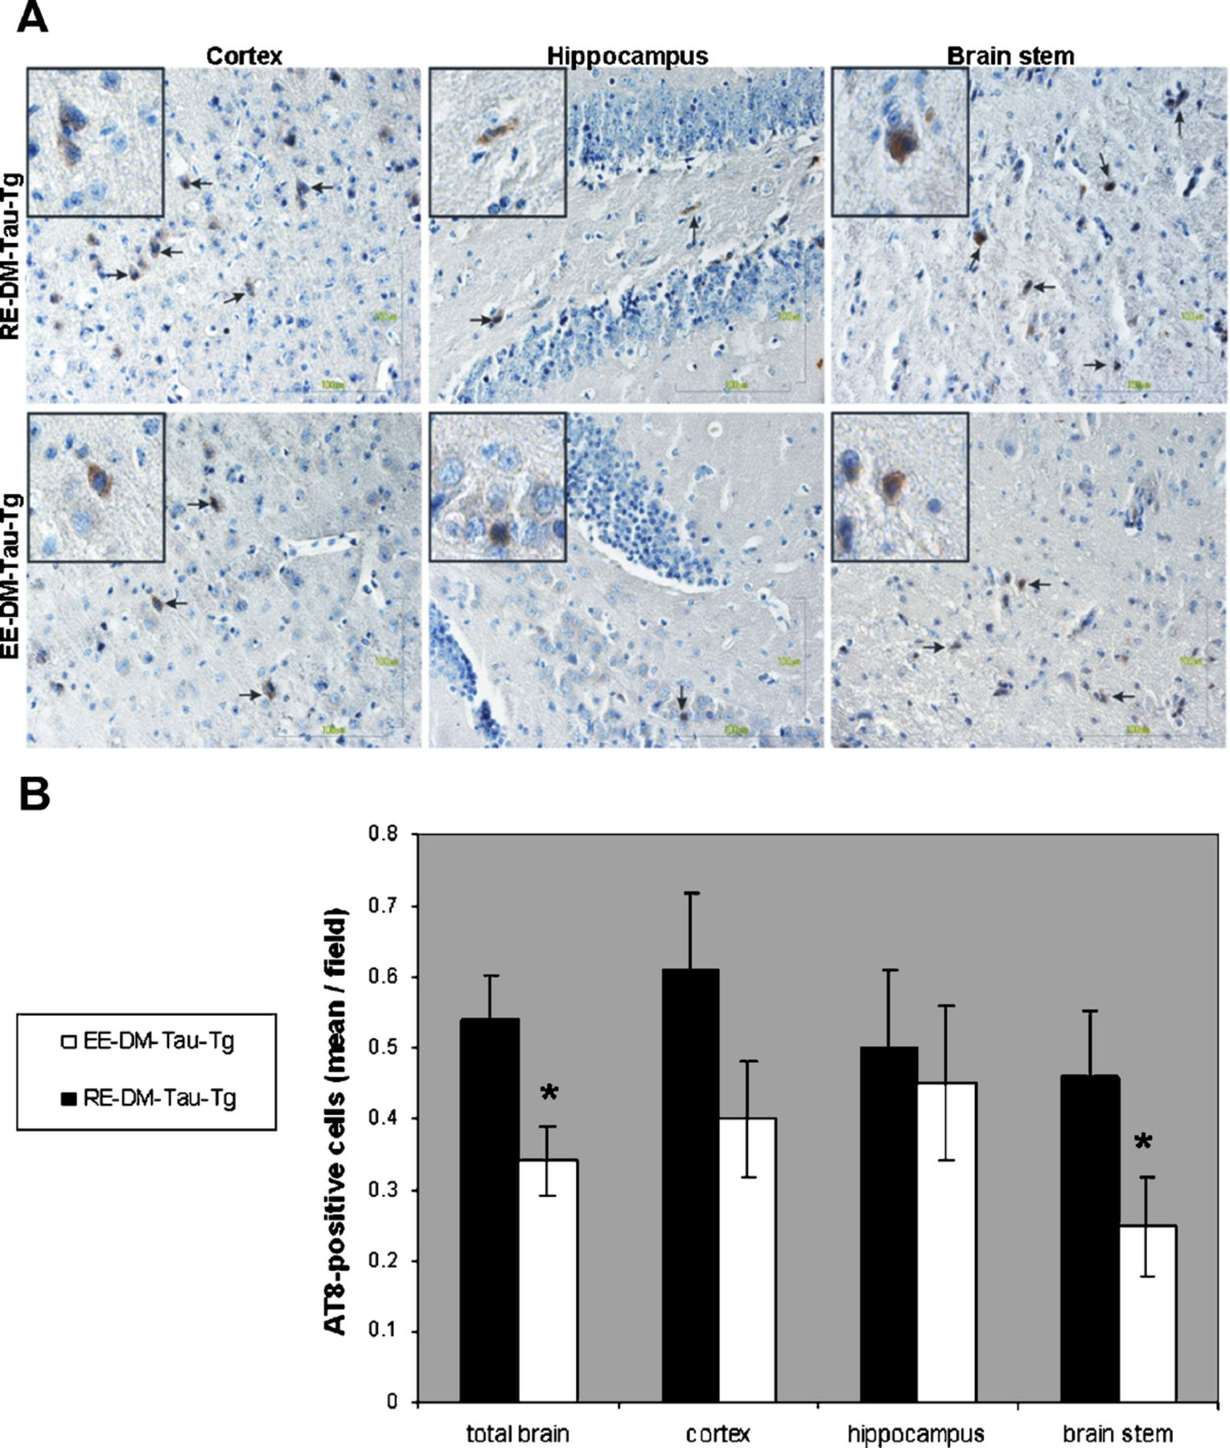
FIGURE 2. Reduced neurofibrillary tangle (NFT) burden assessed by AT8 immunohistochemistry in environmentally enriched ...
Notes:
FIGURE 2. Reduced neurofibrillary tangle (NFT) burden assessed by AT8 immunohistochemistry in environmentally enriched (EE)-DM-Tau-tg mice. (A) A decrease in AT8-positive cells is evident in the cortex, hippocampus, and brainstem of EE-DM-Tau-tg versus regular-environment (RE)-DM-Tau-tg mice. Scale bars = 100 μm. Insets are higher-magnification images from the same fields. (B) Semiquantitative assessment of AT8 staining. p = 0.01 and p = 0.05 for total brain and brainstem, respectively.
Unless provided in the caption above, the following copyright applies to the content of this slide: Copyright © 2011 by the American Association of Neuropathologists, Inc.

Slide 3
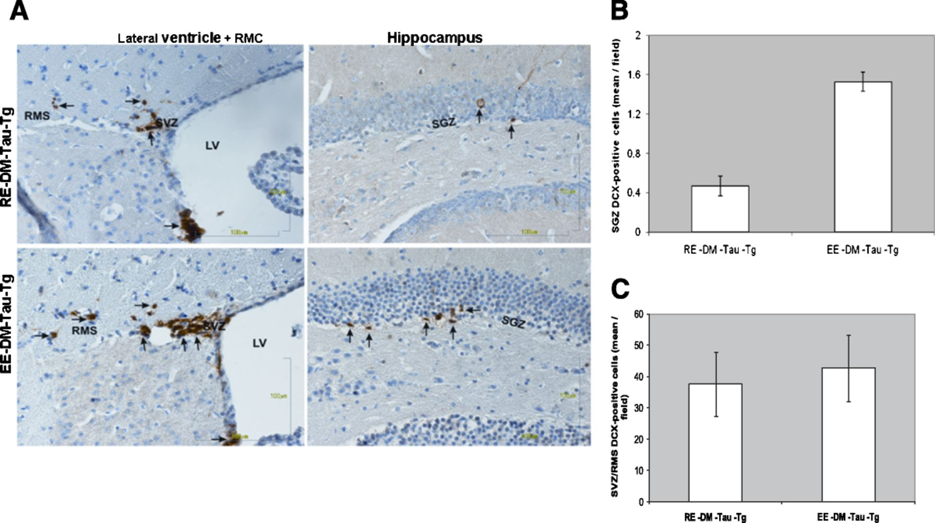
FIGURE 3. Neurogenesis in environmentally enriched (EE)-DM-Tau-tg mice. (A) Greater numbers of doublecortin marker ...
Notes:
FIGURE 3. Neurogenesis in environmentally enriched (EE)-DM-Tau-tg mice. (A) Greater numbers of doublecortin marker (DCX)-positive cells are seen mainly in the hippocampal subgranular zone (SGZ) and, to a lesser extent, in the subventricular zone (SVZ) and the rostral migratory stream (RMS) of EE-DM-Tau-tg versus regular-environment (RE)-DM-Tau-tg mice. (B, C) Semi-quantitative assessment of DCX in the SGZ in hippocampus (p < 0.0001) (B), and in SVZ and RMS (p = 0.76) (C). LV indicates lateral ventricle.
Unless provided in the caption above, the following copyright applies to the content of this slide: Copyright © 2011 by the American Association of Neuropathologists, Inc.

Slide 4
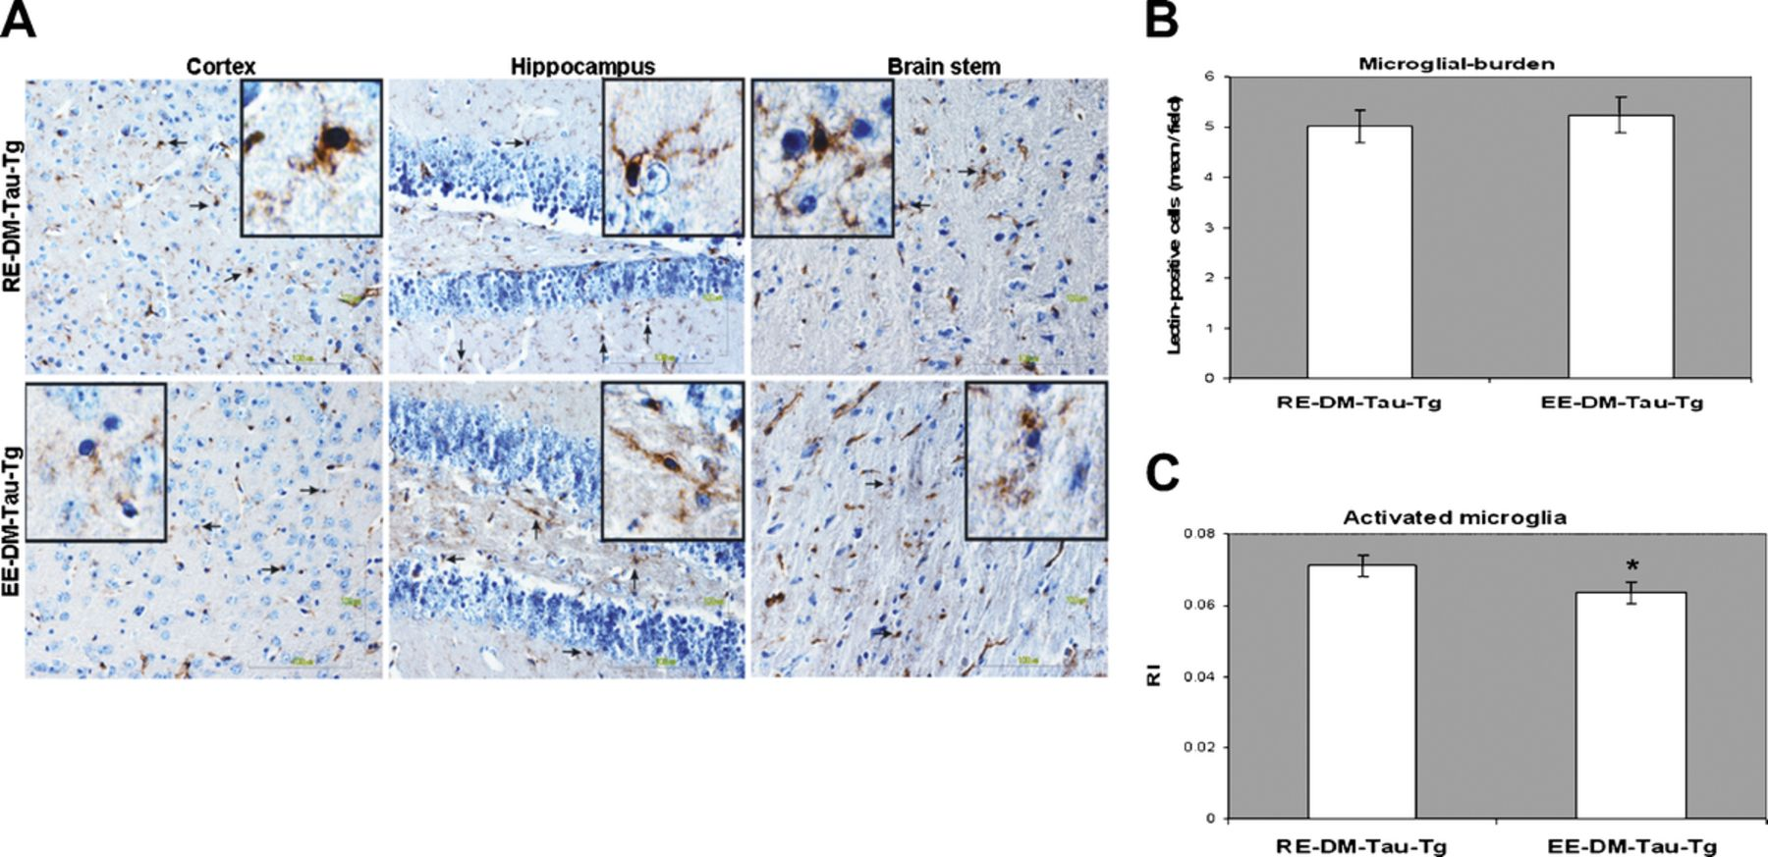
FIGURE 4. There is a slight decrease in activated microglia (assessed by lectin staining) (arrows) in environmentally ...
Notes:
FIGURE 4. There is a slight decrease in activated microglia (assessed by lectin staining) (arrows) in environmentally enriched (EE)-DM-Tau-tg mice. (A) Microglial burden and activation in the cortex, hippocampus, and brainstem of EE-DM-Tau-tg and regular-environment (RE)-DM-Tau-tg mice. Although there are similar numbers of microglia (arrows) in the groups, they have a lower ramification index (RI) (less activated, thinner processes) in EE-DM-Tau-tg versus RE-DM-Tau-tg mice. Scale bars = 100 μm. Insets are higher-magnification images from the same fields. (B, C) Quantitative assessment of total burden of microglia (B) and of activated microglia (C) (p = 0.01).
Unless provided in the caption above, the following copyright applies to the content of this slide: Copyright © 2011 by the American Association of Neuropathologists, Inc.

Slide 5
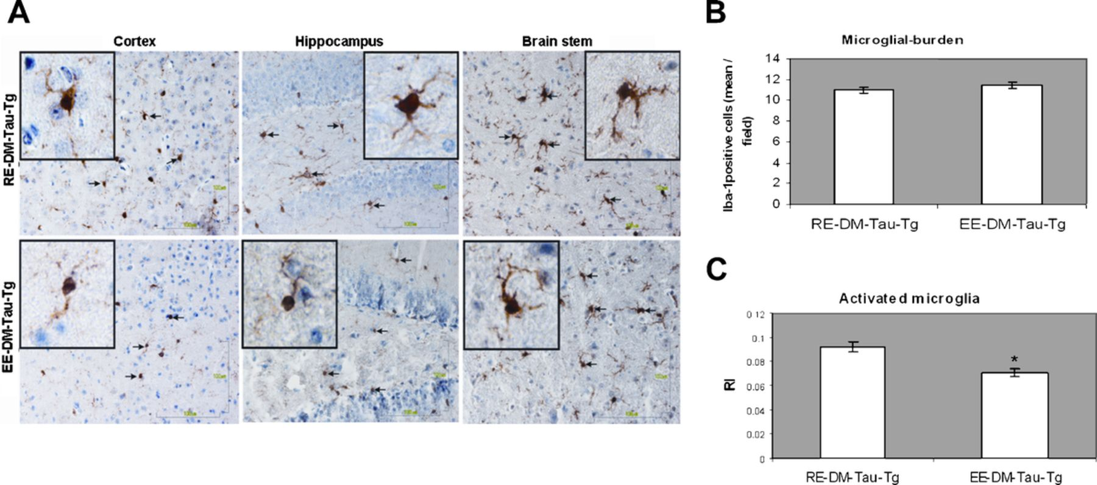
FIGURE 5. There is a slight decrease in activated microglia (assessed by Iba-1 staining) in environmentally enriched ...
Notes:
FIGURE 5. There is a slight decrease in activated microglia (assessed by Iba-1 staining) in environmentally enriched (EE)-DM-Tau-tg mice. (A) Microglial burden and activation in the cortex, hippocampus, and brainstem of EE-DM-Tau-tg and regular-environment (RE)-DM-Tau-tg mice. Although there are similar numbers of microglia (arrows) in both groups, they have a lower ramification index (RI) (thinner processes) in EE-DM-Tau-tg versus RE-DM-Tau-tg mice. Scale bars = 100 μm. Insets are higher-magnification images from the same fields. (B, C) Quantitative assessment of total burden of microglia (B) and of activated microglia (C) (p = 0.02).
Unless provided in the caption above, the following copyright applies to the content of this slide: Copyright © 2011 by the American Association of Neuropathologists, Inc.

Slide 6
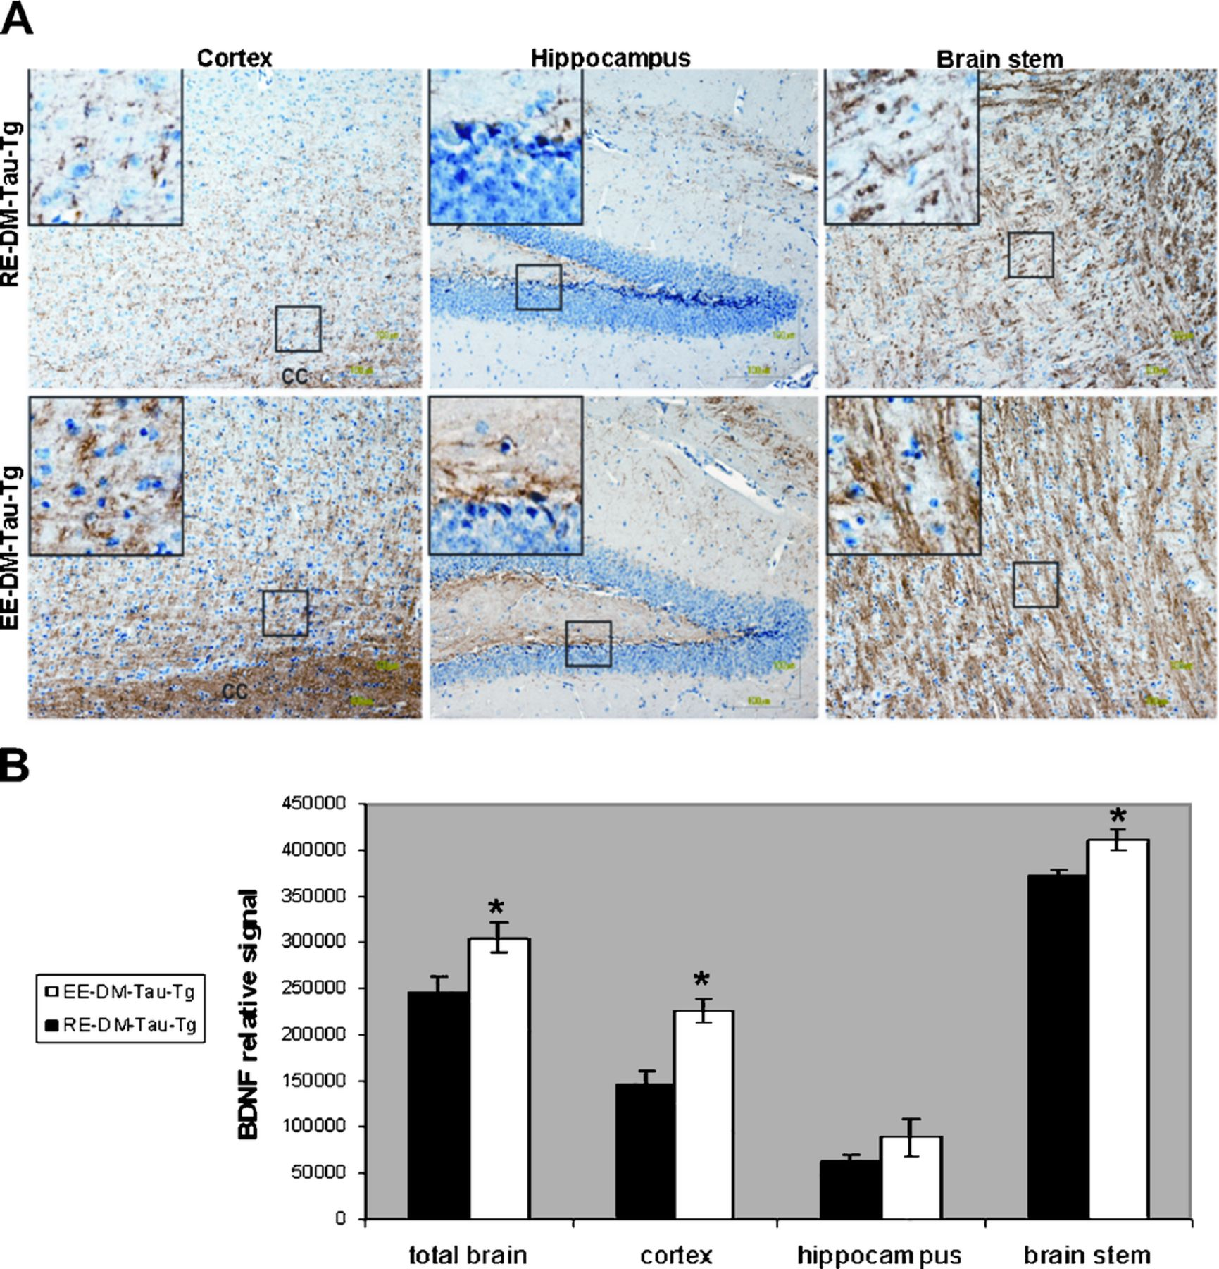
FIGURE 6. Increased brain-derived neurotrophic factor (BDNF) in environmentally enriched (EE)-DM-Tau-tg mice. (A) There ...
Notes:
FIGURE 6. Increased brain-derived neurotrophic factor (BDNF) in environmentally enriched (EE)-DM-Tau-tg mice. (A) There is greater BDNF immunoreactivity in the cortex, hippocampus, and brainstem of EE-DM-Tau-tg versus regular-environment (RE)-DM-Tau-tg mice. Boxes in the photos indicate areas of magnified insets displaying the BDNF-positive processes and axons. Differences are indicated as “more and denser brown signals.” (B) Semiquantitative assessment of BDNF immunoreactivity. p = 0.01, p = 0.0001, and p = 0.003 for total brain, cortex, and brainstem, respectively.
Unless provided in the caption above, the following copyright applies to the content of this slide: Copyright © 2011 by the American Association of Neuropathologists, Inc.

Slide 7
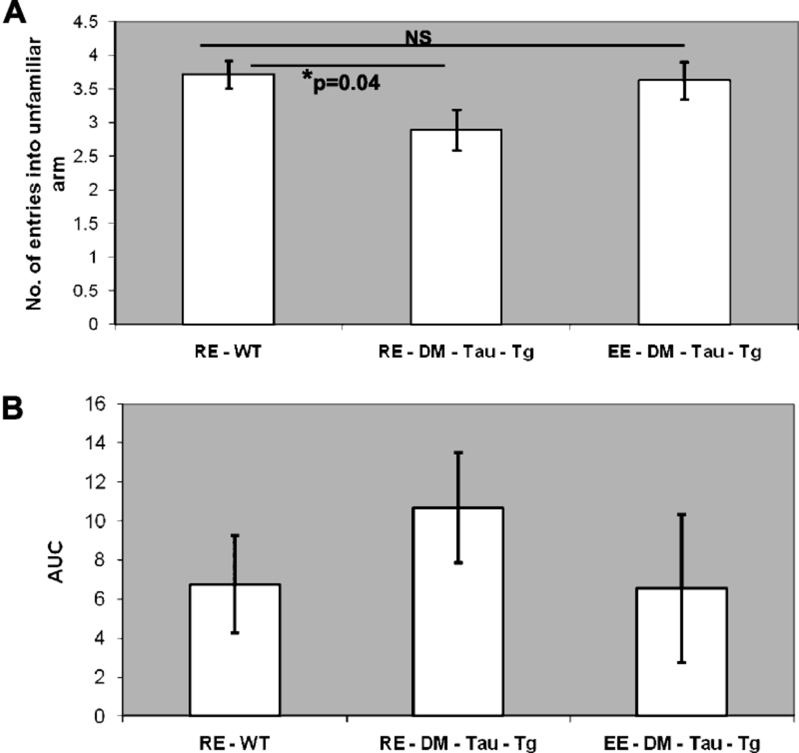
FIGURE 7. Cognitive tasks in environmentally enriched (EE)-DM-Tau-tg mice. (A) In the T-maze, EE-DM-Tau-tg mice show a ...
Notes:
FIGURE 7. Cognitive tasks in environmentally enriched (EE)-DM-Tau-tg mice. (A) In the T-maze, EE-DM-Tau-tg mice show a nonsignificant better performance versus regular-environment (RE)-DM-Tau-tg mice, that is, there are higher numbers of entries into the unfamiliar arm (p = 0.1). The similar performance of the EE-DM-Tau-tg and the RE wild-type (WT) mice (nonsignificant difference [NS], p = 0.8) suggests that the low performance of the RE-DM-Tau-tg (vs RE WT mice, p = 0.04) was restored in EE-DM-Tau-tg mice. (B) In the 8-arm maze, EE-DM-Tau-tg mice needed fewer entries into the arms (calculated as area under the curve [AUC]) versus RE-DM-Tau-tg mice; their performance was similar to that of RE-WT mice, although there were no significant differences among the groups.
Unless provided in the caption above, the following copyright applies to the content of this slide: Copyright © 2011 by the American Association of Neuropathologists, Inc.

