Slide 1
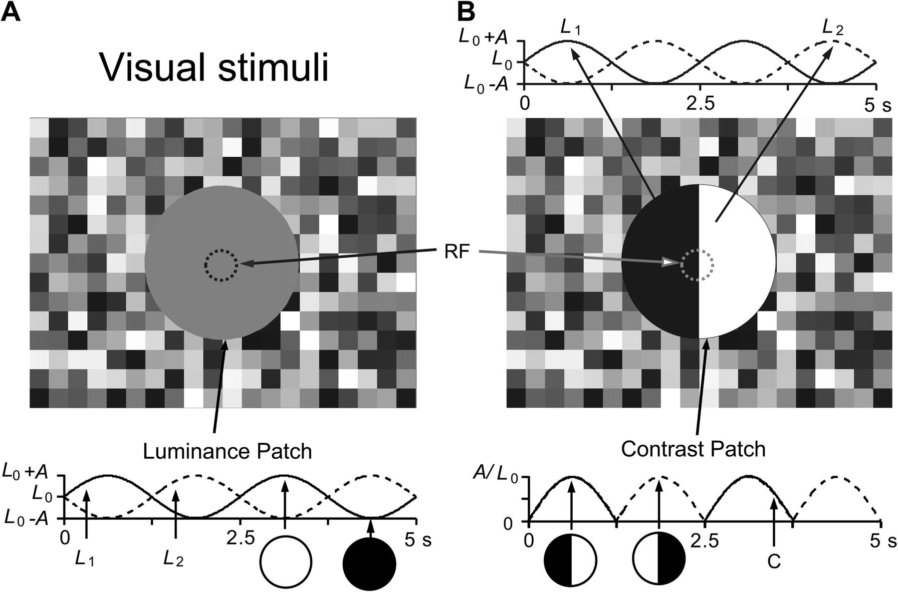
Figure 1. Uniform luminance and contrast stimuli. The visual stimuli are circular patches in area at least 5 times ...
Notes:
Figure 1. Uniform luminance and contrast stimuli. The visual stimuli are circular patches in area at least 5 times larger than the size of the classical RF (the small dotted line circles inside the patches) of a cell. (A) The spatial configuration of the uniform luminance stimulus. Luminance in the patch varies sinusoidally at 0.4 Hz for 2 cycles of 5 s duration in each stimulus presentation. Sinusoidal curves below the stimulus icon indicate luminance changing initially in the rising (L1, solid curve) or falling direction (L2, dashed curve), 2 opposite phases, respectively. Open and filled circles indicate the highest and lowest luminances. L0 is the mean luminance of the stimulus and A is the magnitude of luminance modulating sinusoidally from L0. (B) The spatial configuration of the contrast stimulus. Contrast is generated by different luminance changes in 2 semicircular patches. Luminance in the 2 semicircles varies sinusoidally in the opposite directions described by the sinusoidal curves above the stimulus icon with the same parameters as in (A). The resulting contrast change is delineated by the sinusoidal curves and insets below the icon. The solid and dashed curves represent contrast changes in 2 opposite polarities (phases) as indicated by 2 insets consisted of white and black semicircles, respectively. In this case, L1, L2, L0, and A are the same as in (A). C: Contrast (=A/L0· ∣sin(2πft)∣, see Materials and Methods).
Unless provided in the caption above, the following copyright applies to the content of this slide: © The Author 2011. Published by Oxford University Press. All rights reserved. For permissions, please e-mail: journals.permissions@oup.com

Slide 2
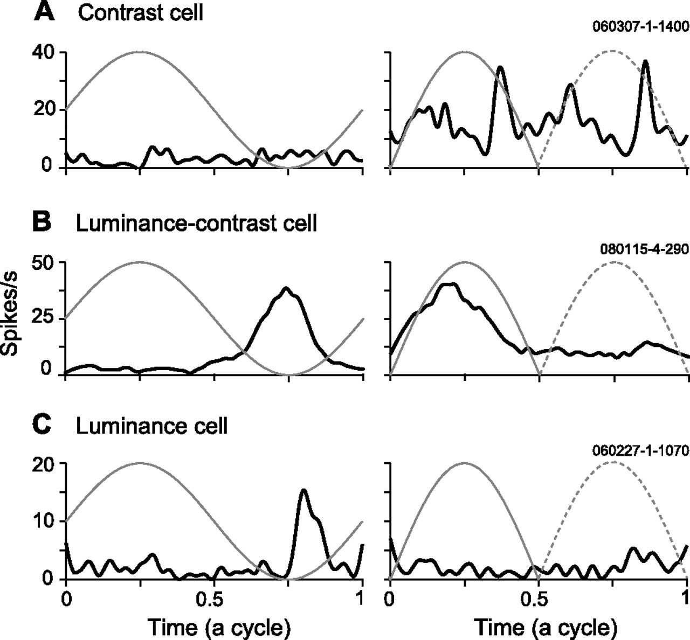
Figure 2. Different responses of 3 types of neurons to uniform luminance and contrast stimuli. The left and right ...
Notes:
Figure 2. Different responses of 3 types of neurons to uniform luminance and contrast stimuli. The left and right columns are responses of example cells to luminance and contrast stimuli, respectively. Dark lines: response curves; Gray lines: the temporal profiles of luminance or contrast changes in the stimuli (a circle: 2.5 s, 0.4 Hz in (A) and (C); 1.25 s, 0.8 Hz in (B)); Dashed gray lines: the temporal profile of contrast change in the opposite polarity of the stimulus. (A) A contrast cell that did not significantly respond to luminance but responded strongly to contrast. The cells had PSI = 0.00 and CLRI = 0.56. (B) A luminance–contrast cell that responded significantly to both luminance and contrast. The cells had PSI = 0. 37 and CLRI = 0.03. (C) A luminance cell that responded significantly to luminance but not to contrast. The cells had CLRI = −0.51.
Unless provided in the caption above, the following copyright applies to the content of this slide: © The Author 2011. Published by Oxford University Press. All rights reserved. For permissions, please e-mail: journals.permissions@oup.com

Slide 3
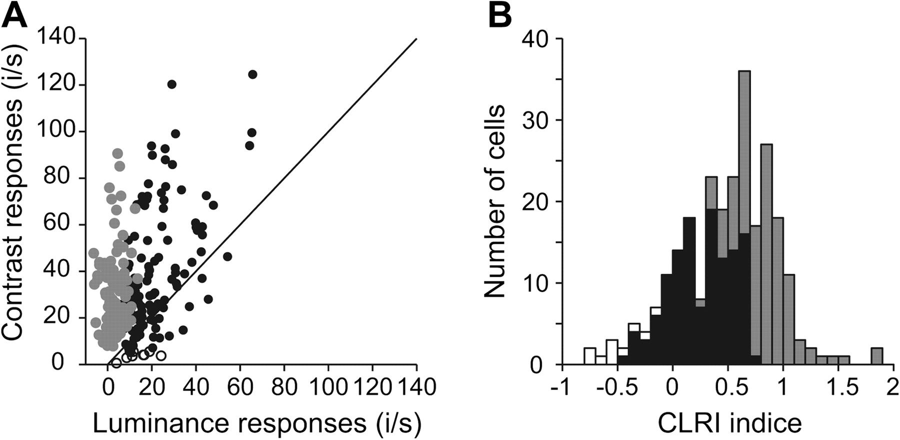
Figure 3. Luminance responses and contrast responses in population. (A) Contrast responses were plotted against ...
Notes:
Figure 3. Luminance responses and contrast responses in population. (A) Contrast responses were plotted against luminance responses in a population of 259 cells. The responses (i/s: spikes/s) were the net firing rates after subtracted the spontaneous firing rate. Each dot represents one cell. The solid line is the diagonal line. (B) Distribution of CLRIs of the population of 259 cells. A negative value of CLRI means that luminance responses of a cell were larger than its contrast responses and a positive one means that contrast responses were larger than its luminance responses. The example contrast cell, luminance–contrast cell, and luminance cell in Figure 2A–C had CLRI = 0.56, CLRI = 0.03, and CLRI = −0.51, respectively. The gray, dark, open dots in (A) and the corresponding gray, dark, open bars in (B) denote to the contrast-only cells, luminance–contrast cells, luminance-only cells that were classified based on t-test criterion in comparison with the classifications based on CLRI criterion. Note that those cells at the leftmost of the abscissa in (A) had luminance responses 1 because their luminance responses were lower than the spontaneous firing rate.
Unless provided in the caption above, the following copyright applies to the content of this slide: © The Author 2011. Published by Oxford University Press. All rights reserved. For permissions, please e-mail: journals.permissions@oup.com

Slide 4
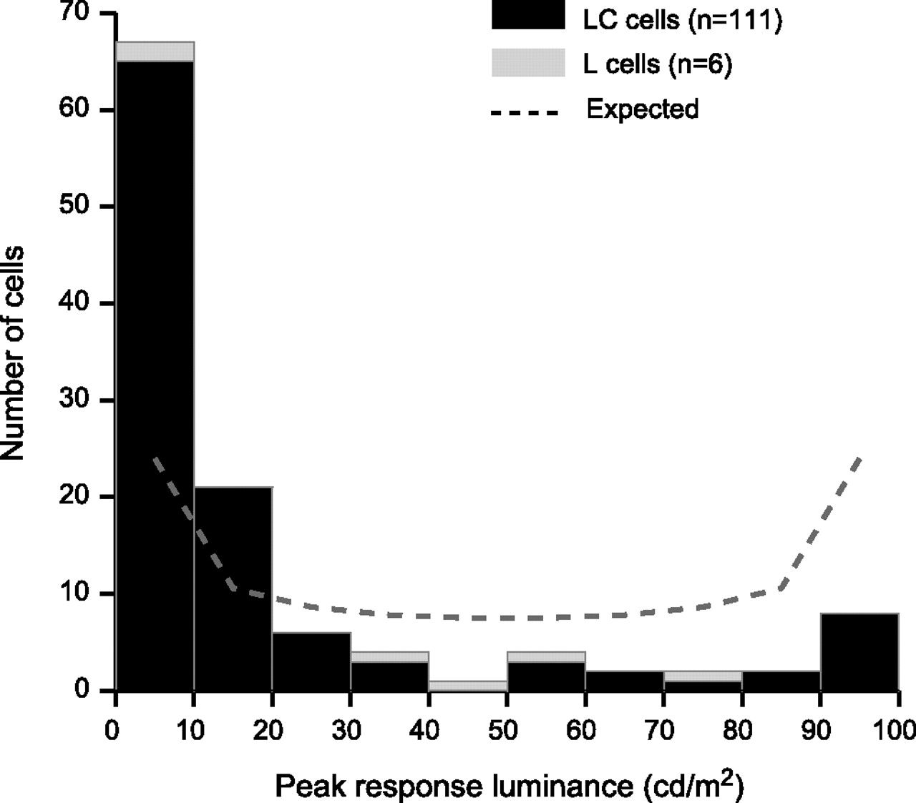
Figure 4. Most of luminance-sensitive neurons respond to low luminance. The abscissa is the luminance to which a cell ...
Notes:
Figure 4. Most of luminance-sensitive neurons respond to low luminance. The abscissa is the luminance to which a cell showed the peak response when luminance modulated at a slow TF of 0.4 Hz, n = 117, including 111 luminance–contrast cells (LC, filled bars) and 6 luminance cells (L, open bars). The dashed curve is the expected distribution of the probability of stimulus samples in the sinusoidal luminance change. Note that contrast cells were excluded from the analysis because they had no significant (P > 0.05) response to uniform luminance.
Unless provided in the caption above, the following copyright applies to the content of this slide: © The Author 2011. Published by Oxford University Press. All rights reserved. For permissions, please e-mail: journals.permissions@oup.com

Slide 5
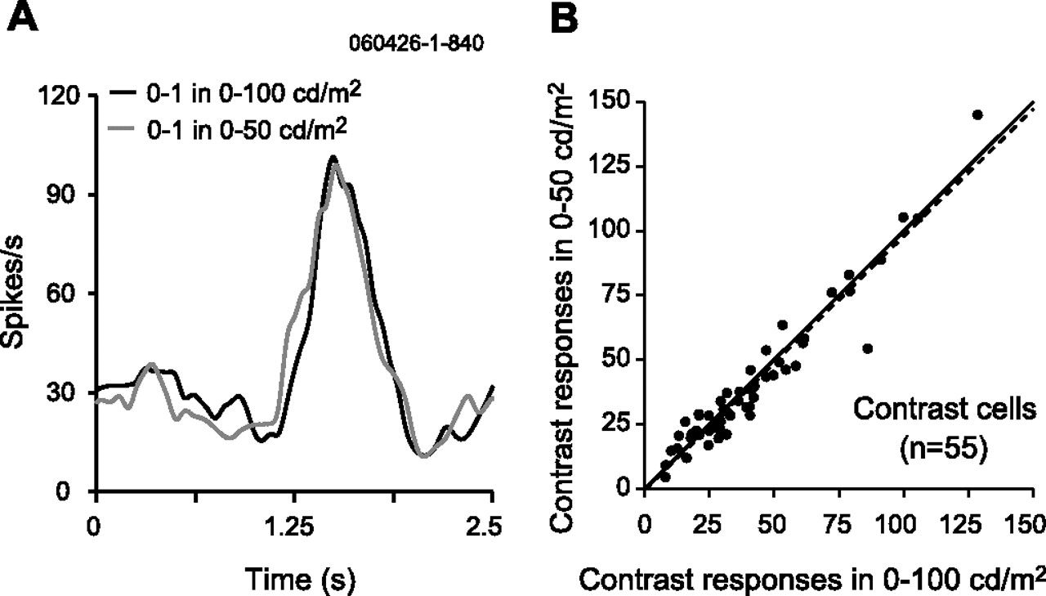
Figure 5. Contrast responses of contrast cells are independent of the luminance ranges that define the contrast ...
Notes:
Figure 5. Contrast responses of contrast cells are independent of the luminance ranges that define the contrast stimuli. (A) Response profiles of an example contrast cell to two 0–100% contrast stimuli that were generated by 0–100 cd/m2 (dark response curve) and by 0–50 cd/m2 luminance ranges (gray response curve) were almost identical. (B) Scatter plot of the peak response magnitudes of 55 contrast cells to the 2 contrast stimuli. Two responses (spikes/s) were highly correlated (r = 0.96, P < 0.01, slope = 0.99 (the dashed line), n = 55). The solid line is the diagonal line. Note that these cells responded significantly only to contrast.
Unless provided in the caption above, the following copyright applies to the content of this slide: © The Author 2011. Published by Oxford University Press. All rights reserved. For permissions, please e-mail: journals.permissions@oup.com

Slide 6
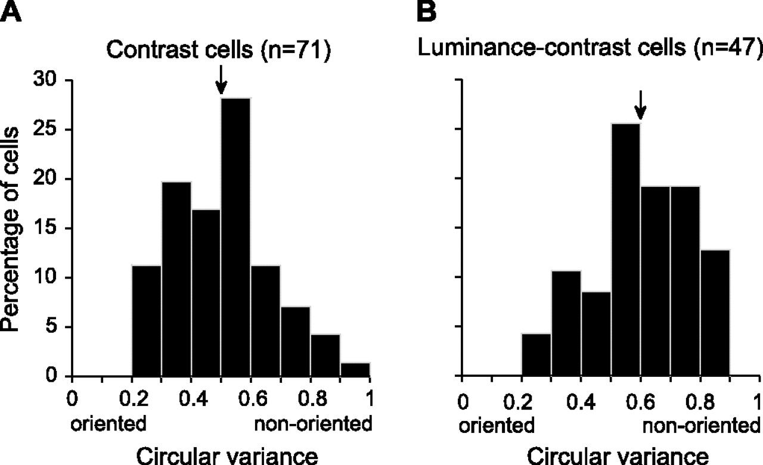
Figure 6. Orientation selectivity of contrast cells is significantly stronger on average than that of ...
Notes:
Figure 6. Orientation selectivity of contrast cells is significantly stronger on average than that of luminance–contrast cells. (A) Distribution of orientation tuning strength (CV) for 71 contrast cells. The arrow indicates the mean of CV 0.50 ± 0.17 for the cells. (B) Distribution of orientation tuning strength (CV) for 47 luminance–contrast cells. The arrow indicates the mean of CV 0.60 ± 0.17 for the cells. Oriented: cells having oriented responses; Nonoriented: cells having nonoriented responses.
Unless provided in the caption above, the following copyright applies to the content of this slide: © The Author 2011. Published by Oxford University Press. All rights reserved. For permissions, please e-mail: journals.permissions@oup.com

Slide 7
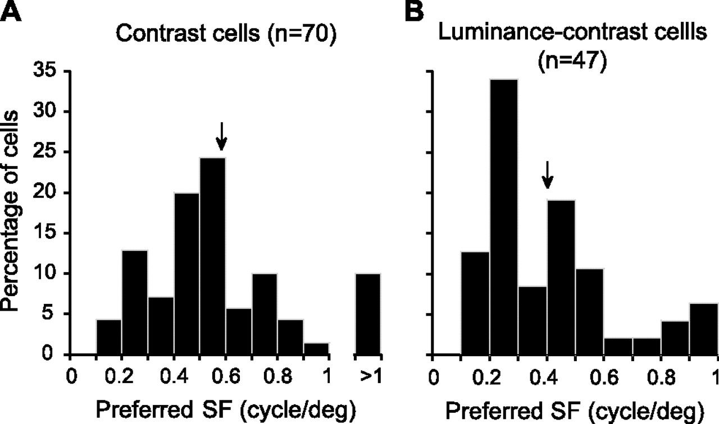
Figure 7. Spatial frequencies of luminance–contrast cells are significantly lower on average than that of contrast ...
Notes:
Figure 7. Spatial frequencies of luminance–contrast cells are significantly lower on average than that of contrast cells. (A) Distribution of the preferred SF for 70 contrast cells with the mean of 0.59 ± 0.35 c/d (arrow). (A) Distribution of the preferred SF for 47 luminance–contrast cells with the mean of 0.40 ± 0.22 c/d (arrow).
Unless provided in the caption above, the following copyright applies to the content of this slide: © The Author 2011. Published by Oxford University Press. All rights reserved. For permissions, please e-mail: journals.permissions@oup.com

Slide 8
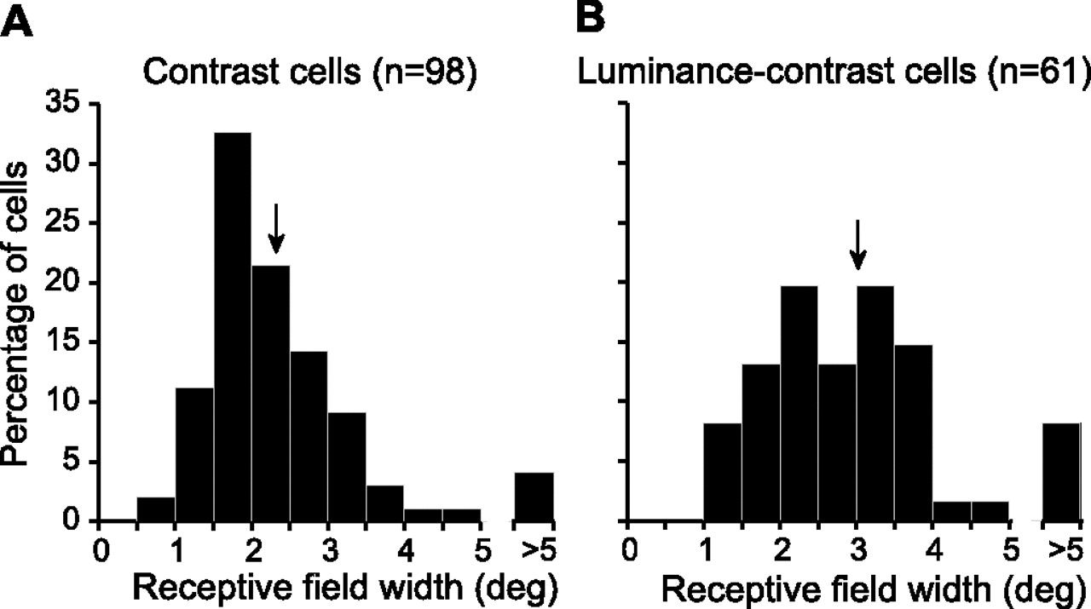
Figure 8. Luminance–contrast cells have significantly larger RFs on average than contrast cells. (A) Distribution of RF ...
Notes:
Figure 8. Luminance–contrast cells have significantly larger RFs on average than contrast cells. (A) Distribution of RF widths for 98 contrast cells with the mean of 2.35 ± 0.99° (arrow). (B) Distribution of RF widths for 61 luminance–contrast cells with the mean of 3.04 ± 1.41° (arrow). Note that the monocontrast cells having a single ON or OFF subregion were included in (A) and (B).
Unless provided in the caption above, the following copyright applies to the content of this slide: © The Author 2011. Published by Oxford University Press. All rights reserved. For permissions, please e-mail: journals.permissions@oup.com

Slide 9
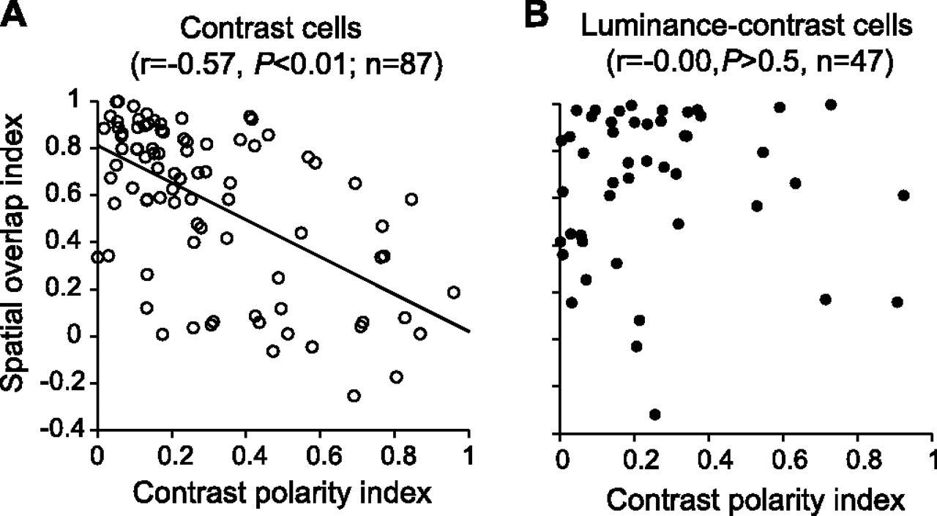
Figure 9. Contrast polarity selectivity of contrast cells is significantly correlated to spatial organization of ON–OFF ...
Notes:
Figure 9. Contrast polarity selectivity of contrast cells is significantly correlated to spatial organization of ON–OFF subregions of their RFs but not for luminance–contrast cells. (A) Overlap indices of ON–OFF subregions in space of contrast cells were plotted against contrast PSIs. Abscissa represents contrast PSIs and ordinate represents spatial overlap indices (OISs) for 87 contrast cells. The correlation between these 2 parameters is significant (r = −0.57, P < 0.01) and the solid line represents the linear regression line with a slope of −0.79, illustrating the trend that the more selective for contrast polarity a contrast cell is, the more segregated in spatial map its ON and OFF subregions are. (B) The same scatter plot for 47 luminance–contrast cells shows no correlation between the 2 indices.
Unless provided in the caption above, the following copyright applies to the content of this slide: © The Author 2011. Published by Oxford University Press. All rights reserved. For permissions, please e-mail: journals.permissions@oup.com

