Slide 1
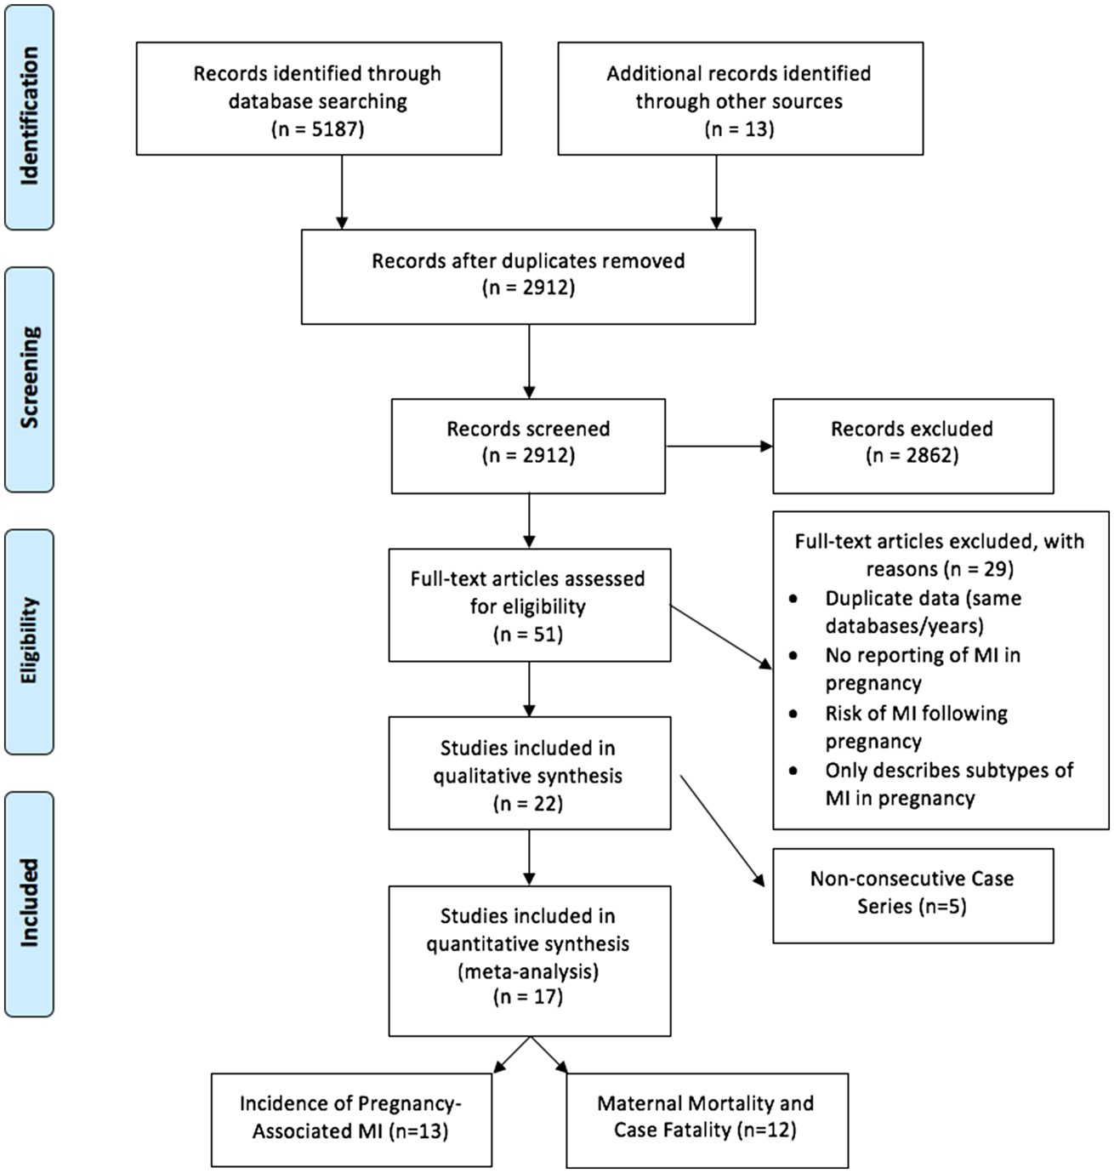
Figure 1 Article flow diagram.
Notes:
Figure 1 Article flow diagram.
Unless provided in the caption above, the following copyright applies to the content of this slide: © The Author 2017. Published by Oxford University Press on behalf of the European Society of Cardiology.This is an Open Access article distributed under the terms of the Creative Commons Attribution Non-Commercial License (http://creativecommons.org/licenses/by-nc/4.0/), which permits non-commercial re-use, distribution, and reproduction in any medium, provided the original work is properly cited. For commercial re-use, please contact journals.permissions@oup.com

Slide 2
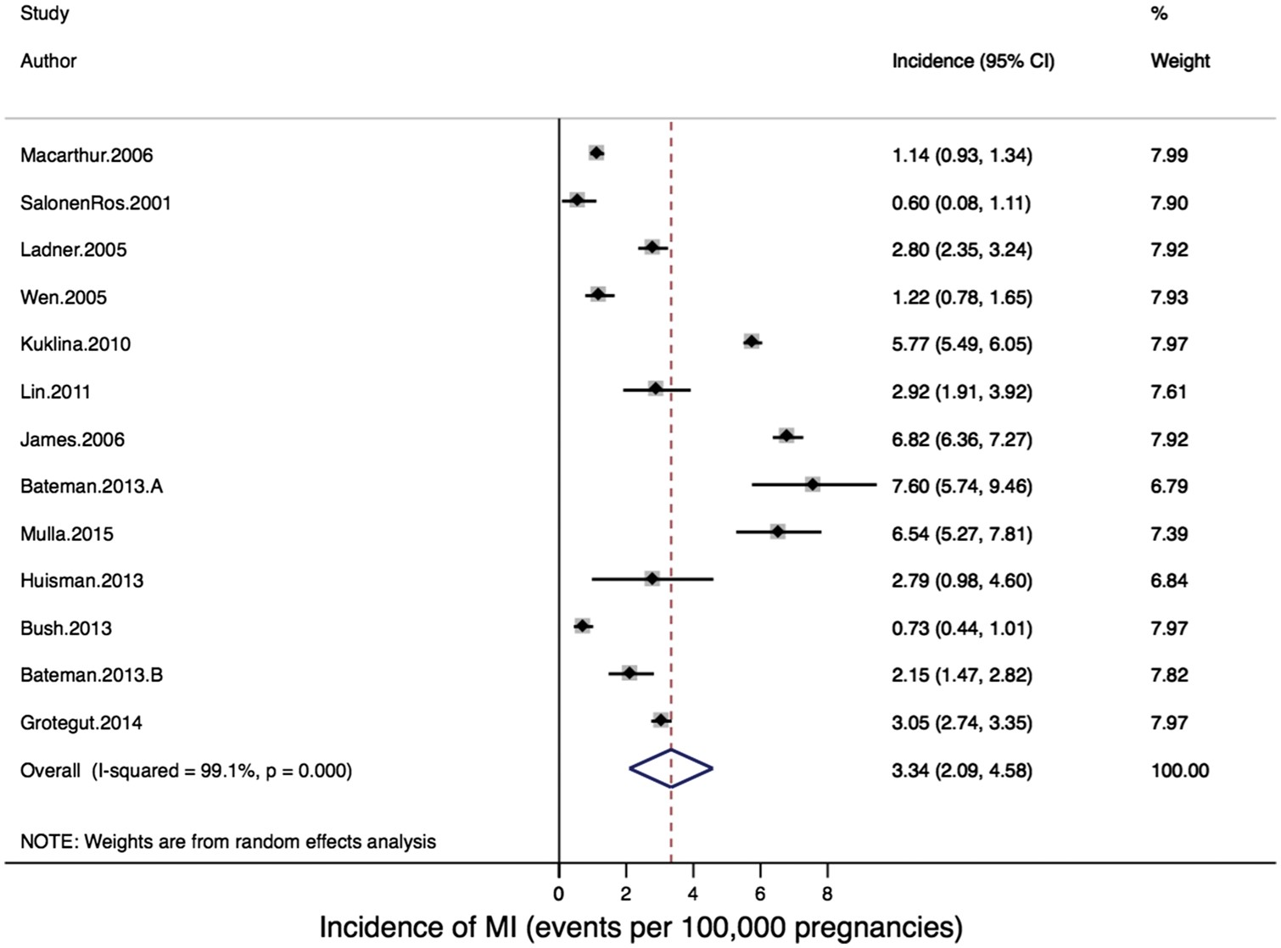
Figure 2 Forest plot of incidence of pregnancy-associated myocardial infarction.
Notes:
Figure 2 Forest plot of incidence of pregnancy-associated myocardial infarction.
Unless provided in the caption above, the following copyright applies to the content of this slide: © The Author 2017. Published by Oxford University Press on behalf of the European Society of Cardiology.This is an Open Access article distributed under the terms of the Creative Commons Attribution Non-Commercial License (http://creativecommons.org/licenses/by-nc/4.0/), which permits non-commercial re-use, distribution, and reproduction in any medium, provided the original work is properly cited. For commercial re-use, please contact journals.permissions@oup.com

Slide 3
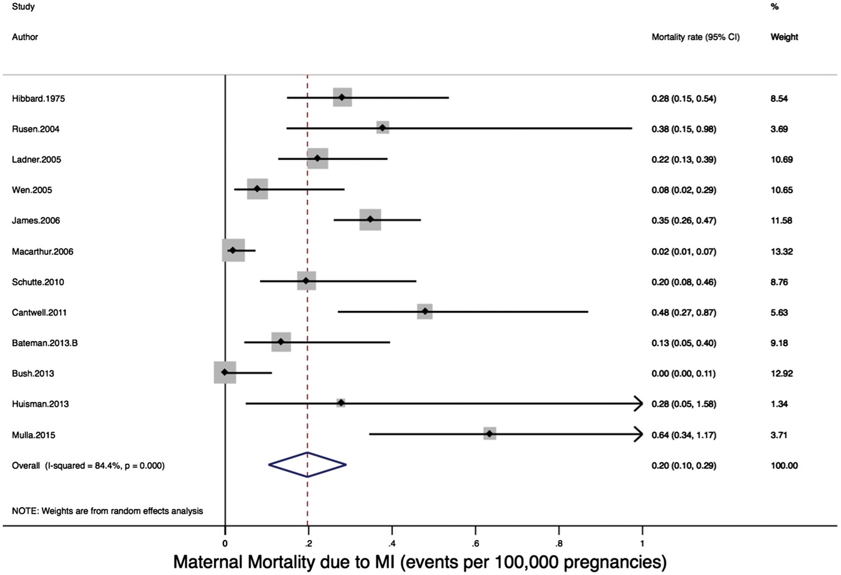
Figure 3 Forest plot of incidence of maternal mortality due to pregnancy-associated myocardial infarction.
Notes:
Figure 3 Forest plot of incidence of maternal mortality due to pregnancy-associated myocardial infarction.
Unless provided in the caption above, the following copyright applies to the content of this slide: © The Author 2017. Published by Oxford University Press on behalf of the European Society of Cardiology.This is an Open Access article distributed under the terms of the Creative Commons Attribution Non-Commercial License (http://creativecommons.org/licenses/by-nc/4.0/), which permits non-commercial re-use, distribution, and reproduction in any medium, provided the original work is properly cited. For commercial re-use, please contact journals.permissions@oup.com

Slide 4
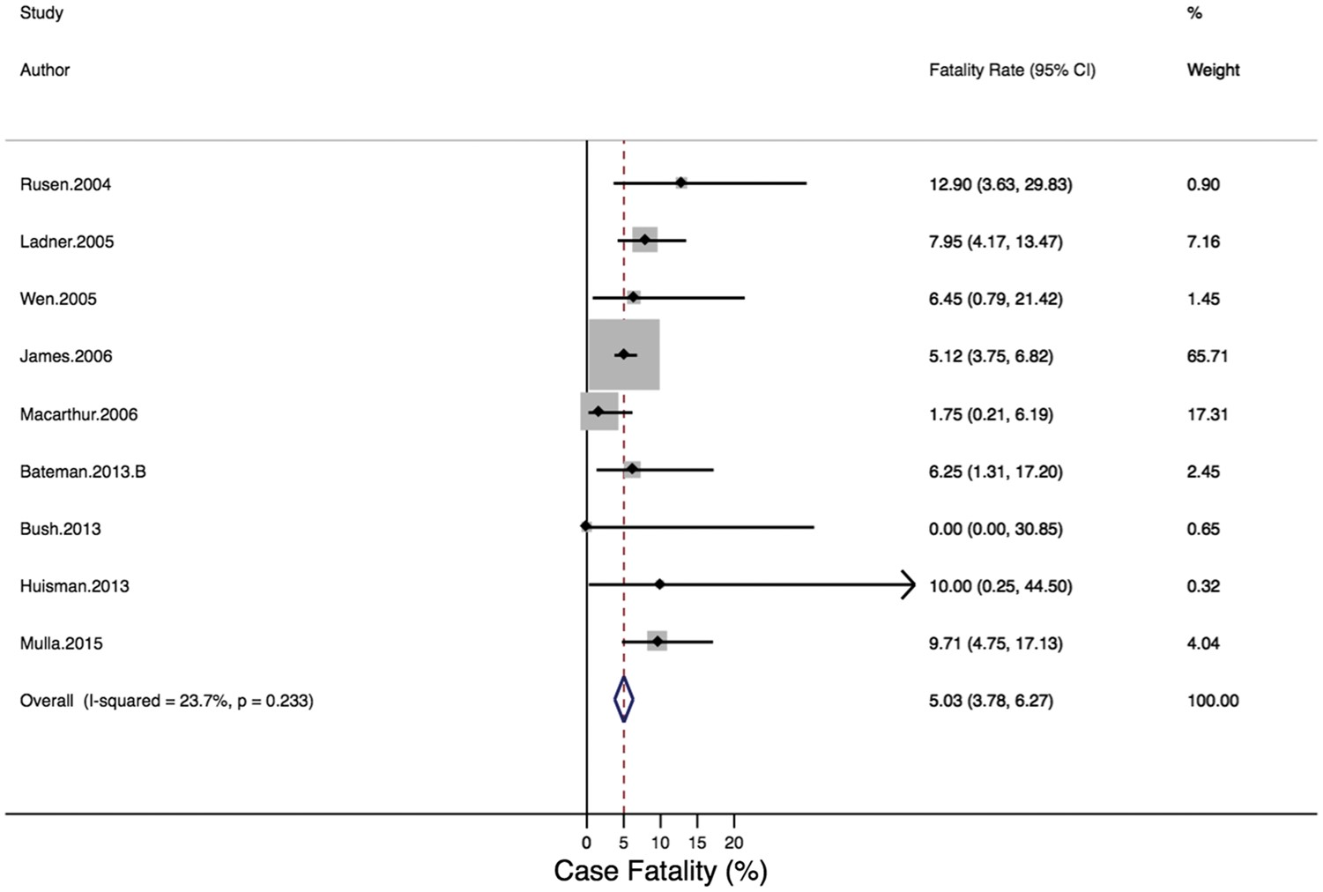
Figure 4 Forest plot of case-fatality rate due to pregnancy-associated myocardial infarction.
Notes:
Figure 4 Forest plot of case-fatality rate due to pregnancy-associated myocardial infarction.
Unless provided in the caption above, the following copyright applies to the content of this slide: © The Author 2017. Published by Oxford University Press on behalf of the European Society of Cardiology.This is an Open Access article distributed under the terms of the Creative Commons Attribution Non-Commercial License (http://creativecommons.org/licenses/by-nc/4.0/), which permits non-commercial re-use, distribution, and reproduction in any medium, provided the original work is properly cited. For commercial re-use, please contact journals.permissions@oup.com

