Slide 1
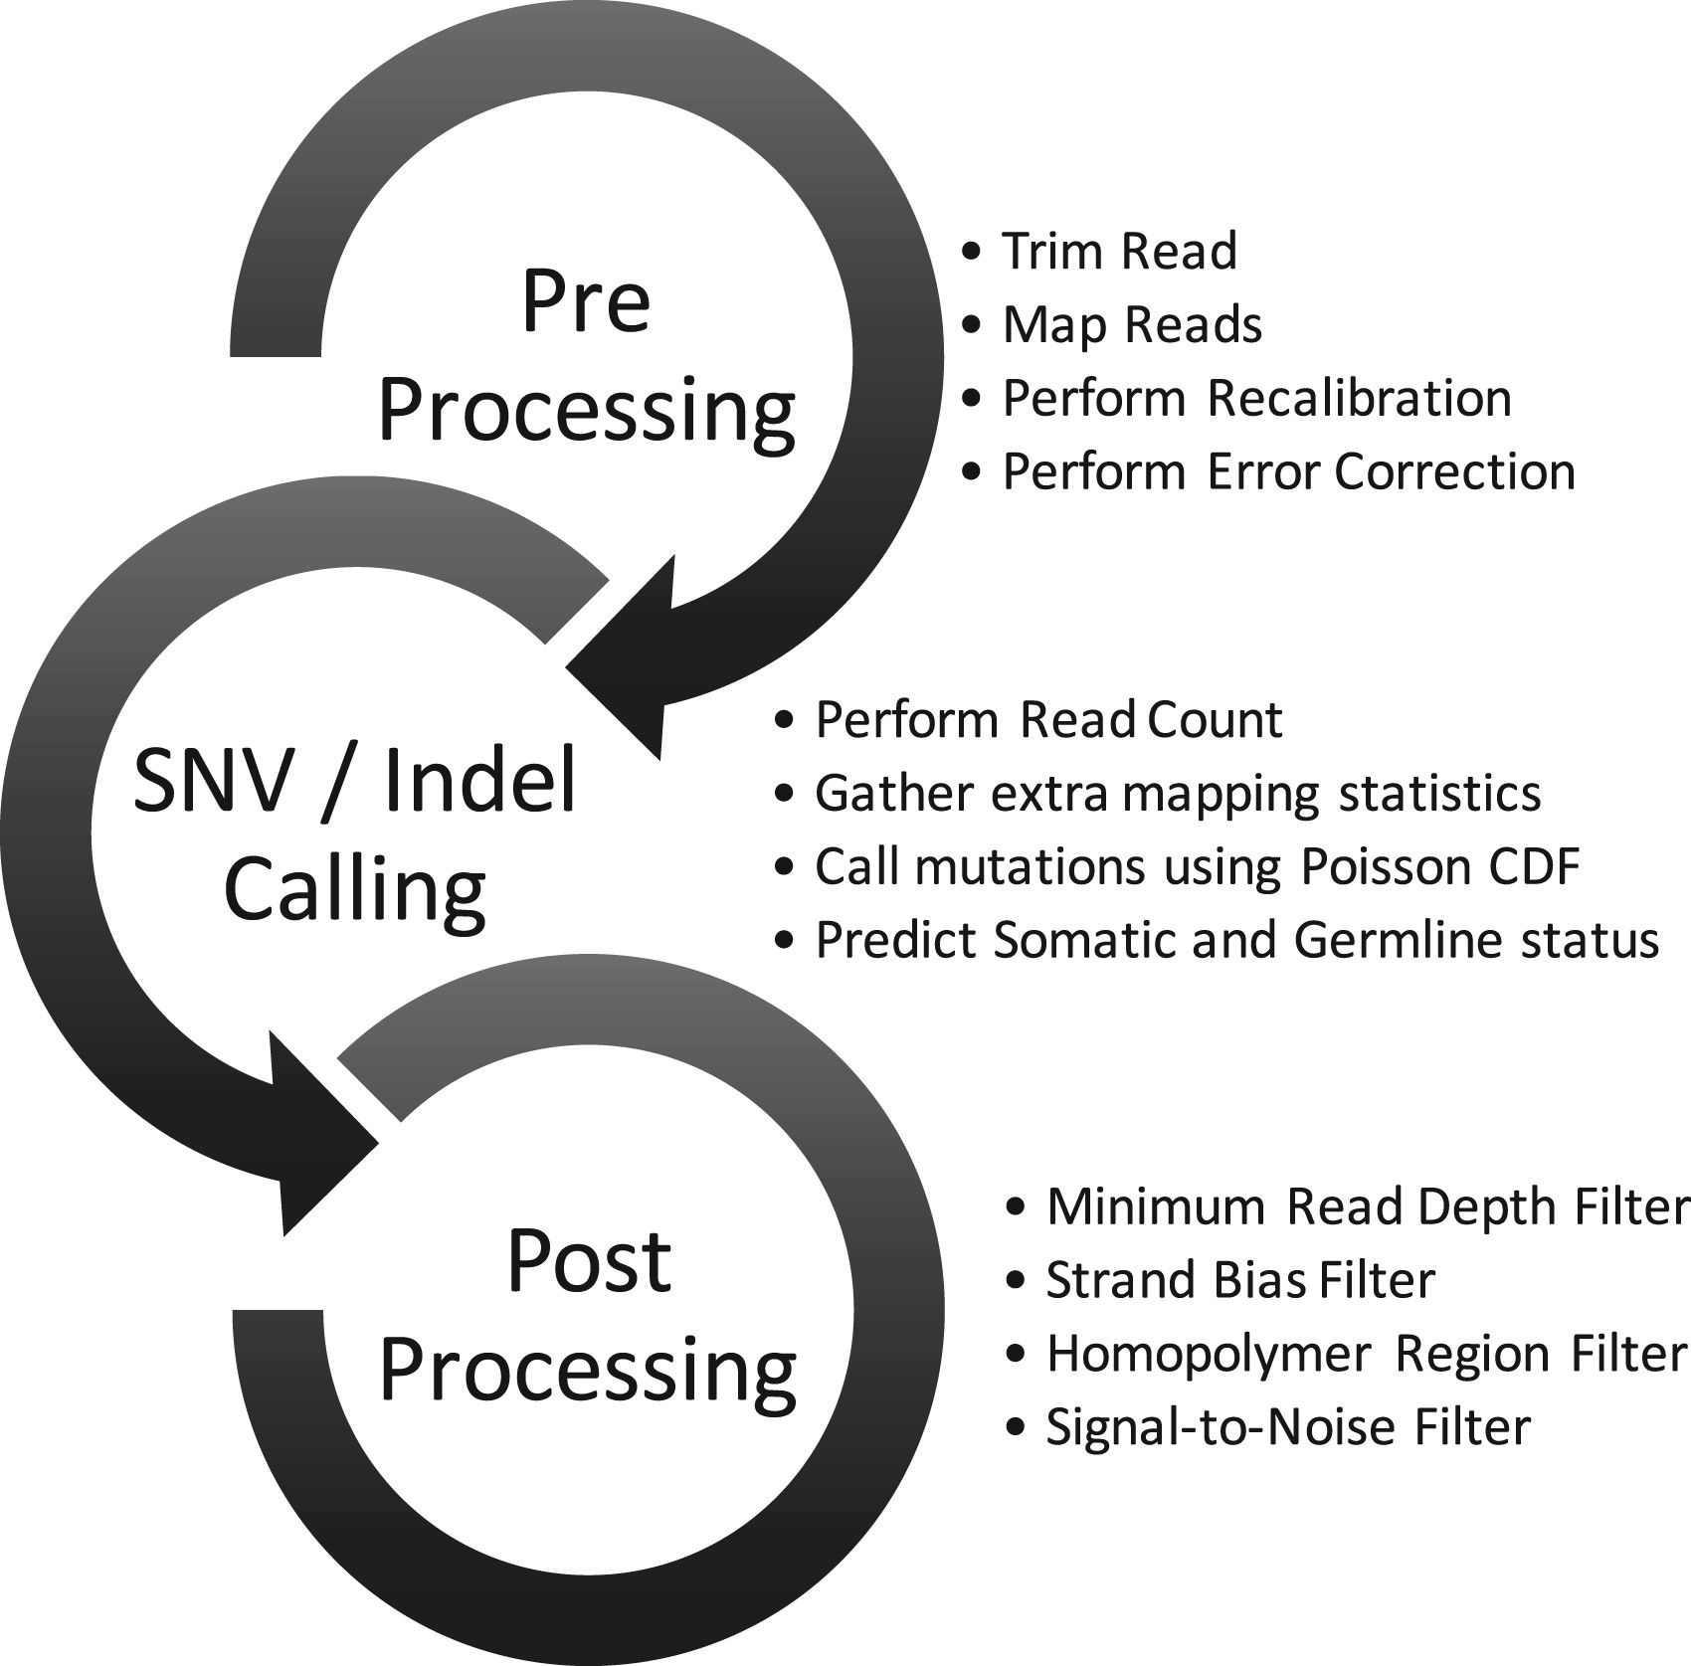
Fig. 1. Overview of SiNVICT data processing pipeline
Notes:
Fig. 1. Overview of SiNVICT data processing pipeline
Unless provided in the caption above, the following copyright applies to the content of this slide: © The Author 2016. Published by Oxford University Press. All rights reserved. For Permissions, please e-mail: journals.permissions@oup.comThis article is published and distributed under the terms of the Oxford University Press, Standard Journals Publication Model (https://academic.oup.com/journals/pages/about_us/legal/notices)

Slide 2
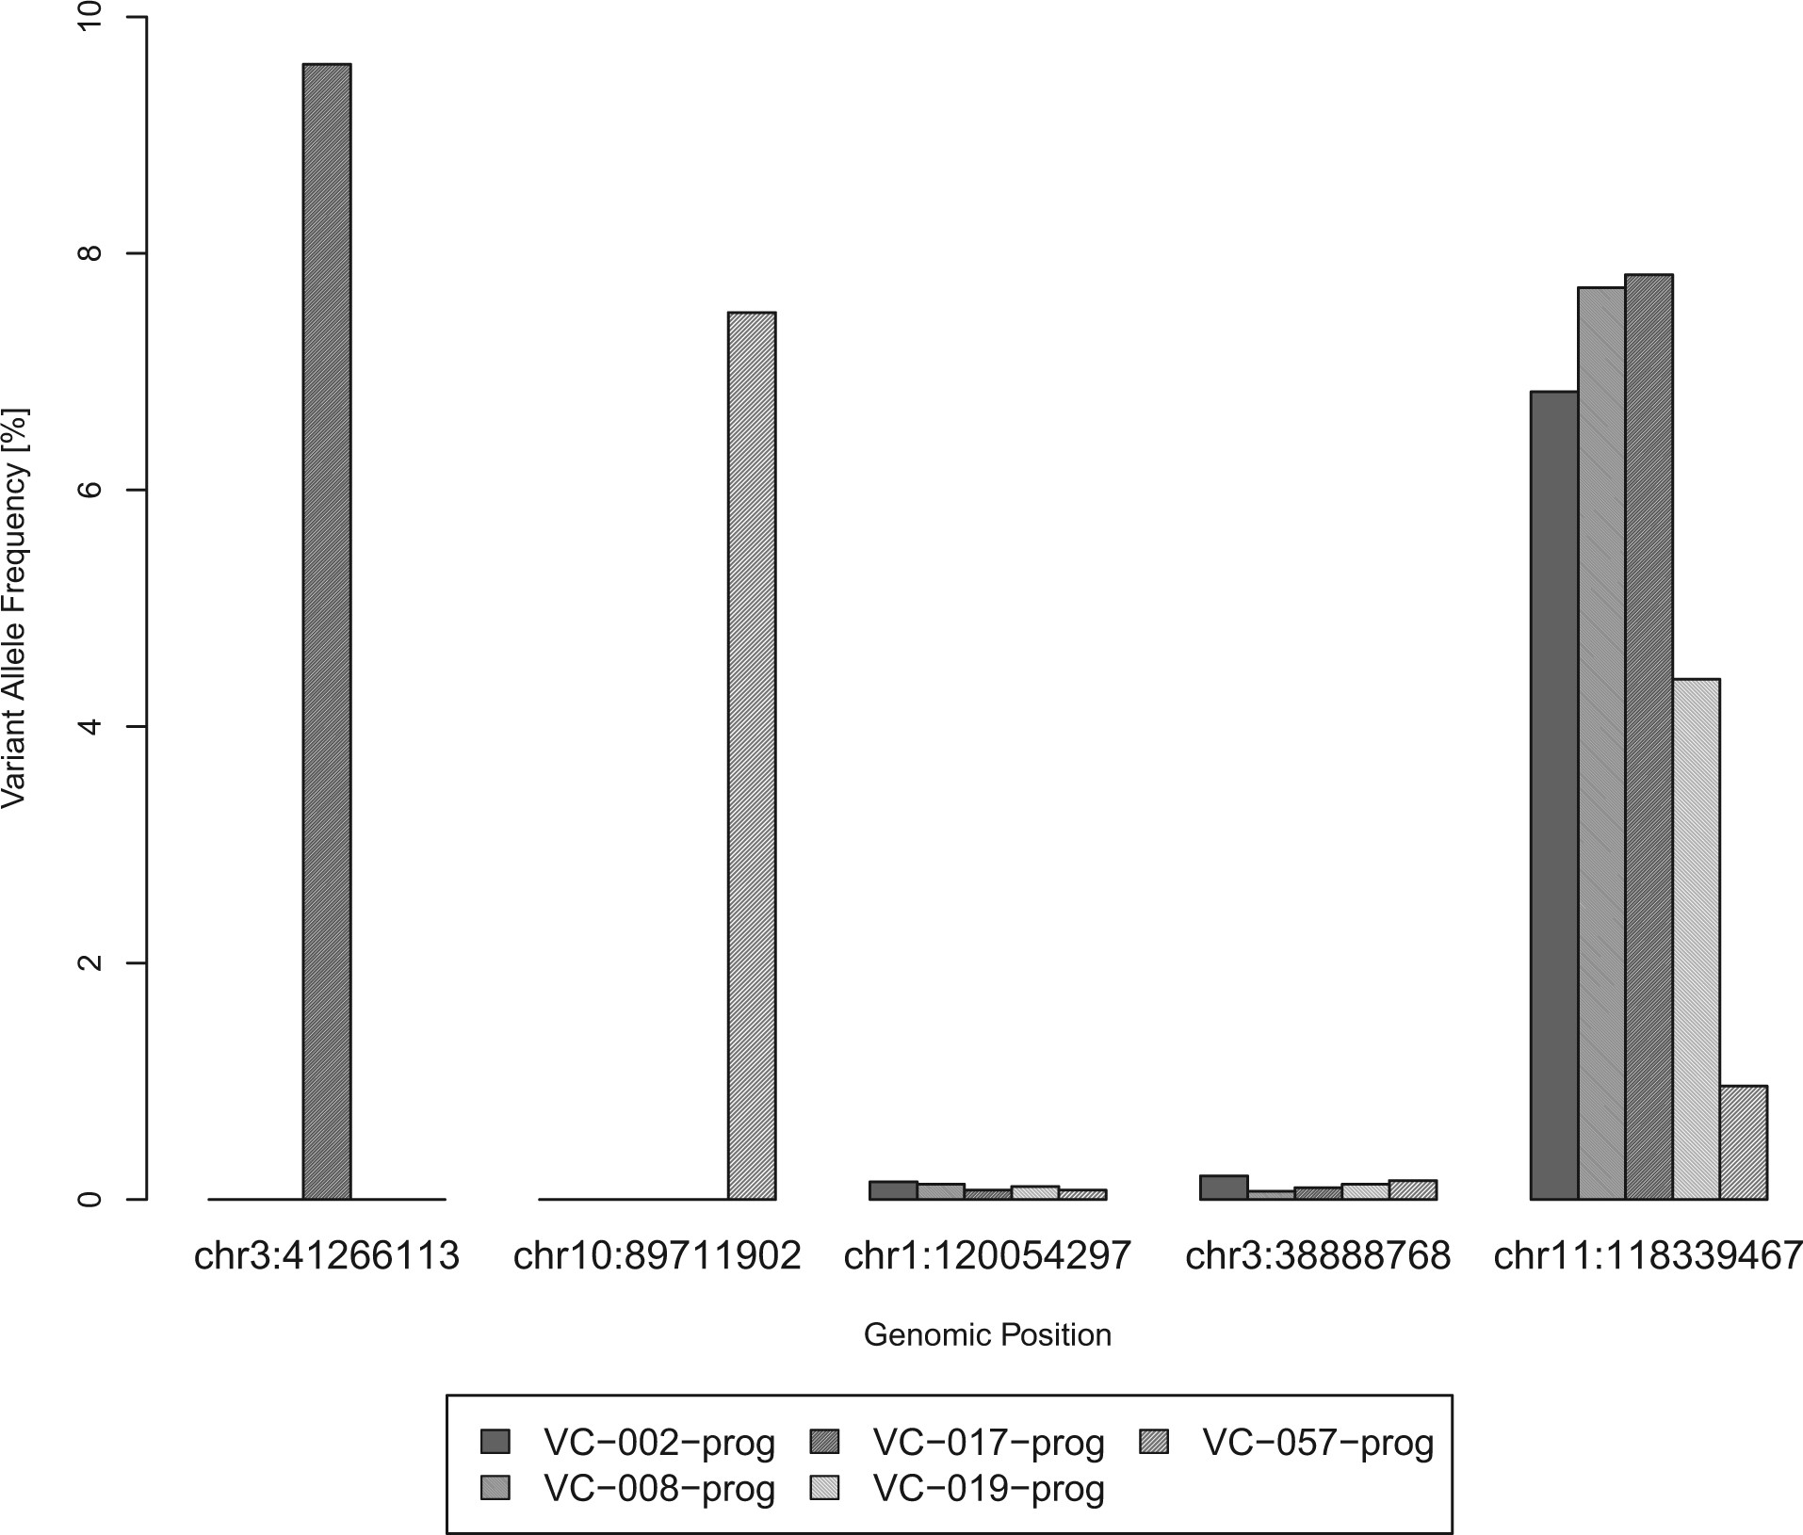
Fig. 2. Calculating the SNR in multiple samples across several genomic loci. The x-axis depicts five loci from a set ...
Notes:
Fig. 2. Calculating the SNR in multiple samples across several genomic loci. The x-axis depicts five loci from a set of samples such that each sample is represented by a distinct colour. For each location on the x-axis, the corresponding value on the y-axis indicates the percentage of the most frequent variant allele. The chance of any one of the loci indicated above having a ‘uniform’ VAF distribution across five unrelated samples is very low and thus there must be location dependent noise in the VAF estimates. Most current SNV callers will report a potential mutation for one of the samples in locations 1 and 2 while they will report a potential mutation for four out of five samples in location 5. They will not make any calls for locations 3 and 4 because of their negligible measured variant allele frequencies. For the last position, all samples but one show substantial evidence for a potential mutation when examined individually. The SNR filter utilized by SiNVICT allows such cases to be filtered out under the assumption that SNVs are expected to be unique to a few patients among a batch for all practical purposes
Unless provided in the caption above, the following copyright applies to the content of this slide: © The Author 2016. Published by Oxford University Press. All rights reserved. For Permissions, please e-mail: journals.permissions@oup.comThis article is published and distributed under the terms of the Oxford University Press, Standard Journals Publication Model (https://academic.oup.com/journals/pages/about_us/legal/notices)

Slide 3
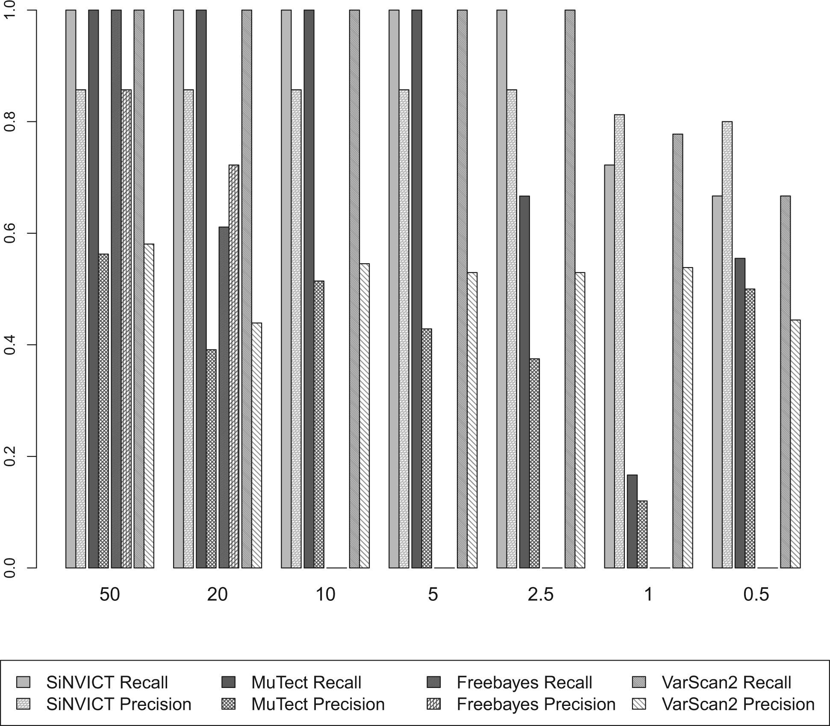
Fig. 3. Precision and Recall of SiNVICT, MuTect, Freebayes and VarScan2 on simulated data. x-axis represents ...
Notes:
Fig. 3. Precision and Recall of SiNVICT, MuTect, Freebayes and VarScan2 on simulated data. x-axis represents different samples with different tumour content levels. In each of these simulated samples, there were 18 manually added SNVs. The total number of bases covered per sample was 8938. All of the 18 SNVs were successfully detected in samples at tumour content levels of 50, 20, 10 and 5% by SiNVICT, MuTect and VarScan2. SiNVICT and VarScan2 also had perfect recall at 2.5% tumour content. In all the cases, SiNVICT had better precision than MuTect, Freebayes and VarScan2. However in tumour content of 1% VarScan2 had better recall (one more SNV detected by VarScan2). SiNVICT made relatively less number of false positive calls resulting in its higher precision. Details about the number of calls are provided in Supplementary Table S2
Unless provided in the caption above, the following copyright applies to the content of this slide: © The Author 2016. Published by Oxford University Press. All rights reserved. For Permissions, please e-mail: journals.permissions@oup.comThis article is published and distributed under the terms of the Oxford University Press, Standard Journals Publication Model (https://academic.oup.com/journals/pages/about_us/legal/notices)

Slide 4
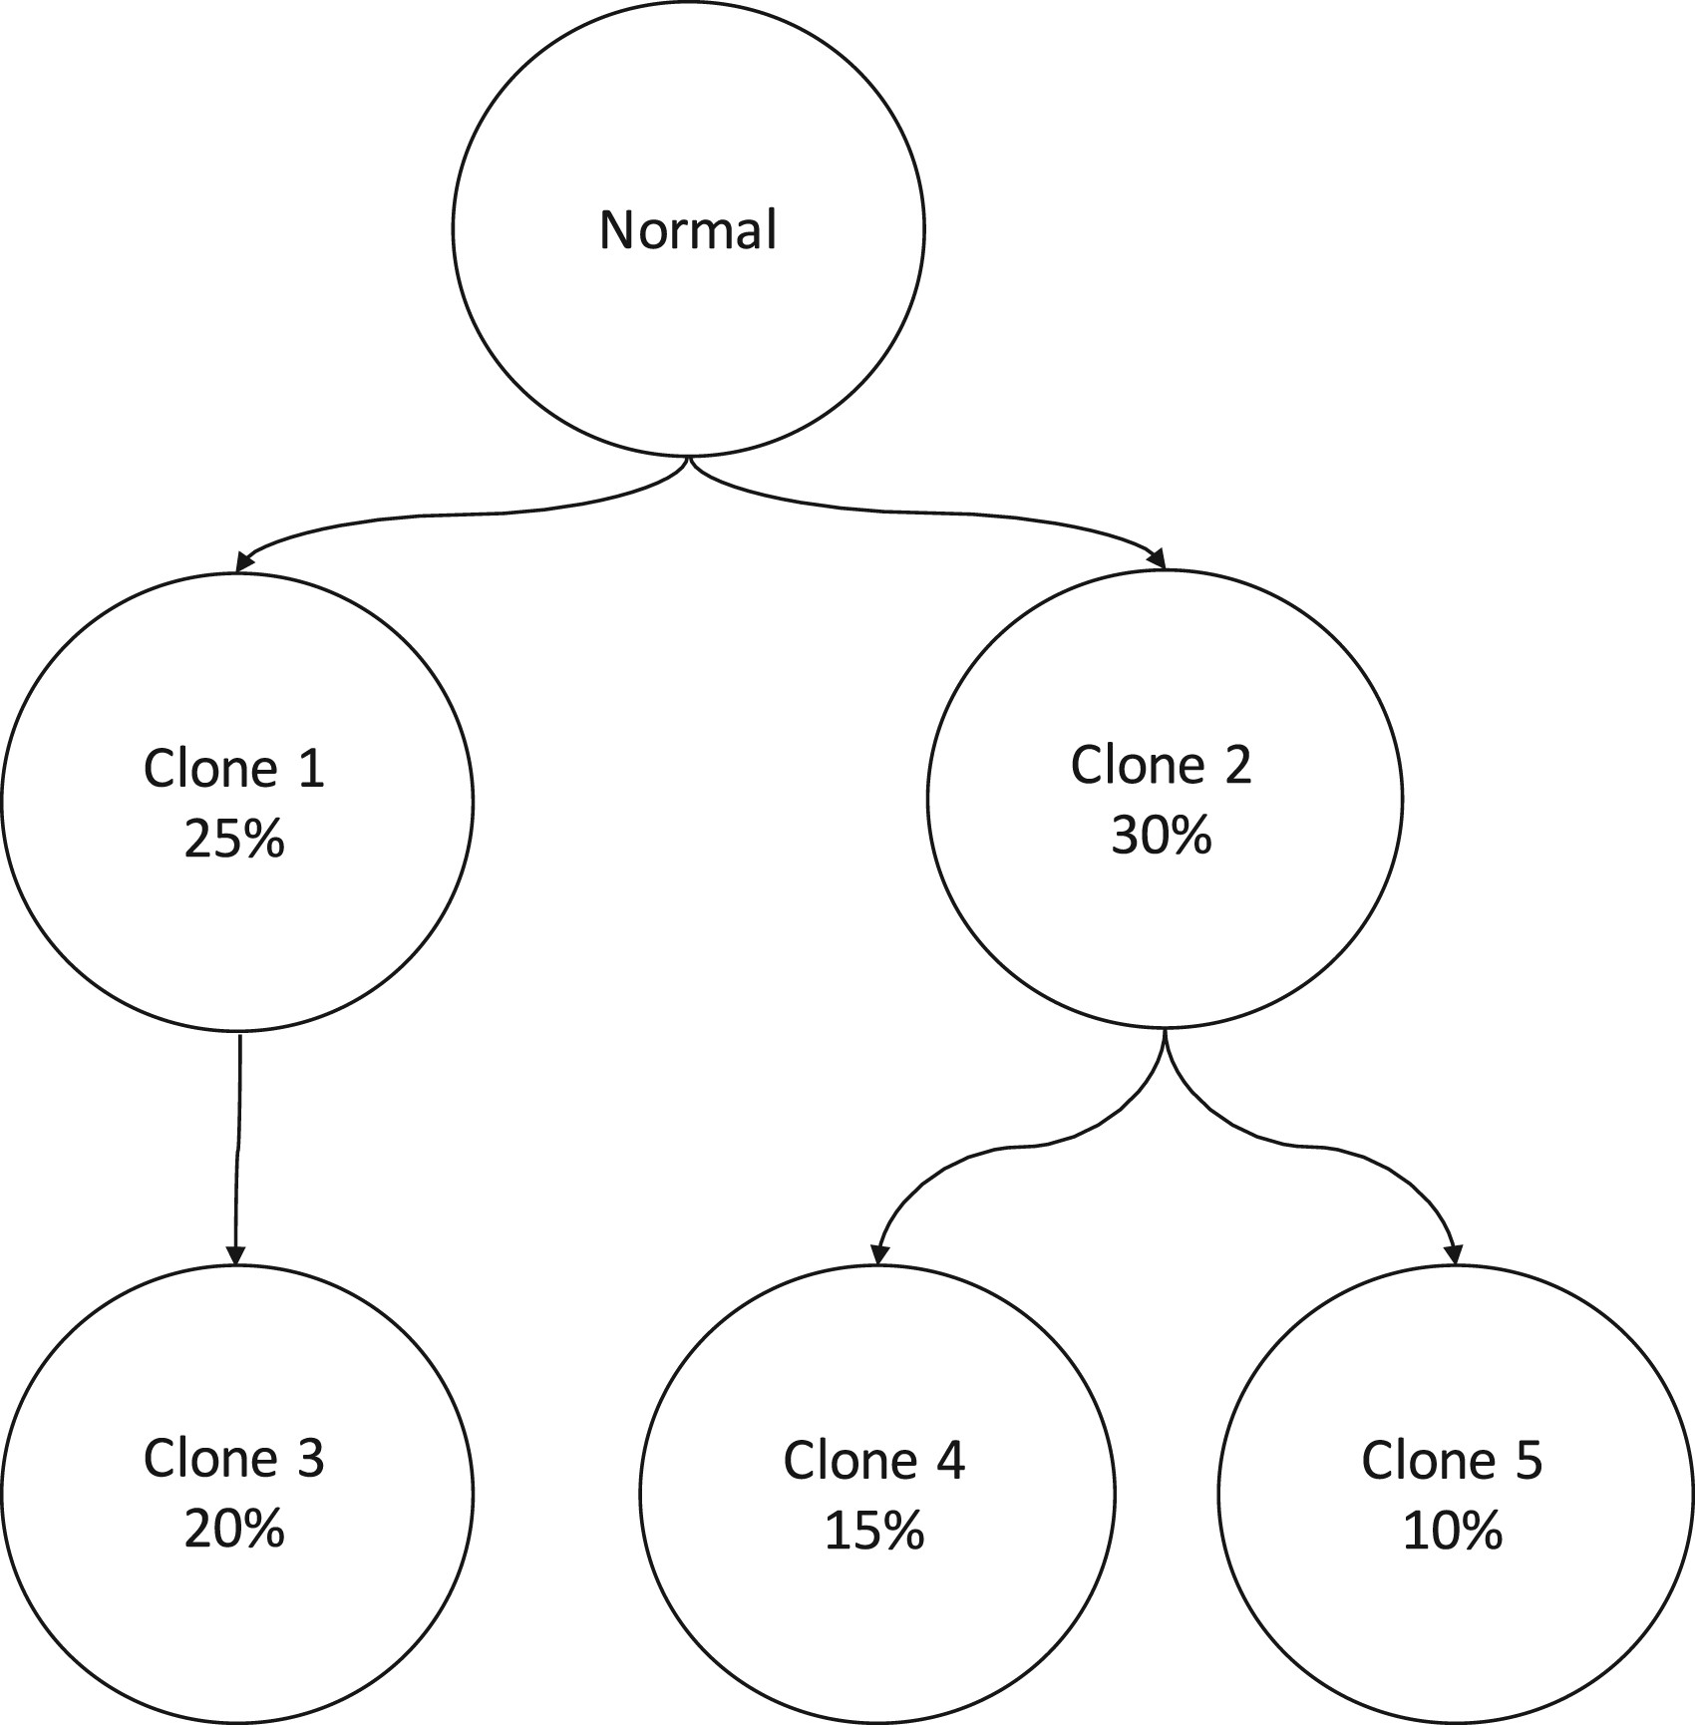
Fig. 4. Sample phylogenetic tree with five clones, randomly selected topology and prevalences to simulate the ...
Notes:
Fig. 4. Sample phylogenetic tree with five clones, randomly selected topology and prevalences to simulate the conditions of SNV detection for a very heterogeneous tumour
Unless provided in the caption above, the following copyright applies to the content of this slide: © The Author 2016. Published by Oxford University Press. All rights reserved. For Permissions, please e-mail: journals.permissions@oup.comThis article is published and distributed under the terms of the Oxford University Press, Standard Journals Publication Model (https://academic.oup.com/journals/pages/about_us/legal/notices)

Slide 5
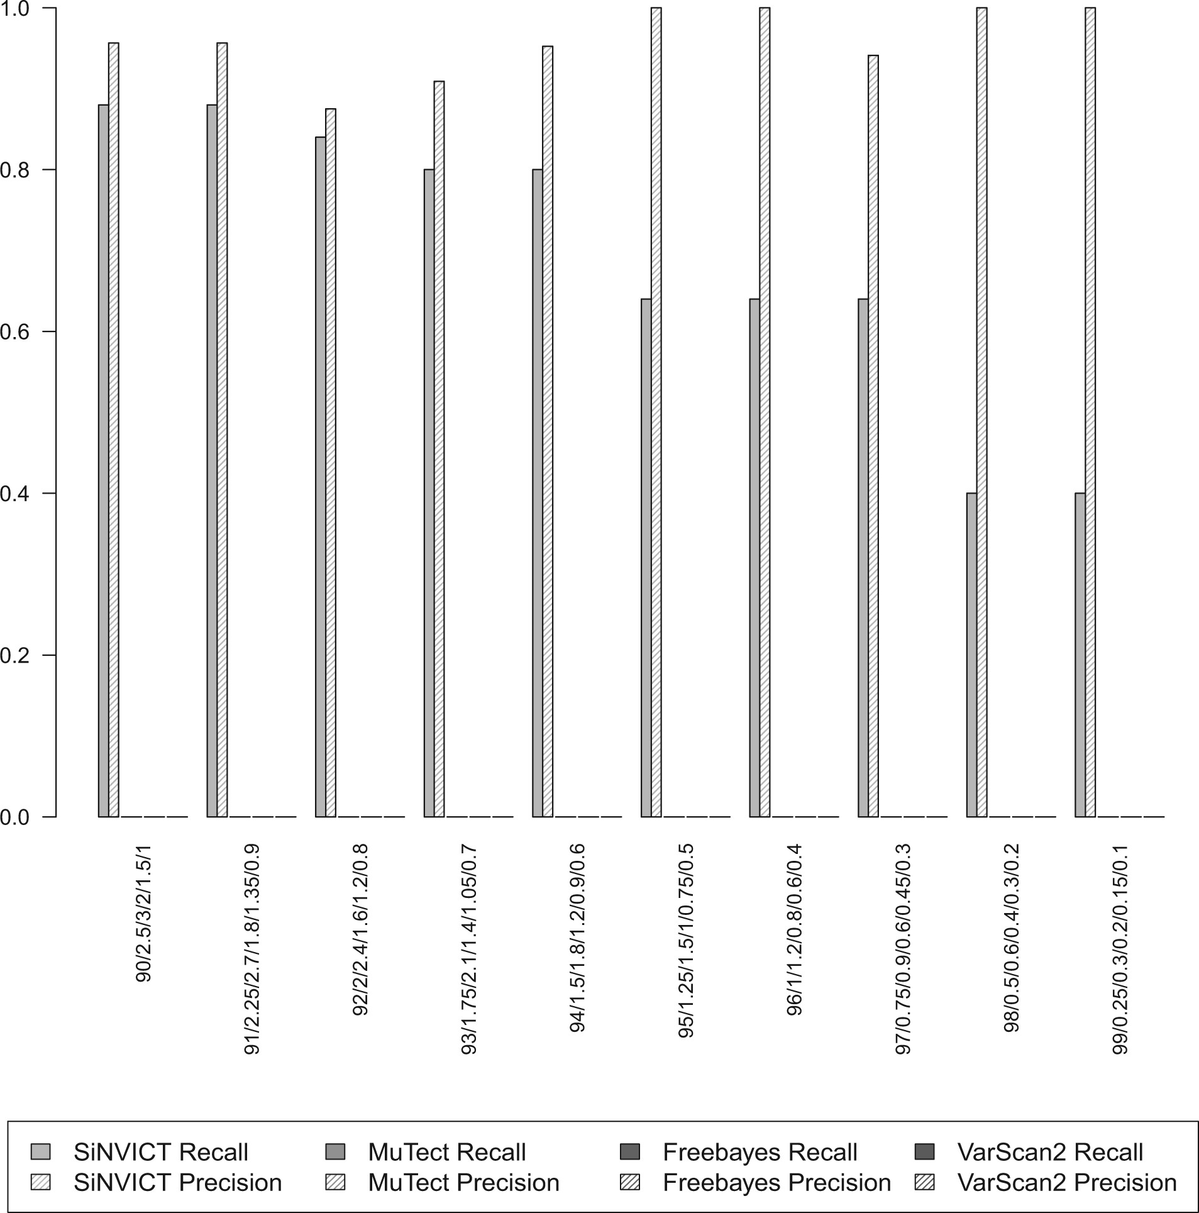
Fig. 5. Precision and Recall of SiNVICT, MuTect, Freebayes and VarScan2 on simulated data consisting of five clones. ...
Notes:
Fig. 5. Precision and Recall of SiNVICT, MuTect, Freebayes and VarScan2 on simulated data consisting of five clones. To each clone, we added five SNVs and each subclone inherited additional mutations from their parents as shown in Figure 4 and the number of bases covered was 31 485. Detection abilities of SiNVICT for such a heterogeneous case was observed to be adequate for higher prevalence clones up to 97% normal mixed with 3% tumour. Beyond this level, the variant allele percentage for all clones fell below 0.6%, which resulted in a reduction of sensitivity. Freebayes, MuTect and VarScan2 failed to provide any calls for these simulated data sets. We believe this is caused due to the rejection of the SNV sites by the triallelic site filter commonly used by such tools. Because of the extremely high read depth we simulated, as well as the highly clonal structure of the samples, most of these SNV locations show evidence towards more than one possible mutation. Detailed information about call statistics are provided in Supplementary Table S4
Unless provided in the caption above, the following copyright applies to the content of this slide: © The Author 2016. Published by Oxford University Press. All rights reserved. For Permissions, please e-mail: journals.permissions@oup.comThis article is published and distributed under the terms of the Oxford University Press, Standard Journals Publication Model (https://academic.oup.com/journals/pages/about_us/legal/notices)

