Slide 1
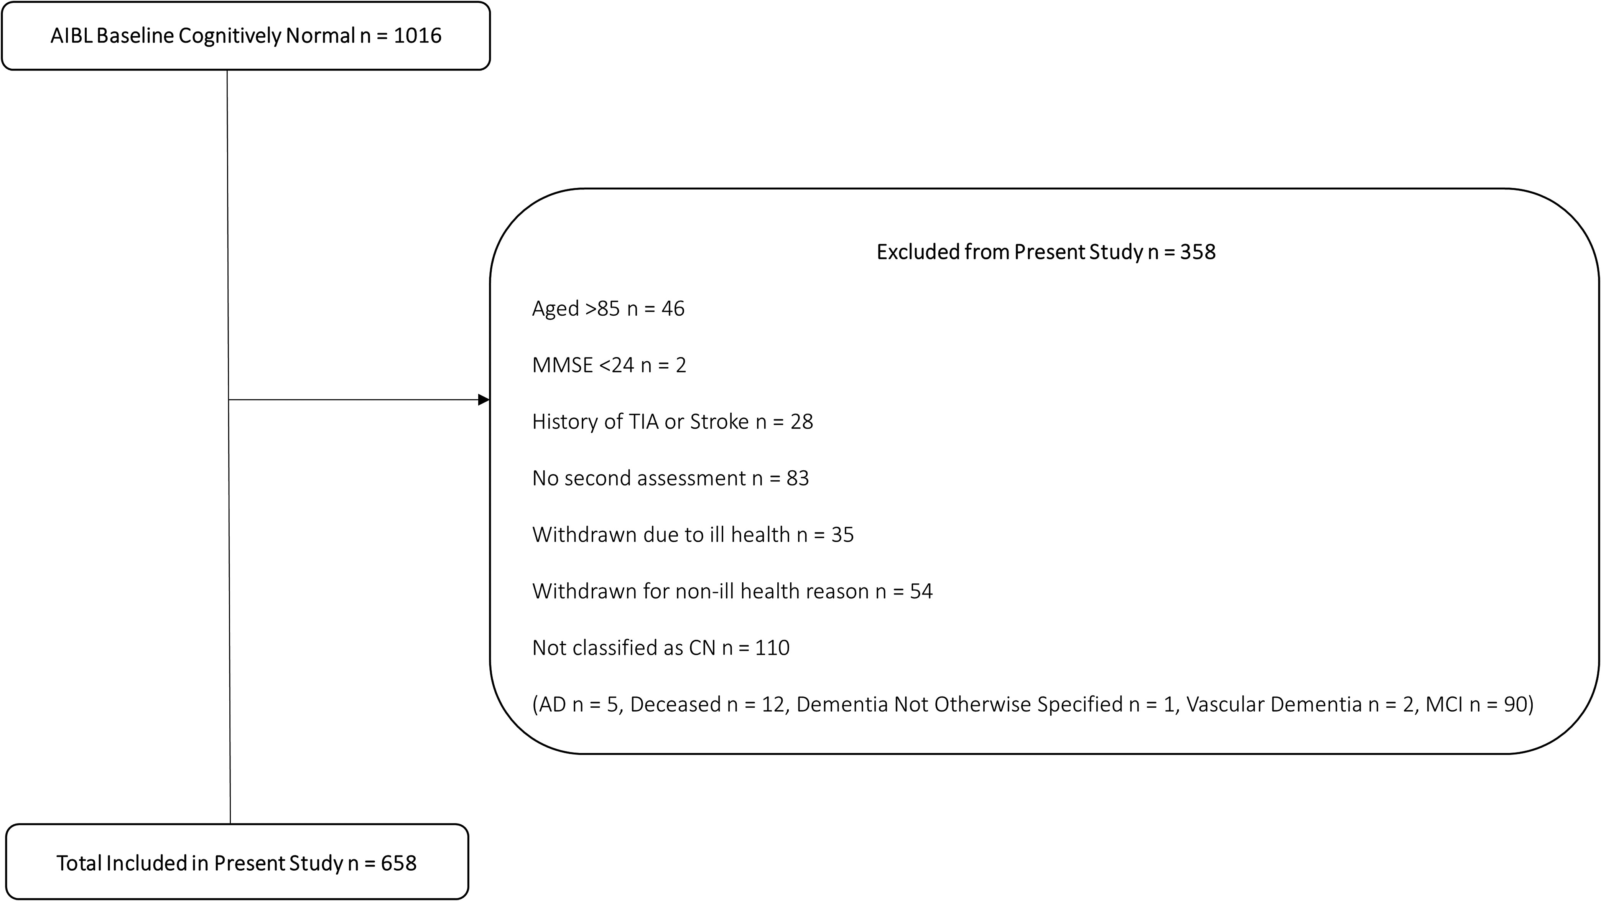
Fig. 1. Study sample screening process.
Notes:
Fig. 1. Study sample screening process.
Unless provided in the caption above, the following copyright applies to the content of this slide: © The Author 2016. Published by Oxford University Press. All rights reserved. For permissions, please e-mail: journals.permissions@oup.com.

Slide 2
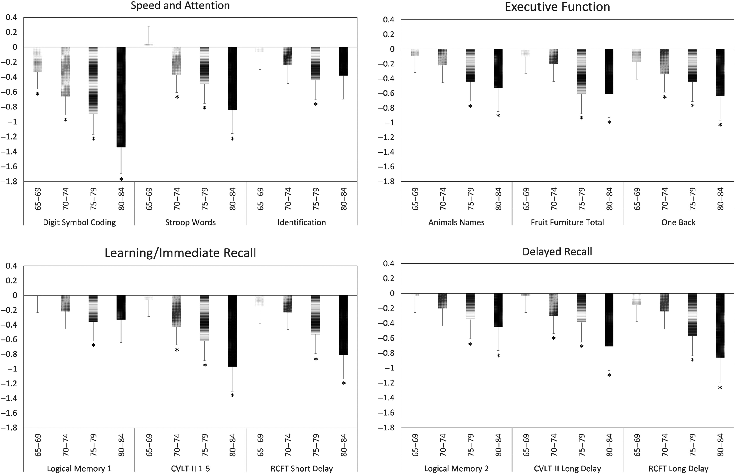
Fig. 2. Magnitude of mean difference (Hedges’ g) in cognitive performance between the 60- to 64-year-old group and ...
Notes:
Fig. 2. Magnitude of mean difference (Hedges’ g) in cognitive performance between the 60- to 64-year-old group and each of the other age groups. *p &lt; .05.
Unless provided in the caption above, the following copyright applies to the content of this slide: © The Author 2016. Published by Oxford University Press. All rights reserved. For permissions, please e-mail: journals.permissions@oup.com.

