Slide 1
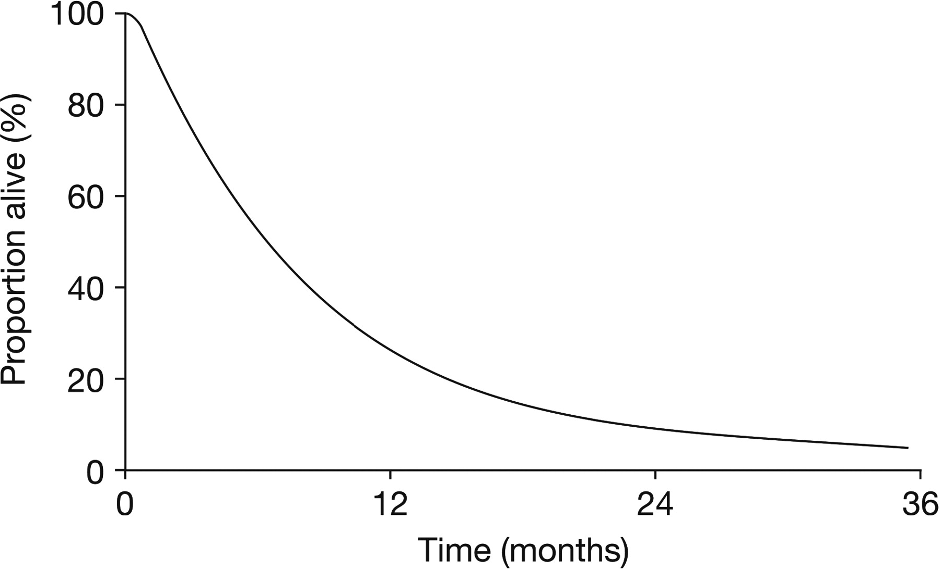
Figure 1 Among 2100 patients with metastatic melanoma enrolled in phase II trials, the median survival time was 6.2 ...
Notes:
Figure 1 Among 2100 patients with metastatic melanoma enrolled in phase II trials, the median survival time was 6.2 months [95% confidence interval (CI) 5.9–6.5 months], with 25.5% (95% CI 23.6% to 27.4%) alive at 1 year. Reprinted with permission from Korn et al. [3]. © 2008 American Society of Clinical Oncology. All rights reserved.
Unless provided in the caption above, the following copyright applies to the content of this slide: © The Author 2012. Published by Oxford University Press on behalf of the European Society for Medical Oncology. All rights reserved. For permissions, please email: journals.permissions@oup.com.

Slide 2
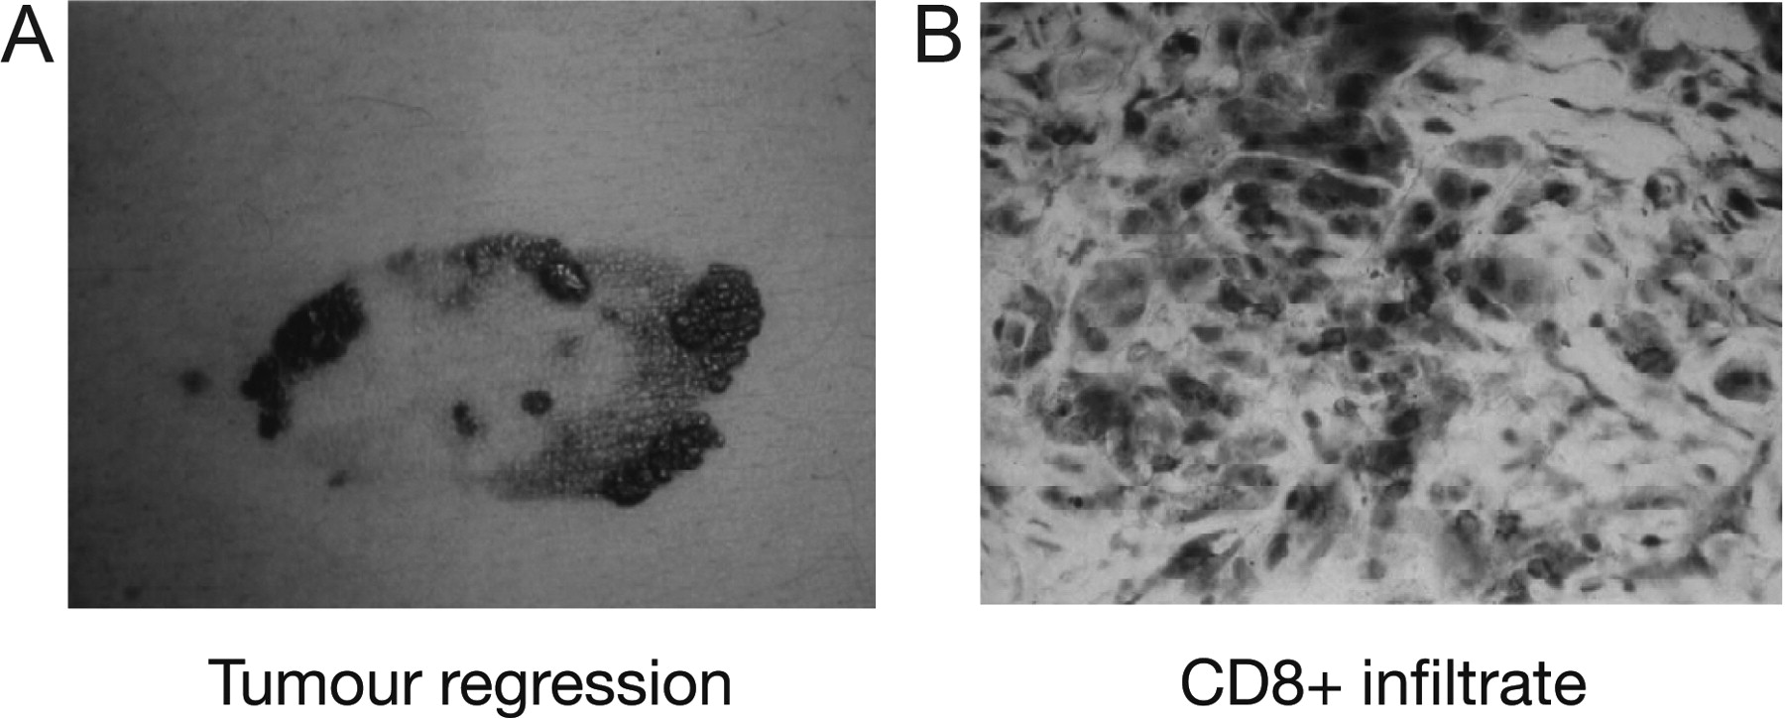
Figure 2 (A) Evidence of spontaneous tumour regression in a patient with melanoma. (B) Histological analysis ...
Notes:
Figure 2 (A) Evidence of spontaneous tumour regression in a patient with melanoma. (B) Histological analysis demonstrates infiltration of CD8+ T cells in regressing lesion.
Unless provided in the caption above, the following copyright applies to the content of this slide: © The Author 2012. Published by Oxford University Press on behalf of the European Society for Medical Oncology. All rights reserved. For permissions, please email: journals.permissions@oup.com.

Slide 3
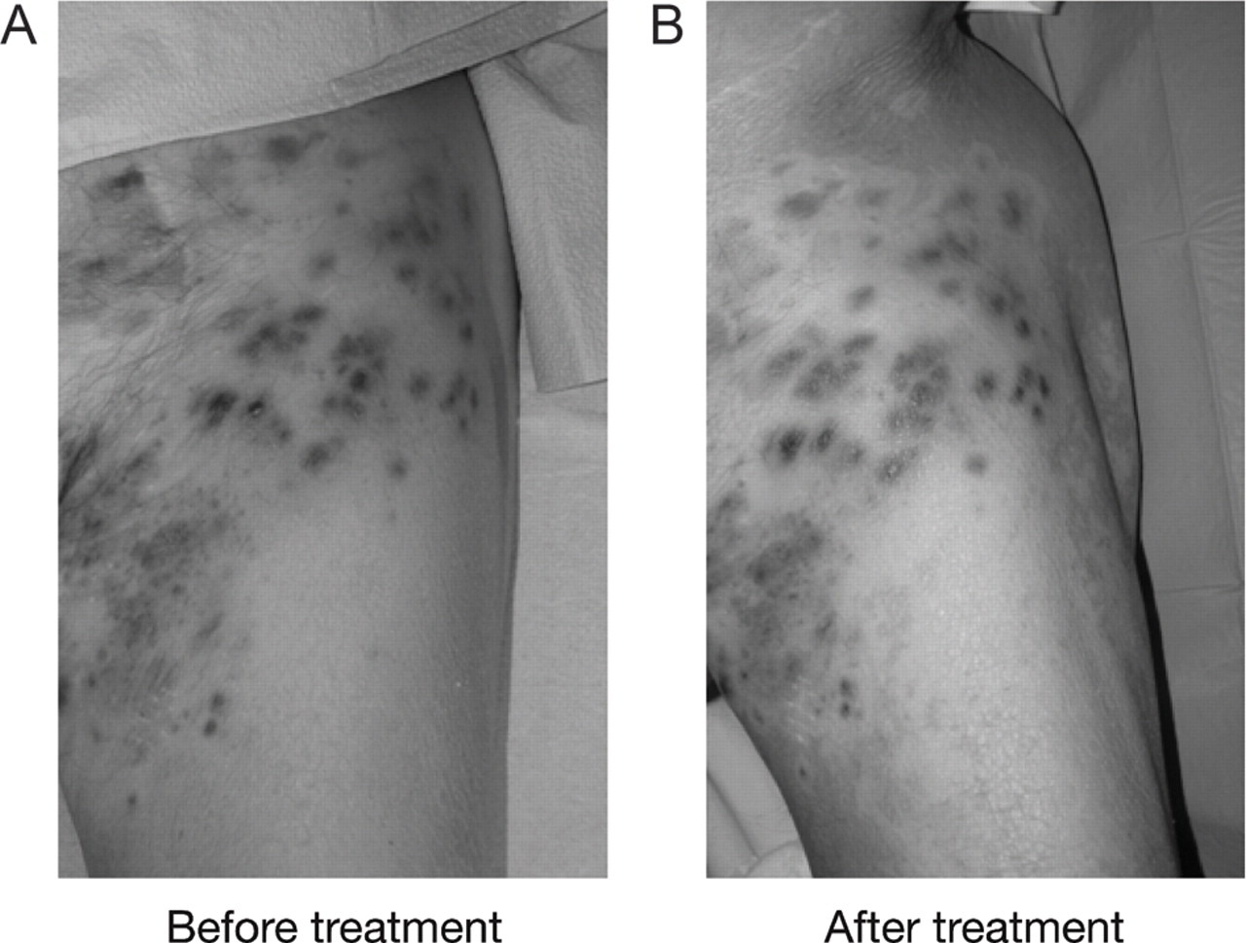
Figure 3 Development of vitiligo in patient with metastatic melanoma following therapy with ipilimumab 10 mg/kg in an ...
Notes:
Figure 3 Development of vitiligo in patient with metastatic melanoma following therapy with ipilimumab 10 mg/kg in an expanded access programme.
Unless provided in the caption above, the following copyright applies to the content of this slide: © The Author 2012. Published by Oxford University Press on behalf of the European Society for Medical Oncology. All rights reserved. For permissions, please email: journals.permissions@oup.com.

Slide 4
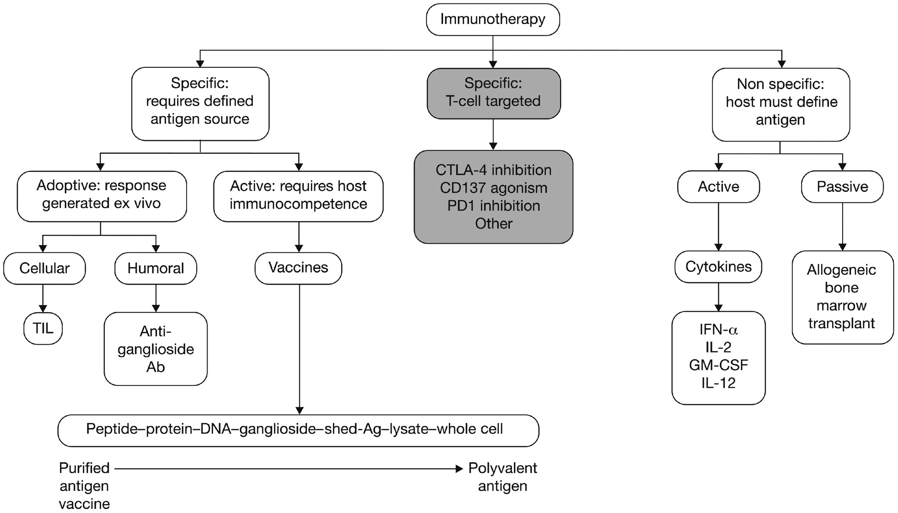
Figure 4 Categorisation of old and new immunotherapies used in the treatment of melanoma. Reproduced with permission ...
Notes:
Figure 4 Categorisation of old and new immunotherapies used in the treatment of melanoma. Reproduced with permission from Faries and Morton [10]. Ab, antibody; Ag, antigen; CTLA-4, cytotoxic T-lymphocyte-associated antigen-4; IFN-α, interferon alpha; IL-2, interleukin-2; IL-12, interleukin-12; GM-CSF, granulocyte-macrophage colony-stimulating factor; PD1, programmed death 1; TIL, tumour-infiltrating lymphocytes.
Unless provided in the caption above, the following copyright applies to the content of this slide: © The Author 2012. Published by Oxford University Press on behalf of the European Society for Medical Oncology. All rights reserved. For permissions, please email: journals.permissions@oup.com.

