Slide 1
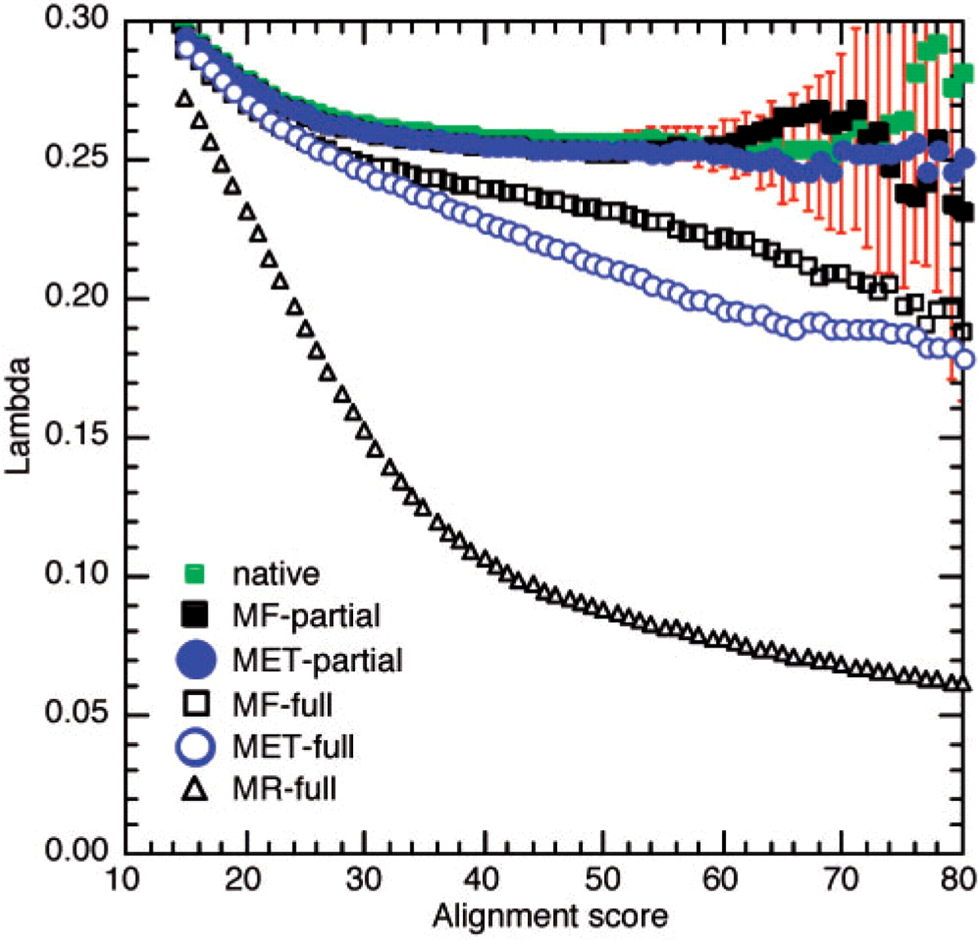
Fig. 1. Estimating λ. Score distribution parameter λ [Equation (1), y-axis] varies with alignment scores (x-axis). In ...
Notes:
Fig. 1. Estimating λ. Score distribution parameter λ [Equation (1), y-axis] varies with alignment scores (x-axis). In practice, we are interested in the asymptotic value of λ for higher scores. Full consensus sequences affected λ significantly (open symbols) when compared to native sequences (green squares). In contrast, partial consensus did not significantly affect λ (filled black and blue symbols). Red error bars estimate the SD (for clarity only shown for native sequences). Note that high alignment scores were attained by few alignments.
Unless provided in the caption above, the following copyright applies to the content of this slide: © 2008 The Author(s)This is an Open Access article distributed under the terms of the Creative Commons Attribution Non-Commercial License (http://creativecommons.org/licenses/by-nc/2.0/uk/) which permits unrestricted non-commercial use, distribution, and reproduction in any medium, provided the original work is properly cited.

Slide 2
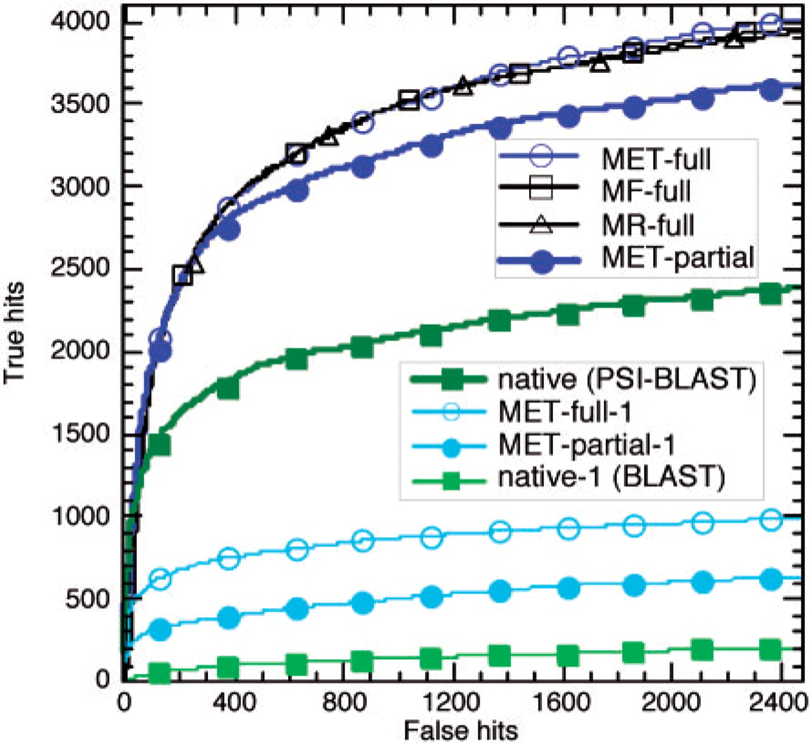
Fig. 2. Comparison of search performance. All-against-all alignments of the test set sequences were ordered by their ...
Notes:
Fig. 2. Comparison of search performance. All-against-all alignments of the test set sequences were ordered by their PSI-BLAST E-values. The cumulative numbers of non-trivial true relations (same SCOP superfamily but different SCOP family) were plotted against the cumulative numbers of false positives (different SCOP-folds). The profile-sequence searches against the full consensus sequences performed best (top three curves: MET-full, MF-full, MR-full). Profile-sequence searches against partial consensus sequences were slightly less efficient (MET-partial), but they were still significantly better than standard profile-sequence (native). Sequence–sequence searches (one cycle of PSI-BLAST with BLOSUM62 matrix) were clearly inferior (MET-full-1, MET-partial-1, native-1).
Unless provided in the caption above, the following copyright applies to the content of this slide: © 2008 The Author(s)This is an Open Access article distributed under the terms of the Creative Commons Attribution Non-Commercial License (http://creativecommons.org/licenses/by-nc/2.0/uk/) which permits unrestricted non-commercial use, distribution, and reproduction in any medium, provided the original work is properly cited.

Slide 3
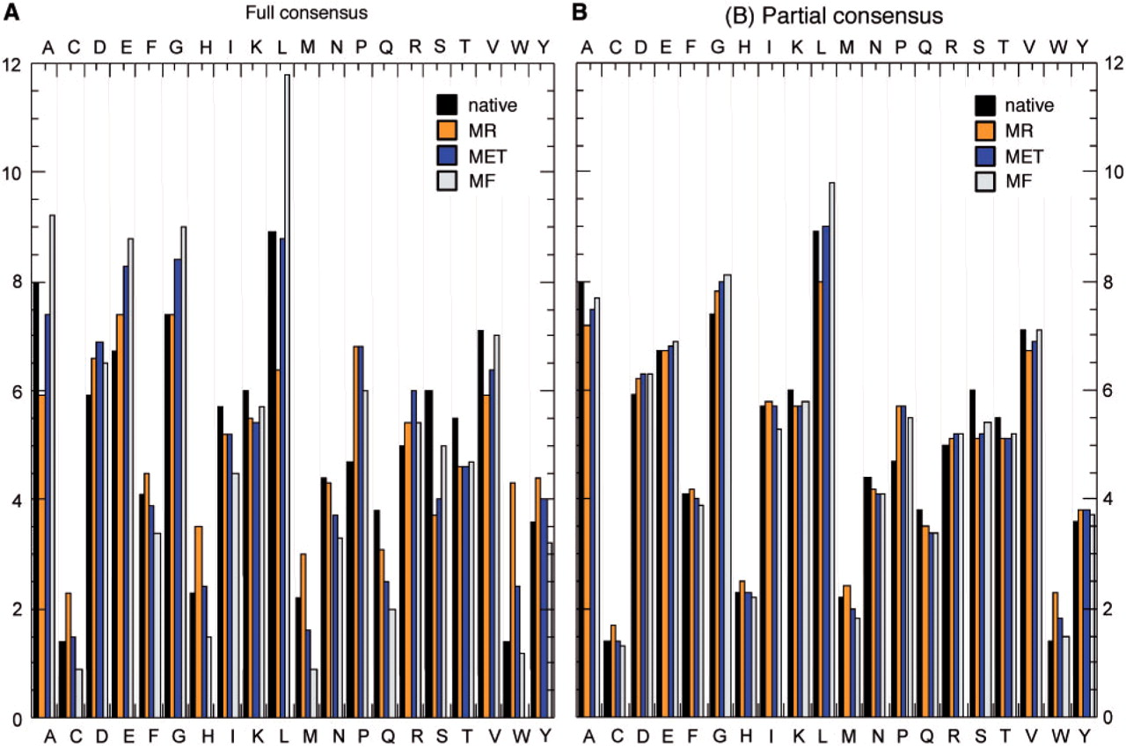
Fig. 3. Comparison of residue compositions. We computed the background residue compositions for consensus and native ...
Notes:
Fig. 3. Comparison of residue compositions. We computed the background residue compositions for consensus and native sequences in our test set. Full consensus sequences (A) differed more from native than partial consensus sequences (B). Choosing the consensus residue corresponding to the highest relative entropy term (blue bars) resulted, on average in smaller deviations from the native composition.
Unless provided in the caption above, the following copyright applies to the content of this slide: © 2008 The Author(s)This is an Open Access article distributed under the terms of the Creative Commons Attribution Non-Commercial License (http://creativecommons.org/licenses/by-nc/2.0/uk/) which permits unrestricted non-commercial use, distribution, and reproduction in any medium, provided the original work is properly cited.

Slide 4
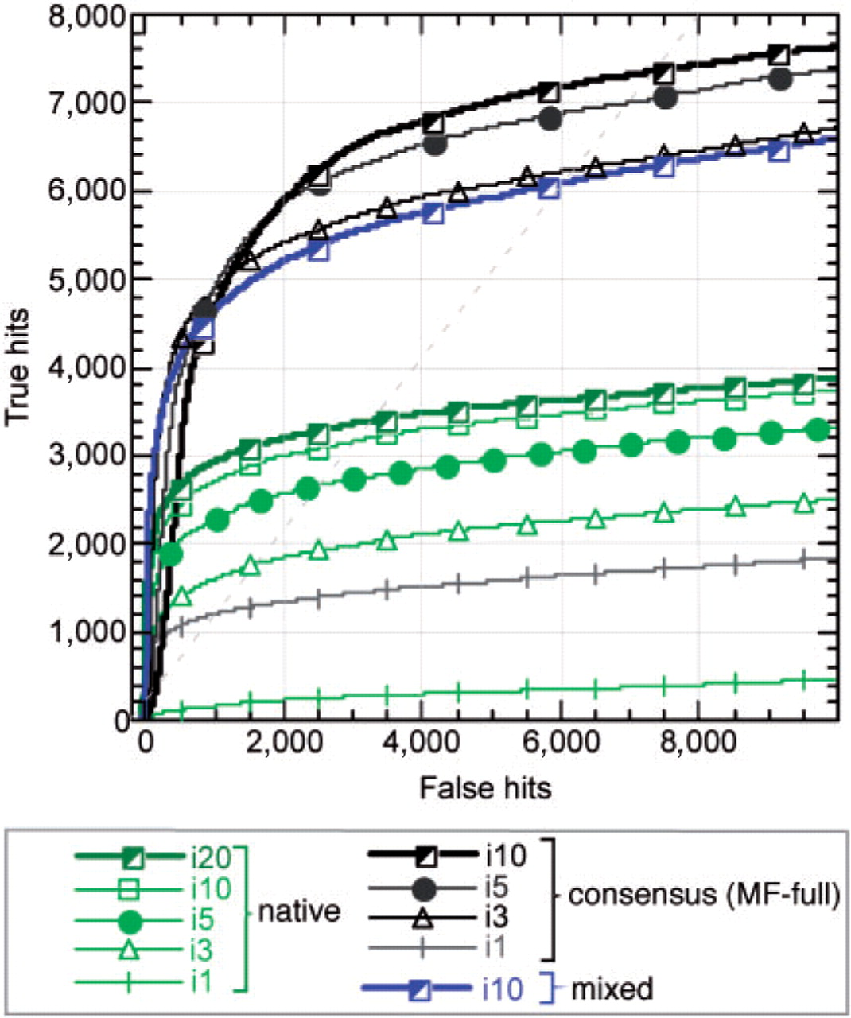
Fig. 4. Iterative PSI-BLAST searches against native and consensus sequences. Iterative PSI-BLAST searches and PSSM ...
Notes:
Fig. 4. Iterative PSI-BLAST searches against native and consensus sequences. Iterative PSI-BLAST searches and PSSM refinements on native sequence database (green lines) resulted in near saturation of performance at about 10 iterations (top two green lines). The corresponding searches on the database of consensus sequences (black lines) found significantly more true hits (same SCOP-fold but different family) with just three iterations (black triangles), while five iterations (black circles) retrieved almost twice as many true hits as the maximum for the native PSI-BLAST. For comparison, a result of the frozen profile-based search against a final database of consensus sequences (MF-full) is presented (blue line).
Unless provided in the caption above, the following copyright applies to the content of this slide: © 2008 The Author(s)This is an Open Access article distributed under the terms of the Creative Commons Attribution Non-Commercial License (http://creativecommons.org/licenses/by-nc/2.0/uk/) which permits unrestricted non-commercial use, distribution, and reproduction in any medium, provided the original work is properly cited.

