Slide 1
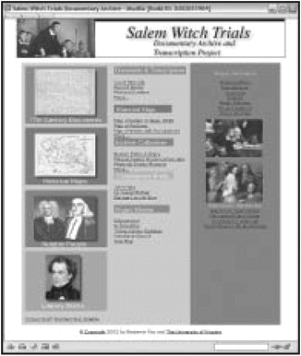
The Salem Witch Trials Documentary Archive and Transcription Project website at ...
Notes:
The Salem Witch Trials Documentary Archive and Transcription Project website at .
Unless provided in the caption above, the following copyright applies to the content of this slide: © 2003 Organization of American Historians (OAH)

Slide 2
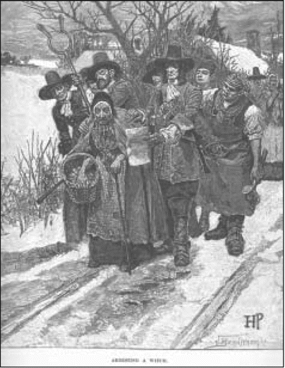
“Arresting a Witch” shows a woman being arrested for witchcraft, depicted conventionally as an old hag by the ...
Notes:
“Arresting a Witch” shows a woman being arrested for witchcraft, depicted conventionally as an old hag by the famous illustrator Howard Pyle. (Harpers New Monthly Magazine 67 [1883]: 221).
Unless provided in the caption above, the following copyright applies to the content of this slide: © 2003 Organization of American Historians (OAH)

Slide 3
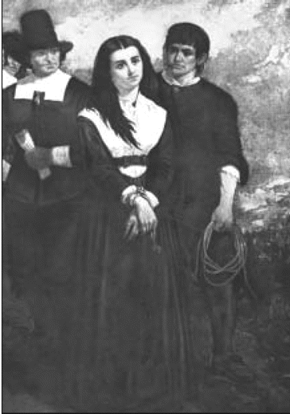
“Witch Hill or The Salem Martyr” by Thomas Noble Slatterwhite, 1869. This image of a modest girl about to be ...
Notes:
“Witch Hill or The Salem Martyr” by Thomas Noble Slatterwhite, 1869. This image of a modest girl about to be hanged for witchcraft contrasts sharply with Howard Pyle's image on the left. (Image courtesy of the New-York Historical Society, New York City)
Unless provided in the caption above, the following copyright applies to the content of this slide: © 2003 Organization of American Historians (OAH)

Slide 4
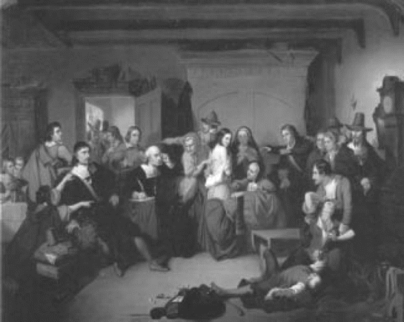
“Examination of a Witch” Generally supposed to represent an event in the Salem witch trials, an earlier ...
Notes:
“Examination of a Witch” Generally supposed to represent an event in the Salem witch trials, an earlier version of this painting was exhibited by the artist in New York in 1848 with a quotation from John Greenleaf Whittier's book Supernaturalism of New England, 1847: “Mary Fisher, a young girl, was seized upon by Deputy Governor Bellingham in the absence of Governor Endicott, and shamefully stripped for the purpose of ascertaining whether she was a witch, with the Devil's mark upon her.” (Painting by Thompkins H. Matteson, 1853. Photograph courtesy of Peabody Essex Museum, Salem, MA.)
Unless provided in the caption above, the following copyright applies to the content of this slide: © 2003 Organization of American Historians (OAH)

Slide 5
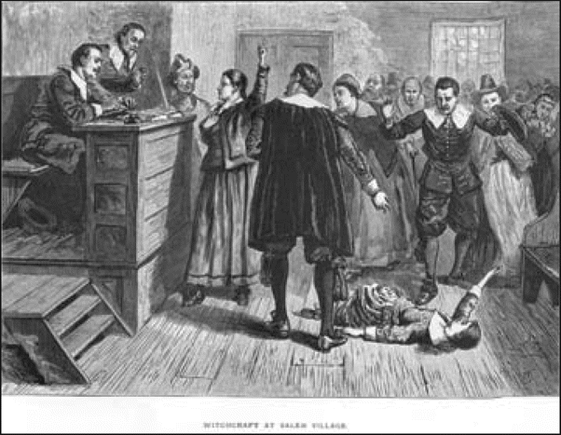
“Witchcraft at Salem Village” In this courtroom scene, an accused woman holds her right hand over her heart ...
Notes:
“Witchcraft at Salem Village” In this courtroom scene, an accused woman holds her right hand over her heart and gestures upward—as though she were declaring her innocence before God—while an “afflicted” girl falls on the floor in front of the judge's bench. (From William A. Crafts, Pioneers in the Settlement of America, Vol. I [Boston: Samuel Walker & Company, 1876].)
Unless provided in the caption above, the following copyright applies to the content of this slide: © 2003 Organization of American Historians (OAH)

Slide 6
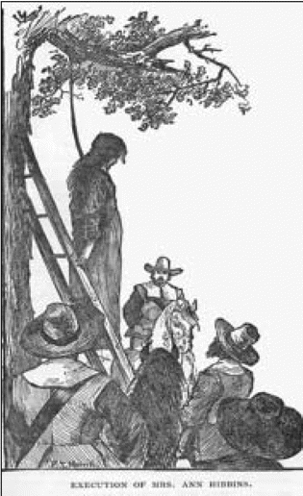
“Execution of Mrs. Ann Hibbins” by F. T. Merrill, 1886. This illustration depicts the execution of Ann ...
Notes:
“Execution of Mrs. Ann Hibbins” by F. T. Merrill, 1886. This illustration depicts the execution of Ann Hibbins on Boston Commons in 1657. (From Clarence W. Hobbs, Lynn and Surroundings [Lynn, MA: Lewis & Winship Publishers, 1886], 52.)
Unless provided in the caption above, the following copyright applies to the content of this slide: © 2003 Organization of American Historians (OAH)

Slide 7
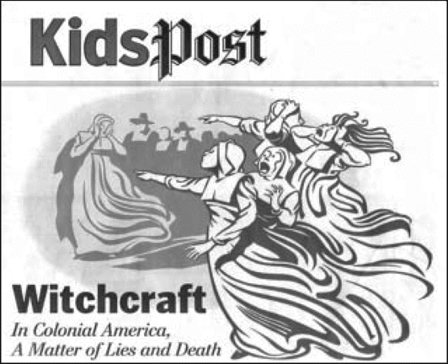
“Witchcraft in Colonial America: A Matter of Lies and Death” by Steven McCracken, 2001. A scene of ...
Notes:
“Witchcraft in Colonial America: A Matter of Lies and Death” by Steven McCracken, 2001. A scene of “afflicted” girls in Salem, accusing a woman of witchcraft. (Washington Post, “KidsPost”, 31 October 2001. © Washington Post.)
Unless provided in the caption above, the following copyright applies to the content of this slide: © 2003 Organization of American Historians (OAH)

