Slide 1
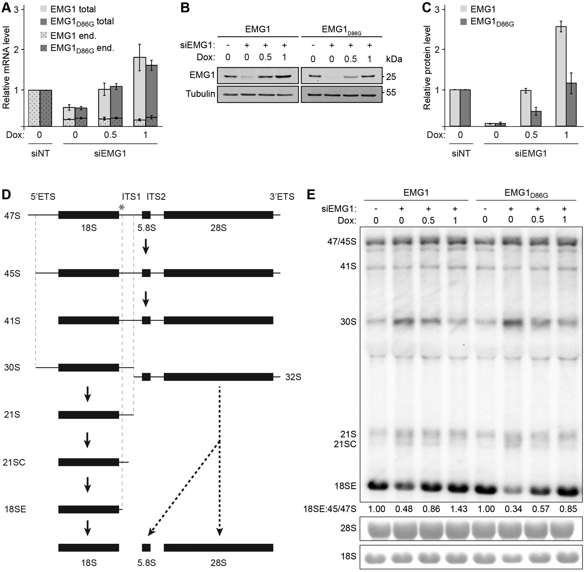
Figure 1. The Bowen-Conradi syndrome mutation destabilises the EMG1 protein. (A) HEK293 cell lines were transfected ...
Notes:
Figure 1. The Bowen-Conradi syndrome mutation destabilises the EMG1 protein. (A) HEK293 cell lines were transfected with non-target siRNAs (siNT) or siRNAs against EMG1 (siEMG1) and RNAi was performed for 72 h. 24 h before harvesting, expression of untagged wild-type EMG1 (EMG1) or EMG1 carrying the Bowen-Conradi syndrome mutation (EMG1D86G) was induced by addition of doxycycline at the concentrations indicated (ng/ml). After harvesting of cells, RNA was extracted and the level of the endogenous EMG1 mRNA (end.), and the endogenous and tet-induced EMG1 mRNAs (total), normalised to the GAPDH mRNA was determined by qPCR. Data from three independent experiments are shown as mean +/- SEM. (B-C) Proteins extracted from siRNA-treated cells prepared as described in (A) were analysed by SDS-PAGE followed by western blotting using antibodies against EMG1 and Tubulin (B), and the levels of EMG1 protein, normalised to Tubulin were quantified (C). Data from three independent experiments are shown as mean +/- SEM. (D) Simplified schematic overview of pre-rRNA processing in human cells. Mature rRNAs are shown as filled rectangles and spacers as lines. ETS – external transcribed spacer; ITS – internal transcribed spacer. An asterisk indicates the target site on the 47S pre-rRNA of the probe used for northern blotting. (E) Pre-rRNA levels in total cellular RNA prepared as described in (A) were analysed by northern blotting using a probe hybridising to the 5’ end of ITS1. Numbers below the northern blot panel indicate the relative quantitation of the 18SE pre-rRNA compared to 47/45S pre-rRNAs. The mature 18S and 28S rRNAs were visualised by methylene blue staining.
Unless provided in the caption above, the following copyright applies to the content of this slide: © The Author 2016. Published by Oxford University Press.This is an Open Access article distributed under the terms of the Creative Commons Attribution Non-Commercial License (http://creativecommons.org/licenses/by-nc/4.0/), which permits non-commercial re-use, distribution, and reproduction in any medium, provided the original work is properly cited. For commercial re-use, please contact journals.permissions@oup.com

Slide 2
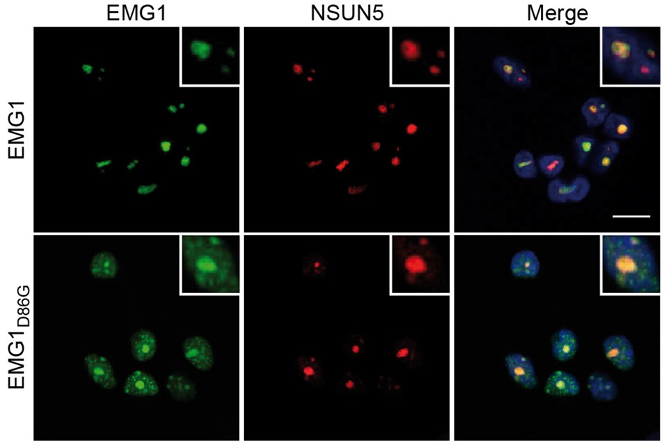
Figure 2 EMG1_{D86G} accumulates in nuclear foci HEK293 cell lines were transfected with siRNAs against EMG1 ...
Notes:
Figure 2 EMG1D86G accumulates in nuclear foci HEK293 cell lines were transfected with siRNAs against EMG1 and the expression of untagged, siRNA-insensitive wild-type EMG1 (EMG1) or EMG1 carrying the Bowen-Conradi syndrome mutation (EMG1D86G) was induced at the endogenous level by the addition of doxycycline. Cells were fixed and immunofluorescence was performed using antibodies against EMG1 (green) and NSUN5 (nucleolar marker; red), and nuclei were visualised by DAPI staining (blue) in the overlay (merge). Scale bar indicates 10 μm.
Unless provided in the caption above, the following copyright applies to the content of this slide: © The Author 2016. Published by Oxford University Press.This is an Open Access article distributed under the terms of the Creative Commons Attribution Non-Commercial License (http://creativecommons.org/licenses/by-nc/4.0/), which permits non-commercial re-use, distribution, and reproduction in any medium, provided the original work is properly cited. For commercial re-use, please contact journals.permissions@oup.com

Slide 3
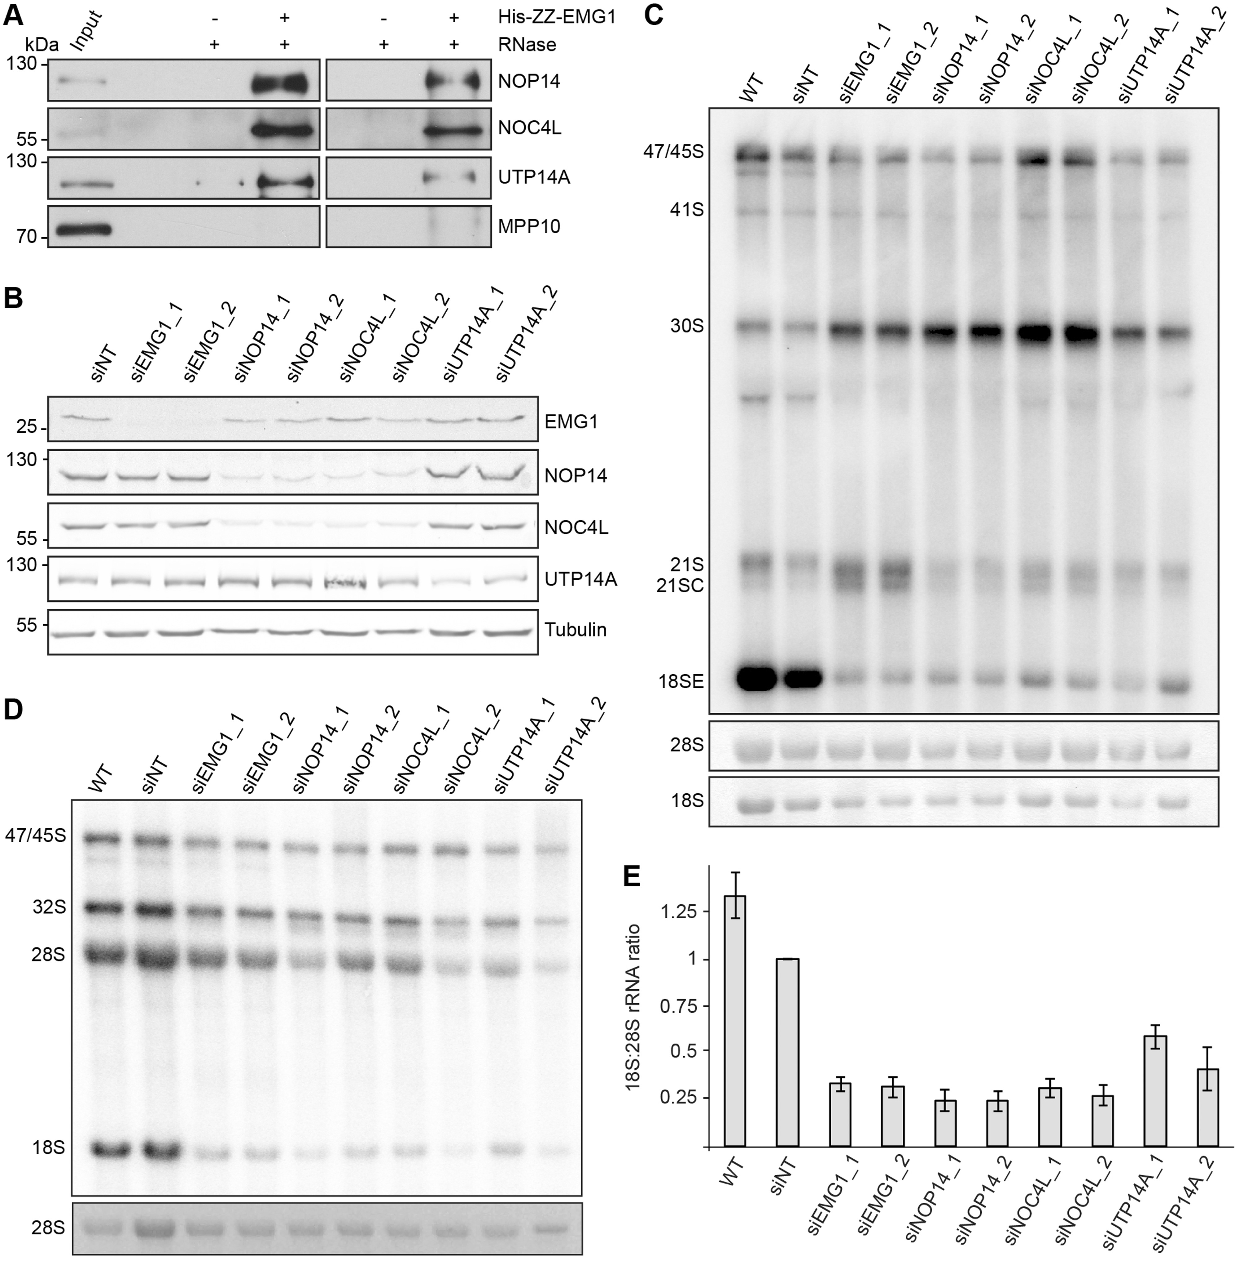
Figure 3 EMG1 is part of a pre-ribosomal subcomplex containing NOP14, NOC4L and UTP14a. (A) His-ZZ-tagged EMG1 was ...
Notes:
Figure 3 EMG1 is part of a pre-ribosomal subcomplex containing NOP14, NOC4L and UTP14a. (A) His-ZZ-tagged EMG1 was immobilised on IgG sepharose and after incubation with HeLa cell lysate, complexes were treated with RNase (+) or left untreated (-). EMG1 and co-precipitated proteins were eluted by cleavage using TEV protease and eluates were analysed by western blotting using antibodies against the indicated endogenous proteins. (B) HeLa cells were transfected with non-target siRNAs (siNT) or siRNAs against NOP14, NOC4L, UTP14A or EMG1 and harvested after 72 h. Proteins were analysed by western blotting using antibodies against the indicated ribosome biogenesis cofactors, and tubulin as loading control. (C) HeLa cells were treated with siRNAs as in (B), total RNA was extracted and pre-rRNA levels were monitored by northern blotting using a probe hybridising the 5’ end of ITS1. The mature 18S and 28S rRNA, visualised by methylene blue staining, served as a loading control. (D) HeLa cells were transfected with siRNAs as in (B) and after 72 h, cells were pulse-labelled with 32P-orthophosphate and then grown in normal media for a further 3 h. Total RNA was extracted, separated by agarose-glyoxal gel electrophoresis and newly synthesised precursor and mature rRNAs were detected using a phosphorimager. Mature 28S rRNA, visualised by ethidium bromide staining, served as a loading control. (E) The ratio of newly synthesised 18S to 28S rRNAs was quantified in the pulse-labelling experiments and data from three independent experiments are shown as mean +/- SEM.
Unless provided in the caption above, the following copyright applies to the content of this slide: © The Author 2016. Published by Oxford University Press.This is an Open Access article distributed under the terms of the Creative Commons Attribution Non-Commercial License (http://creativecommons.org/licenses/by-nc/4.0/), which permits non-commercial re-use, distribution, and reproduction in any medium, provided the original work is properly cited. For commercial re-use, please contact journals.permissions@oup.com

Slide 4
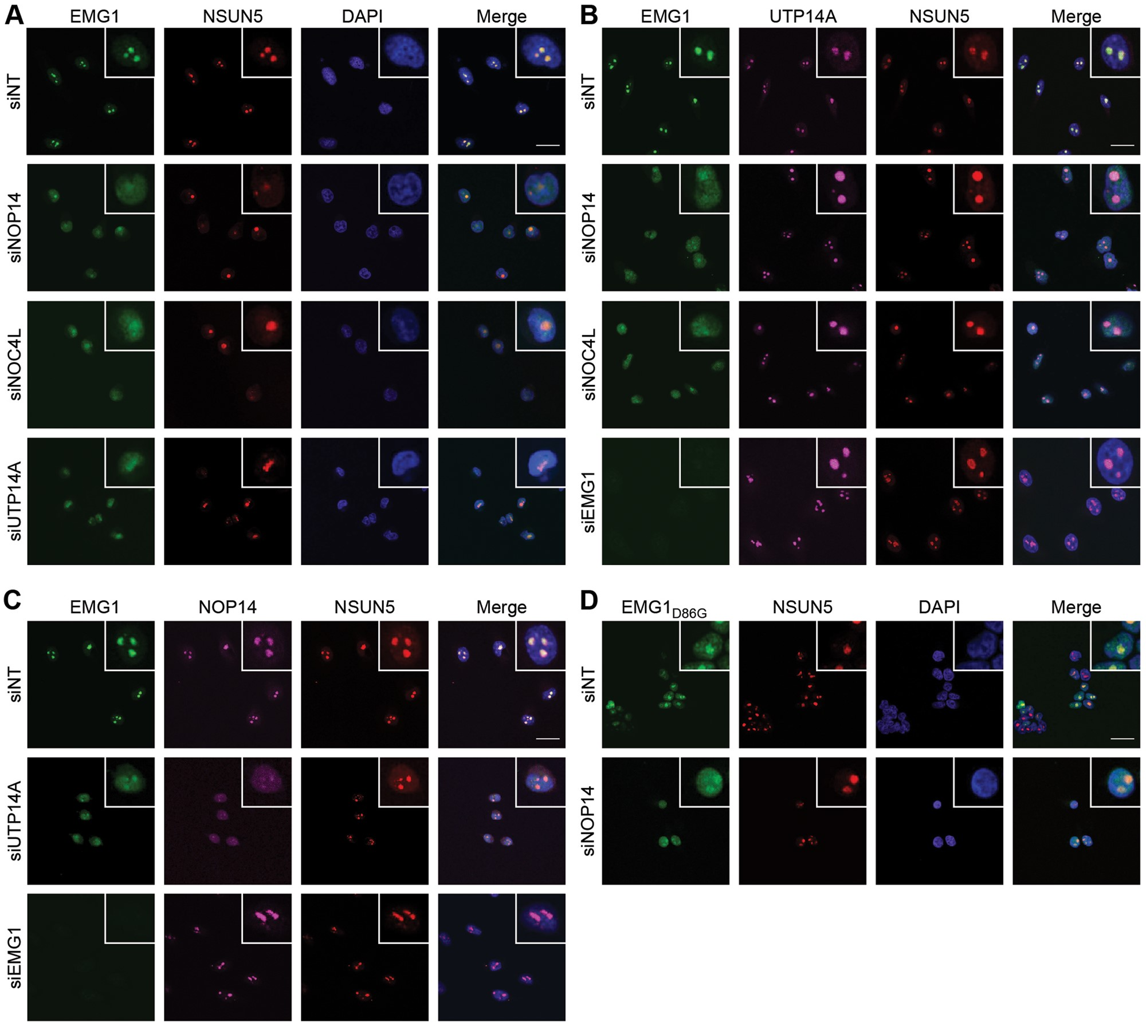
Figure 4 Hierarchical recruitment of EMG1, NOP14/NOC4L and UTP14A into the nucleolus. (A–C) HeLa cells were ...
Notes:
Figure 4 Hierarchical recruitment of EMG1, NOP14/NOC4L and UTP14A into the nucleolus. (A–C) HeLa cells were transfected with non-target siRNAs (siNT) or those targeting the factors indicated to the left of each panel and the localisation of EMG1 (green), NSUN5 (red) and UTP14A or NOP14 (purple) was determined by immunofluorescence using antibodies against the endogenous proteins. Nuclear material was visualised by DAPI staining (blue). The scale bar indicates 20 μm. (D) HEK293 cell lines expressing siRNA-resistant, untagged EMG1 or EMG1D86G at endogenous levels were transfected with siRNAs against endogenous EMG1 and co-transfected with either non-target siRNAs (siNT) or siRNAs against NOP14. The localisation of EMG1 and EMG1D86G was determined by immunofluorescence using an anti-EMG1 antibody. Nuclear material was visualised by DAPI staining (blue). The scale bar indicates 20 μm.
Unless provided in the caption above, the following copyright applies to the content of this slide: © The Author 2016. Published by Oxford University Press.This is an Open Access article distributed under the terms of the Creative Commons Attribution Non-Commercial License (http://creativecommons.org/licenses/by-nc/4.0/), which permits non-commercial re-use, distribution, and reproduction in any medium, provided the original work is properly cited. For commercial re-use, please contact journals.permissions@oup.com

Slide 5
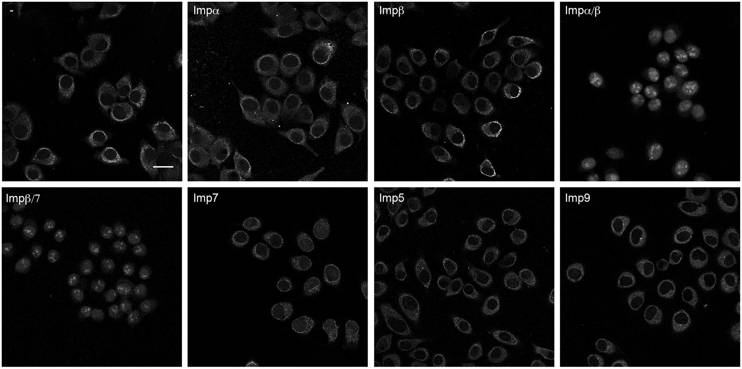
Figure 5 Nuclear import of Emg1 can be mediated by Impα/β or the Impβ/7 heterodimer. Import of GFP-tagged EMG1 into ...
Notes:
Figure 5 Nuclear import of Emg1 can be mediated by Impα/β or the Impβ/7 heterodimer. Import of GFP-tagged EMG1 into the nuclei of permeabilised HeLa cells was performed in the presence of Ran, an energy-regenerating system and the importins indicated. The localisation of EMG1 was determined by confocal fluorescence microscopy. The scale bar indicates 25 μm.
Unless provided in the caption above, the following copyright applies to the content of this slide: © The Author 2016. Published by Oxford University Press.This is an Open Access article distributed under the terms of the Creative Commons Attribution Non-Commercial License (http://creativecommons.org/licenses/by-nc/4.0/), which permits non-commercial re-use, distribution, and reproduction in any medium, provided the original work is properly cited. For commercial re-use, please contact journals.permissions@oup.com

Slide 6
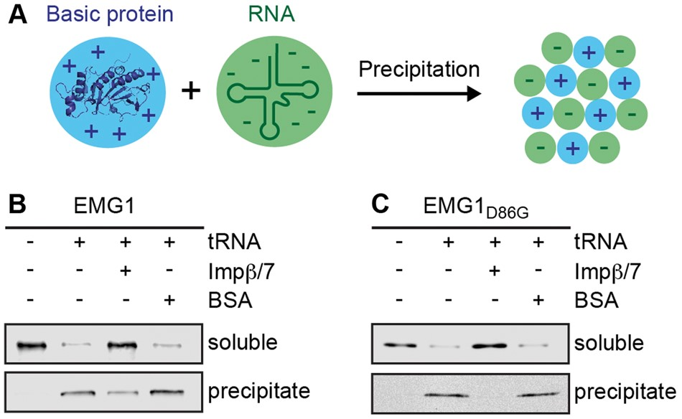
Figure 6 The importinβ/7 complex suppresses EMG1 precipitation in the presence of polyanions. (A) Schematic view of ...
Notes:
Figure 6 The importinβ/7 complex suppresses EMG1 precipitation in the presence of polyanions. (A) Schematic view of the precipitation of basic proteins in the presence of polyanions such as nucleic acids. (B) Soluble His-ZZ-tagged EMG1 alone or together with recombinantly expressed Impβ/7 or BSA was incubated with tRNA. After centrifugation, soluble and precipitated proteins were analysed by western blotting using an antibody against EMG1. (C) The anti-aggregation assay was performed using EMG1D86G as described in (B), but under less basic conditions to improve solubility of the mutant protein.
Unless provided in the caption above, the following copyright applies to the content of this slide: © The Author 2016. Published by Oxford University Press.This is an Open Access article distributed under the terms of the Creative Commons Attribution Non-Commercial License (http://creativecommons.org/licenses/by-nc/4.0/), which permits non-commercial re-use, distribution, and reproduction in any medium, provided the original work is properly cited. For commercial re-use, please contact journals.permissions@oup.com

Slide 7
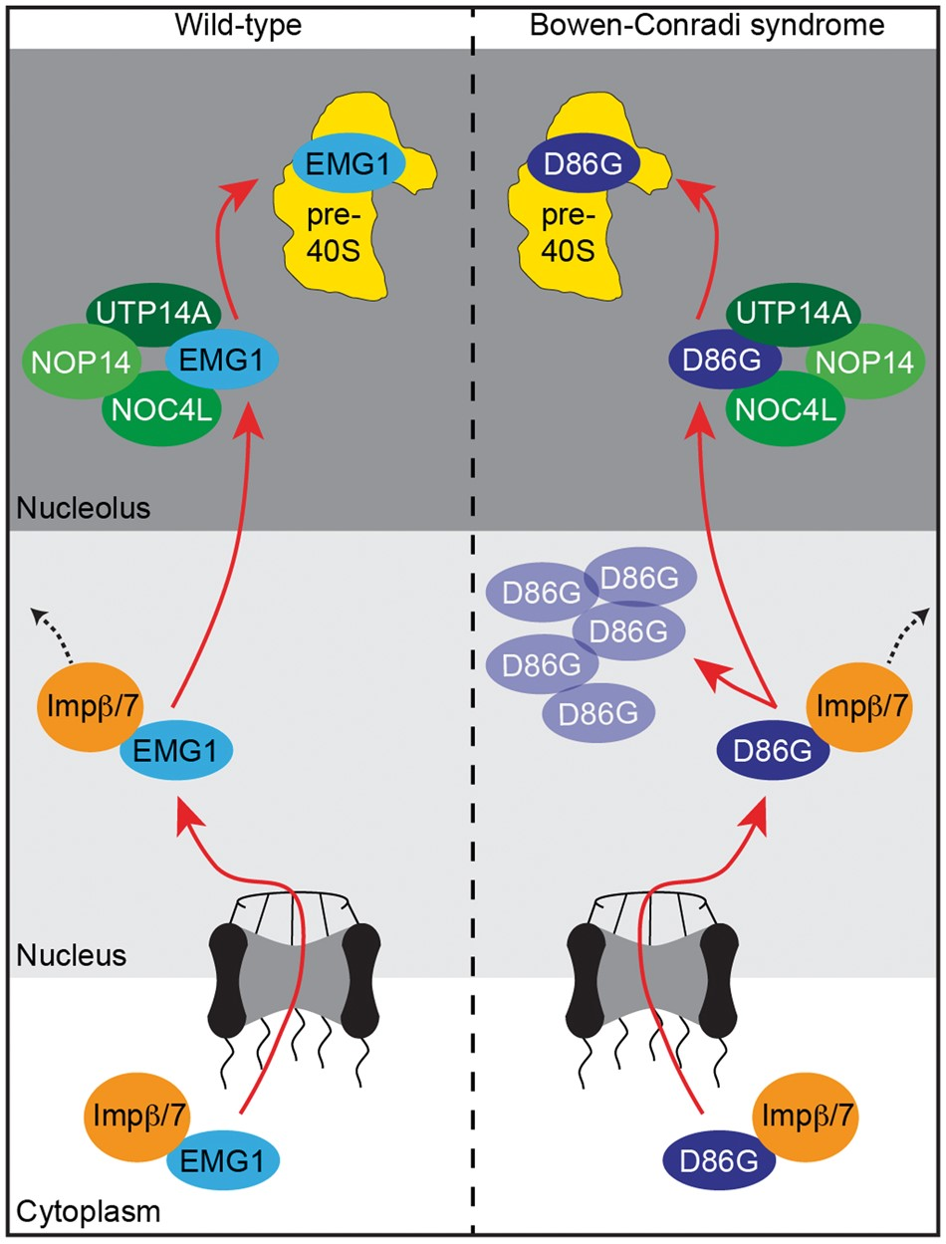
Figure 7 EMG1 in Bowen-Conradi syndrome. The Impβ/7 dimer binds to EMG1 in the cytoplasm and acts as a chaperone ...
Notes:
Figure 7 EMG1 in Bowen-Conradi syndrome. The Impβ/7 dimer binds to EMG1 in the cytoplasm and acts as a chaperone during nuclear import of EMG1. EMG1 is then recruited by a subcomplex containing NOP14, NOC4L and UTP14a to the nucleolus where is fulfils its essential functions in the biogenesis of the small ribosomal subunit. In Bowen-Conradi syndrome, EMG1D86G is chaperoned into the nucleus by Impβ/7, where it accumulates in nuclear speckles leading to proteasome-dependent protein degradation. Only a fraction of EMG1D86G can be recruited to the nucleolus and the decreased pre-ribosomal levels of EMG1D86G lead to defects in small ribosomal subunit maturation.
Unless provided in the caption above, the following copyright applies to the content of this slide: © The Author 2016. Published by Oxford University Press.This is an Open Access article distributed under the terms of the Creative Commons Attribution Non-Commercial License (http://creativecommons.org/licenses/by-nc/4.0/), which permits non-commercial re-use, distribution, and reproduction in any medium, provided the original work is properly cited. For commercial re-use, please contact journals.permissions@oup.com

