Slide 1
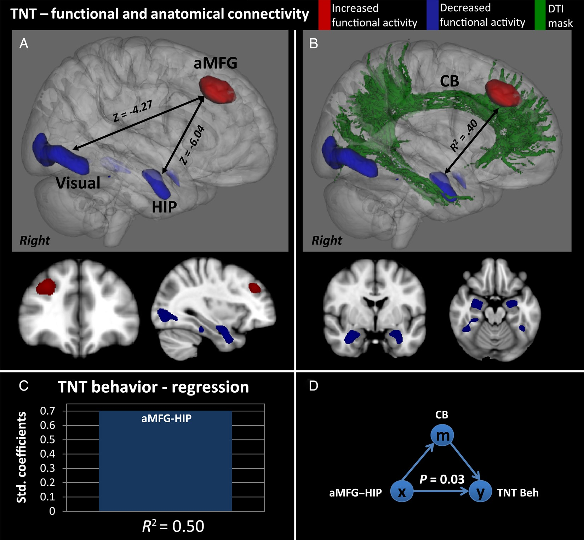
Figure 1. Functional and anatomical connectivity of the TNT (N = 21). (A) Significant brain regions of seed-based ...
Notes:
Figure 1. Functional and anatomical connectivity of the TNT (N = 21). (A) Significant brain regions of seed-based functional connectivity identified through the GLM. Z indicates the maximum functional connectivity parameter estimate (red/upregulation and blue/downregulation). (B) Significant WM tracts overlayed on the functional pathways, of which FA values predict the functional coherence. R2 indicates the variance explained in the functional connectivity by the FA values from the CB. (C) Feature selection and multiple regression indicating the combination of predictors (aMFG–HIP) explaining the most variance in behavior (inhibition of memory retrieval). (D) Mediation analyses testing the indirect effect of a mediator (CB) on the relationship between the independent (aMFG–HIP) and dependent variables (inhibition of memory retrieval).
Unless provided in the caption above, the following copyright applies to the content of this slide: © The Author 2015. Published by Oxford University Press. All rights reserved. For Permissions, please e-mail: journals.permissions@oup.com

Slide 2
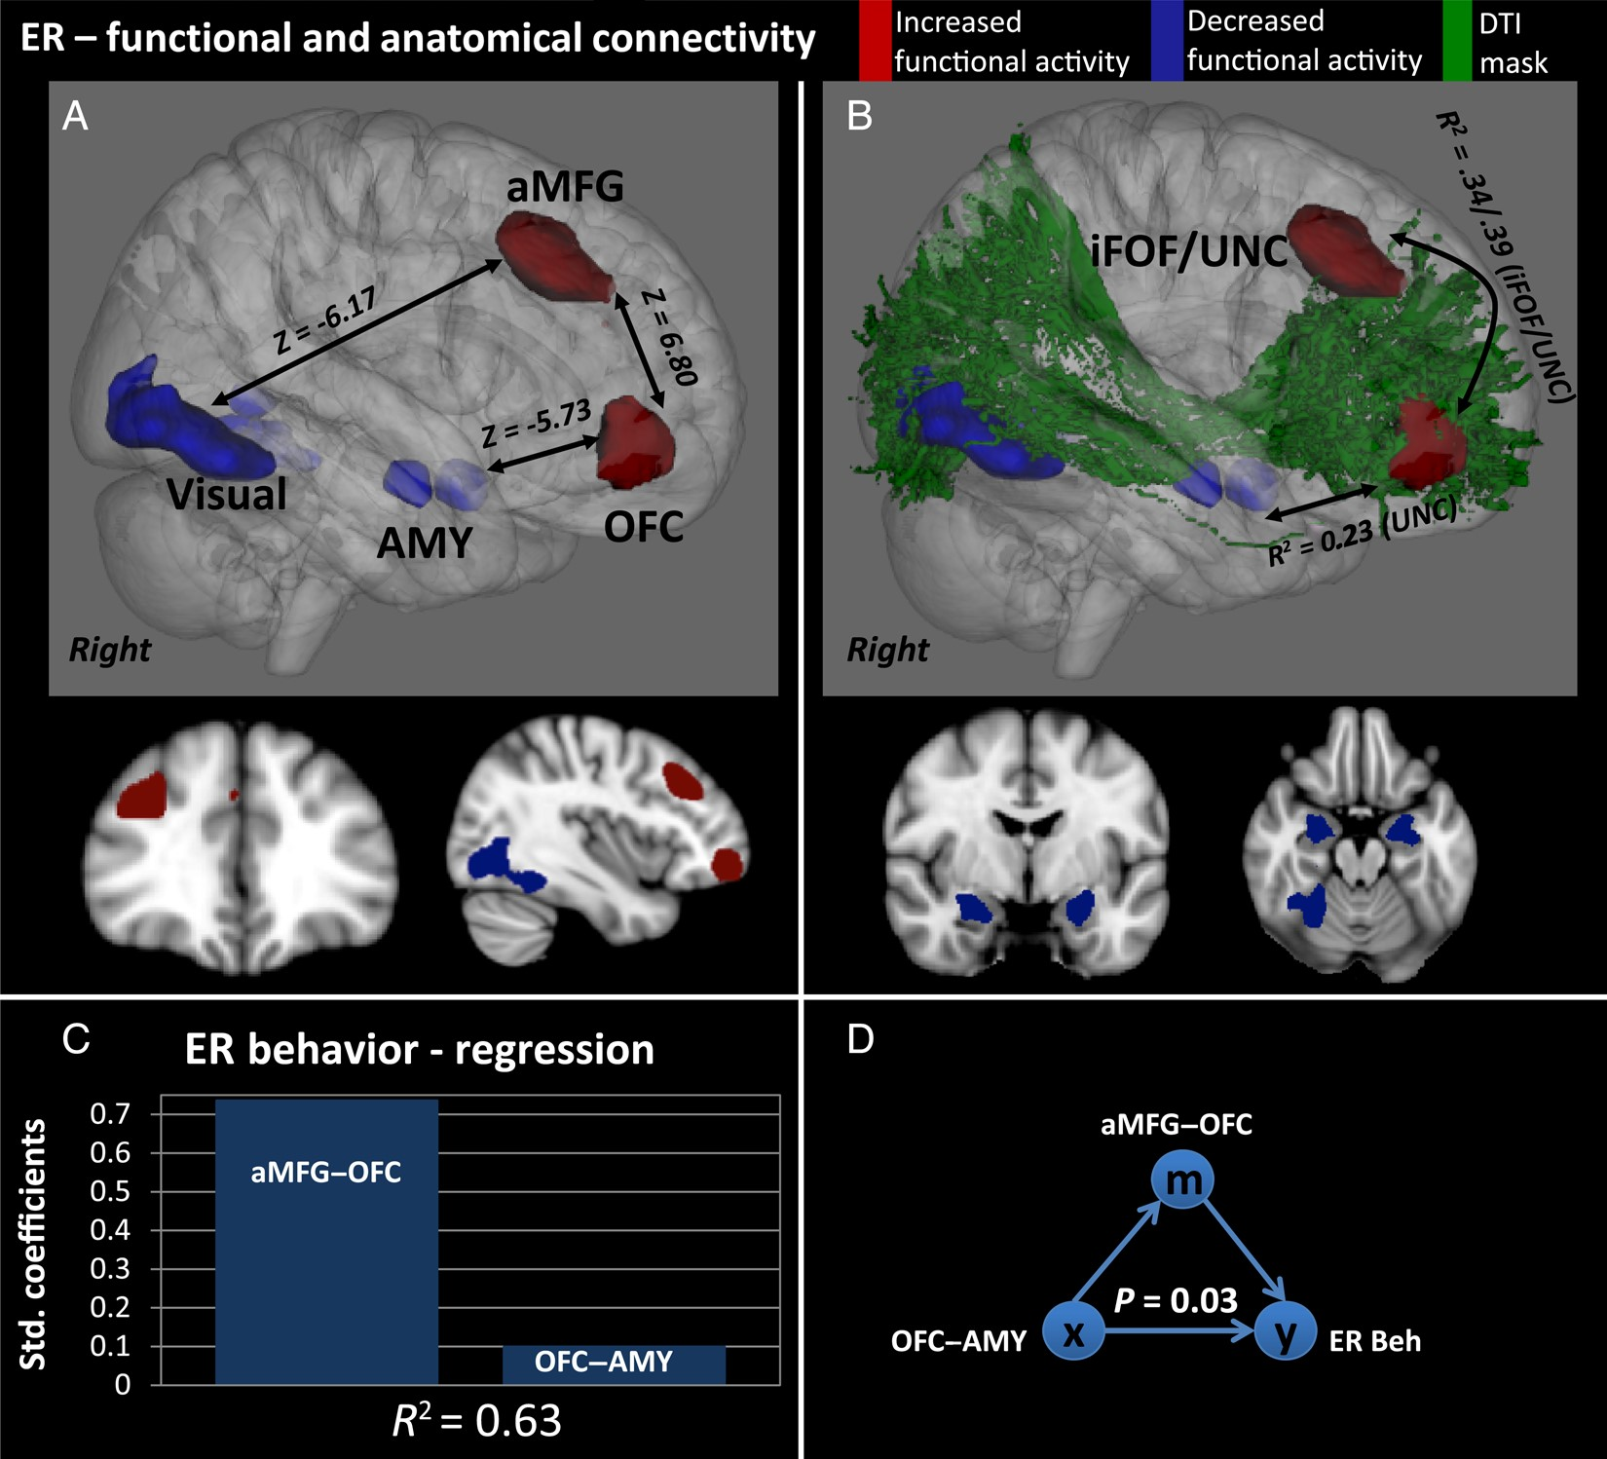
Figure 2. Functional and anatomical connectivity of the emotion regulation task (ER) (N = 21). (A) Significant brain ...
Notes:
Figure 2. Functional and anatomical connectivity of the emotion regulation task (ER) (N = 21). (A) Significant brain regions of seed-based functional connectivity identified through the GLM. Z indicates the maximum functional connectivity parameter estimate (red/upregulation and blue/downregulation). (B) Significant WM tracts overlayed on the functional pathways, of which FA values predict the functional coherence. R2 indicates the variance explained in the functional connectivity by the FA values from the iFOF and UNC. (C) Feature selection and multiple regression indicating the combination of predictors (aMFG–OFC and OFC–AMY) explaining the most variance in behavior (inhibition of emotional response). (D) Mediation analyses testing the indirect effect of a mediator (aMFG–OFC) on the relationship between the independent (OFC–AMY) and dependent variables (inhibition of emotional response).
Unless provided in the caption above, the following copyright applies to the content of this slide: © The Author 2015. Published by Oxford University Press. All rights reserved. For Permissions, please e-mail: journals.permissions@oup.com

Slide 3
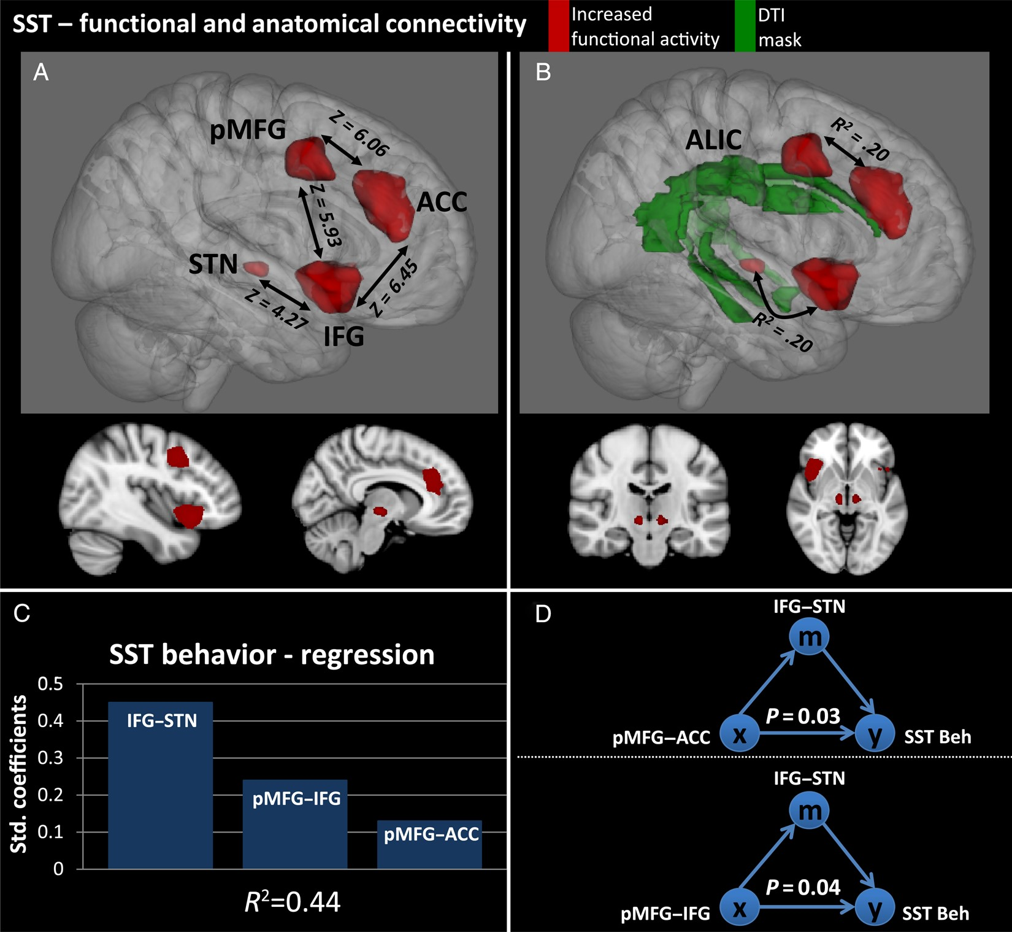
Figure 3. Functional and anatomical connectivity of the SST (N = 21). (A) Significant brain regions of seed-based ...
Notes:
Figure 3. Functional and anatomical connectivity of the SST (N = 21). (A) Significant brain regions of seed-based functional connectivity identified through the GLM. Z indicates the maximum functional connectivity parameter estimate (red/upregulation and blue/downregulation). (B) Significant WM tracts overlayed on the functional pathways, of which FA values predict the functional coherence. R2 indicates the variance explained in the functional connectivity by the FA values from the ALIC. (C) Feature selection and multiple regression indicating the combination of predictors (IFG–STN, pMFG–IFG, and pMFG–ACC) explaining the most variance in behavior (inhibition of motor response). (D) Mediation analyses testing the indirect effect of a mediator (IFG–STN) on the relationship between both independent (pMFG–ACC and pMFG–IFG) and dependent variables (inhibition of motor response).
Unless provided in the caption above, the following copyright applies to the content of this slide: © The Author 2015. Published by Oxford University Press. All rights reserved. For Permissions, please e-mail: journals.permissions@oup.com

Slide 4
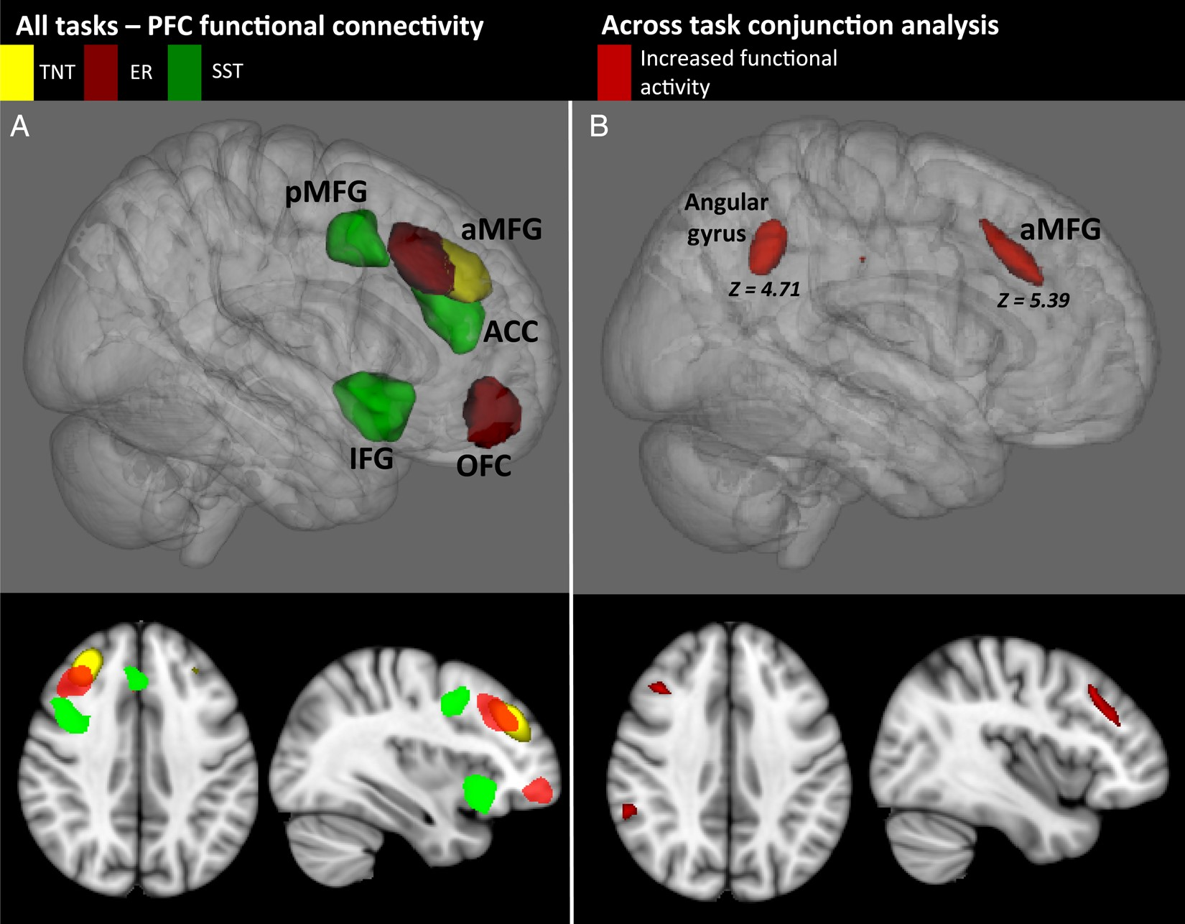
Figure 4. (A) Significant prefrontal brain regions of seed-based functional connectivity identified through the GLM ...
Notes:
Figure 4. (A) Significant prefrontal brain regions of seed-based functional connectivity identified through the GLM within individual tasks [Think/No-Think (TNT) = yellow, Emotion Regulation (ER) = red, and Stop-signal (SST) = green)] (N = 21). (B) Repeated-measures ANOVA and conjunction analysis of functional activation across the 3 tasks indicating common activation of the angular gyrus and aMFG. Z indicates the peak functional activity parameter estimate across tasks.
Unless provided in the caption above, the following copyright applies to the content of this slide: © The Author 2015. Published by Oxford University Press. All rights reserved. For Permissions, please e-mail: journals.permissions@oup.com

