Slide 1
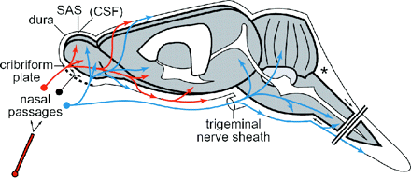
Fig. 1. The anatomical extraneuronal pathways provided by the olfactory and trigeminal nerves following intranasal ...
Notes:
Fig. 1. The anatomical extraneuronal pathways provided by the olfactory and trigeminal nerves following intranasal administration. Intranasally applied drugs are rapidly transported into the CNS tissue by the peripheral olfactory system (shown in red), connecting the nasal passages and olfactory bulb/rostal brain, and peripheral trigeminal system (shown in blue), connecting the nasal passages and the brainstem/spinal cord. Cisternal sampling in rats (asterisk) has demonstrated that some molecules, mostly smaller molecular weight solutes, can rapidly enter the cerebrospinal fluid (CSF) after intranasal administration (shown in black). Abbreviation: SAS, subarachnoid space. This figure was originally published in Thorne RG, Pronk GJ, Padmanabhan V, Frey WH 2nd. Delivery of insulin-like growth factor-I to the rat brain and spinal cord along olfactory and trigeminal pathways following intranasal administration. Neuroscience. 2004;127:481-496 (Copyright Elsevier, 2004).
Unless provided in the caption above, the following copyright applies to the content of this slide: Society for Neuro-Oncology

Slide 2
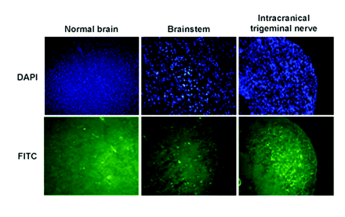
Fig. 2. Distribution of fluorescein-labeled GRN163 by intranasal delivery into normal brain in athymic rats. Faint ...
Notes:
Fig. 2. Distribution of fluorescein-labeled GRN163 by intranasal delivery into normal brain in athymic rats. Faint fluorescence of 3'-fluorescein isothiocyanate (FITC) - labeled GRN163 was detected diffusely in normal brain, brainstem, and intracranial trigeminal nerves at 10 min after intranasal delivery into non-tumor-bearing rats. 4',6-Diamidine-2'-phenylindole dihydrochloride (DAPI) indicates nuclear staining in blue; FITC staining reveals fluorescently labeled GRN163 in green.
Unless provided in the caption above, the following copyright applies to the content of this slide: Society for Neuro-Oncology

Slide 3
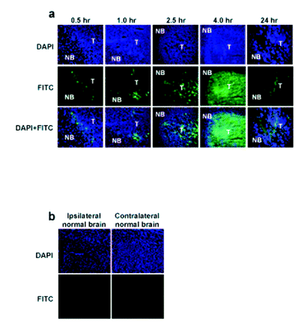
Fig. 3. Distribution of fluorescein-labeled GRN163 by intranasal delivery into intracerebral tumors in athymic rats. ...
Notes:
Fig. 3. Distribution of fluorescein-labeled GRN163 by intranasal delivery into intracerebral tumors in athymic rats. (A) Accumulation of 3'-fluorescein isothiocyanate (FITC) - labeled GRN163 in tumor cells at each point in time from 0.5 to 24 h after intranasal delivery into tumor-bearing rats. Merged images of 4',6-diamidine-2'-phenylindole dihydrochloride (DAPI) and FITC staining are shown in the lower panels. Abbreviations: T, tumor; NB, normal brain. (B) No accumulation of FITC-labeled GRN163 was detected in normal brain at 4 h after intranasal delivery into tumor-bearing rats.
Unless provided in the caption above, the following copyright applies to the content of this slide: Society for Neuro-Oncology

Slide 4
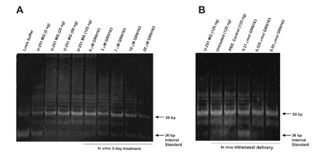
Fig. 4. Inhibition of telomerase activity by GRN163 in glioblastoma cells and intracerebral xenografts. (A) U-251 MG ...
Notes:
Fig. 4. Inhibition of telomerase activity by GRN163 in glioblastoma cells and intracerebral xenografts. (A) U-251 MG cells were treated with a range of doses of GRN163 for 3 days. Cells were collected and telomerase activity was measured for 125 ng protein extract per lane using the telomere repeat amplification protocol (TRAP) assay. A standard batch of U-251 MG cell line was used as a positive control, and lysis buffer was used as a negative control. (B) Rats were treated intranasally with daily doses of 0.21, 0.325, and 0.65 μmol GRN163 for 12 days. The intracerebral tumors were collected and telomerase activity was measured for 125 ng protein extract per lane using the TRAP assay. Tumor tissue from untreated or PBS-Control rats was used as a positive control.
Unless provided in the caption above, the following copyright applies to the content of this slide: Society for Neuro-Oncology

Slide 5
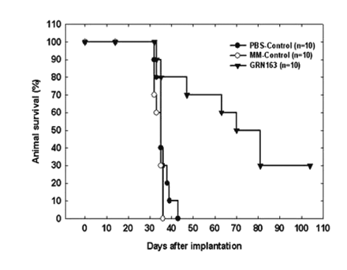
Fig. 5. Survival of rats treated with intranasal GRN163. Animals in both PBS- and MM-Control groups had median ...
Notes:
Fig. 5. Survival of rats treated with intranasal GRN163. Animals in both PBS- and MM-Control groups had median survivals of 35 days, whereas animals in the GRN163 treatment group had a median survival of 75.5 days, significantly longer than either control group (p < 0.01).
Unless provided in the caption above, the following copyright applies to the content of this slide: Society for Neuro-Oncology

Slide 6
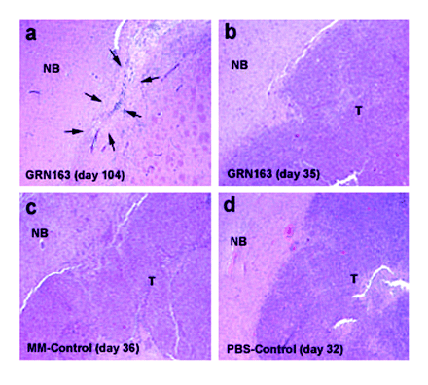
Fig. 6. Intranasal GRN163 inhibits tumor growth in athymic rats. (A) Brain from a rat that was treated with ...
Notes:
Fig. 6. Intranasal GRN163 inhibits tumor growth in athymic rats. (A) Brain from a rat that was treated with intranasal GRN163 and euthanized on day 104, with no symptoms of tumor. The injection site shows astrogliosis with a macrophage infiltrate and foci of hemosiderin and calcium, along with several small vessels (arrows). No neoplastic cells are present. (B-D) Interface of normal brain and neoplasm treated with intranasal GRN163 (B), MM-Control (C), and PBS-Control (D). Days are post-tumor implantation to euthanization due to neurological symptoms. Abbreviations: T, tumor; NB, normal brain.
Unless provided in the caption above, the following copyright applies to the content of this slide: Society for Neuro-Oncology

