Slide 1
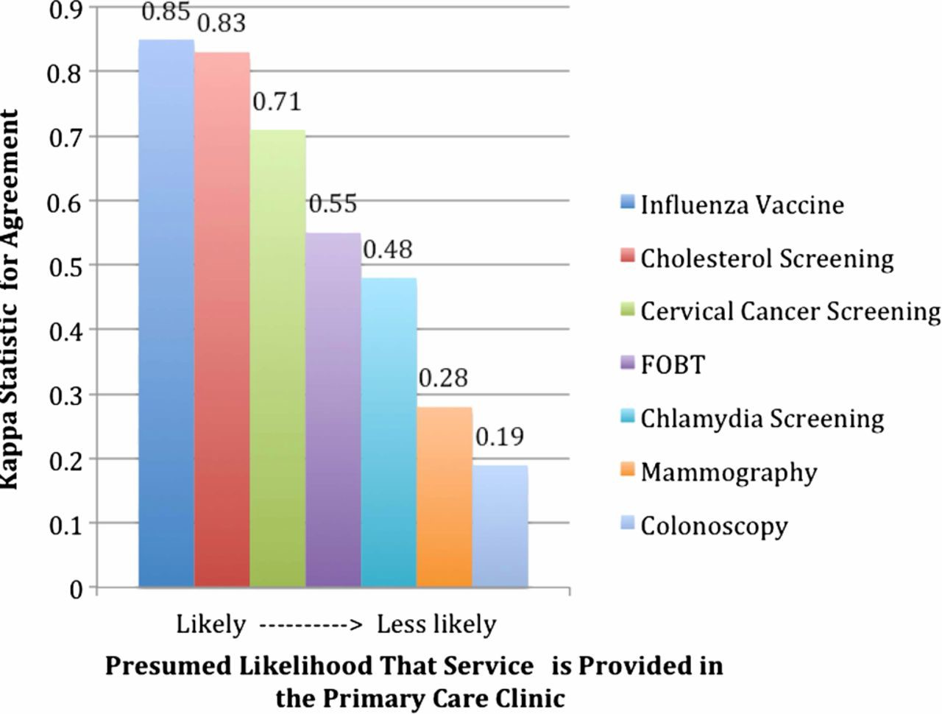
Figure 1 Decreasing κ statistic for agreement between electronic health record and Medicaid claims potentially related ...
Notes:
Figure 1 Decreasing κ statistic for agreement between electronic health record and Medicaid claims potentially related to location of service provision. Flexible sigmoidoscopy, body mass index, and tobacco assessment were not included because of low overall numbers.
Unless provided in the caption above, the following copyright applies to the content of this slide: Published by the BMJ Publishing Group Limited. For permission to use (where not already granted under a licence) please go to http://group.bmj.com/group/rights-licensing/permissions

