Slide 1
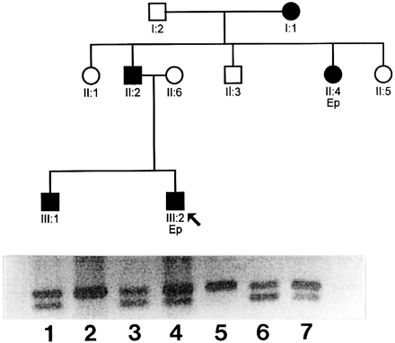
Fig. 1 Upper panel. Pertinent part of the pedigree of the EA1/epilepsy family. Filled symbols indicate individuals ...
Notes:
Fig. 1 Upper panel. Pertinent part of the pedigree of the EA1/epilepsy family. Filled symbols indicate individuals with EA1. The two individuals with epilepsy are indicated by `Ep'. The lower panel shows an agarose gel containing the DNA fragments following digestion with the restriction endonuclease DdeI. Normal individuals have the upper band only (159 bp undigested mismatch PCR product as described under Subjects and methods) as shown for cases II1 and II3 (cases I2 and II5 did not harbour the mutation; data not shown). The presence of the C677G mutation introduces a restriction site in the affected individuals (cases I1, II2, II4, III1, III2), and two bands are visible in these cases. These are the upper band, which is the undigested 159-bp product, and the lower band, which is the larger 131-bp product of digestion. The smaller 28-bp product of digestion is not shown. Lane 1, case III1; lane 2, case II1; lane 3, case II2; lane 4, case III2; lane 5, case II3; lane 6, case I1; lane 7, case II4. The proband (case III2) is indicated by an arrow.
Unless provided in the caption above, the following copyright applies to the content of this slide: © Oxford University Press 1999

Slide 2
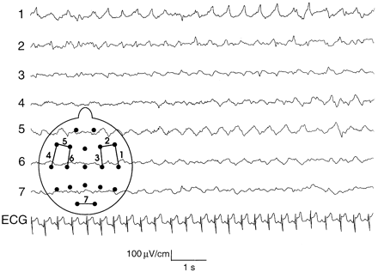
Fig. 2 EEG of case III2 during complex partial epileptic seizure. Right temporal sharp and slow waves generalize to ...
Notes:
Fig. 2 EEG of case III2 during complex partial epileptic seizure. Right temporal sharp and slow waves generalize to involve the right hemisphere.
Unless provided in the caption above, the following copyright applies to the content of this slide: © Oxford University Press 1999

Slide 3
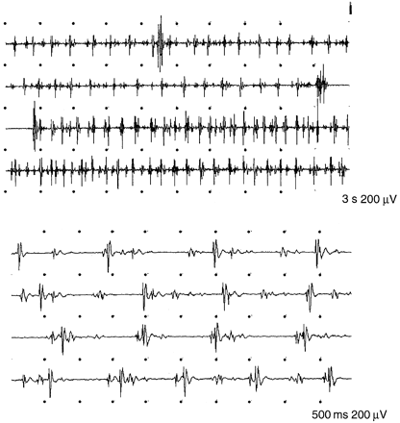
Fig. 3 Surface EMG, case III2. Upper panel: continuous motor unit activity, rhythmically occurring singlets and ...
Notes:
Fig. 3 Surface EMG, case III2. Upper panel: continuous motor unit activity, rhythmically occurring singlets and duplets with variation in spike frequency. Lower panel: spike and shadow potentials.
Unless provided in the caption above, the following copyright applies to the content of this slide: © Oxford University Press 1999

Slide 4
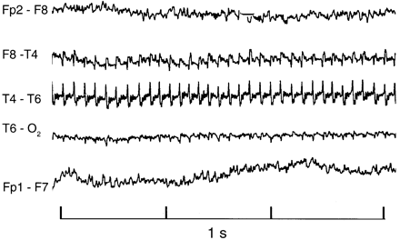
Fig. 4 Normal EEG in case II2 shows rhythmic EMG (10/s) over the temporal region.
Notes:
Fig. 4 Normal EEG in case II2 shows rhythmic EMG (10/s) over the temporal region.
Unless provided in the caption above, the following copyright applies to the content of this slide: © Oxford University Press 1999

Slide 5
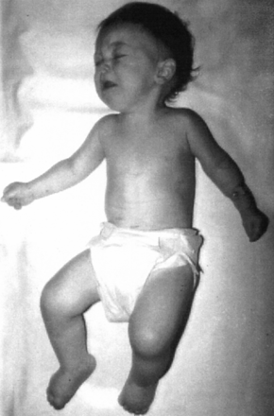
Fig. 5 Case III1, aged 8 months. Fists are clenched, knees are flexed and feet held in plantar flexion as a result ...
Notes:
Fig. 5 Case III1, aged 8 months. Fists are clenched, knees are flexed and feet held in plantar flexion as a result of the continuous muscle fibre activity.
Unless provided in the caption above, the following copyright applies to the content of this slide: © Oxford University Press 1999

Slide 6
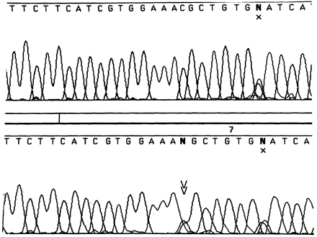
Fig. 6 Electropherogram of Kv1.1 gene DNA sequence. (Upper panel) Wild-type DNA sequence. (Lower panel) Sequence ...
Notes:
Fig. 6 Electropherogram of Kv1.1 gene DNA sequence. (Upper panel) Wild-type DNA sequence. (Lower panel) Sequence from the proband (case III2). The silent polymorphism at position 684 (indicated by X) is present in both the control and the proband. The C→G mutation at position 677 indicated by the double arrowhead is present only in the proband.
Unless provided in the caption above, the following copyright applies to the content of this slide: © Oxford University Press 1999

Slide 7
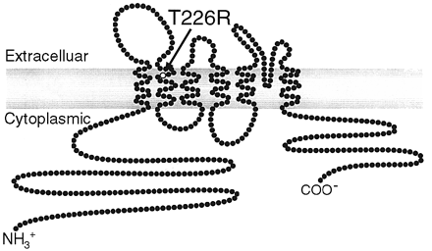
Fig. 7 Schematic representation of one subunit of Kv1.1. The site of the T226R amino acid substitution resulting ...
Notes:
Fig. 7 Schematic representation of one subunit of Kv1.1. The site of the T226R amino acid substitution resulting from the C677G point mutation in the second transmembrane domain is indicated.
Unless provided in the caption above, the following copyright applies to the content of this slide: © Oxford University Press 1999

Slide 8
Fig. 8 Table illustrating that threonine at position 226 (arrow) is highly conserved through evolution.
Notes:
Fig. 8 Table illustrating that threonine at position 226 (arrow) is highly conserved through evolution.
Unless provided in the caption above, the following copyright applies to the content of this slide: © Oxford University Press 1999

Slide 9
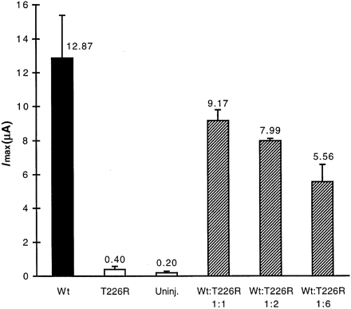
Fig. 9 Amplitude histogram of whole-cell currents in Xenopus laevis oocytes. Currents of cells injected with wild ...
Notes:
Fig. 9 Amplitude histogram of whole-cell currents in Xenopus laevis oocytes. Currents of cells injected with wild type (Wt) were compared with cells injected with mutant (T226R) and with uninjected cells. Cells were voltage-clamped at –100 mV and current amplitudes were measured at the end of a 350-ms pulse to +40 mV. Error bars indicate standard deviation (n is between 5 and 9). The concentration of mRNA was determined by ethidium bromide staining and spectrophotometry to adjust the ratio of mutant to wild-type subunits. Oocytes injected with mutant mRNA show a marked reduction in voltage-activated currents. Increasing amounts of mutant mRNA were injected in the presence of a constant amount of wild-type mRNA. A progressive decline in voltage-activated current was obtained as the amount of mutant mRNA increased.
Unless provided in the caption above, the following copyright applies to the content of this slide: © Oxford University Press 1999

