Slide 1
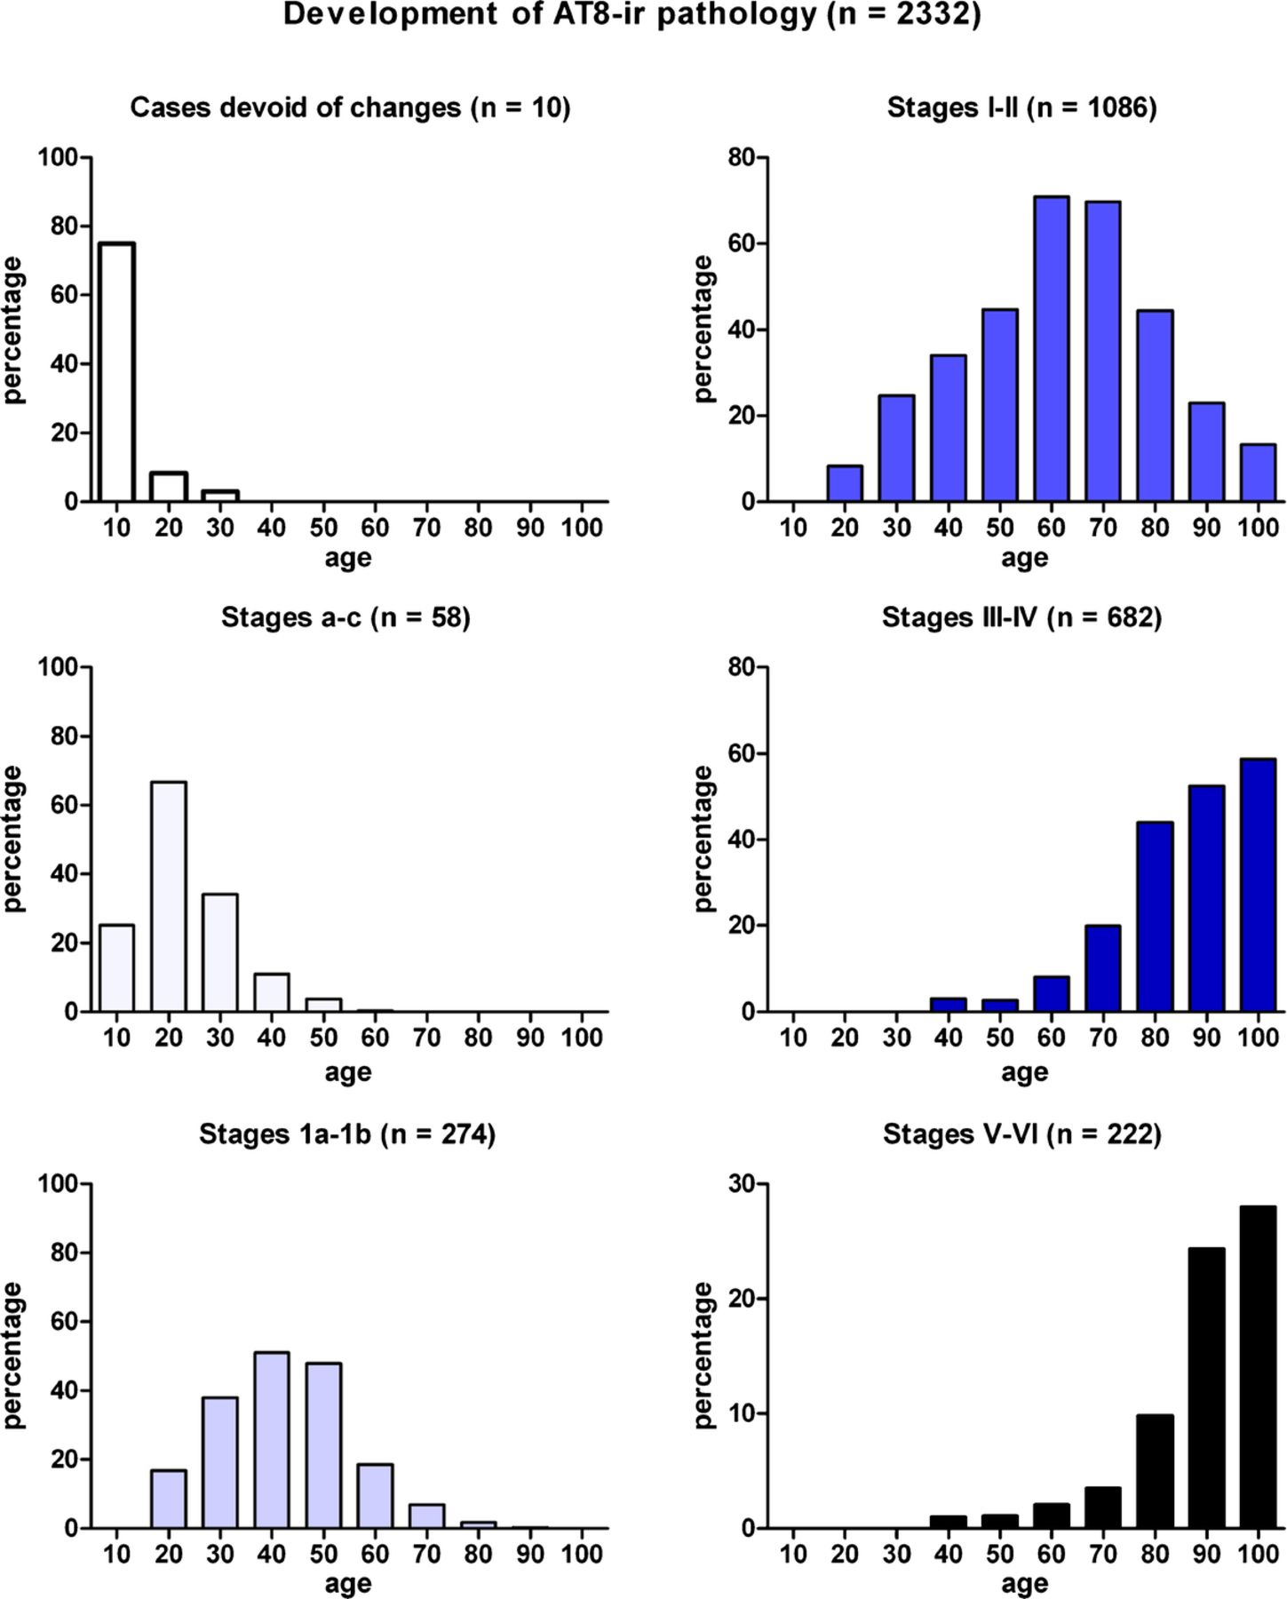
FIGURE 1. Development of abnormal intraneuronal tau deposits in 2,332 nonselected autopsy cases. White columns ...
Notes:
FIGURE 1. Development of abnormal intraneuronal tau deposits in 2,332 nonselected autopsy cases. White columns represent the relative frequency of cases devoid of any tau deposits. Pale blue columns show the development of subtle subcortical lesions in cases with Stages a to c pathology. Columns in medium blue show an extension of these nonargyrophilic lesions into portions of the cerebral cortex (Stages 1a and 1b). Development of the pretangle material into argyrophilic neurofibrillary lesions characterizes Stages I to VI as follows: deep blue for Stage I and II cases, dark blue for Stage III and IV cases, and black for Stage V and VI cases.
Unless provided in the caption above, the following copyright applies to the content of this slide: Copyright © 2011 by the American Association of Neuropathologists, Inc.

Slide 2
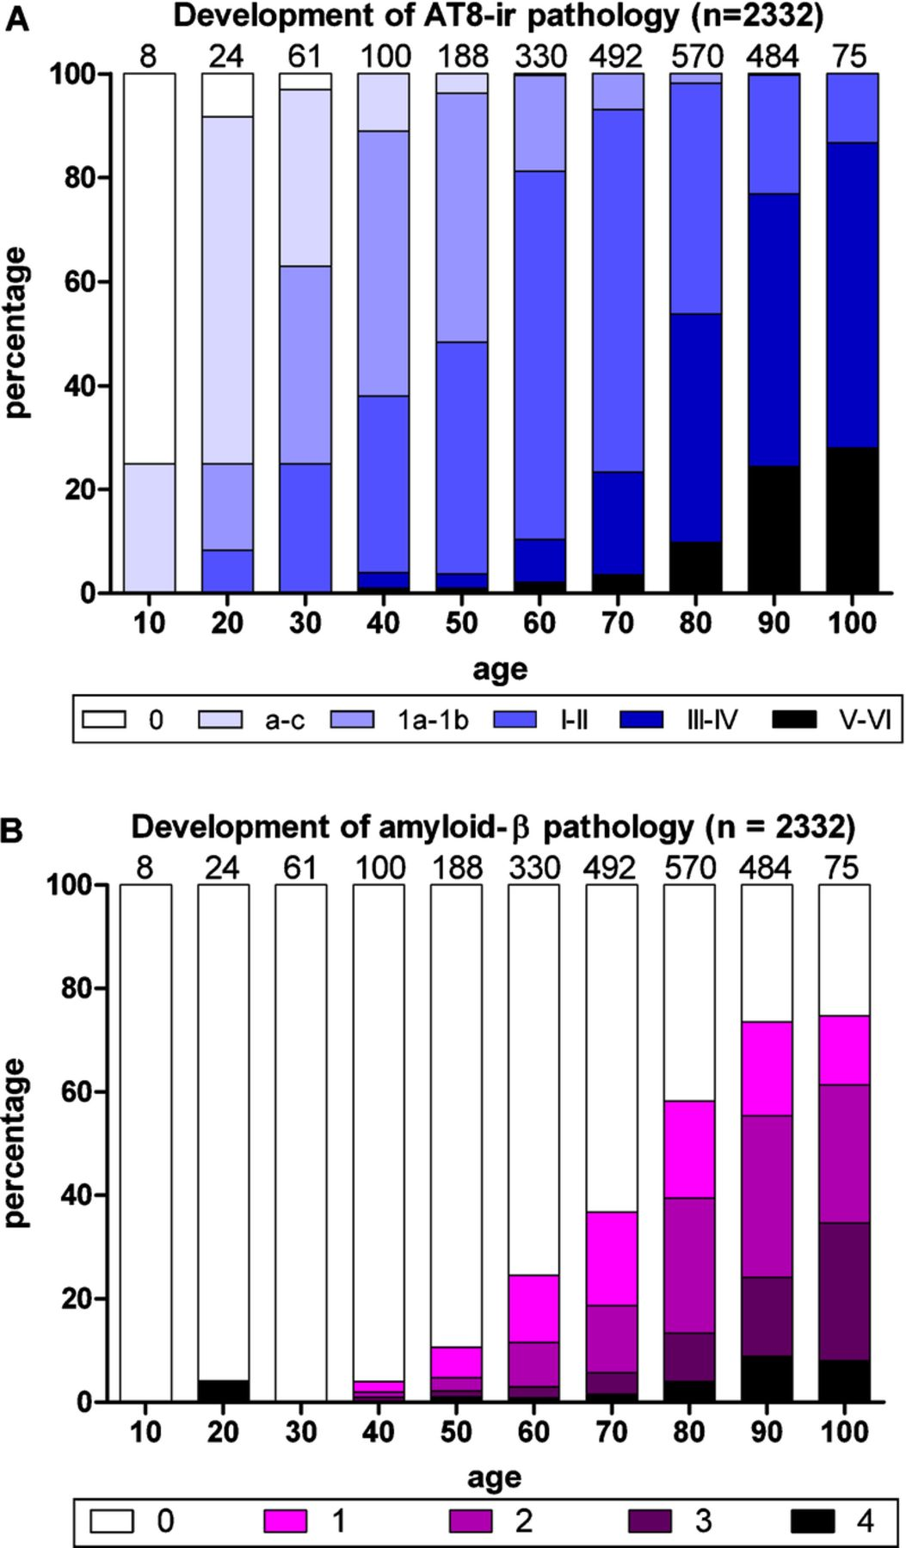
FIGURE 2. Development of AT8-immunoreactivity (ir) versus β-amyloid pathologic findings. (A) White columns indicate the ...
Notes:
FIGURE 2. Development of AT8-immunoreactivity (ir) versus β-amyloid pathologic findings. (A) White columns indicate the relative frequency of 2,332 nonselected autopsy cases devoid of any abnormal intraneuronal tau deposits. Columns in shades of blue indicate the relative frequency of cases with all types of intraneuronal lesions. (B) Development of extracellular β-amyloid deposits. Purple areas within the columns indicate subgroups of cases showing plaque-like β-amyloid deposits in temporal neocortex (Phase 1, light purple), allocortex and neocortical association areas (Phases 2 and 3, middle purple and dark purple), or in virtually all cerebral cortical regions (Phase 4, black). Note the relatively late appearance of β-amyloid plaques.
Unless provided in the caption above, the following copyright applies to the content of this slide: Copyright © 2011 by the American Association of Neuropathologists, Inc.

Slide 3
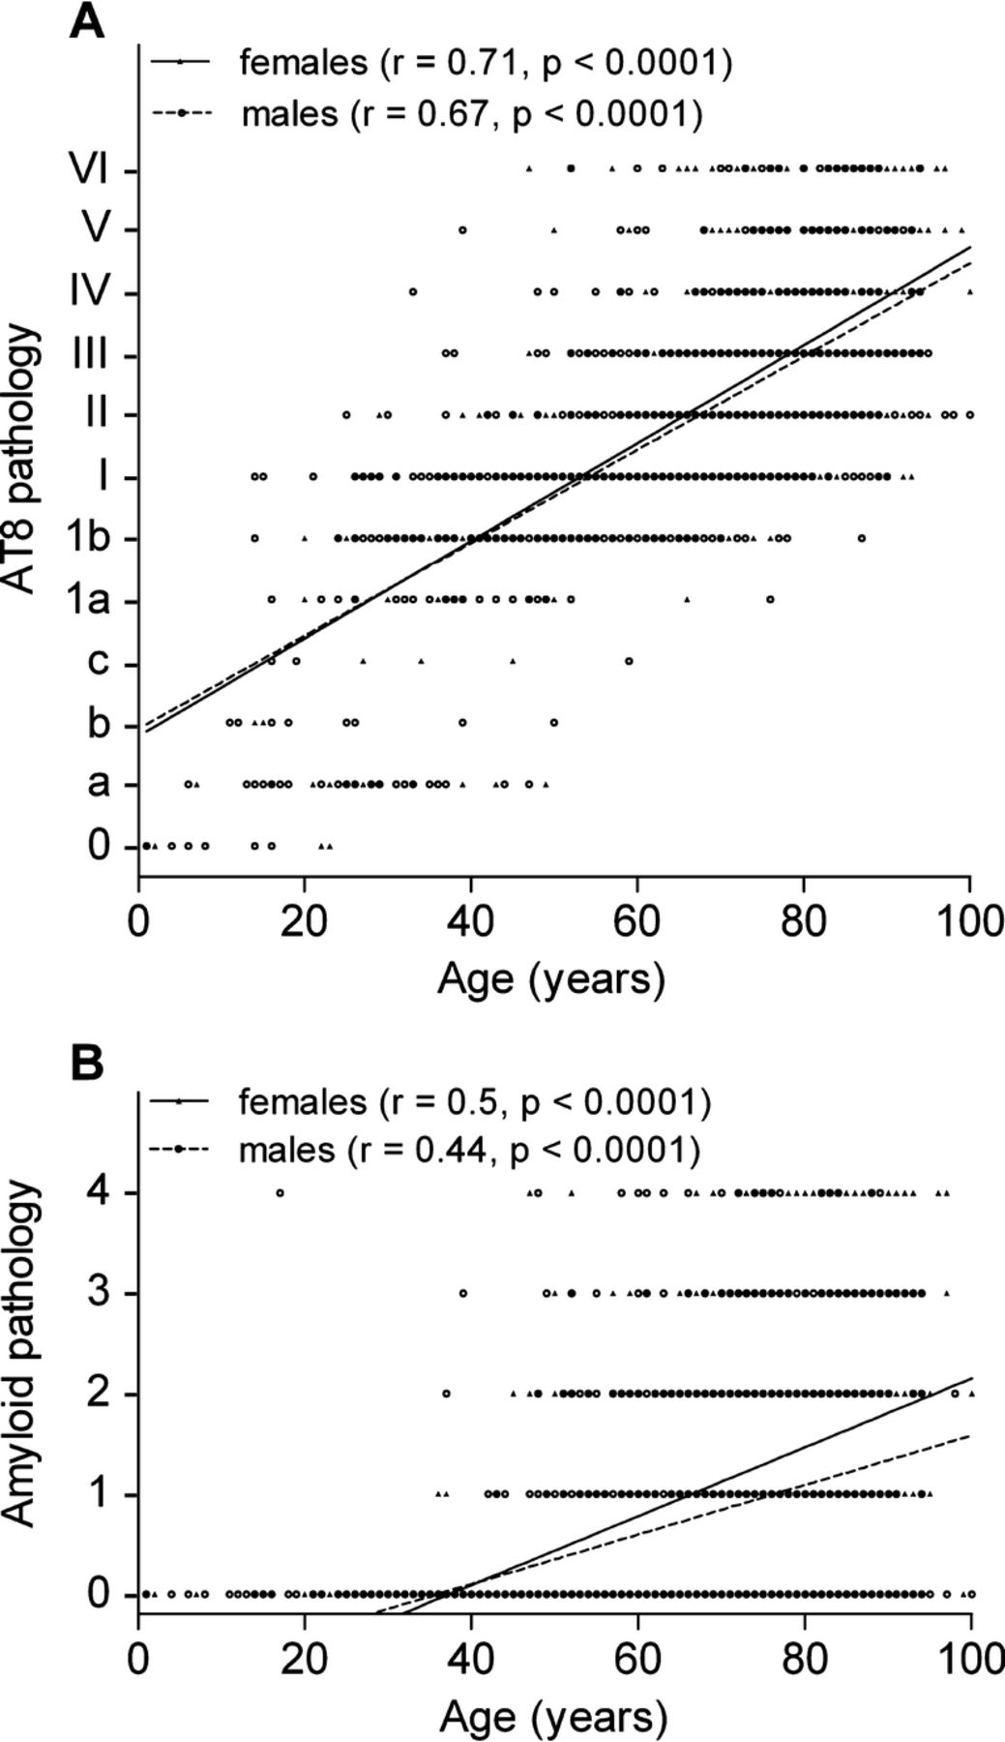
FIGURE 3. Scatter plots of AD-related pathologic findings (AT8 and β-amyloid) by age with separate regression lines for ...
Notes:
FIGURE 3. Scatter plots of AD-related pathologic findings (AT8 and β-amyloid) by age with separate regression lines for males and females. (A) There is a significant correlation between AT8 pathology and age, but there is no significant difference between the slopes of the regression lines of males and females (p= 0.23). (B) There is a significant correlation between β-amyloid pathology and age in males and females; the slope of regression line between age and β-amyloid deposition was greater (p < 0.001) in females than in males.
Unless provided in the caption above, the following copyright applies to the content of this slide: Copyright © 2011 by the American Association of Neuropathologists, Inc.

Slide 4
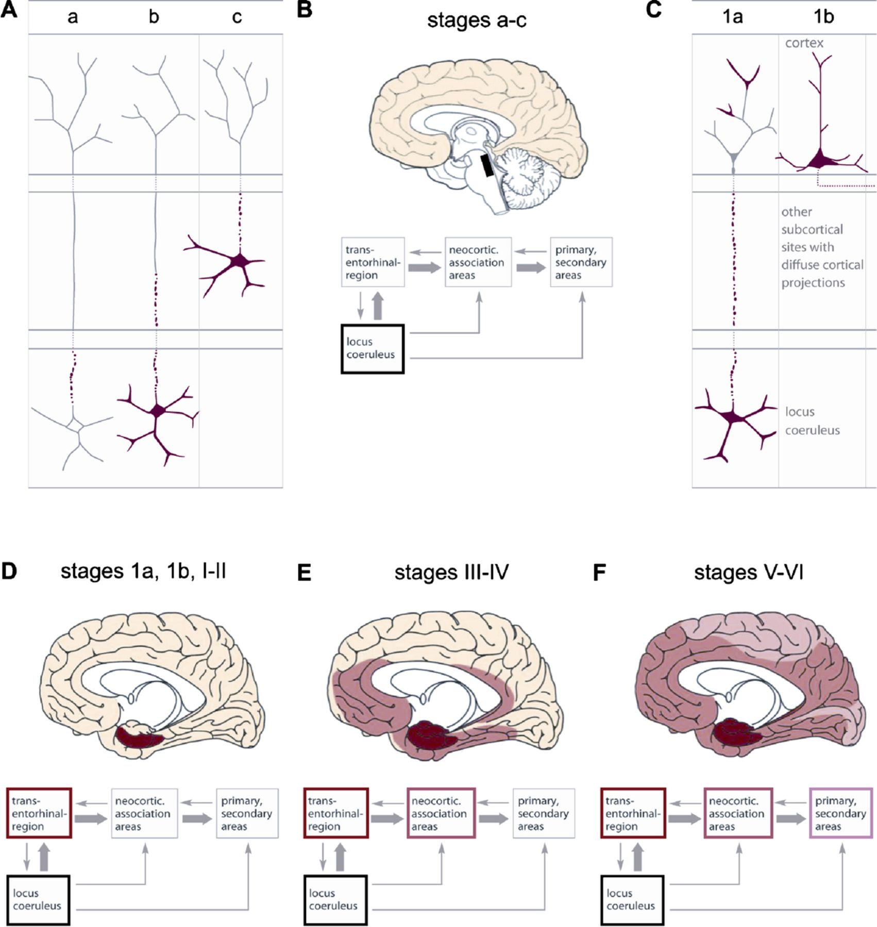
FIGURE 4. Summary of stages in the development of Alzheimer disease (AD)-associated tau pathology. (A) Postulated ...
Notes:
FIGURE 4. Summary of stages in the development of Alzheimer disease (AD)-associated tau pathology. (A) Postulated phases in the development of early AD-associated tau pathology. Cellular processes of brainstem nerve cells (e.g. caeruleus neurons) are the earliest structures that display AT8-immunoreactive pretangle material (Stage a). The material fills the soma and dendritic processes of a few neuromelanin-containing caeruleus neurons (Stage b). In Stage c, pretangle material occurs in nerve cells of other nonthalamic brainstem nuclei with diffuse cortical projections (upper raphe nuclei, magnocellular nuclei of the basal forebrain, hypothalamic tuberomammillary nucleus). (B) The regions involved in Stages a to c are illustrated schematically and accompanied by a block diagram of key regions and their interconnectivity. Involvement of the locus coeruleus is indicated by black framing. (C) In Stage 1a, portions of neuronal processes containing pretangle material appear in the transentorhinal region. These processes may represent pathologically altered terminals of caeruleus axons. In Stage 1b, isolated pyramidal cell somata of the transentorhinal region together with their cellular processes become filled with pretangle material and, thereafter, increase in number. (D-F) Schemata as in B but without the brainstem illustrating the medial temporal regions. The 4 brain schemata are accompanied by color-coded boxes showing subcortical pretangle Stages a, b, and c (black); cortical pretangle Stages 1a and 1b (dark red); NFT/NT Stages I and II (dark red); NFT/NT Stages III and IV (medium red); and NFT/NT Stages V and VI (light red). The close interconnections by axonal projections between the locus coeruleus and transentorhinal region permits speculation as to whether disease progression of tau lesions in AD could be attributable to anterograde induction of tau pathology from one nerve cell to the next in the neuronal chain.
Unless provided in the caption above, the following copyright applies to the content of this slide: Copyright © 2011 by the American Association of Neuropathologists, Inc.

