Slide 1
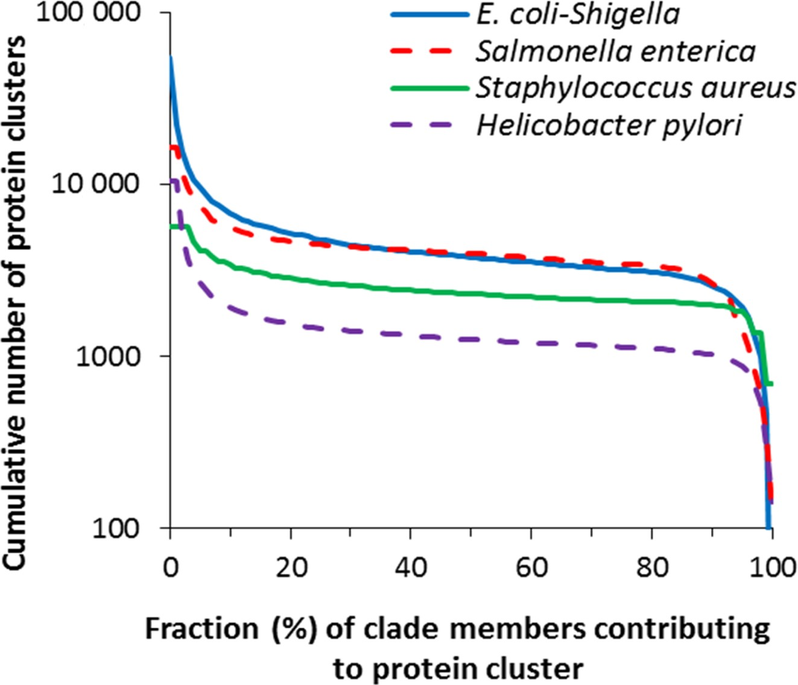
Figure 1. Cumulative number of protein clusters (Y) is defined for a given X (%) as the number of clusters containing ...
Notes:
Figure 1. Cumulative number of protein clusters (Y) is defined for a given X (%) as the number of clusters containing proteins from fraction x ≥ X of all members of the clade. Data are presented for the four well studied clades.
Unless provided in the caption above, the following copyright applies to the content of this slide: Published by Oxford University Press on behalf of Nucleic Acids Research 2016. This work is written by (a) US Government employee(s) and is in the public domain in the US.

Slide 2
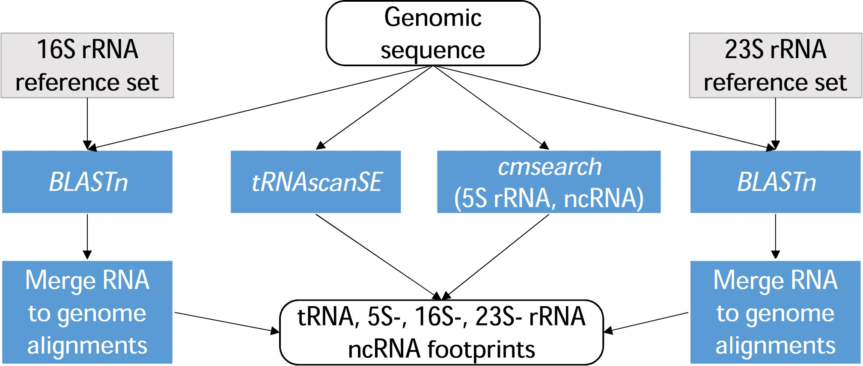
Figure 2. A fragment of the PGAP execution graph: prediction of structural RNA genes (ncRNA, tRNA, 5S-, 16S-, 23S- ...
Notes:
Figure 2. A fragment of the PGAP execution graph: prediction of structural RNA genes (ncRNA, tRNA, 5S-, 16S-, 23S- rRNA).
Unless provided in the caption above, the following copyright applies to the content of this slide: Published by Oxford University Press on behalf of Nucleic Acids Research 2016. This work is written by (a) US Government employee(s) and is in the public domain in the US.

Slide 3
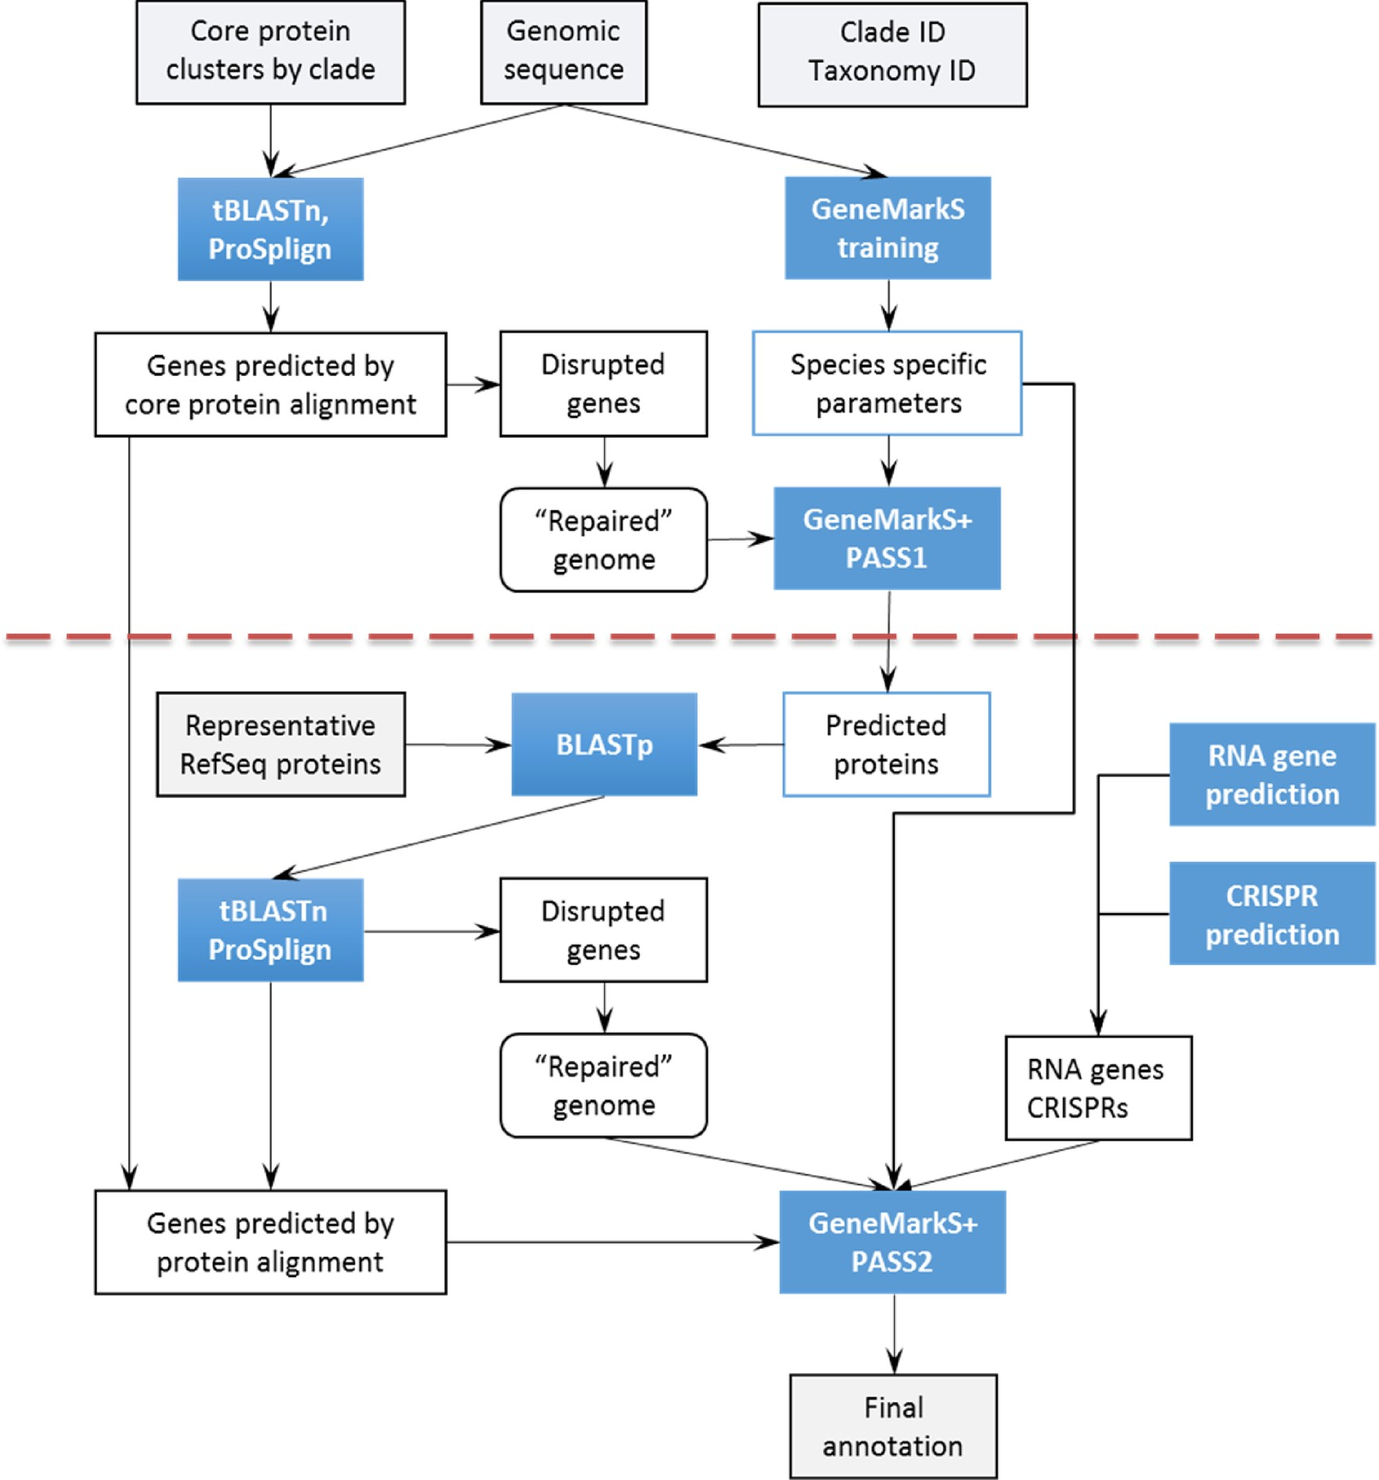
Figure 3. Flowchart of PGAP. The red dotted line indicates separation between pass one and pass two (see text for ...
Notes:
Figure 3. Flowchart of PGAP. The red dotted line indicates separation between pass one and pass two (see text for details).
Unless provided in the caption above, the following copyright applies to the content of this slide: Published by Oxford University Press on behalf of Nucleic Acids Research 2016. This work is written by (a) US Government employee(s) and is in the public domain in the US.

Slide 4
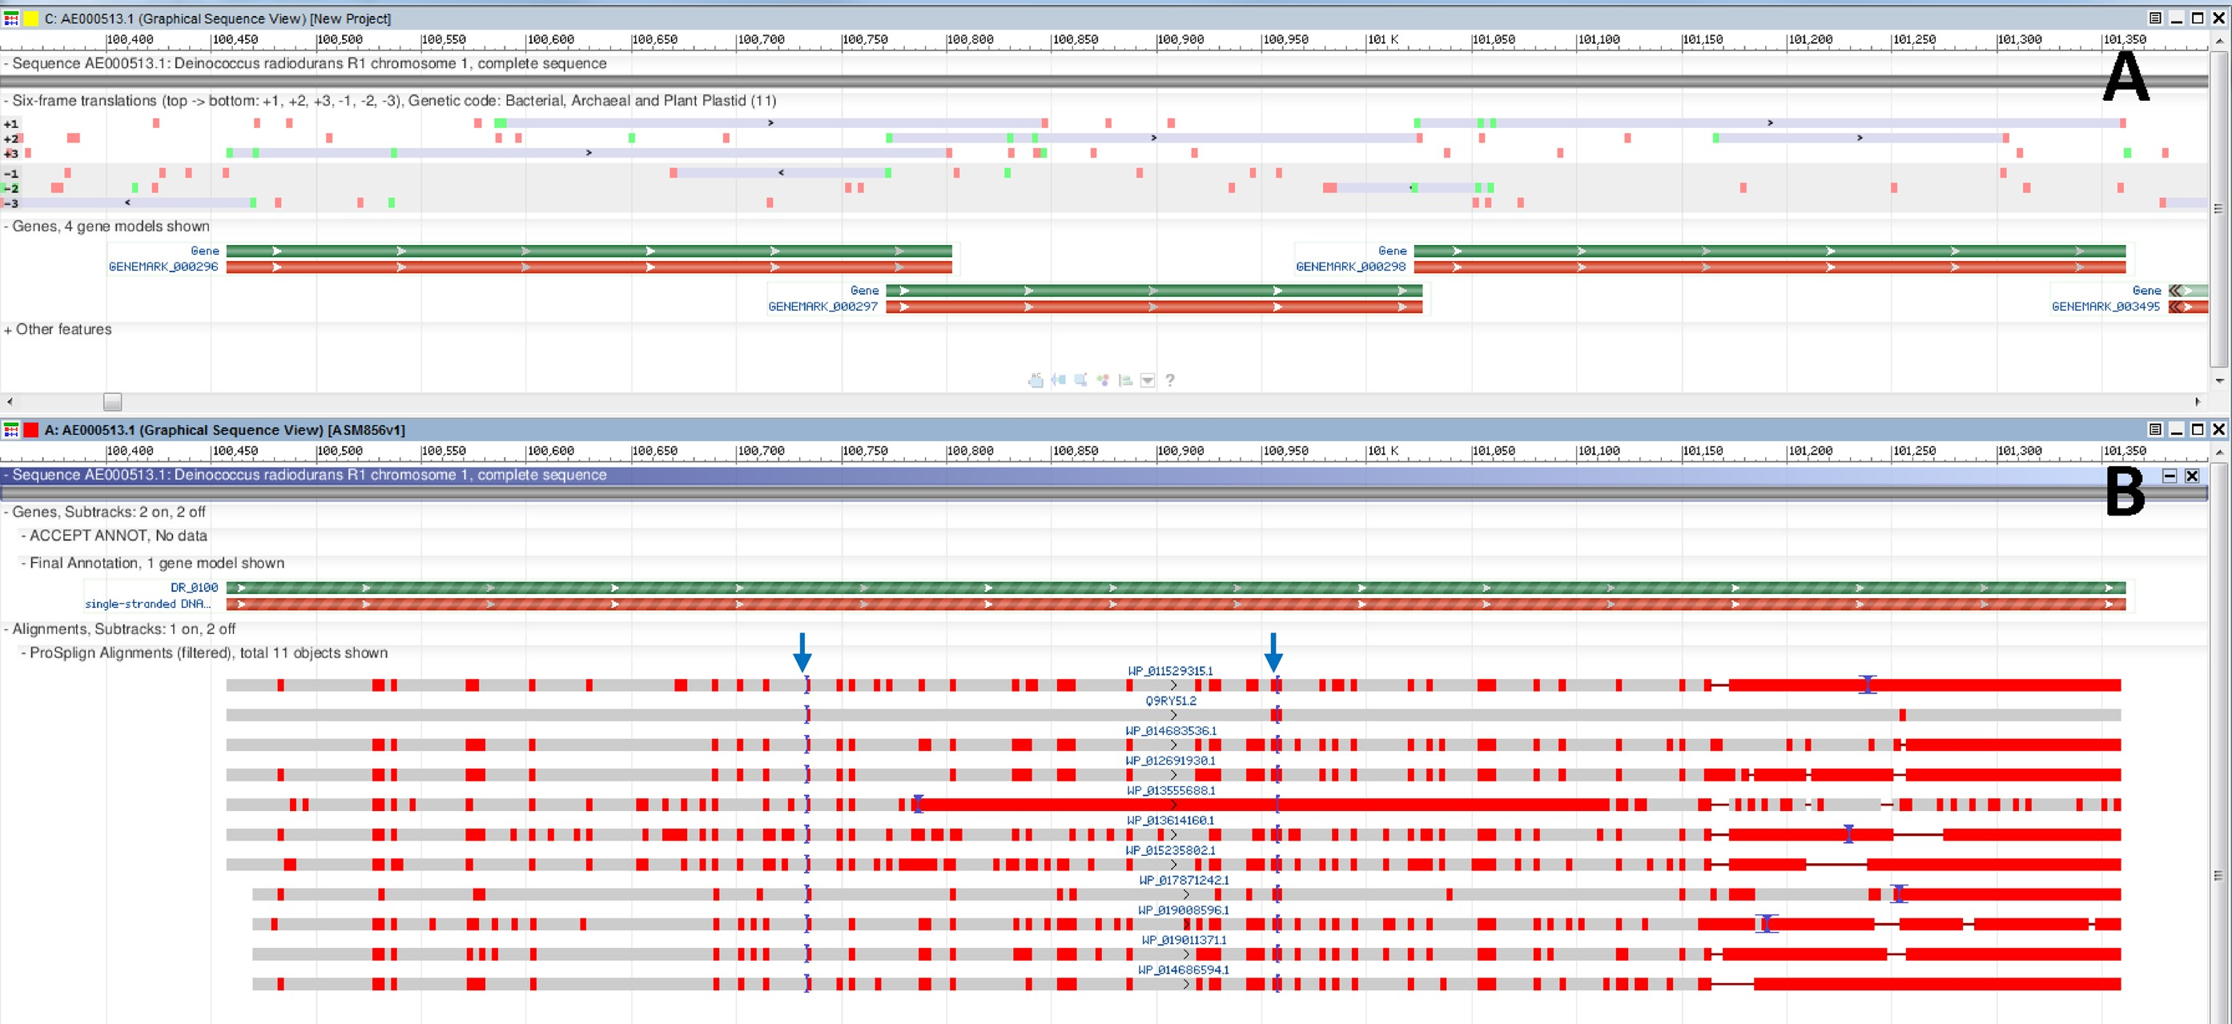
Figure 4. A region in the Deinococcus radiodurans R1 genome assembly (GCA_000008565.1) contains three overlapping ORFs ...
Notes:
Figure 4. A region in the Deinococcus radiodurans R1 genome assembly (GCA_000008565.1) contains three overlapping ORFs predicted ab initio as CDSs in the first pass of PGAP. Automatic evaluation of the cross-species protein evidence through the second pass of PGAP reveals proteins bearing homology to all three fragments. Alignment of the proteins to the genome reveals otherwise unpredicted frameshifts. Green bars represent genes, red bars – coding regions; grey bars – alignments with red vertical bars indicating mismatches. (A) A region of Chromosome 1 of D. radiodurans (AE000513.1) containing the three CDS features is displayed alongside the six-frame translation. (B) The same region, updated to include final annotation markup with a frameshifted CDS as well as supporting proteins that demonstrate a consistent pattern and location of two frameshifts (marked by arrows at positions 100 733 and 100 959).
Unless provided in the caption above, the following copyright applies to the content of this slide: Published by Oxford University Press on behalf of Nucleic Acids Research 2016. This work is written by (a) US Government employee(s) and is in the public domain in the US.

Slide 5
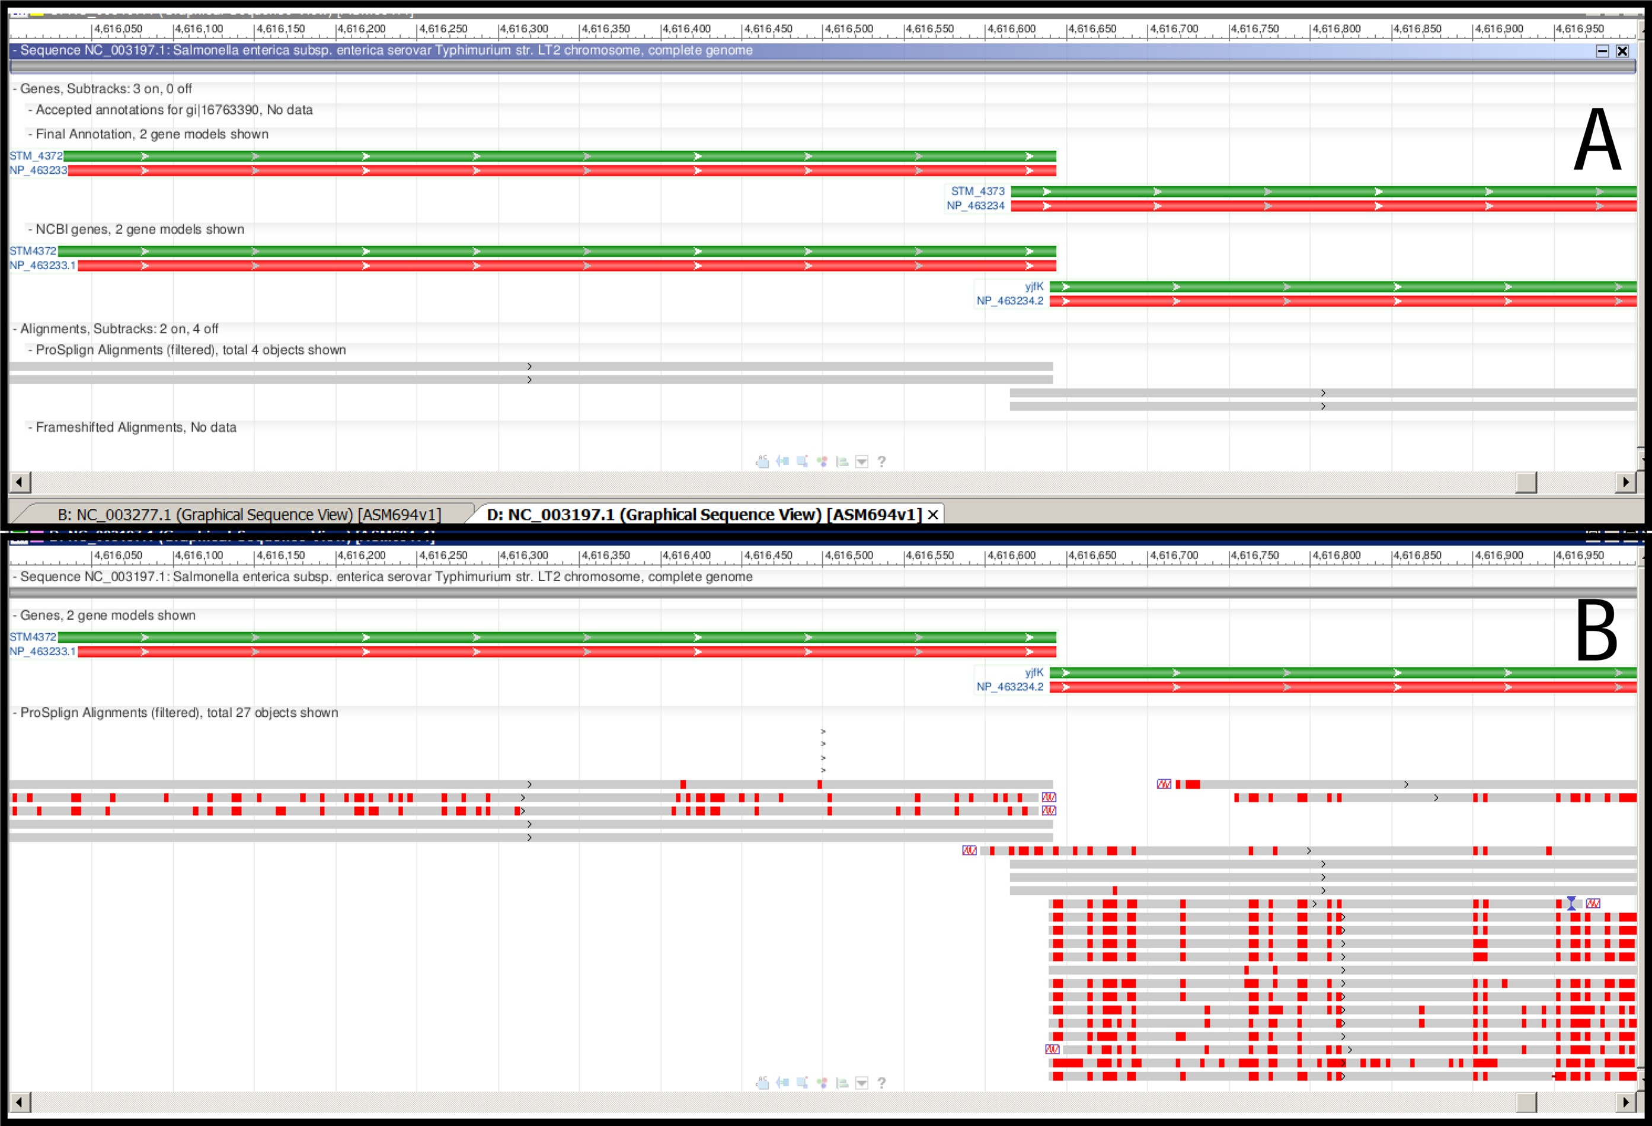
Figure 5. Annotation of genome of Salmonella enterica subsp. enterica serovar Typhimurium str. LT2 (NC_003197). Protein ...
Notes:
Figure 5. Annotation of genome of Salmonella enterica subsp. enterica serovar Typhimurium str. LT2 (NC_003197). Protein alignment provides support for gene start selection. See legend to Figure 4 for description of the meaning of green, red and gray bars. (A) the first round of alignments of protein representatives from the ‘core’ protein clusters doesn't give enough evidence for gene start selection. (B) the second round of alignments clearly supports a shorter gene model which does not overlap with the upstream gene.
Unless provided in the caption above, the following copyright applies to the content of this slide: Published by Oxford University Press on behalf of Nucleic Acids Research 2016. This work is written by (a) US Government employee(s) and is in the public domain in the US.

Slide 6
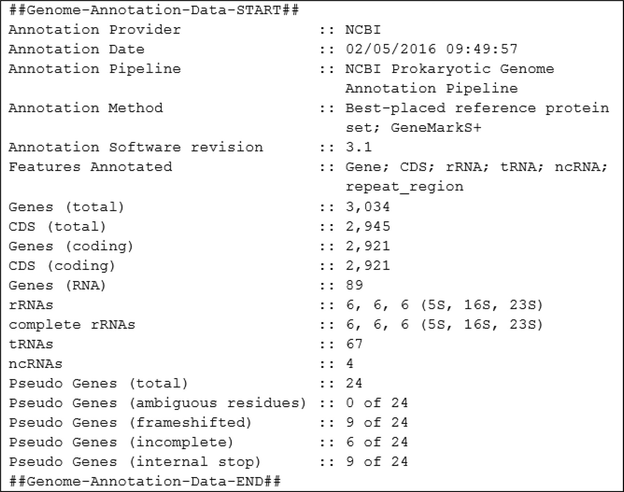
Figure 6. A summary of PGAP genome annotation process is provided in the COMMENT section of GenBank and RefSeq records. ...
Notes:
Figure 6. A summary of PGAP genome annotation process is provided in the COMMENT section of GenBank and RefSeq records. The example is given for Listeria monocytogenes strain CFSAN010068, complete genome NZ_CP014250.1.
Unless provided in the caption above, the following copyright applies to the content of this slide: Published by Oxford University Press on behalf of Nucleic Acids Research 2016. This work is written by (a) US Government employee(s) and is in the public domain in the US.

Slide 7
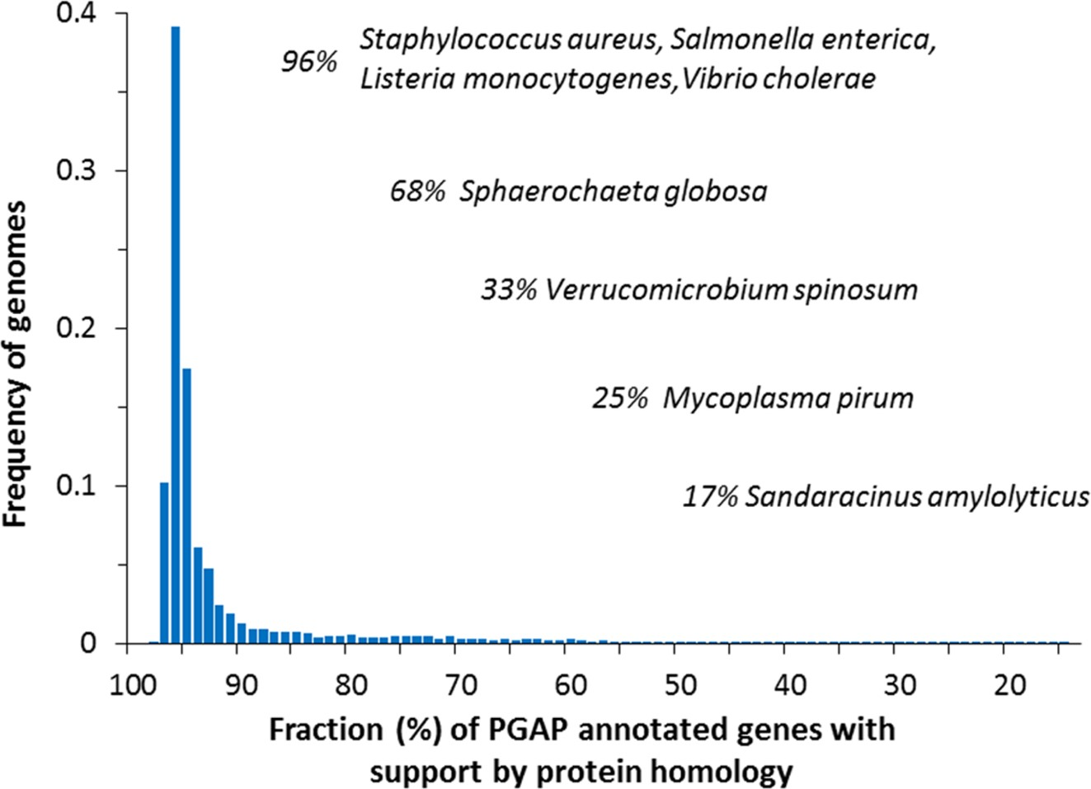
Figure 7. Frequency histogram of genomes with respect to the fraction of the whole complement of genes supported by ...
Notes:
Figure 7. Frequency histogram of genomes with respect to the fraction of the whole complement of genes supported by similarity to proteins in RefSeq. In about 50% of the total set of genomes in consideration, mostly from highly populated clades, more than 95% of protein-coding genes are supported by protein sequence similarity.
Unless provided in the caption above, the following copyright applies to the content of this slide: Published by Oxford University Press on behalf of Nucleic Acids Research 2016. This work is written by (a) US Government employee(s) and is in the public domain in the US.

