Slide 1
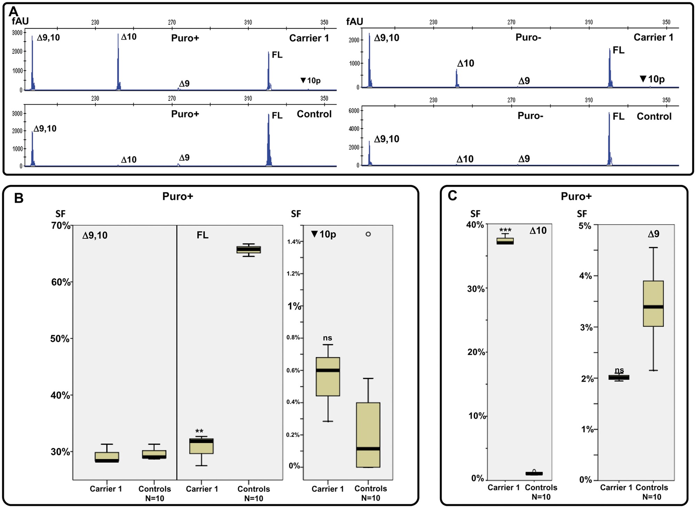
Figure 1. Capillary Electrophoresis analyses of BRCA1 alternative splicing landscape in LCLs from one BRCA1 c.[594-2A ...
Notes:
Figure 1. Capillary Electrophoresis analyses of BRCA1 alternative splicing landscape in LCLs from one BRCA1 c.[594-2A > C; 641A > G] carrier (Carrier 1) and 10 Controls. Panel A shows representative examples of capillary electrophoresis analysis of RT-PCR products generated with the E8.1-E11p assay in LCLs treated (Puro+) or untreated (Puro−) with the NMD inhibitor puromycin. The fluorescence intensity of each peak ( Y -axis) is expressed in arbritary units (AU). The analyses detected the FL transcript, and up to four alternative splicing events, two in-frame (Δ9,10 and ▼10p) and two out-of-frame (Δ9 and Δ10). In these particular examples, ▼10p transcripts are detected only in Carrier 1, but we have detected ▼10p transcripts in Controls, as summarized in panel B. The presence of ▼10p in Controls has been further confirmedby RNAseq (see Supplementary Material, Fig. S3 ).The boxplots in Panel B (displaying low, Q1, median, Q3 and high values) show the SF of in-frame transcripts (Δ9,10, FL and ▼10p) observed in Carrier 1 (three technical replicas) and 10 Controls. SF expressed as the % of the corresponding peak area to the Σ of all five peak areas detected by capillary electrophoresis. This particular experiment was performed with the E8.2-E11q.2 assay. Note that the ▼10p SF is rather minor (<1%) regardless of the LCL tested. The FL SF was much lower in Carrier 1 than in Control samples. The boxplots in Panel C (displaying low, Q1, median, Q3, and high values) show the SF of out-of-frame transcripts (Δ9 and Δ10) observed in Carrier 1 (three technical replicates) and 10 Controls. The relative contribution of Δ10 to the overall signal was much higher in Carrier 1 than in Control samples. Normal outliers (>1.5 interquartile range, IQR) display small circles. ( ** represents P ≤ 0.01) ( *** represents P ≤ 0.001) (ns = non-significant).
Unless provided in the caption above, the following copyright applies to the content of this slide: © The Author 2016. Published by Oxford University Press. All rights reserved. For permissions, please e-mail: journals.permissions@oup.com

Slide 2
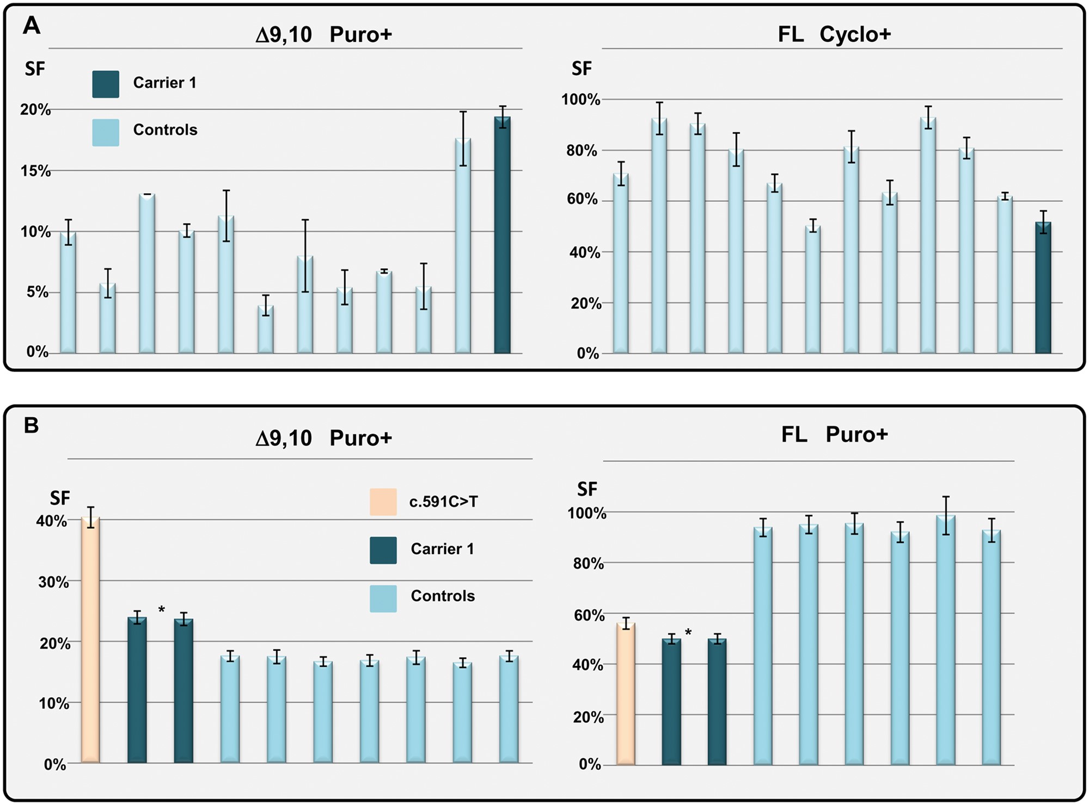
Figure 2. Quantification of major in-frame transcripts Δ9,10 and FL in LCLs from one BRCA1 c.[594-2A > C; 641A > G] ...
Notes:
Figure 2. Quantification of major in-frame transcripts Δ9,10 and FL in LCLs from one BRCA1 c.[594-2A > C; 641A > G] carrier (Carrier 1) and Controls. Experiments were performed in LCLs treated with Puromycin (Puro+). Panel A displays Δ9,10 SF and FL SF , estimated as the ratio between the GADPH normalized absolute numbers of Δ9,10 (or FL) molecules and absolute number of all BRCA1 transcripts, as determined by qPCR analysis performed with standard curves (see Supplementary Material, Methods and Fig. S4 ). Standard deviation of 3 independent measures is shown. Panel B displays dPCR data measuring Δ9,10 SF and FL (inclusion of exons 9 and 10) SF , using exon23-24 junction as a proxy for overall BRCA1 expression level. The precision of each measure (as determined by the QuantStudio 3D Analysis Cloud Software) is indicated. Two technical replicates of Carrier 1 are shown. We included as positive control a LCL carrying the BRCA1 c.591C > T variant, known to increase Δ9,10 SF . The Δ9,10 SF in Carrier 1 was higher than in Controls (24% in two technical replicates of Carrier 1 versus an average of 17% in 7 control samples, Mann–Whitney U test; P = 0.028 for difference between groups), but a 50% reduction of FL SF (50% in two technical replicas of Carrier 1 versus an average of 94% in six control samples, Mann–Whitney U test; P = 0.036 for difference between groups).
Unless provided in the caption above, the following copyright applies to the content of this slide: © The Author 2016. Published by Oxford University Press. All rights reserved. For permissions, please e-mail: journals.permissions@oup.com

Slide 3
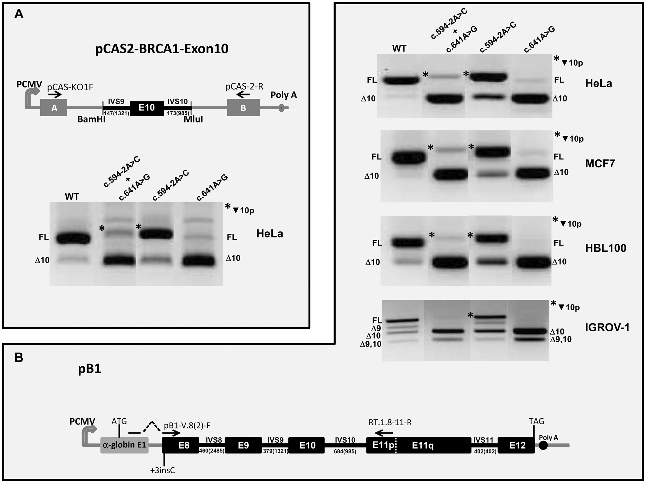
Figure 3. Analysis of BRCA1 c.594-2A > C and c.641A > G variants with splicing reporter minigene assays. The figure ...
Notes:
Figure 3. Analysis of BRCA1 c.594-2A > C and c.641A > G variants with splicing reporter minigene assays. The figure shows schematic non-scale representations of the splicing reporter minigenes pCAS2-BRCA1-exon10 (panel A) and pB1 (panel B) used for splicing assays. Minigenes were constructed as described under Supplementary Material , Methods. PCMV indicates the cytomegalovirus promoter, boxes represent exons and lines in between indicate introns. BRCA1 sequences are highlighted in black. Arrows represent primers used in RT-PCR reactions. With the exception of pB1 BRCA1 intron 11 (402 nt-long FL IVS11), minigenes harbor partial segments of BRCA1 introns. For comparative purposes, the size in nucleotides of each segment is shown together with the size corresponding to the endogenous FL BRCA1 introns shown in brackets. As indicated, pB1 carries an additional cytosine (+3insC) in exon 8 to keep the ORF with α-globin exon 1 ( 8 ). Splicing assays were performed by analyzing the splicing pattern of WT and mutant minigenes (c.594-2A > C, c.641A > G and c.[594-2A > C; 641A > G]) transiently expressed in human cells (HeLa, COS-7, MCF7, HBL100 or IGROV-1) as described under Supplementary Methods . The images show RT-PCR products separated in ethidium bromide-stained agarose gels. FL, full-length; Δ9, exon 9 skipping; Δ10, exon 10 skipping; Δ9,10, skipping of both exons 9 and 10; asterisk, retention of 21 intronic nucleotides immediately upstream exon 10 (▼10p). One can note that: (i) the relative level of alternatively spliced pB1(WT) transcripts is higher in IGROV-1 than in HeLa, MCF-7 or HBL100 cells, and (ii) the predominant alternative splicing event of pB1(WT) in these cell lines is Δ10, whereas that of endogenous wild-type BRCA1 in blood related samples is Δ9,10 ( Fig. 4 and Supplementary Material, Figs 1 and 2 ).
Unless provided in the caption above, the following copyright applies to the content of this slide: © The Author 2016. Published by Oxford University Press. All rights reserved. For permissions, please e-mail: journals.permissions@oup.com

Slide 4
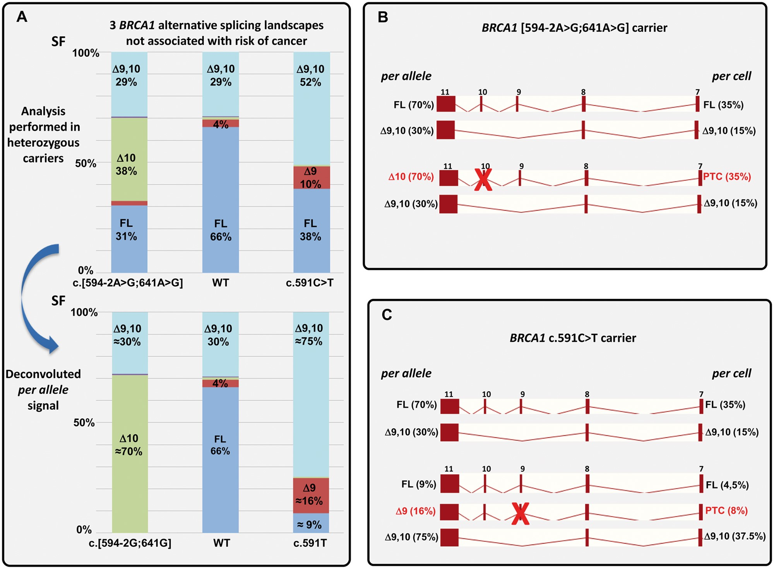
Figure 4. Combined genetic and splicing analyses of BRCA1 c.[594-2A > C; 641A > G] and BRCA1 c.591C > T supports a ...
Notes:
Figure 4. Combined genetic and splicing analyses of BRCA1 c.[594-2A > C; 641A > G] and BRCA1 c.591C > T supports a BRCA1 Δ9,10 rescue model with far-reaching clinical implications. Panel A (top) shows the SF of five alternative splicing events detected by capillary electrophoresis analysis of RT-PCR products generated with the E8.2-E11q.2 assay (Puro+ experiments, 36 cycle PCRs, see Fig.1 and Supplementary Material, Fig. 1 for further details). As shown, this description of the BRCA1 alternative splicing landscape in the vicinity of exon 10 is different in healthy control samples, c.[594-2A > C; 641A > G] carriers, and c.591C > T carriers. Yet, we show in the present study that none of these three BRCA1 splicing landscapes is associated with high risk of developing BRCA1-related cancers. The chart displays SFs that, in carriers, represent a combined signal from the variant allele and the accompanying WT allele. Panel A (bottom). Deduced per allele SFs are shown. Assuming that SFs arising from the accompanying WT allele equal to the average SFs observed in 10 Control samples (as shown in the central chart bar), we deconvoluted the SFs corresponding to c.[594-2G; c.641G] (left chart bar) and c.591T (right chart bar) alleles. Panel B. The cartoon represents the relative per allele (100% equals to the overall expression level arising from one individual allele) and per cell (100% equals to the overall expression arising from a diploid genome) expression (BRCA1 exons 7–11) in a c.[594-2G; c.641G] carrier, inferred from capillary EP analyses shown in Panel A. For simplicity, only FL and Δ9,10 transcripts are shown, albeit Δ9 and ▼10p transcripts account for ≈5% of the per cell expression. Truncating (out-of-frame) events are highlighted with a red cross. The analysis suggests that expressing up to ≈35% of BRCA1 PTC-NMD transcripts (per diploid genome) is not associated with high-risk of developing cancer. The analysis suggests as well that a BRCA1 allele expressing up to ≈70% (per allele) BRCA1 PTC-NMD transcripts is not associated with high-risk of developing cancer (a relevant finding in the context of the two-hit model). Panel C. The cartoon represents the relative per allele (100% equals to the overall expression level arising from one individual allele) and per cell (100% equals to the overall expression arising from a diploid genome) expression (BRCA1 exons 7–11) in a c.591C > T carrier, inferred from capillary EP analyses shown in Panel A. For simplicity, only FL, Δ9,10 and Δ9 (variant allele) are shown, albeit Δ9 (wt allele), Δ10 (wt and variant allele), and ▼10p (wt and variant allele) transcripts account for ≈5% of the per cell expression. The data strongly suggests that BRCA1Δ9,10 transcripts, representing up to 51% (per diploid genome) and up to 71% (per allele) of the overall BRCA1 expression code for a BRCA1 protein with tumor suppressor activity. The model displayed in this figure is intended to illustrate the most relevant findings of our study. Yet, some limitations should be highlighted. First, the model assumes (based on 36-cycle PCR capillary EP data) that Δ9,10SF in Controls and c.[594-2A > C; 641A > G] carriers is ≈29%, while other experiments suggests that the actual value is probably lower in both instances ( Fig. 2 , Supplementary Material, Fig. 2 ), albeit slightly increased in Carriers versus Controls. The model has been elaborated with data obtained in LCLs, not in clinically relevant tissues such as breast or ovarian. PTC, premature termination codon.
Unless provided in the caption above, the following copyright applies to the content of this slide: © The Author 2016. Published by Oxford University Press. All rights reserved. For permissions, please e-mail: journals.permissions@oup.com

