Slide 1
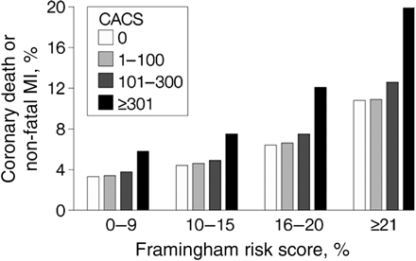
Figure 1 Predicted event rates for Coronary Artery Calcium Score in relation to Framingham risk categories. Predicted ...
Notes:
Figure 1 Predicted event rates for Coronary Artery Calcium Score in relation to Framingham risk categories. Predicted 7-year event rates from COX regression model for coronary artery disease death or non-fatal MI for categories of Framingham risk score (FRS) or coronary artery calcium score (CACS) in subjects without previous cardiovascular disease reported by Greenland et al. In intermediate FRS risk patients, a CACS >300 Agatston units identifies subjects at high cardiovascular risk whereas in the low FRS category subjects remain at low risk for any level of CACS. Reproduced with permission from reference 26
Unless provided in the caption above, the following copyright applies to the content of this slide: Published on behalf of the European Society of Cardiology. All rights reserved. © The Author 2010. For permissions please email: journals.permissions@oxfordjournals.org

