Slide 1
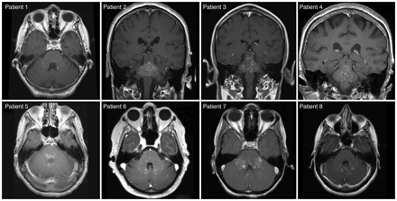
Figure 1 Characteristic pontine-predominant MRI characteristics of CLIPPERS syndrome. MRI brain with gadolinium ...
Notes:
Figure 1 Characteristic pontine-predominant MRI characteristics of CLIPPERS syndrome. MRI brain with gadolinium showing foci of pontine enhancement with a curvilinear pattern highly suggestive of a perivascular distribution in all eight patients.
Unless provided in the caption above, the following copyright applies to the content of this slide: © The Author (2010). Published by Oxford University Press on behalf of the Guarantors of Brain. All rights reserved. For Permissions, please email: journals.permissions@oxfordjournals.org

Slide 2
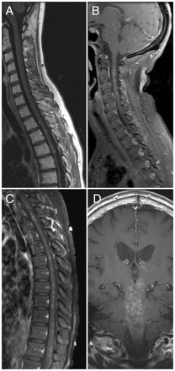
Figure 2 Representative MRI findings outside of primary brainstem abnormalities. Similar foci of gadolinium ...
Notes:
Figure 2 Representative MRI findings outside of primary brainstem abnormalities. Similar foci of gadolinium enhancement seen in upper thoracic cord (A), upper cervical cord (B), mid-lower thoracic cord (C) and basal ganglia (D).
Unless provided in the caption above, the following copyright applies to the content of this slide: © The Author (2010). Published by Oxford University Press on behalf of the Guarantors of Brain. All rights reserved. For Permissions, please email: journals.permissions@oxfordjournals.org

Slide 3
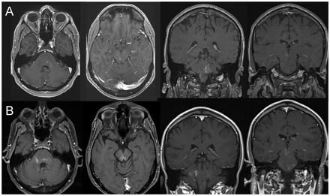
Figure 3 Progression of lesions over 6 months in Patient 3. MRI brain (T1 weighted post gadolinium) at presentation ...
Notes:
Figure 3 Progression of lesions over 6 months in Patient 3. MRI brain (T1 weighted post gadolinium) at presentation shows asymmetric enhancement in the left pons and right mesencephalon (A, top panels), which progressed over 6 months (B, bottom panels) to become more extensive and symmetric.
Unless provided in the caption above, the following copyright applies to the content of this slide: © The Author (2010). Published by Oxford University Press on behalf of the Guarantors of Brain. All rights reserved. For Permissions, please email: journals.permissions@oxfordjournals.org

Slide 4
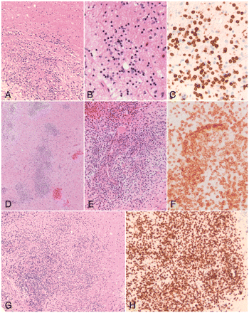
Figure 4 Neuropathology from Patients 1, 2, and 5. Marked perivascular and parenchymal lymphocytic infiltrates in the ...
Notes:
Figure 4 Neuropathology from Patients 1, 2, and 5. Marked perivascular and parenchymal lymphocytic infiltrates in the white matter (haematoxylin and eosin stain), for Patients 1 (A × 100, B × 200), 2 (D × 40, E × 200), and 5 (G × 100). The lymphocytic infiltrate was composed predominantly of CD3 positive (T) lymphocytes in all cases (Patient 1, C × 400; Patient 2, F × 400; Patient 5, H × 200); similar pathology was demonstrated in Patient 6 (results not shown).
Unless provided in the caption above, the following copyright applies to the content of this slide: © The Author (2010). Published by Oxford University Press on behalf of the Guarantors of Brain. All rights reserved. For Permissions, please email: journals.permissions@oxfordjournals.org

Slide 5
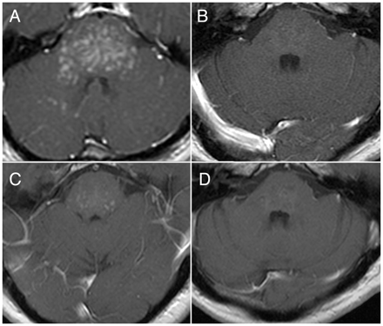
Figure 5 Marked reduction in extent of gadolinium enhancement following immunotherapy in Patient 2. Axial ...
Notes:
Figure 5 Marked reduction in extent of gadolinium enhancement following immunotherapy in Patient 2. Axial T1 MRI brain with gadolinium. (A) At time of relapse, off of all immunosuppressive therapy and prior to brain biopsy. (B) Near complete resolution of gadolinium enhancing lesions following chronic oral prednisone. (C) Recurrent gadolinium enhancing lesions following discontinuation of prednisone. (D) Improvement and stability for over 1.5 years on methotrexate monotherapy.
Unless provided in the caption above, the following copyright applies to the content of this slide: © The Author (2010). Published by Oxford University Press on behalf of the Guarantors of Brain. All rights reserved. For Permissions, please email: journals.permissions@oxfordjournals.org

