Slide 1
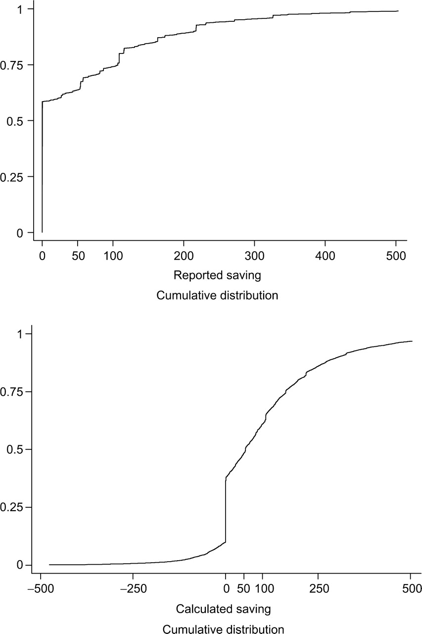
Fig. 1. Cumulative Distribution Functions of Reported and Calculated Saving
Notes:
Fig. 1. Cumulative Distribution Functions of Reported and Calculated Saving
Unless provided in the caption above, the following copyright applies to the content of this slide: © Oxford University Press 2007 All rights reserved

Slide 2
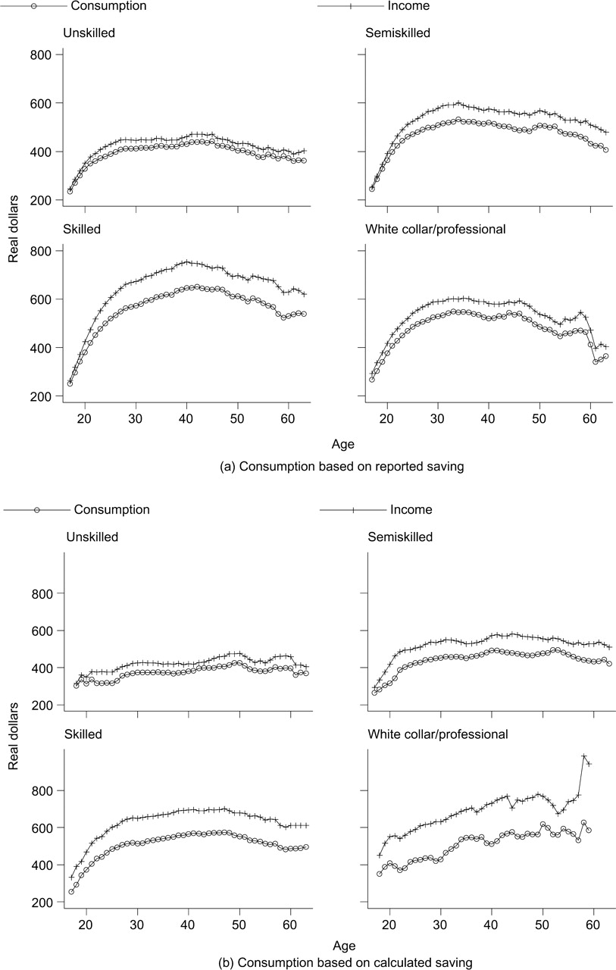
Fig. 2. Consumption and Income Profiles by Skill Class
Notes:
Fig. 2. Consumption and Income Profiles by Skill Class
Unless provided in the caption above, the following copyright applies to the content of this slide: © Oxford University Press 2007 All rights reserved

