Slide 1
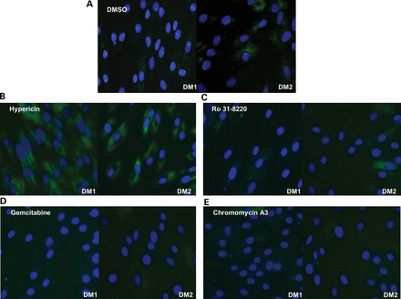
Figure 1. Compound treatments reduce nuclear foci. (A–E) Images of KBTeloMyoD fibroblast cells (DM1) and KagoTelo ...
Notes:
Figure 1. Compound treatments reduce nuclear foci. (A–E) Images of KBTeloMyoD fibroblast cells (DM1) and KagoTelo fibroblast cells (DM2) following RNA FISH using Cy3-(CAG)10 probe (green) for the localization of the mutant transcript and Hoechst (blue) to indicate the cell nucleus. Treatment with (A) DMSO, (B) hypericin (4.4 μm), (C) Ro 31-8220 (4.4 μm), (D) gemcitabine (4.4 μm) and (E) chromomycin A3 (4.4 μm).
Unless provided in the caption above, the following copyright applies to the content of this slide: © The Author 2013. Published by Oxford University Press.This is an Open Access article distributed under the terms of the Creative Commons Attribution License (http://creativecommons.org/licenses/by/3.0/), which permits unrestricted reuse, distribution, and reproduction in any medium, provided the original work is properly cited.

Slide 2
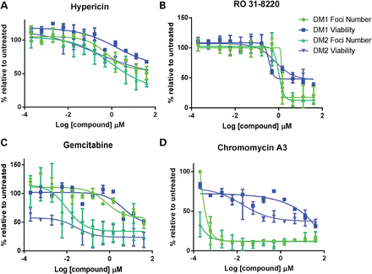
Figure 2. Compound treatment and toxicity profiles. Standard concentration curves showing the effect of compound ...
Notes:
Figure 2. Compound treatment and toxicity profiles. Standard concentration curves showing the effect of compound treatments in KBTeloMyoD cells (DM1) and KagoTelo cells (DM2) in which the percentages of foci (green) and cell viability (blue) are represented relative to DMSO treatment on the ‘y’-axis. Compound concentration (log μm) is indicated on the ‘x’-axis for hypericin (A), Ro 31-8220 (B), gemcitabine (C) and chromomycin A3 (D).
Unless provided in the caption above, the following copyright applies to the content of this slide: © The Author 2013. Published by Oxford University Press.This is an Open Access article distributed under the terms of the Creative Commons Attribution License (http://creativecommons.org/licenses/by/3.0/), which permits unrestricted reuse, distribution, and reproduction in any medium, provided the original work is properly cited.

Slide 3
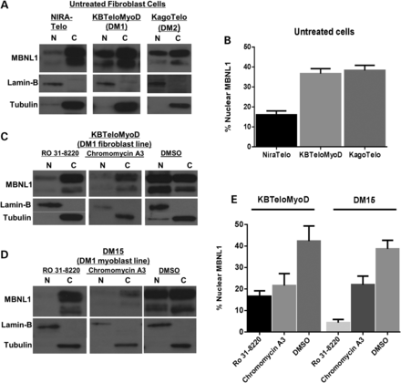
Figure 3. The subcellular distribution of MBNL1. (A) Western blots showing the distribution of MBNL1 in nuclear (N) and ...
Notes:
Figure 3. The subcellular distribution of MBNL1. (A) Western blots showing the distribution of MBNL1 in nuclear (N) and cytoplasmic (C) compartments of cell lines NIRATelo (control), KBTeloMyoD (DM1) and KAGOTelo (DM2). (B) Histograms show data compiled from intensity scans of triplicate blots for each cell line, normalized against values for lamin-B and tubulin. (C and D) Western blots showing the distribution of MBNL1 in nuclear (N) and cytoplasmic (C) compartments of fibroblast cell line KBTeloMyoD (DM1) (C) and DM1 myoblast cell line DM15 (D) following treatment with Ro 31-8220 (10 μm), chromomycin A3 (40 nm) and DMSO. (E) Histograms are shown of data compiled from intensity scans of triplicate blots for cell lines KBTeloMyoD and DM15 following treatment with Ro 31-8220 (10 μm), chromomycin A3 (40 nm) and DMSO normalized against values for lamin-B and tubulin.
Unless provided in the caption above, the following copyright applies to the content of this slide: © The Author 2013. Published by Oxford University Press.This is an Open Access article distributed under the terms of the Creative Commons Attribution License (http://creativecommons.org/licenses/by/3.0/), which permits unrestricted reuse, distribution, and reproduction in any medium, provided the original work is properly cited.

Slide 4
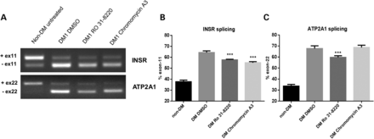
Figure 4. The effect of compound treatment on INSR and ATP2A1 alternative splicing. (A) Ethidium-stained agarose gels ...
Notes:
Figure 4. The effect of compound treatment on INSR and ATP2A1 alternative splicing. (A) Ethidium-stained agarose gels show RT–PCR fragment analysis of INSR and ATP2A1 splicing in DM differentiated fibroblast cell lines compared with non-DM differentiated fibroblast cells following treatment with Ro 31-8220 (10 μm), chromomycin A3 (40 nm) and DMSO (control). (B) Histograms show the percentage of INSR transcripts with the minus exon 11 isoform following compound treatment. (C) Histograms show the percentage of ATP2A1 transcripts with the minus exon 22 isoform following compound treatment. In each case, the data represent separate measurements produced for three biological replicates. Statistical analysis demonstrates the significance of compound treatments on both INSR and ATP2A1 splicing profiles towards that of the non-DM form.
Unless provided in the caption above, the following copyright applies to the content of this slide: © The Author 2013. Published by Oxford University Press.This is an Open Access article distributed under the terms of the Creative Commons Attribution License (http://creativecommons.org/licenses/by/3.0/), which permits unrestricted reuse, distribution, and reproduction in any medium, provided the original work is properly cited.

Slide 5
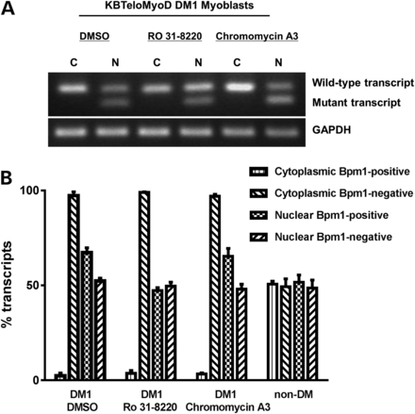
Figure 5. The effect of compound treatment on repeat expansion transcripts. The relative proportions of the mutant and ...
Notes:
Figure 5. The effect of compound treatment on repeat expansion transcripts. The relative proportions of the mutant and wild-type DMPK transcripts in KBTeloMyoD differentiated fibroblast cells (DM1) were assessed following treatments with Ro 31-8220 (10 μm), chromomycin A3 (40 nm) and DMSO control. (A) Ethidium bromide-stained gel showing RT–PCR products from nuclear (N) and cytoplasmic (C) RNA fractions of KBTeloMyoD cells following the amplification and BpmI restriction enzyme digestion of a fragment of DMPK. GAPDH is used as a loading control. (B) Histograms showing the relative proportions of mutant (BpmI positive) and wild-type (BpmI negative) nuclear DMPK transcripts expressed as a percentage of the total nuclear DMPK transcripts. Quantitative RT–PCR was conducted using Genescan analysis of areas under the peaks following amplification of DMPK and BpmI restriction enzyme digestion.
Unless provided in the caption above, the following copyright applies to the content of this slide: © The Author 2013. Published by Oxford University Press.This is an Open Access article distributed under the terms of the Creative Commons Attribution License (http://creativecommons.org/licenses/by/3.0/), which permits unrestricted reuse, distribution, and reproduction in any medium, provided the original work is properly cited.

Slide 6
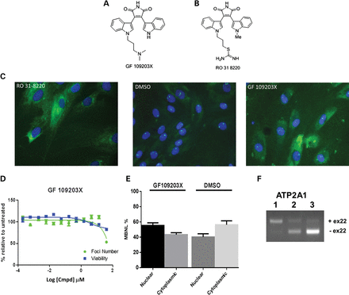
Figure 6. Comparing the effects of Ro 31-8220 and GF 109203X. The structure of GF 109203X is shown in (A) and Ro ...
Notes:
Figure 6. Comparing the effects of Ro 31-8220 and GF 109203X. The structure of GF 109203X is shown in (A) and Ro 31-8220 in (B). (C) Images of KBTeloMyoD fibroblast cells (DM1) are shown following treatment with Ro 31-8220 at 10 μm, DMSO and GF 109 203X at 40 μm. (D) The standard concentration curves for GF 109 203X treatment of KBTeloMyoD fibroblast cells in which the percentages of foci (green) and cell viability (blue) are represented relative to DMSO treatment. (E) Histogram showing nuclear and cytoplasmic distribution of MBNL1 following GF 109 203X treatment. The graph shows the combined data of triplicate samples for comparison of GF 109 203X and DMSO treatments. (F) The alternative splicing patterns of ATP2A1 obtained for untreated SBTeloMyoD differentiated fibroblasts (non-DM cells) (lane 1), KBTeloMyoD differentiated fibroblasts (DM1) treated with DMSO (lane 2) and KBTeloMyoD differentiated fibroblasts (DM1) treated with GF 109 203X (lane 3).
Unless provided in the caption above, the following copyright applies to the content of this slide: © The Author 2013. Published by Oxford University Press.This is an Open Access article distributed under the terms of the Creative Commons Attribution License (http://creativecommons.org/licenses/by/3.0/), which permits unrestricted reuse, distribution, and reproduction in any medium, provided the original work is properly cited.

Slide 7
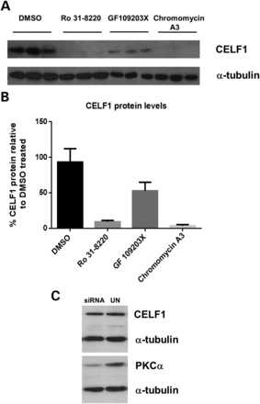
Figure 7. The effect of compound treatment on CELF1 protein levels. (A) CELF1 and α-tubulin protein levels were ...
Notes:
Figure 7. The effect of compound treatment on CELF1 protein levels. (A) CELF1 and α-tubulin protein levels were analysed on protein extracts from KB Telo MyoD cells (DM1) following treatment with DMSO, Ro 31-8220 (10 μm), GF 109203X (10 μm) and chromomycin A3 (40 nm). (B) Histogram shows quantification of CELF1 protein normalized against α-tubulin levels. (C) CELF1 protein levels were analysed in western blot analysis of untreated and PKCα knockdown extracts. PKCα inhibition was verified by western blot, normalized against α-tubulin.
Unless provided in the caption above, the following copyright applies to the content of this slide: © The Author 2013. Published by Oxford University Press.This is an Open Access article distributed under the terms of the Creative Commons Attribution License (http://creativecommons.org/licenses/by/3.0/), which permits unrestricted reuse, distribution, and reproduction in any medium, provided the original work is properly cited.

