Slide 1
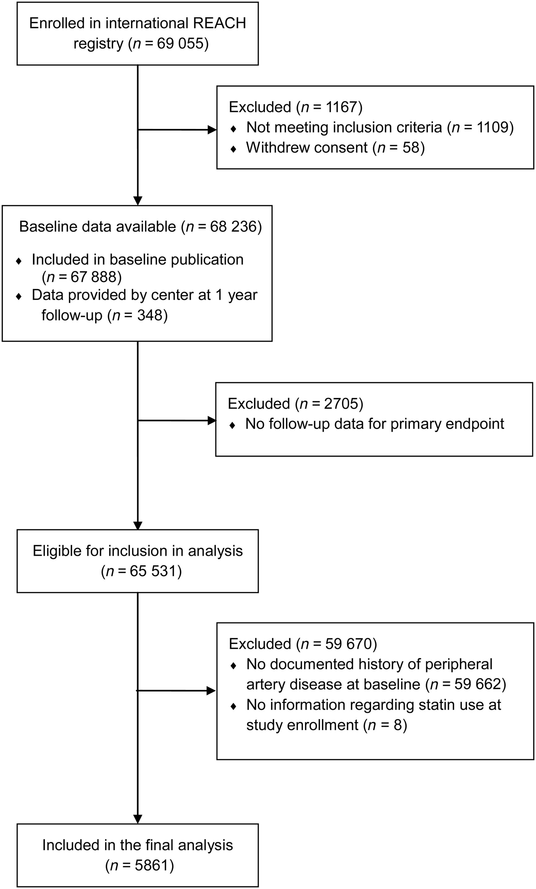
Figure 1 CONSORT flow diagram of study participants.
Notes:
Figure 1 CONSORT flow diagram of study participants.
Unless provided in the caption above, the following copyright applies to the content of this slide: Published on behalf of the European Society of Cardiology. All rights reserved. © The Author 2014. For permissions please email: journals.permissions@oup.com.

Slide 2
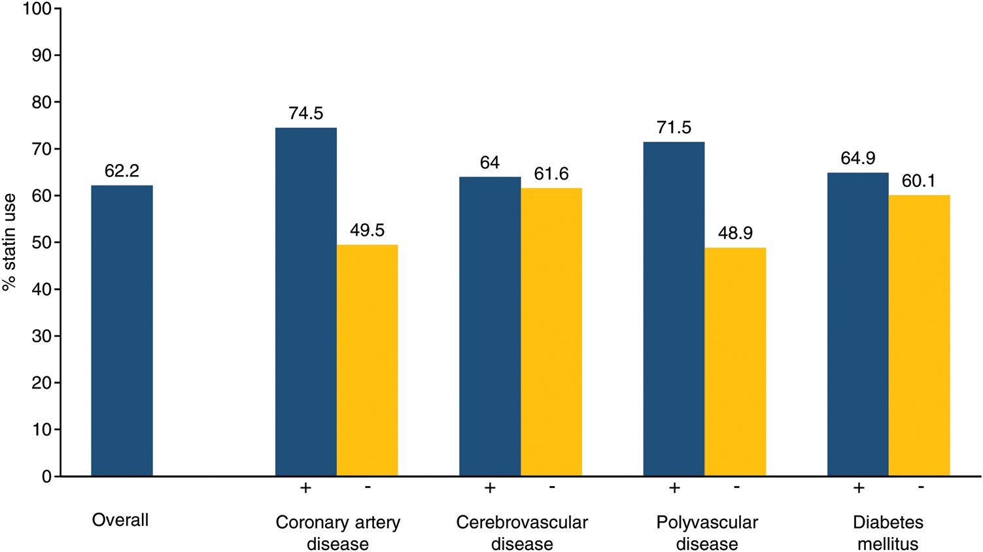
Figure 2 Proportion of patients on statins at enrolment.
Notes:
Figure 2 Proportion of patients on statins at enrolment.
Unless provided in the caption above, the following copyright applies to the content of this slide: Published on behalf of the European Society of Cardiology. All rights reserved. © The Author 2014. For permissions please email: journals.permissions@oup.com.

Slide 3
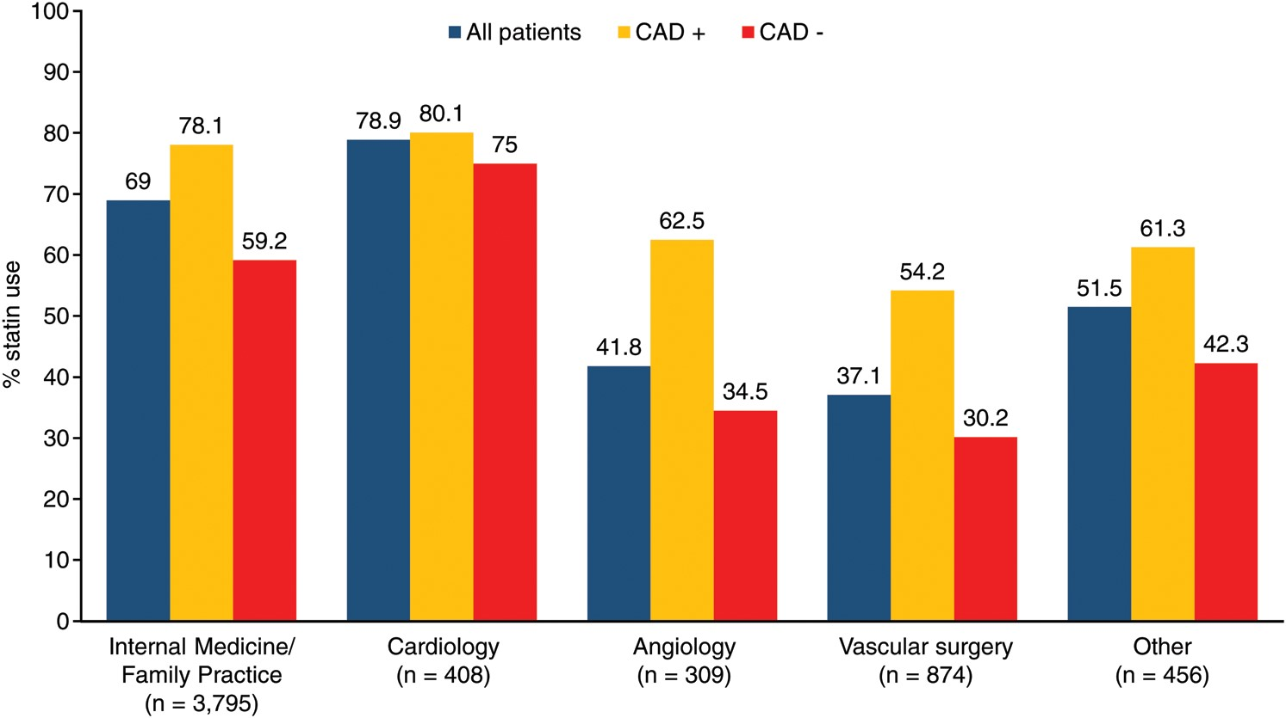
Figure 3 Proportion of patients on statins at enrolment based on enrolling investigator's subspecialty. Also reported ...
Notes:
Figure 3 Proportion of patients on statins at enrolment based on enrolling investigator's subspecialty. Also reported are proportions based on the presence of concomitant CAD or not. CAD indicates coronary artery disease.
Unless provided in the caption above, the following copyright applies to the content of this slide: Published on behalf of the European Society of Cardiology. All rights reserved. © The Author 2014. For permissions please email: journals.permissions@oup.com.

Slide 4
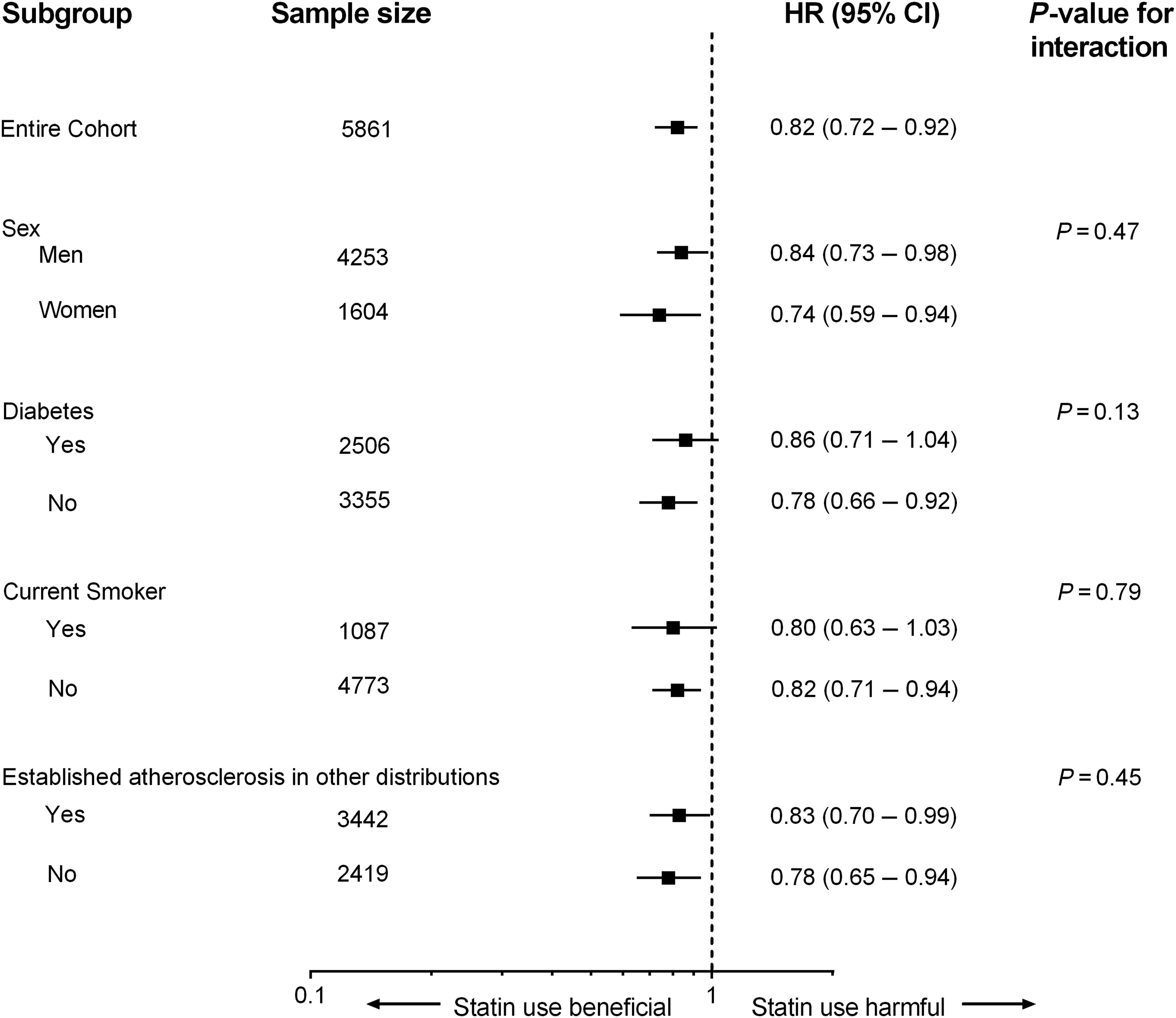
Figure 4 Subgroup analysis of the effect of statin use on the composite adverse limb outcome at 4 years. CI, ...
Notes:
Figure 4 Subgroup analysis of the effect of statin use on the composite adverse limb outcome at 4 years. CI, confidence intervals; HR, hazard ratio.
Unless provided in the caption above, the following copyright applies to the content of this slide: Published on behalf of the European Society of Cardiology. All rights reserved. © The Author 2014. For permissions please email: journals.permissions@oup.com.

