Slide 1
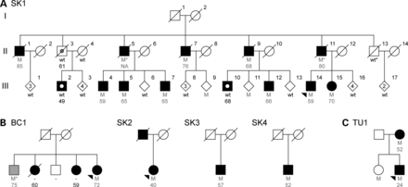
Figure 1. Pedigrees with DNAJC13 mutations. Individual pedigrees are labeled and numbered according to their geographic ...
Notes:
Figure 1. Pedigrees with DNAJC13 mutations. Individual pedigrees are labeled and numbered according to their geographic origin (SK, Saskatchewan, Canada; BC, British Columbia, Canada; TU, Tunisia). (A) Original family used for exome sequencing and identification of DNAJC13 p.Asn855Ser. (B) Additional kindreds presenting DNAJC13 p.Asn855Ser mutations. (C) Pedigree presenting the p.Arg2115Leu variant. Black-filled symbols indicate individuals diagnosed with PD, phenocopies are highlighted with a white circle, gray filled symbols indicate dementia, and gray circle indicates progressive supranuclear palsy. Heterozygote mutation carriers (M) with corresponding age at disease onset are indicated in gray and wild-type (wt) genotypes in black. An asterisk indicates an inferred mutation carrier.
Unless provided in the caption above, the following copyright applies to the content of this slide: © The Author 2013. Published by Oxford University Press. All rights reserved. For Permissions, please email: journals.permissions@oup.com

Slide 2
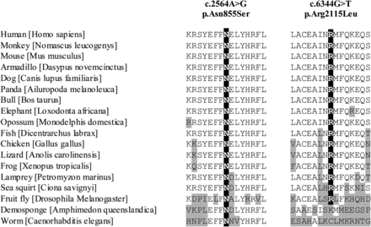
Figure 2. DNAJC13 mutations and cross-species conservation. Protein orthologs were aligned via ClustalW. Amino acid ...
Notes:
Figure 2. DNAJC13 mutations and cross-species conservation. Protein orthologs were aligned via ClustalW. Amino acid positions for DNAJC13 p.Asn855Ser and p.Arg2115Leu are highlighted in black. Protein orthologs with amino acid positions differing from those of the human sequence are indicated in gray. RefSeq accession numbers: Homo sapiens, NP_056083.3; Nomascus leucogenys, XP_003265273.1; Mus musculus, NP_001156498.1; Dasypus novemcinctus, ENSDNOP00000006627; Canis lupus familiaris, XP_542783.3; Ailuropoda melanoleuca, XP_002926293.1; Bos taurus, DAA33060.1; Loxodonta africana, XP_003420956.1; Monodelphis domestica, ENSMODP00000014684; Dicentrarchus labrax, CBN82117.1; Gallus gallus, ENSGALP00000019064; Anolis carolinensis, ENSACAG00000000850; Xenopus tropicalis, ENSXETG00000001850; Petromyzon marinus, ENSPMAP00000010330; Ciona savignyi, SINCSAVP00000001383; Drosophila melanogaster, NP_610467.1; Amphimedon queenslandica, XP_003383293.1; Caenorhabditis elegans, NP_492222.
Unless provided in the caption above, the following copyright applies to the content of this slide: © The Author 2013. Published by Oxford University Press. All rights reserved. For Permissions, please email: journals.permissions@oup.com

Slide 3
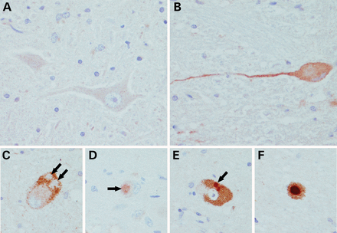
Figure 3. Immunological staining of DNAJC13 in brain sections from p.Asn855Ser mutation carriers SK1 II-7 (A–C) and SK1 ...
Notes:
Figure 3. Immunological staining of DNAJC13 in brain sections from p.Asn855Ser mutation carriers SK1 II-7 (A–C) and SK1 II-9 (D–F). (A) Negative staining in hypoglossal motor neurons. (B) Finely granular cytoplasmic immunoreactivity in dorsal motor nucleus of vagus. A subset of Lewy bodies (<50%) were positively labeled (arrows). Some Lewy bodies were completely unstained (C) two in a locus coeruleus neuron; others had weak staining (D) dorsal motor nucleus and some had dark immunoreactivity (E and F) substantia nigra.
Unless provided in the caption above, the following copyright applies to the content of this slide: © The Author 2013. Published by Oxford University Press. All rights reserved. For Permissions, please email: journals.permissions@oup.com

Slide 4
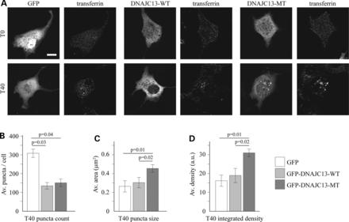
Figure 4. Transferrin uptake in cells over expressing wild-type and mutant DNAJC13 protein. (A) COS7 cells were ...
Notes:
Figure 4. Transferrin uptake in cells over expressing wild-type and mutant DNAJC13 protein. (A) COS7 cells were transiently transfected with either GFP, wild-type DNAJC13 (GFP-DNAJC13-WT) or DNAJC13 p.Asn855Ser (GFP-DNAJC13-MT). Transferrin uptake assay was performed and cells imaged at T0 (prior to uptake) or T40 (40 min after chase). (B) Average number of transferrin positive puncta, (C) positive puncta size and (D) mean integrated density of puncta per cell 40 min after uptake. Statistically significant Fisher's LSD post hoc values are provided.
Unless provided in the caption above, the following copyright applies to the content of this slide: © The Author 2013. Published by Oxford University Press. All rights reserved. For Permissions, please email: journals.permissions@oup.com

