Slide 1
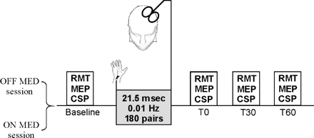
Fig. 1 Overview of the experimental paradigm. Patients with Parkinson's disease were studied in separate sessions ...
Notes:
Fig. 1 Overview of the experimental paradigm. Patients with Parkinson's disease were studied in separate sessions ‘off’ and ‘on’ medications. Measure of cortical excitability (RMT, MEP amplitude and CSP) were assessed from the APB and ADM muscles at baseline and for up to 1 h after the end of the PAS protocol. PAS involved median nerve stimulation preceding TMS over the motor spot for APB by 21.5 ms, at 0.01 Hz, for 30 min.
Unless provided in the caption above, the following copyright applies to the content of this slide: © The Author (2006). Published by Oxford University Press on behalf of the Guarantors of Brain. All rights reserved. For Permissions, please email: journals.permissions@oxfordjournals.org

Slide 2
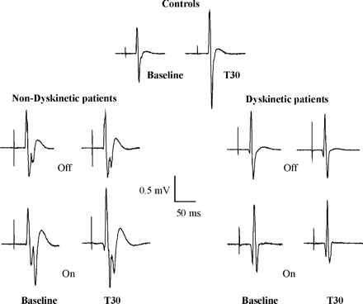
Fig. 2 Representative MEPs from the APB muscle of a control subject and from a dyskinetic and non-dyskinetic patient ...
Notes:
Fig. 2 Representative MEPs from the APB muscle of a control subject and from a dyskinetic and non-dyskinetic patient off and on medication at baseline and 30 min after PAS (T30). Each MEP represents average of 20 trials. PAS led to increased MEP amplitude in the control subject but not in the dyskinetic or the non-dyskinetic patients off medications. In the on medication state, the effect of PAS on MEP amplitude was restored in the non-dyskinetic patient but not in the dyskinetic patient.
Unless provided in the caption above, the following copyright applies to the content of this slide: © The Author (2006). Published by Oxford University Press on behalf of the Guarantors of Brain. All rights reserved. For Permissions, please email: journals.permissions@oxfordjournals.org

Slide 3
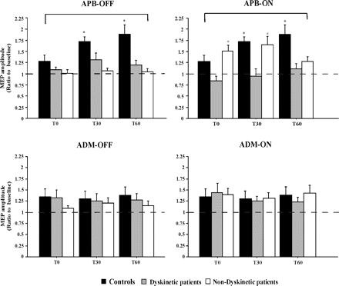
Fig. 3 Effect of PAS on MEP amplitudes. The data is plotted as a ratio to the baseline MEP amplitude. Ratios higher ...
Notes:
Fig. 3 Effect of PAS on MEP amplitudes. The data is plotted as a ratio to the baseline MEP amplitude. Ratios higher than 1 indicate facilitation and ratios below 1 indicate inhibition of MEP amplitude. In the APB muscle, PAS increased MEP amplitudes in controls but not in dyskinetic and non-dyskinetic patients off medication. In the on medication state, potentiation of MEP by PAS in the APB muscle was restored in the non-dyskinetic group but not in the dyskinetic group. PAS did not significantly increase the MEP amplitude in the ADM muscle in controls and both patients' groups either in the ‘off’ or ‘on’ medication states. *P < 0.01, **paired t-test compared with baseline. The data for the control group is duplicated in the OFF and ON graphs for clarity of comparison. Error bars represent standard error.
Unless provided in the caption above, the following copyright applies to the content of this slide: © The Author (2006). Published by Oxford University Press on behalf of the Guarantors of Brain. All rights reserved. For Permissions, please email: journals.permissions@oxfordjournals.org

Slide 4
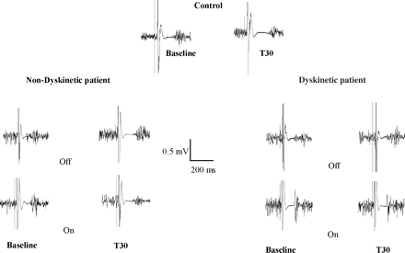
Fig. 4 Effect of PAS and medication on CSP duration. The recordings are from the APB muscle in a control subject and ...
Notes:
Fig. 4 Effect of PAS and medication on CSP duration. The recordings are from the APB muscle in a control subject and a dyskinetic and a non-dyskinetic patient off and on medication at baseline and at T30. Each trace is the average of 10 trials. PAS prolonged the CSP in the control subject and in the non-dyskinetic patient but had no effect in the dyskinetic patient. Medication (on versus off) change prolonged the CSP but did not change the effect of PAS on CSP.
Unless provided in the caption above, the following copyright applies to the content of this slide: © The Author (2006). Published by Oxford University Press on behalf of the Guarantors of Brain. All rights reserved. For Permissions, please email: journals.permissions@oxfordjournals.org

Slide 5
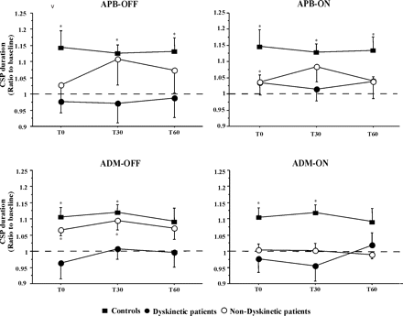
Fig. 5 Effect of PAS on CSP duration. PAS prolonged CSP duration in both the APB and ADM muscles in the control ...
Notes:
Fig. 5 Effect of PAS on CSP duration. PAS prolonged CSP duration in both the APB and ADM muscles in the control group. In non-dyskinetic patients, there was a tendency for increase in CSP duration following PAS. CSP did not change following PAS in the dyskinetic group, either on or off dopaminergic medications. Data are shown as a ratio to baseline CSP duration. Ratios higher than 1 indicate prolongation of CSP following PAS. *P < 0.01, paired t-test compared with baseline values. The data for the control group is duplicated in the OFF and ON graphs for clarity of comparison. Error bars represent standard error.
Unless provided in the caption above, the following copyright applies to the content of this slide: © The Author (2006). Published by Oxford University Press on behalf of the Guarantors of Brain. All rights reserved. For Permissions, please email: journals.permissions@oxfordjournals.org

