Slide 1
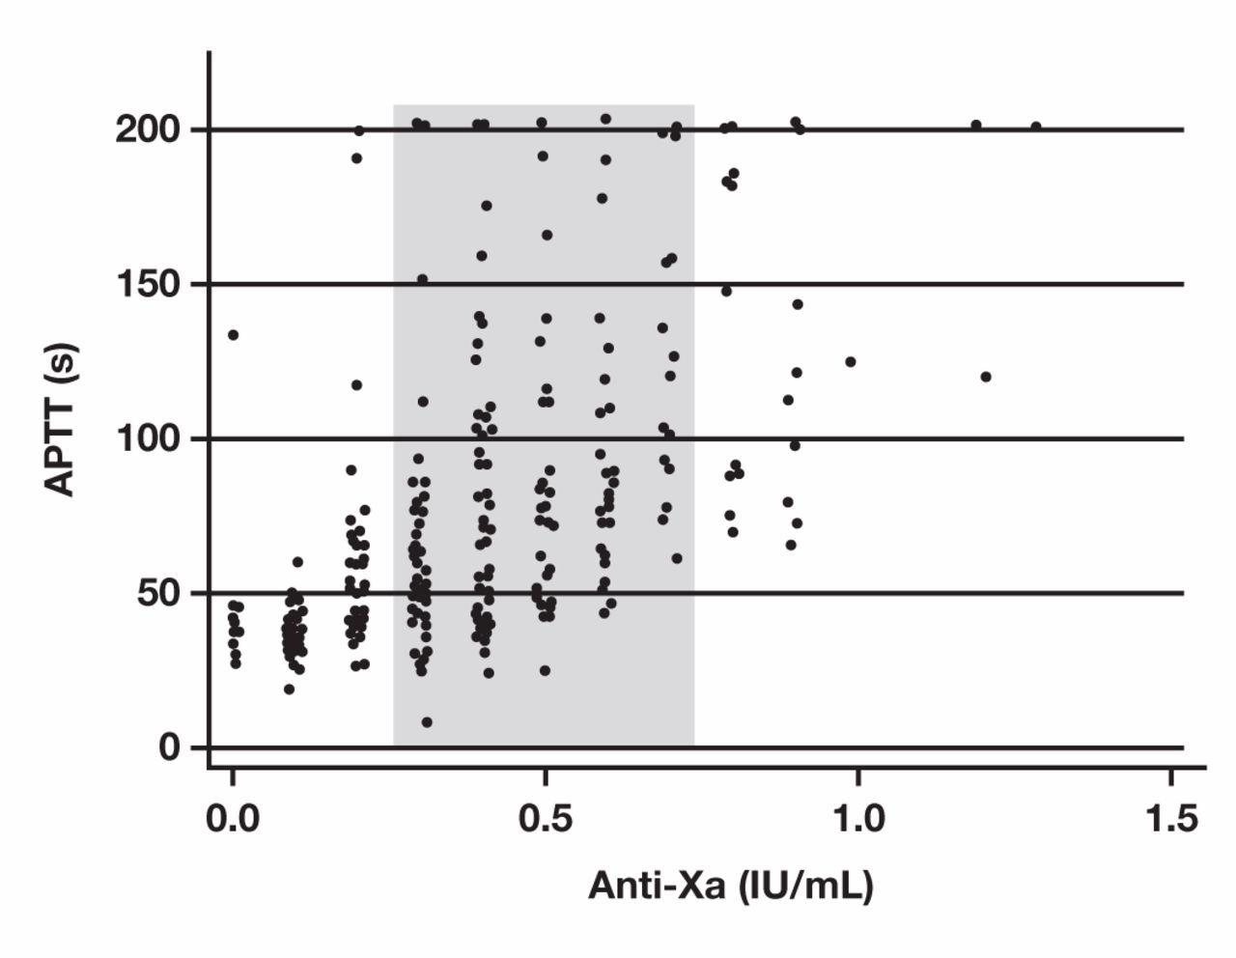
Figure 1 Paired measurements of anti-Xa activity and activated partial thromboplastin time (APTT) were performed on ...
Notes:
Figure 1 Paired measurements of anti-Xa activity and activated partial thromboplastin time (APTT) were performed on 569 samples obtained from 149 patients receiving unfractionated heparin therapy and plotted as a x-y scatterplot. Linear regression analysis between the 2 measurements shows that the correlation was low (r = 0.61; 95% confidence interval, 0.56–0.66). The shaded gray area highlights measurements of anti-Xa in the therapeutic range (0.3–0.7 IU/mL).
Unless provided in the caption above, the following copyright applies to the content of this slide: © American Society for Clinical Pathology

Slide 2
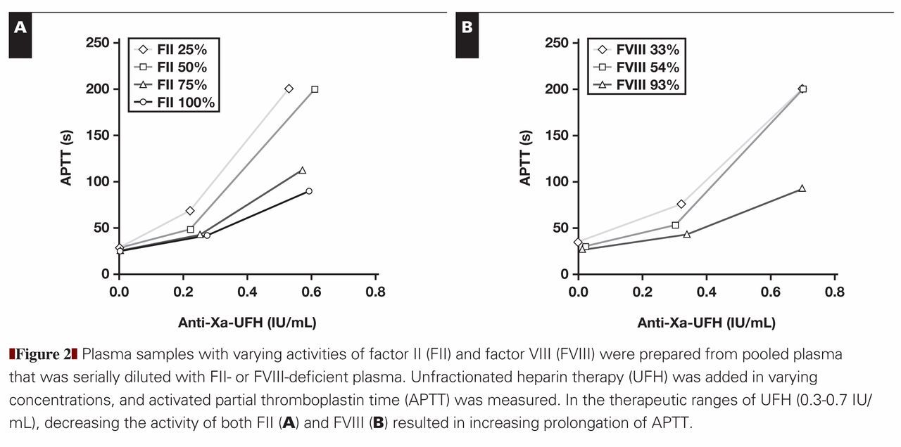
Figure 2 Plasma samples with varying activities of factor II (FII) and factor VIII (FVIII) were prepared from pooled ...
Notes:
Figure 2 Plasma samples with varying activities of factor II (FII) and factor VIII (FVIII) were prepared from pooled plasma that was serially diluted with FII- or FVIII-deficient plasma. Unfractionated heparin therapy (UFH) was added in varying concentrations, and activated partial thromboplastin time (APTT) was measured. In the therapeutic ranges of UFH (0.3–0.7 IU/mL), decreasing the activity of both FII (A) and FVIII (B) resulted in increasing prolongation of APTT.
Unless provided in the caption above, the following copyright applies to the content of this slide: © American Society for Clinical Pathology

Slide 3
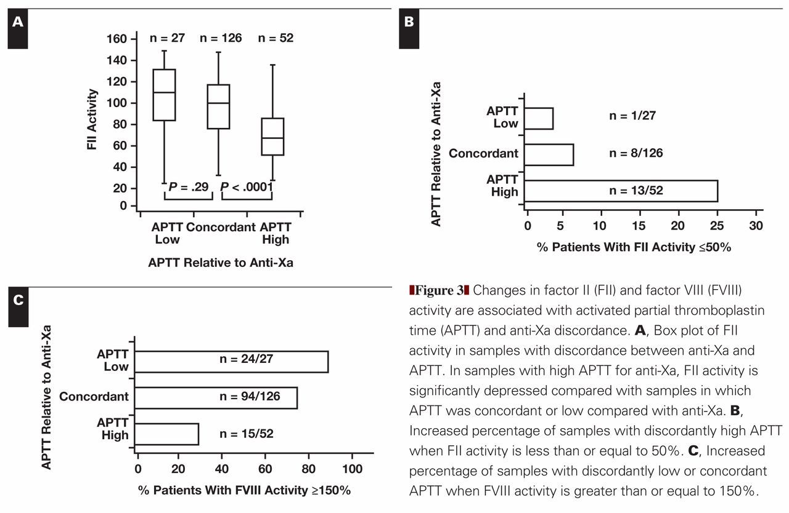
Notes:
Unless provided in the caption above, the following copyright applies to the content of this slide: © American Society for Clinical Pathology

Slide 4
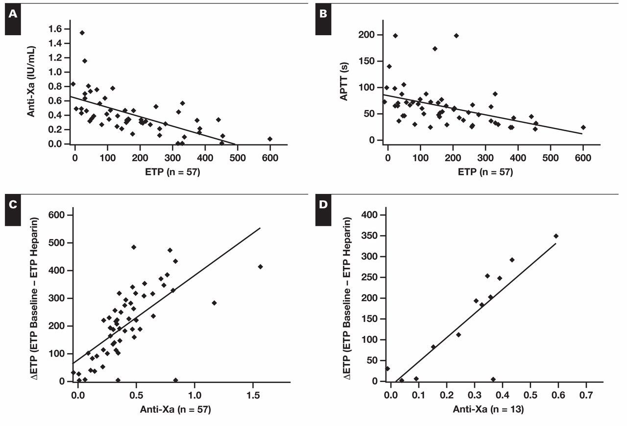
Figure 4 Correlation of endogenous thrombin potential (ETP) with activated partial thromboplastin time (APTT) and ...
Notes:
Figure 4 Correlation of endogenous thrombin potential (ETP) with activated partial thromboplastin time (APTT) and anti-Xa. Decreasing ETP correlates with increasing (A) anti-Xa and (B) APTT; however, coefficient of correlation is poor (A, r = −0.63; B, r = −0.44) C, Heparin activity as measured by anti-Xa correlates closely with change in ETP (r = 0.69). ∆ETP is the change in ETP at baseline and after heparin treatment. D, ∆ETP correlates well with heparin activity as measured by anti-Xa in samples with normal factor VIII and factor II activity (r = 0.83).
Unless provided in the caption above, the following copyright applies to the content of this slide: © American Society for Clinical Pathology

Slide 5
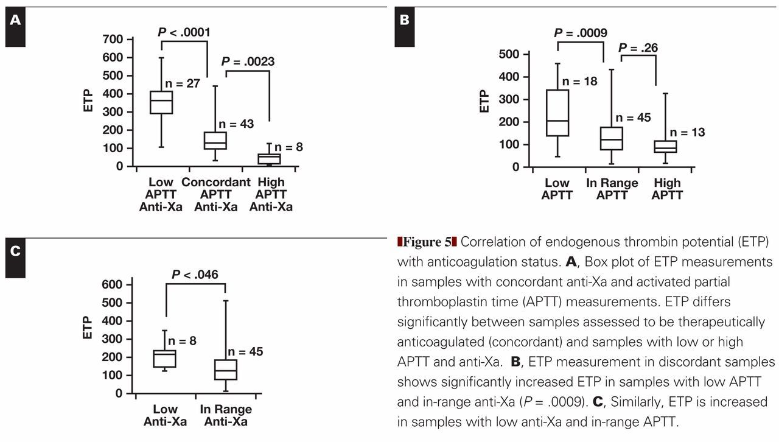
Notes:
Unless provided in the caption above, the following copyright applies to the content of this slide: © American Society for Clinical Pathology

