Slide 1
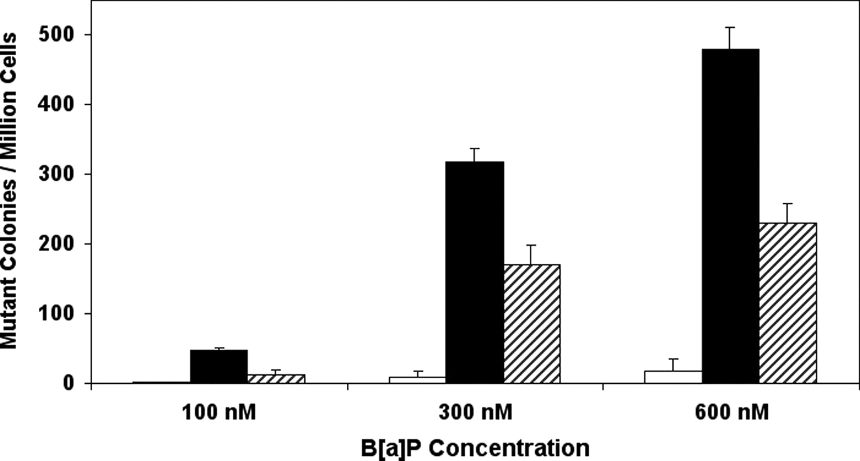
Fig. 1 Mutagenicity of B[ a ]P at different concentrations in transgenic cell lines. V79MZ cells genetically ...
Notes:
Fig. 1 Mutagenicity of B[ a ]P at different concentrations in transgenic cell lines. V79MZ cells genetically modified to express hCYP1A1 (V79MZh1A1), or V79MZh1A1 cells further modified to express both hCYP1A1 and hGSTP1 (V79MZh1A1/P1-23) were exposed to 100, 300 or 600 nM B[ a ]P for 48 h, and the hprt mutagenicity assay was performed as described in Materials and methods. Legend: open bars, V79MZ control; filled bars, V79MZh1A1; cross-hatched bars, V79MZh1A1/hGSTP1-23. Results are the mean ± standard deviation (SD) of at least four independent assays.
Unless provided in the caption above, the following copyright applies to the content of this slide: © The Author 2006. Published by Oxford University Press. All rights reserved. For Permissions, please email: journals.permissions@oxfordjournals.org

Slide 2
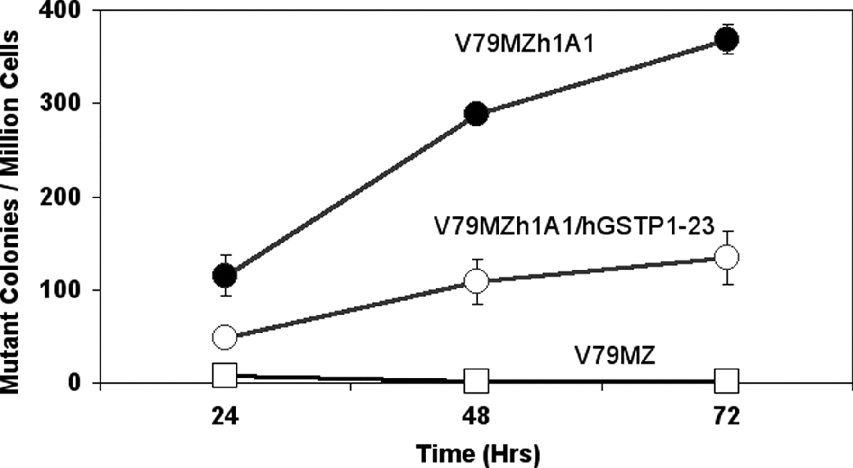
Fig. 2 Time course of B[ a ]P mutagenicity in transgenic cell lines. V79MZ cells genetically modified to express ...
Notes:
Fig. 2 Time course of B[ a ]P mutagenicity in transgenic cell lines. V79MZ cells genetically modified to express hCYP1A1 (V79MZh1A1), or V79MZh1A1 cells further modified to express both hCYP1A1 and hGSTP1 (V79MZh1A1/P1-23) were exposed to 300 nM B[ a ]P for the indicated times, and the hprt mutagenicity assay was performed as described in Materials and methods. Symbols: open squares, V79MZ control; filled circles, V79MZh1A1; open circles, V79MZh1A1/hGSTP1-23. Results are the mean ± SD of at least three independent assays.
Unless provided in the caption above, the following copyright applies to the content of this slide: © The Author 2006. Published by Oxford University Press. All rights reserved. For Permissions, please email: journals.permissions@oxfordjournals.org

Slide 3
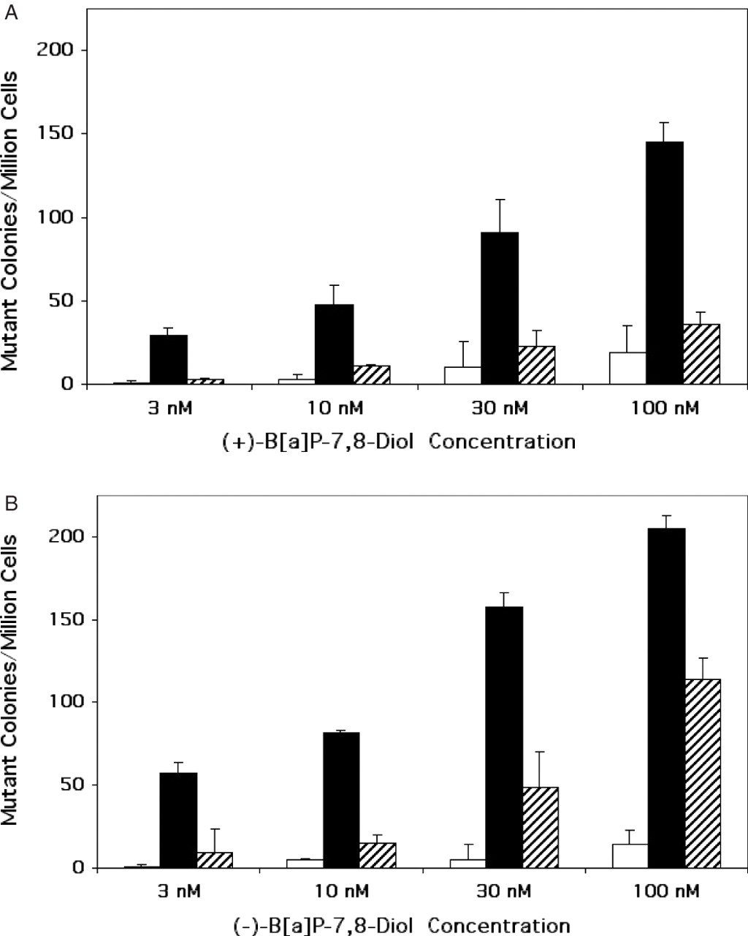
Fig. 3 Mutagenicity of B[ a ]P-7,8-dihydrodiol enantiomers at different concentrations in transgenic cell lines. ...
Notes:
Fig. 3 Mutagenicity of B[ a ]P-7,8-dihydrodiol enantiomers at different concentrations in transgenic cell lines. V79MZ cells (open bars) genetically modified to express hCYP1A1 (V79MZh1A1; filled bars), or V79MZh1A1 cells further modified to express both hCYP1A1 and hGSTP1 (V79MZh1A1/P1-23, cross-hatched bars) were exposed to 3, 10, 30 or 100 nM (+)-B[ a ]P-7,8-diol ( A ) or (−)-B[ a ]P-7,8-diol ( B ) for 48 h, and the hprt mutagenicity assay was performed as described in Materials and methods. Results are presented as the mean ± SD of at least three independent experiments.
Unless provided in the caption above, the following copyright applies to the content of this slide: © The Author 2006. Published by Oxford University Press. All rights reserved. For Permissions, please email: journals.permissions@oxfordjournals.org

Slide 4
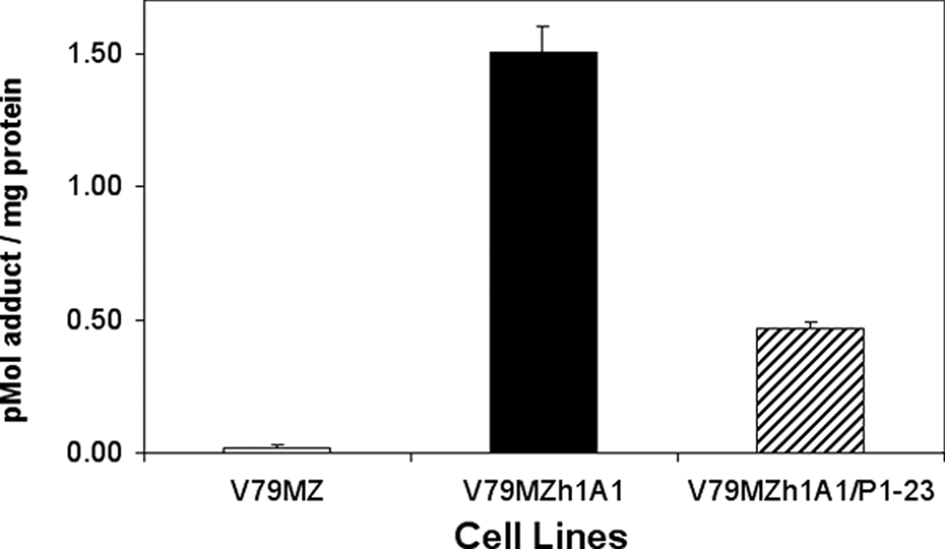
Fig. 4 Total cellular macromolecular alkylation in transgenic cell lines exposed to 3H-B[ a ]P. V79MZ cells ...
Notes:
Fig. 4 Total cellular macromolecular alkylation in transgenic cell lines exposed to 3H-B[ a ]P. V79MZ cells genetically modified to express hCYP1A1 (V79MZh1A1), or V79MZh1A1 cells further modified to express both hCYP1A1 and hGSTP1 (V79MZh1A1/P1-23) were exposed to 100 nM 3 H-B[ a ]P for 48 h, and total cellular adducts were measured as described in Materials and methods. Results are presented as the mean ± SD of at least three independent experiments.
Unless provided in the caption above, the following copyright applies to the content of this slide: © The Author 2006. Published by Oxford University Press. All rights reserved. For Permissions, please email: journals.permissions@oxfordjournals.org

Slide 5
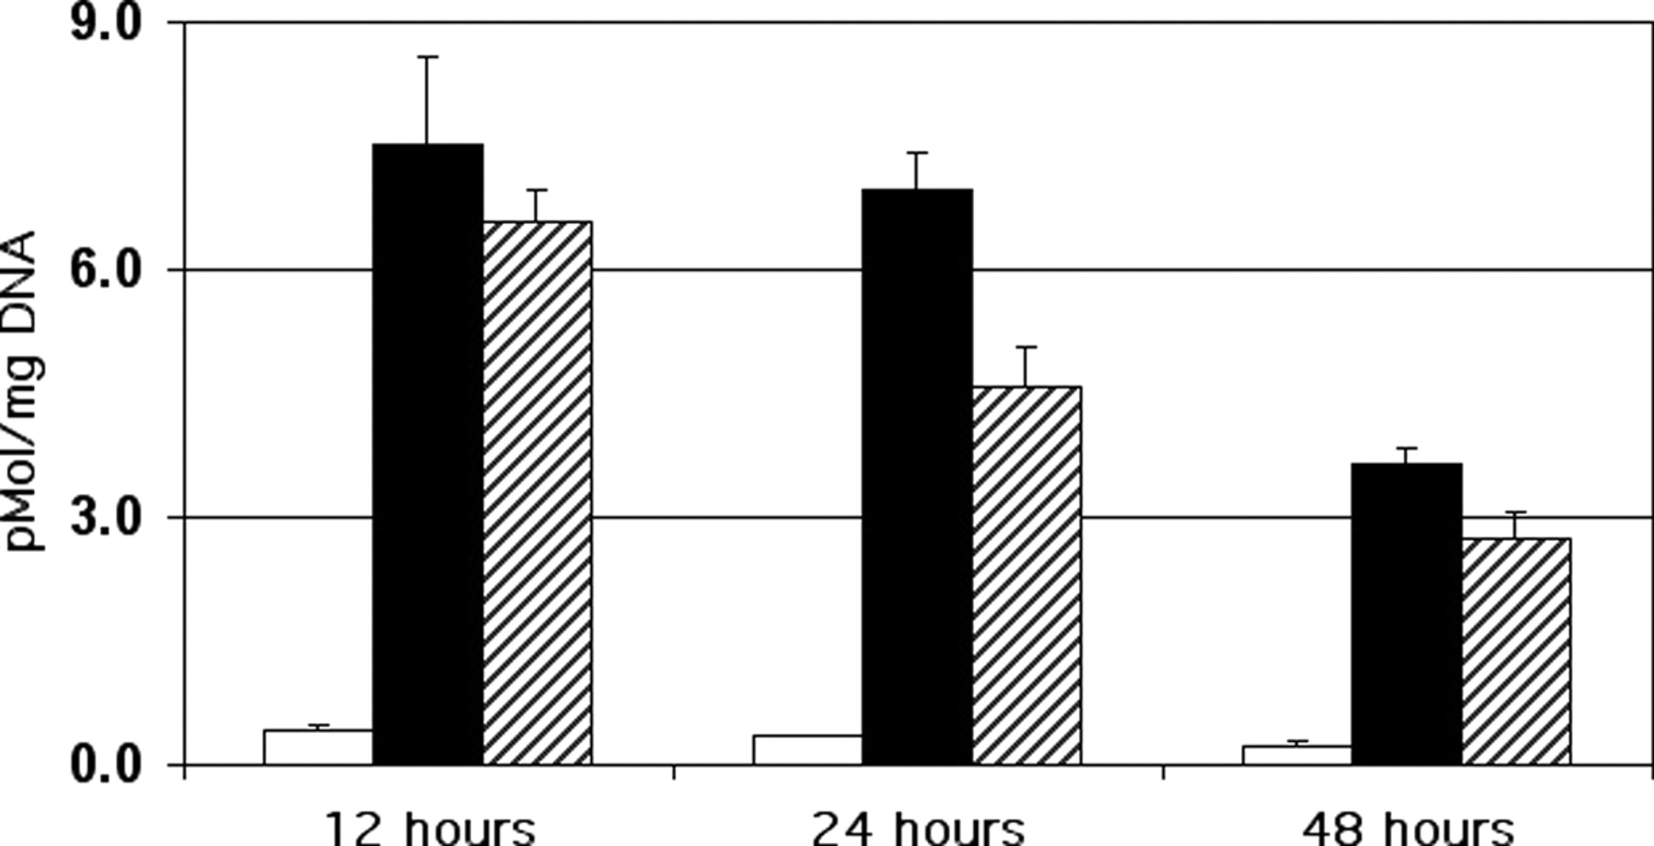
Fig. 5 Total DNA adducts in transgenic cell lines exposed to 3H-B[ a ]P. Cells were exposed to 100 nM ³ ...
Notes:
Fig. 5 Total DNA adducts in transgenic cell lines exposed to 3H-B[ a ]P. Cells were exposed to 100 nM 3 H-B[ a ]P for the indicated times, DNA was isolated and analyzed as described in Materials and methods, and results were expressed as pMol/mg DNA. Legend: open bars, V79MZ control; filled bars, V79MZh1A1; cross-hatched bars, V79MZh1A1/hGSTP1-23. Results are the mean ± SD of at least three independent experiments.
Unless provided in the caption above, the following copyright applies to the content of this slide: © The Author 2006. Published by Oxford University Press. All rights reserved. For Permissions, please email: journals.permissions@oxfordjournals.org

Slide 6
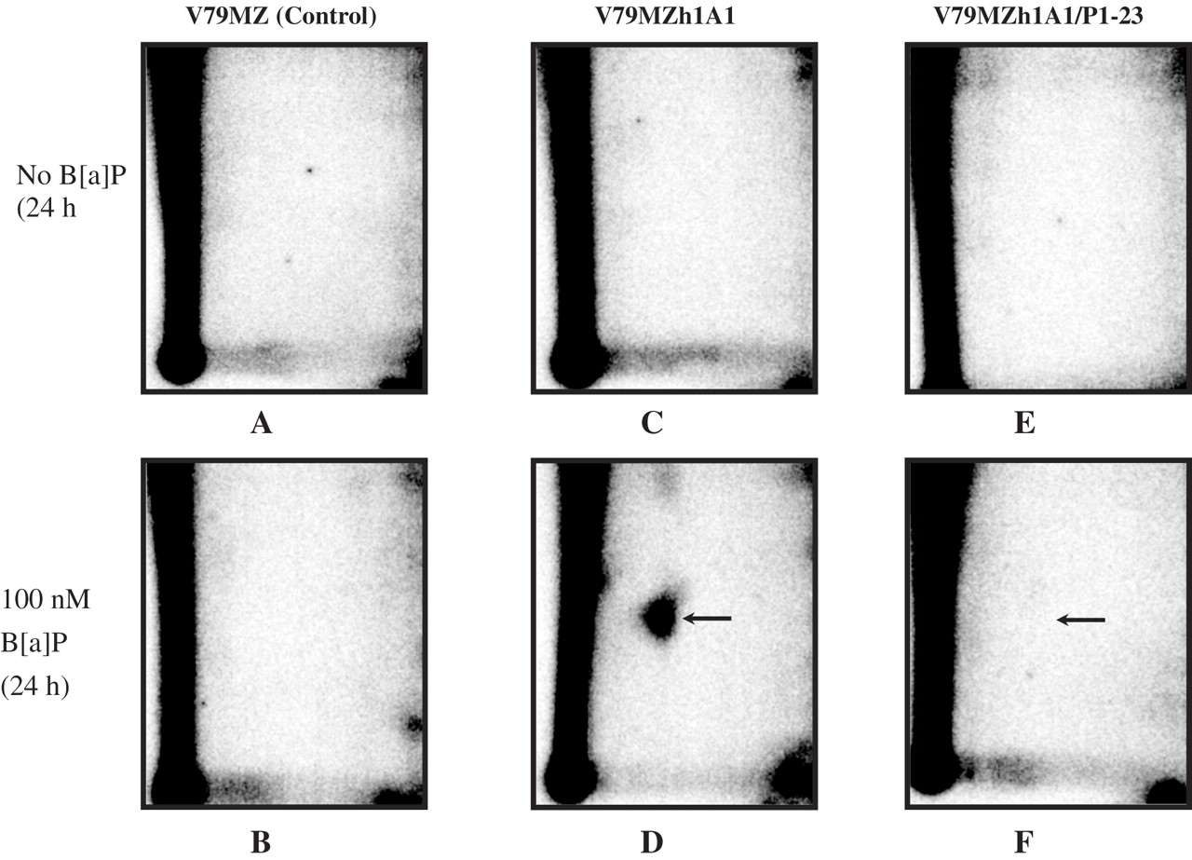
Fig. 6 Analysis of B[ a ]P-DNA adducts in transgenic cell lines by 32P-post-labeling. Cells were treated with ...
Notes:
Fig. 6 Analysis of B[ a ]P-DNA adducts in transgenic cell lines by 32P-post-labeling. Cells were treated with vehicle (upper figures) or 100 nM B[ a ]P (lower figures) for the indicated times, and DNA was isolated and adducts were identified and measured by 32 P-post-labeling as described in Materials and methods. Cell lines: ( A and B ) V79MZ control; ( C and D ) V79MZh1A1; ( E and F ) V79MZh1A1/hGSTP1-23. Arrow, migration position of the N2-guanine-BPDE adduct.
Unless provided in the caption above, the following copyright applies to the content of this slide: © The Author 2006. Published by Oxford University Press. All rights reserved. For Permissions, please email: journals.permissions@oxfordjournals.org

