Slide 1
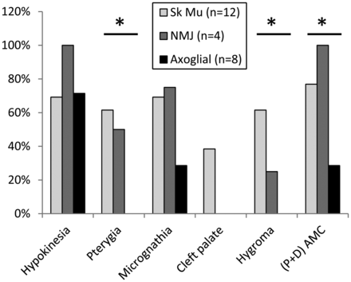
Figure 1. Percentage of AMC patients with associated symptoms and classified upon the primary tissue targets (Sk Mu, ...
Notes:
Figure 1. Percentage of AMC patients with associated symptoms and classified upon the primary tissue targets (Sk Mu, skeletal muscle; NMJ, neuromuscular junction or axoglial). Asterisk indicates a significant difference (P < 0.02) between groups using Fisher's exact test. (P+D) AMC indicates that contractures involved both proximal and distal joints.
Unless provided in the caption above, the following copyright applies to the content of this slide: © The Author 2013. Published by Oxford University Press. All rights reserved. For Permissions, please email: journals.permissions@oup.com

Slide 2
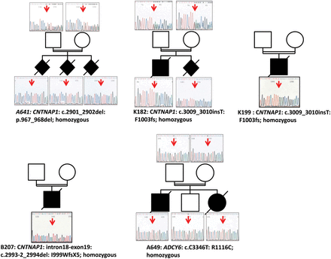
Figure 2. Sanger sequencing of mutations identified in CNTNAP1 and ADCY6 in AMC families. Arrows indicate mutant ...
Notes:
Figure 2. Sanger sequencing of mutations identified in CNTNAP1 and ADCY6 in AMC families. Arrows indicate mutant nucleotide positions. Open symbols: unaffected; filled symbols: affected. The nucleotide and amino acid changes are indicated as well as the genotype (homozygous) in affected individuals.
Unless provided in the caption above, the following copyright applies to the content of this slide: © The Author 2013. Published by Oxford University Press. All rights reserved. For Permissions, please email: journals.permissions@oup.com

Slide 3
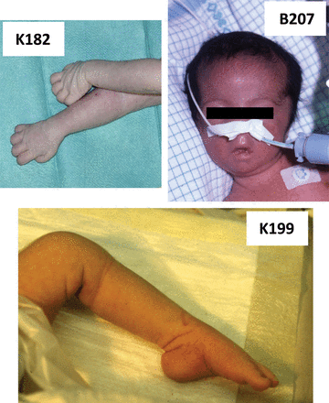
Figure 3. Clinical features of arthrogryposis associated with mutations of CNTNAP1. Note the distal involvement of ...
Notes:
Figure 3. Clinical features of arthrogryposis associated with mutations of CNTNAP1. Note the distal involvement of joint retractions and facial diplegia.
Unless provided in the caption above, the following copyright applies to the content of this slide: © The Author 2013. Published by Oxford University Press. All rights reserved. For Permissions, please email: journals.permissions@oup.com

Slide 4
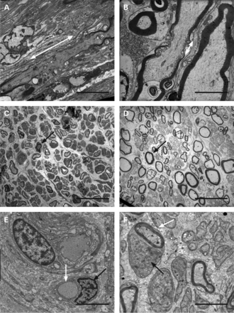
Figure 4. TEM analysis of nerve in AMC fetuses carrying deleterious mutations of CNTNAP1 (A and C) and ADCY6 (E). (A) ...
Notes:
Figure 4. TEM analysis of nerve in AMC fetuses carrying deleterious mutations of CNTNAP1 (A and C) and ADCY6 (E). (A) Longitudinal section of sciatic nerve in AMC fetus A641 and control (B) of the same gestational age (32 wg). Note the marked widening of the node of Ranvier in AMC fetus (white arrow). (C) Transverse ultra-thin section showing the absence of large myelinated axons associated with thinner myelin sheaths in the AMC fetus K182 when compared with control (D) of the same gestational age (34 wg). (E) Lack of myelin surrounding axon (white arrow), while Schwann cell morphology appeared to be normal (black arrow) in AMC fetus A649 when compared with control of the same age (F, 40 wg). Scale bars: A and B; E and F: 3.8 µm; C and D: 20 µm.
Unless provided in the caption above, the following copyright applies to the content of this slide: © The Author 2013. Published by Oxford University Press. All rights reserved. For Permissions, please email: journals.permissions@oup.com

Slide 5
Figure 5. Adcy6a and b genes are essential for PNS myelination. (A, B, E, F, I and J) mbp mRNA expression by in situ ...
Notes:
Figure 5. Adcy6a and b genes are essential for PNS myelination. (A, B, E, F, I and J) mbp mRNA expression by in situ hybridization in WT (A and B), embryos injected with the two control five mismatched morpholinos (MOs) (0.3 pmol 5 mis adcy6a MO + 0.3 pmol 5 mis adcy6b MO per embryo, E and F), and embryos injected with adcy6a and adcy6b MOs (0.3 pmol adcy6a MO + 0.3 pmol adcy6b MO per embryo, I and J), respectively. For convenience, we used adcy6 MO instead of adcy6a and b MOs. Note that mbp expression is severely reduced specifically in the PNS in embryos injected with both adcy6a and b MOs (compare I with A and E), while its expression is normal and comparable with controls in the CNS (compare J with B and F). Arrows in (A) and (E) indicate mbp expression along the posterior lateral line nerve (PLLn). Arrows in (B, F and J) indicate the expression of mbp in the hindbrain and spinal cord, while the arrowheads indicate its expression in the PLL ganglion (PLLg). Note the absence of mbp expression in the PLLg in J. (C, D, G, H, K and L) Schwann cells and PLLn labeling using the transgenic line foxd3::GFP and acetylated tubulin (ac Tub) antibody, respectively. Note the presence of Schwann cells and PLLn in the adcy6 morphants as observed in controls (compare K with C and G; L with D and H). Arrows in (C, G and K) indicate Schwann cells along the PLLn and in (D, H and L) indicate the PLLn. Scale bar: 200 μm in A, B, E, F, I and J; 100 μm in C, D, G, H, K and L.
Unless provided in the caption above, the following copyright applies to the content of this slide: © The Author 2013. Published by Oxford University Press. All rights reserved. For Permissions, please email: journals.permissions@oup.com

