Slide 1
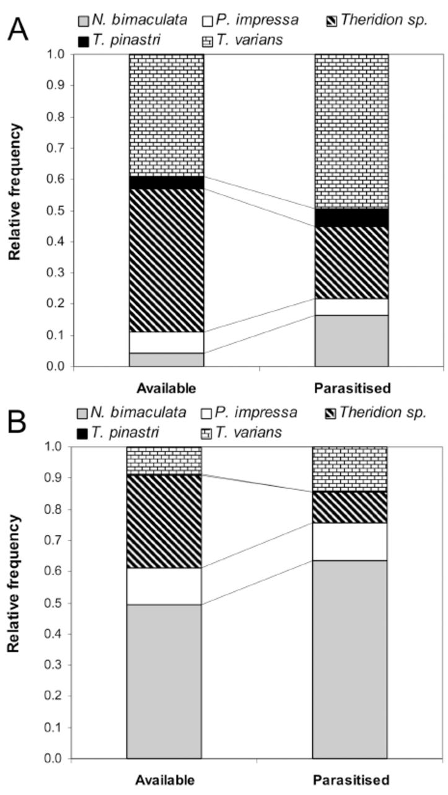
Figure 1 Comparison of relative frequency of available and parasitized “Theridion” spider hosts in the field in 2007 ...
Notes:
Figure 1 Comparison of relative frequency of available and parasitized “Theridion” spider hosts in the field in 2007 (A) and 2008 (B). High quality figures are available online.
Unless provided in the caption above, the following copyright applies to the content of this slide: This is an open access paper. We use the Creative Commons Attribution 3.0 license that permits unrestricted use, provided that the paper is properly attributed.This is an Open Access article distributed under the terms of the Creative Commons Attribution License (http://creativecommons.org/licenses/by/3.0/), which permits unrestricted reuse, distribution, and reproduction in any medium, providedthe original work is properly cited.

Slide 2
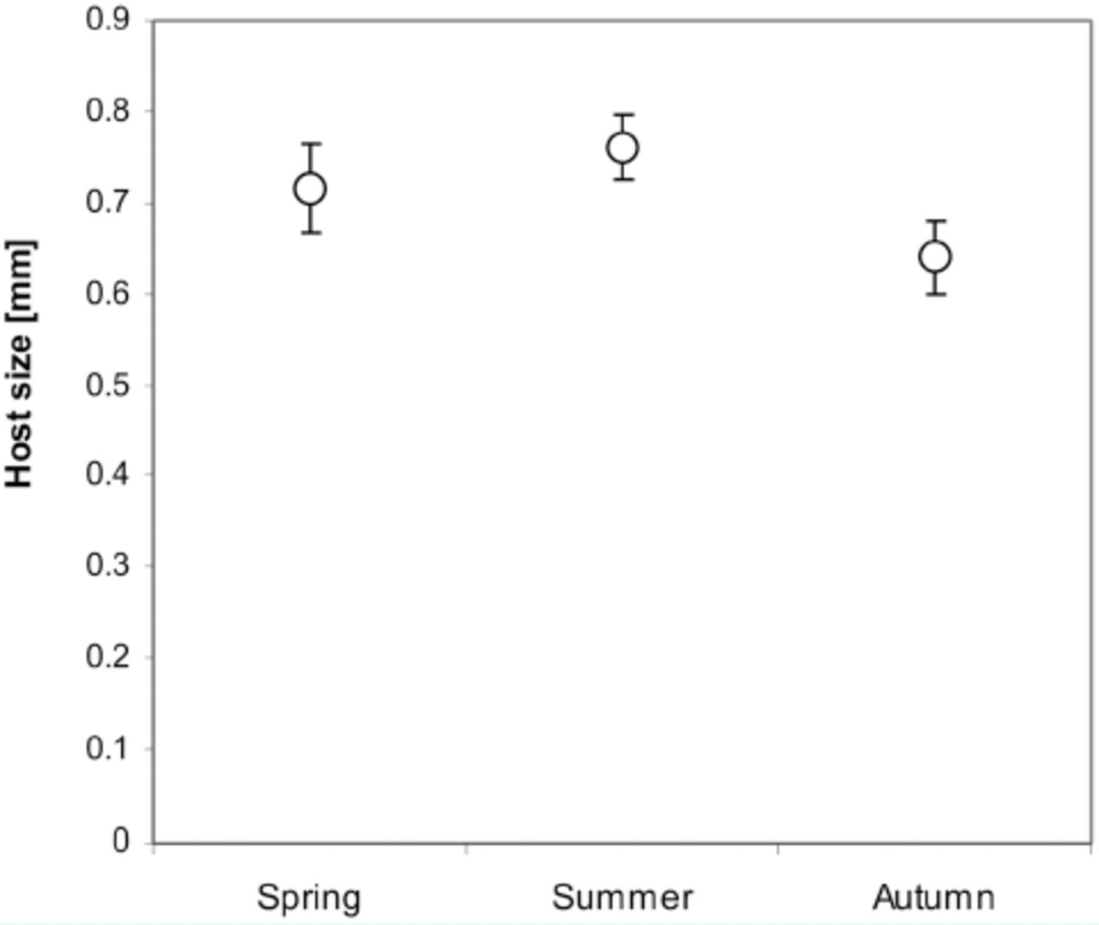
Figure 2 Comparison of the size (prosoma length) of available juvenile “Theridion” hosts during season. Points are ...
Notes:
Figure 2 Comparison of the size (prosoma length) of available juvenile “Theridion” hosts during season. Points are means; uncertainty bars represent 95% confidence intervals. High quality figures are available online.
Unless provided in the caption above, the following copyright applies to the content of this slide: This is an open access paper. We use the Creative Commons Attribution 3.0 license that permits unrestricted use, provided that the paper is properly attributed.This is an Open Access article distributed under the terms of the Creative Commons Attribution License (http://creativecommons.org/licenses/by/3.0/), which permits unrestricted reuse, distribution, and reproduction in any medium, providedthe original work is properly cited.

Slide 3
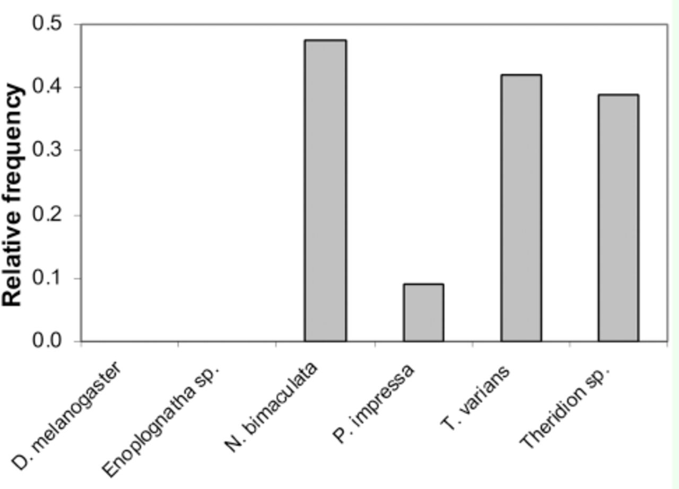
Figure 3 Relative frequencies of six taxa parasitized by wasps in laboratory experiments. High quality figures are ...
Notes:
Figure 3 Relative frequencies of six taxa parasitized by wasps in laboratory experiments. High quality figures are available online.
Unless provided in the caption above, the following copyright applies to the content of this slide: This is an open access paper. We use the Creative Commons Attribution 3.0 license that permits unrestricted use, provided that the paper is properly attributed.This is an Open Access article distributed under the terms of the Creative Commons Attribution License (http://creativecommons.org/licenses/by/3.0/), which permits unrestricted reuse, distribution, and reproduction in any medium, providedthe original work is properly cited.

Slide 4
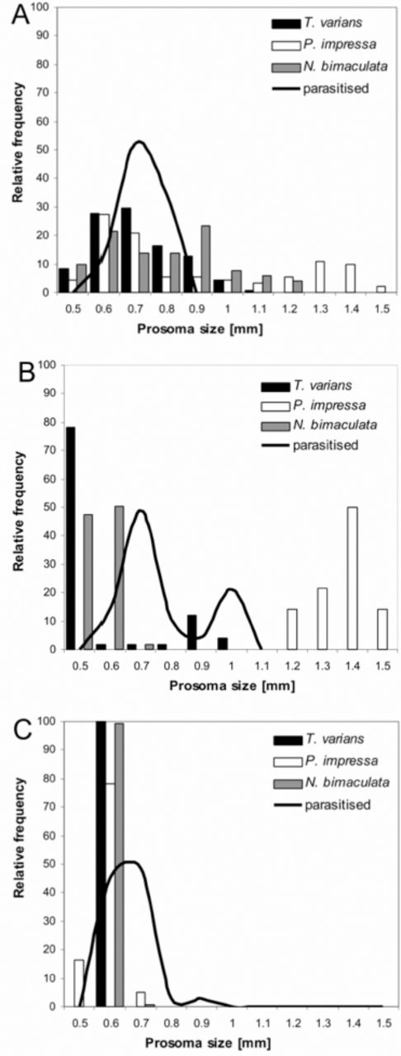
Figure 4 Relative frequencies of prosoma sizes of three major available host species (bars) and parasitized ...
Notes:
Figure 4 Relative frequencies of prosoma sizes of three major available host species (bars) and parasitized individuals (line) in spring (A), in summer (B) and in autumn (C). Bars were generated from spider relative abundance in the particular prosoma size (for each species separately). Lines were generated from all parasitized spiders in the particular prosoma size collected in the field in the particular season. High quality figures are available online.
Unless provided in the caption above, the following copyright applies to the content of this slide: This is an open access paper. We use the Creative Commons Attribution 3.0 license that permits unrestricted use, provided that the paper is properly attributed.This is an Open Access article distributed under the terms of the Creative Commons Attribution License (http://creativecommons.org/licenses/by/3.0/), which permits unrestricted reuse, distribution, and reproduction in any medium, providedthe original work is properly cited.

