Slide 1
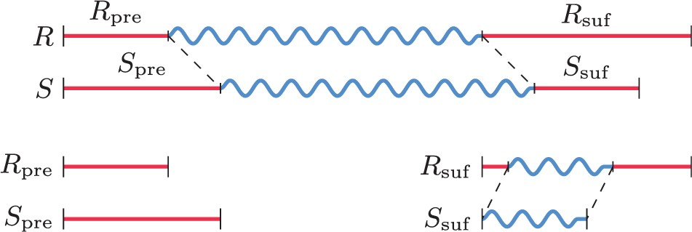
Fig. 1. Graphical representation of the extraction algorithm with reference string R and sample string S, with the ...
Notes:
Fig. 1. Graphical representation of the extraction algorithm with reference string R and sample string S, with the recursion showing a common substring in the suffixes (suf), but not in the prefixes (pre). The wavy lines denote the LCS during that iteration
Unless provided in the caption above, the following copyright applies to the content of this slide: © The Author 2015. Published by Oxford University Press. All rights reserved. For Permissions, please e-mail: journals.permissions@oup.com

Slide 2
Fig. 2. Performance of the extraction algorithm per chromosome on a desktop PC (3.4 GHz and 16 GB RAM)
Notes:
Fig. 2. Performance of the extraction algorithm per chromosome on a desktop PC (3.4 GHz and 16 GB RAM)
Unless provided in the caption above, the following copyright applies to the content of this slide: © The Author 2015. Published by Oxford University Press. All rights reserved. For Permissions, please e-mail: journals.permissions@oup.com

Slide 3
Fig. 3. HGVS Description lengths of the extraction algorithm per chromosome
Notes:
Fig. 3. HGVS Description lengths of the extraction algorithm per chromosome
Unless provided in the caption above, the following copyright applies to the content of this slide: © The Author 2015. Published by Oxford University Press. All rights reserved. For Permissions, please e-mail: journals.permissions@oup.com

Slide 4
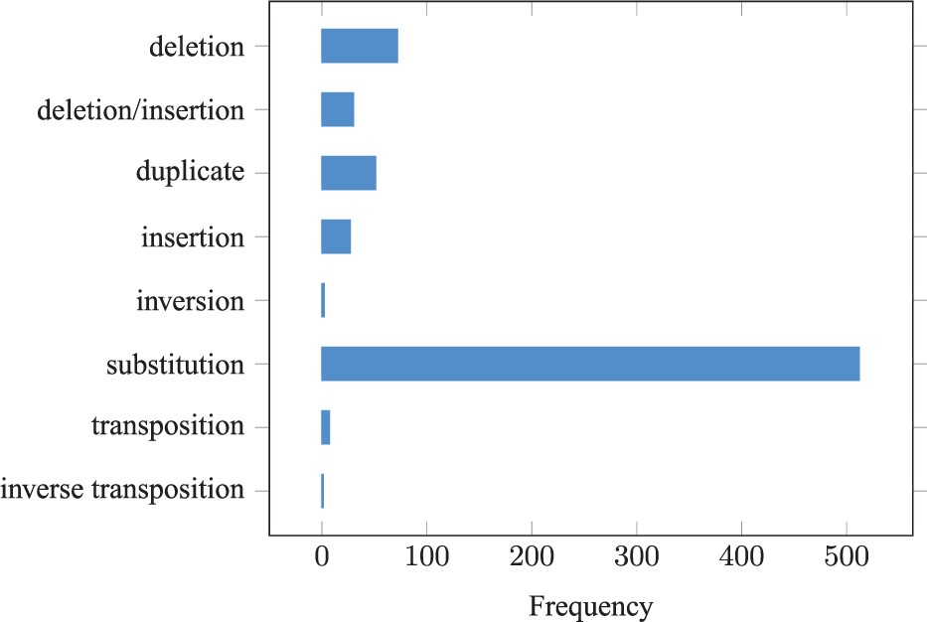
Fig. 4. The distribution of HGVS operators for Chromosome 2 (NCBI36 versus GRCh37)
Notes:
Fig. 4. The distribution of HGVS operators for Chromosome 2 (NCBI36 versus GRCh37)
Unless provided in the caption above, the following copyright applies to the content of this slide: © The Author 2015. Published by Oxford University Press. All rights reserved. For Permissions, please e-mail: journals.permissions@oup.com

