Slide 1
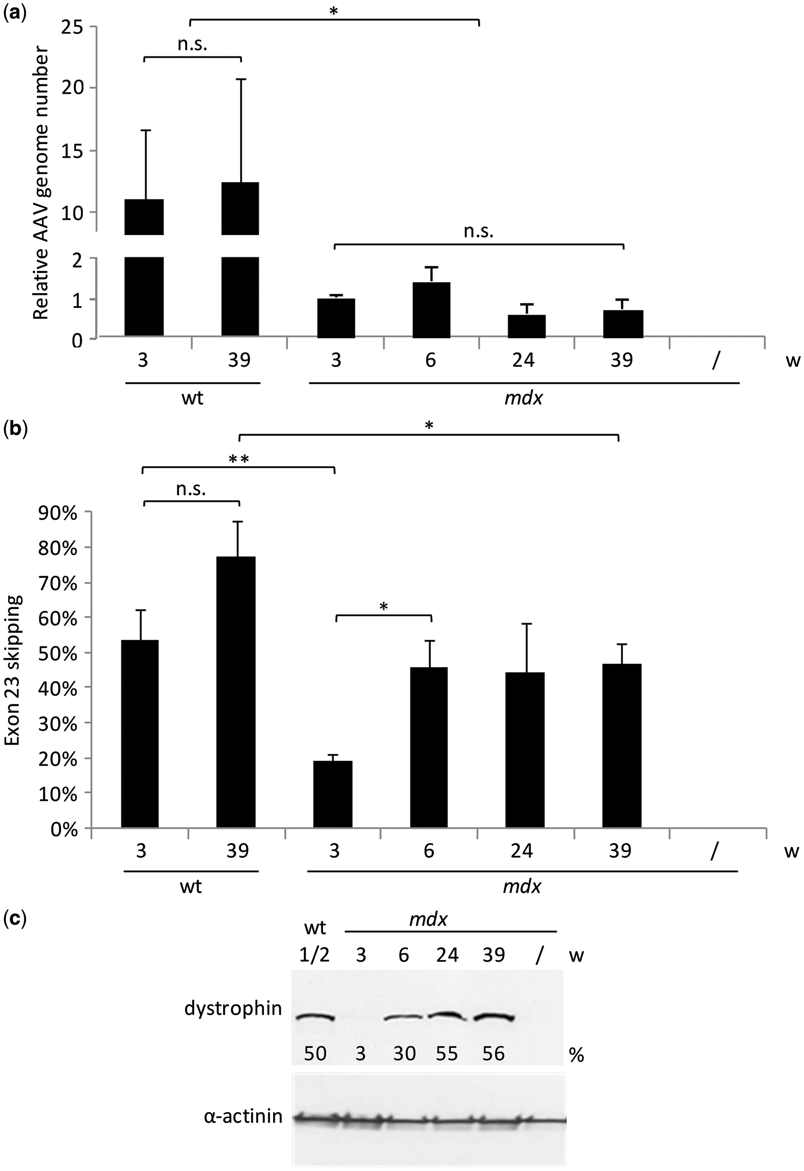
Figure 1. Kinetics of therapeutic vector genome maintenance in mdx muscles. Tibialis anterior (TA) muscles of wild-type ...
Notes:
Figure 1. Kinetics of therapeutic vector genome maintenance in mdx muscles. Tibialis anterior (TA) muscles of wild-type (wt) and mdx mice were injected with 3E + 10 vector genomes (vg) of AAV1-U7ex23 and the mice were sacrificed 3, 6, 24 and 39 weeks later (3, 6, 24 or 39w). (A) Quantification of AAV genomes by absolute Taqman qPCR in injected mdx TAs. AAV genome content is expressed as the AAV genome number relative to the value obtained for the mdx muscles injected with AAV1-U7ex23 at three weeks post-injection. (B) Quantification of exon 23 skipping performed by relative TaqMan qPCR and expressed as a percentage of total dystrophin transcripts. (C) Dystrophin restoration was evaluated by western blotting with NCL-DYS1 monoclonal antibodies (upper panel) on whole protein extracts from the treated muscles (lower panel: α-actinin). The result of one representative TA is shown per condition. Dystrophin restoration was quantified by ImageJ software and expressed as the percentage of dystrophin expression in wt muscle. The data presented in (A) and (B) represent the mean values of three or four TAs per group ± SEM. One of two representative experiments is shown. n.s., non-significant, *P ≤ 0.05, **P ≤ 0.001, Student’s t-test.
Unless provided in the caption above, the following copyright applies to the content of this slide: © The Author 2016. Published by Oxford University Press. All rights reserved. For permissions, please e-mail: journals.permissions@oup.com

Slide 2
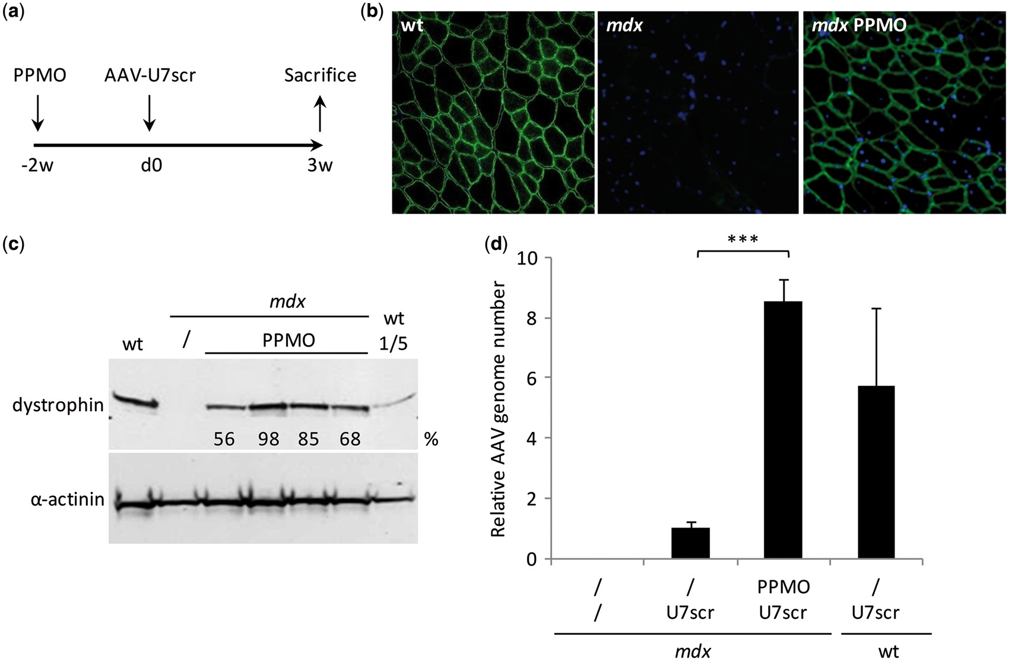
Figure 2. Effect of dystrophin restoration by Pip6a-PMO pre-treatment on vector genome maintenance. (A) TAs from mdx ...
Notes:
Figure 2. Effect of dystrophin restoration by Pip6a-PMO pre-treatment on vector genome maintenance. (A) TAs from mdx and wt mice were injected with 1 nmole of Pip6a-PMO two weeks (-2w) before the injection of 1E + 11 vg of the non-therapeutic AAV1-U7scr vector (day 0, d0). Control mdx and wt TAs were injected with AAV1-U7scr vector alone. Four TAs were injected per group. The mice were sacrificed 3 weeks later (3w). (B) Dystrophin rescue monitored by immunostaining with the NCL-DYS2 monoclonal antibody on transverse sections of TA muscles. One representative immunostained section is shown per condition. (C) Dystrophin restoration evaluated by western blotting with NCL-DYS1 monoclonal antibodies (upper panel) on whole protein extracts from the PPMO-treated muscles (lower panel: α-actinin). Dystrophin restoration was quantified by ImageJ software and expressed as the percentage of dystrophin expression in wt muscle. (D) Quantification of AAV genomes by absolute Taqman qPCR. AAV genome content is expressed as the AAV genome number relative to the value obtained for the non PPMO-treated mdx muscles. The data represent the mean values of four muscles per group ± SEM. n. s.: non-significant, ***P < 0.001, Student’s t-test. One of two representative experiments is shown.
Unless provided in the caption above, the following copyright applies to the content of this slide: © The Author 2016. Published by Oxford University Press. All rights reserved. For permissions, please e-mail: journals.permissions@oup.com

Slide 3
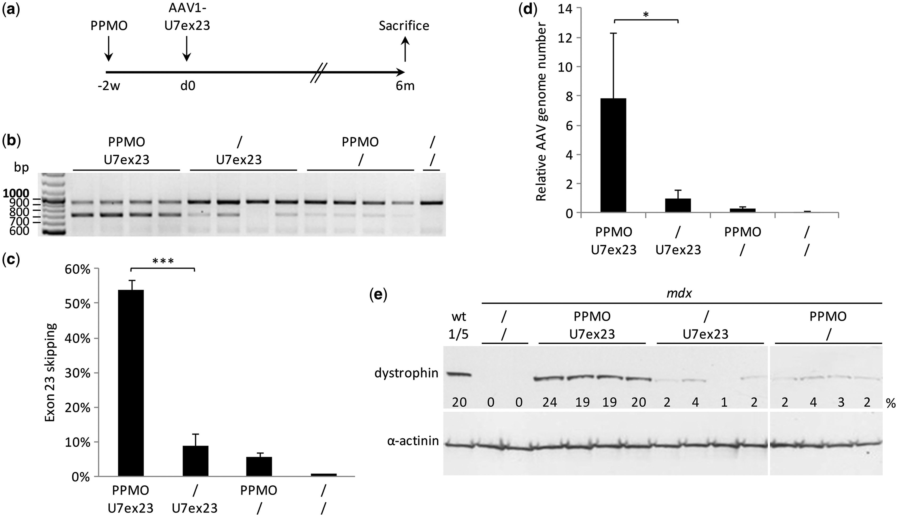
Figure 3. Effect of Pip6a-PMO pre-treatment on dystrophin rescue by low dose of AAV1-U7ex23. (A) Mdx TAs were injected ...
Notes:
Figure 3. Effect of Pip6a-PMO pre-treatment on dystrophin rescue by low dose of AAV1-U7ex23. (A) Mdx TAs were injected with 1 nmole of Pip6a-PMO two weeks (-2w) before the injection of 1E + 10 vg of therapeutic AAV1-U7ex23 vector (day 0, d0). Control mdx TAs were injected with PPMO or AAV1-U7ex23 vector alone. Four TAs were injected per group. The mice were sacrificed 6 months later (6m). (B) Level of exon 23 skipping estimated by nested RT-PCR. The 901 bp PCR product corresponds to full-length dystrophin transcripts whereas the 688 bp product corresponds to transcripts lacking exon 23. (C) Quantification of exon 23 skipping performed by relative TaqMan qPCR and expressed as a percentage of total dystrophin transcripts. (D) Quantification of AAV genomes by absolute Taqman qPCR. AAV genome content is expressed as the AAV genome number relative to the value obtained for the non PPMO-treated mdx muscles. The data presented in (C) and (D) represent the mean values of the four TAs per group ± SEM. * P < 0.05, ***P < 0.001, Student’s t-test. (E) Dystrophin restoration evaluated by western blotting with NCL-DYS1 monoclonal antibodies (upper panel) on whole protein extracts from the treated muscles (lower panel: α-actinin). Dystrophin restoration was quantified by ImageJ software and expressed as the percentage of dystrophin expression in wt muscle.
Unless provided in the caption above, the following copyright applies to the content of this slide: © The Author 2016. Published by Oxford University Press. All rights reserved. For permissions, please e-mail: journals.permissions@oup.com

Slide 4
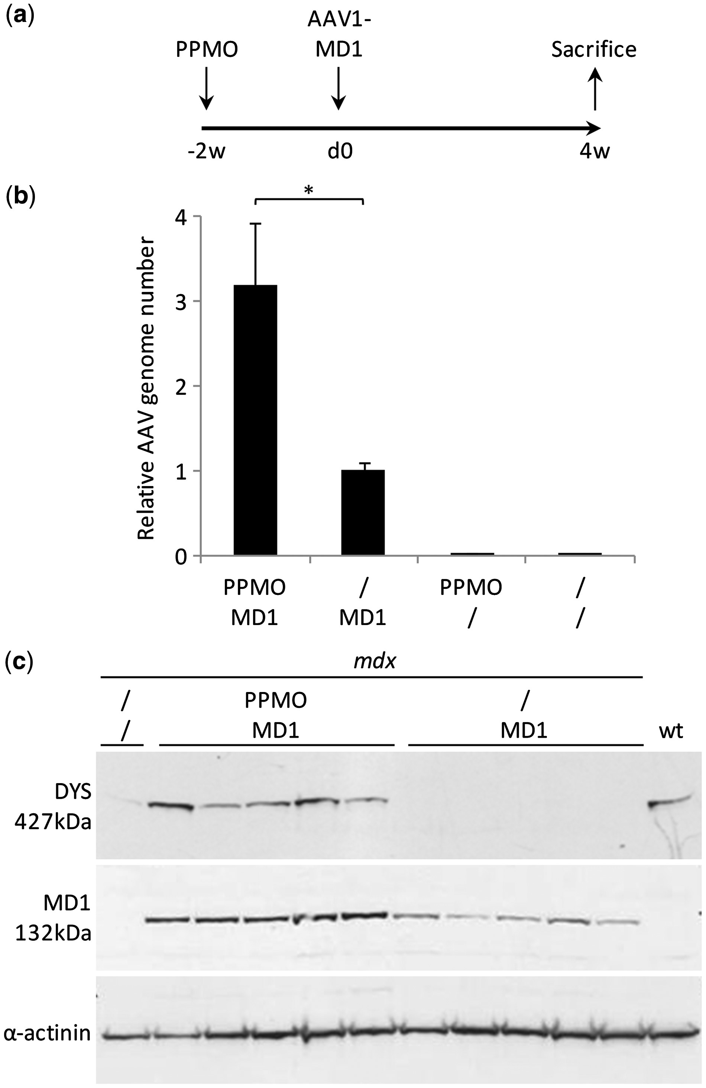
Figure 4. Effect of Pip6a-PMO pre-treatment on AAV1-mediated micro-dystrophin gene therapy. (A) Mdx TAs were injected ...
Notes:
Figure 4. Effect of Pip6a-PMO pre-treatment on AAV1-mediated micro-dystrophin gene therapy. (A) Mdx TAs were injected with 1 nmole of Pip6a-PMO two weeks (-2w) before injection of 1E + 10 vg of AAV1-MD1 micro-dystrophin expressing vector (day 0, d0). Control mdx TAs were injected with PPMO or AAV1-MD1 vector alone. Five TAs were injected per group. The mice were sacrificed 4 weeks later (4w). (B) Quantification of AAV genomes by absolute Taqman qPCR. AAV genome content is expressed as the AAV genome number relative to the value obtained for the non PPMO-treated mdx muscles. The data represent the mean values of the 5 muscles per group ± SEM. *P < 0.05, Student’s t-test. (C) Expression of PPMO-induced dystrophin (DYS, 427kDa) and micro-dystrophin (µDYS, 132kDa) evaluated by western blotting with MANEX1011B monoclonal antibodies (upper panel) on whole protein extracts from the treated muscles (lower panel: α-actinin).
Unless provided in the caption above, the following copyright applies to the content of this slide: © The Author 2016. Published by Oxford University Press. All rights reserved. For permissions, please e-mail: journals.permissions@oup.com

